Slide 1
Patient Care WG Allergy and Intolerances Project
HL7 WG Meeting 2014
Chicago
Update to EHR WG
September 17, 2014 -- Q2

Slide 2
Status of Allergy & Intolerances Project
DAM - published
Clinical Models – published (DSTU)
Comparative analysis with C-CDA Allergy and Intolerance templates (R1.1)
Question re EHR MU Profile ballot re allergies and intolerances
Use of value sets
Meetings – Alternate Wednesdays – 5 PM EDT

Slide 3
C-CDA R1.1 Harmonization
Add criticality concept
Allergy and Intolerance Type Value Set codes
LOINC for what type of allergy, intolerance or allergy/intolerance (unknown)
Specific drug
Drug ingredient
Drug class
Food
Device
Environmental substance
Biologic
Blood product
Synthetic substance

Slide 4
FHIR
Two FHIR resources
Adverse reaction
Allergy and intolerance
Harmonization with OpenEHR
Calls – Every Thursday at 5 PM EDT

Slide 5
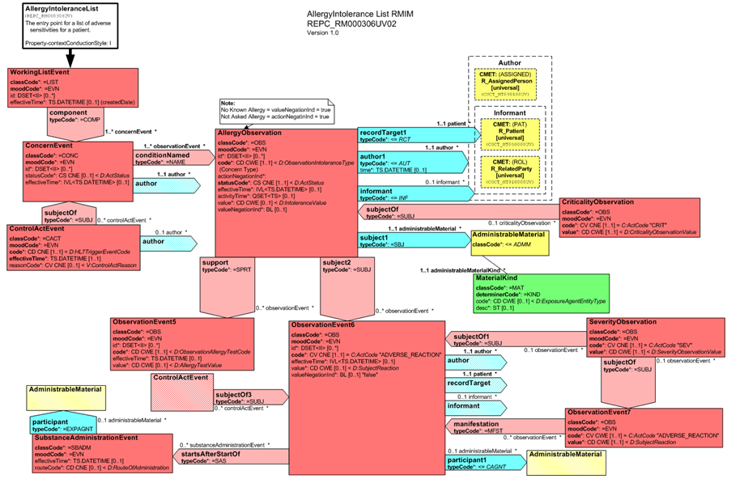
Allergy Model

