Slide 1
Electronic Medication Management (eMM)
International Activities/Projects
eMM Landscape and Concepts
Dr Stephen Chu
CTI, NEHTA

Slide 2
eMM: Landscape
Electronic Medication Management
  Three key components
    Contents
    Infrastructures
      Trigger events; messages; services
      Registry; repository
    Applications/User interface/viewer

Slide 3
eMM: Landscape
Electronic Medication Management
  Key components
Triggers
Registry/
Directory
Messages
Services
eMM
Repository
SEHR/
PHR
Interfaces
Contents

Slide 4
eMM: Landscape
Electronic Medication Management
  Key components
Medication Management Plan
Complexity
Medication Profile
(processing,
… etc)
Medication Review Record
Medication History List
Data components
Long term
Short term/episodic
Intermittent
PRN

Slide 5
eMM: Landscape
Electronic Medication Management
  Key components
Medication Management Plan
Complexity
Medication Profile
(processing,
… etc)
Medication Review Record
Medication History List
Data components
Prescribed √
Dispensed √
Administered ???
Administration/conformance Profile:
Omission frequency + reasons
Dose variation frequency + reasons
Frequency variation frequency + reasons
Intermittent + PRN frequency + reasons

Slide 6
eMM: Landscape
Electronic Medication Management
  Three key components
    Contents
    Infrastructures
      Trigger events; messages; services
      Registry; repository
    Applications/User interface/viewer

Slide 7
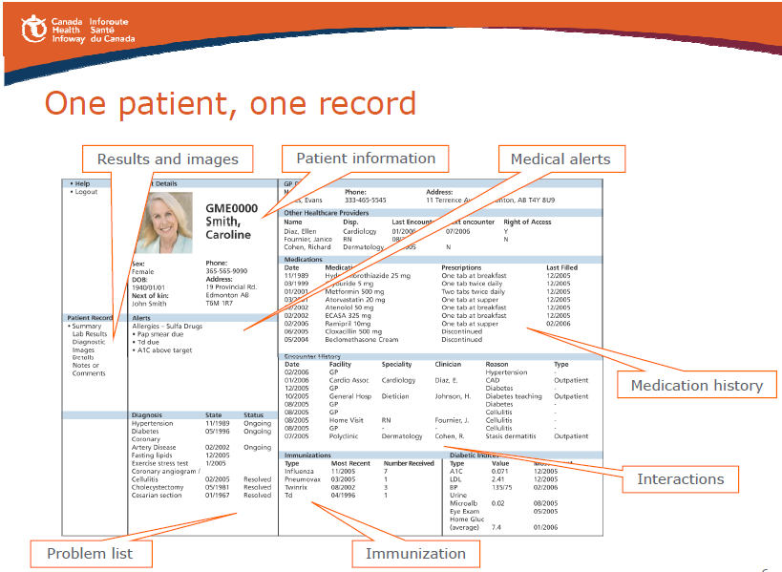
eMM: Application/Interface

