Slide 1
HL7 Working Group Meeting Atlanta GA (US), May 2013
HL7 Templates
Versioning and Relationships
HL7 Templates WG
2013-05-09

Slide 2
Scope of Work
Template
Glossary
Templates Versioning
Templates Relationships
Templates in Instances
Exchange Format for Templates
Contributions to Harmonization with IHE
Templates WG discussion on weekly calls etc from October 2012 to May 2013

Slide 3
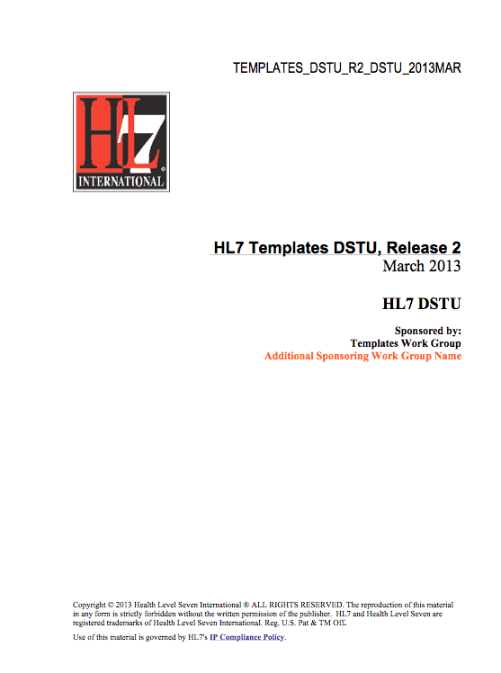
DSTU ballot
…is part of the upcoming Templates DSTU R2 ballot
Planned for the Cambridge meeting September 2013 as Ballot for Comments
DSTU (normative) ballot for the January Orlando meeting

Slide 4
Template Versioning
Dimensions:
Governance group
Purpose
Template Design (Meta Data and Body)
Validated Instance (Fragments)
New Template vs Version of a Template
Link to Relationship between templates

Slide 5
Template Relationships
Applies to Template Design Work
Summary I: inter-template relationships
Replacement (replaces)
Specializations / Generalizations (specializes, generalizes)
Design Copy (copies)
Adaptation (adapts)
Equivalency (equals)
Backwards compatibility
Containment / Inclusion

Slide 6
Template Relationships
Summary II: relationships to other artefacts
Model Derivation
Examples: conceptual model, Detailed Clinical Model, HL7 R-MIM, HL7 CMET, …
Adoption / Usage
Means “I like”, “I follow”, “I use”, “I wish to review”

Slide 7
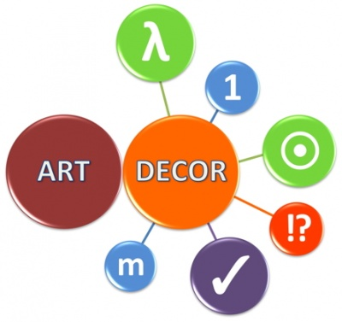
Update ART-DECOR
More than 12 projects (EU)
Introduction “MyCommunity”
Draft version of Template editor
Version management, Template relationships
Building Block Repository (BBR)
“Refs” to other projects, to C-CDA, epSOS, IHE
Further Development on Schematron-Engine
Open vs closed templates, use of repositories
art-decor.org

Slide 8
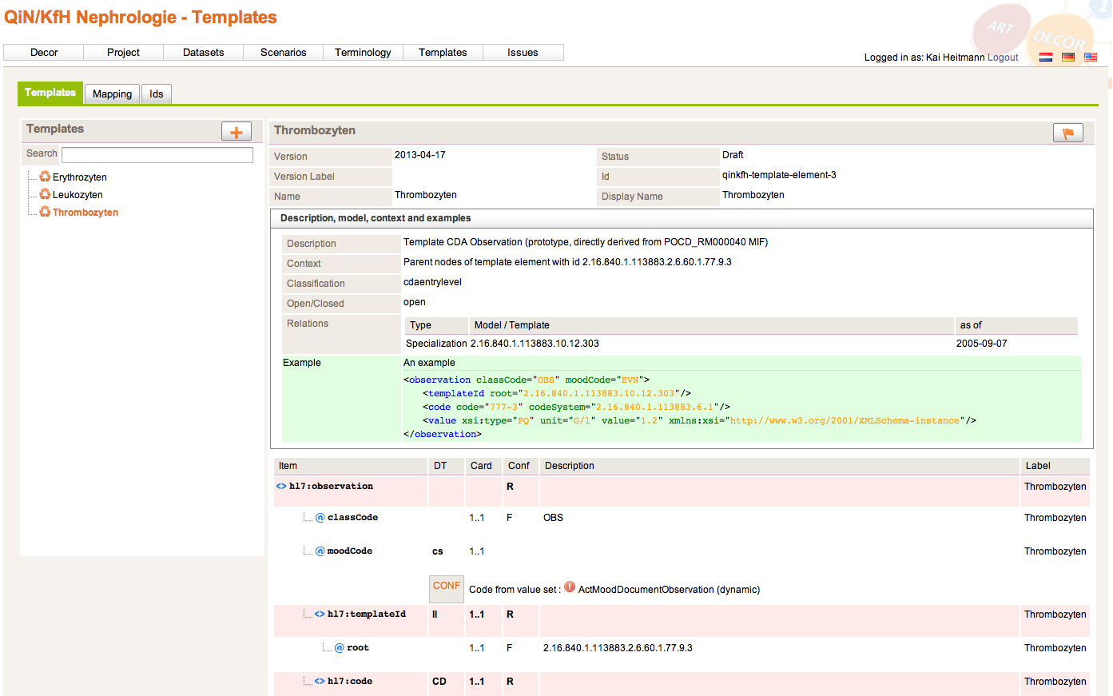
Update ART-DECOR

Slide 9
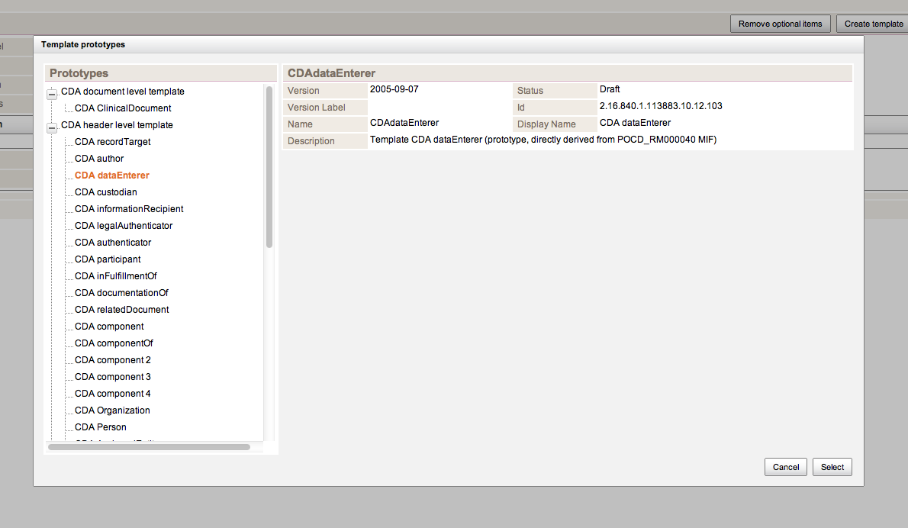
Update ART-DECOR

Slide 10
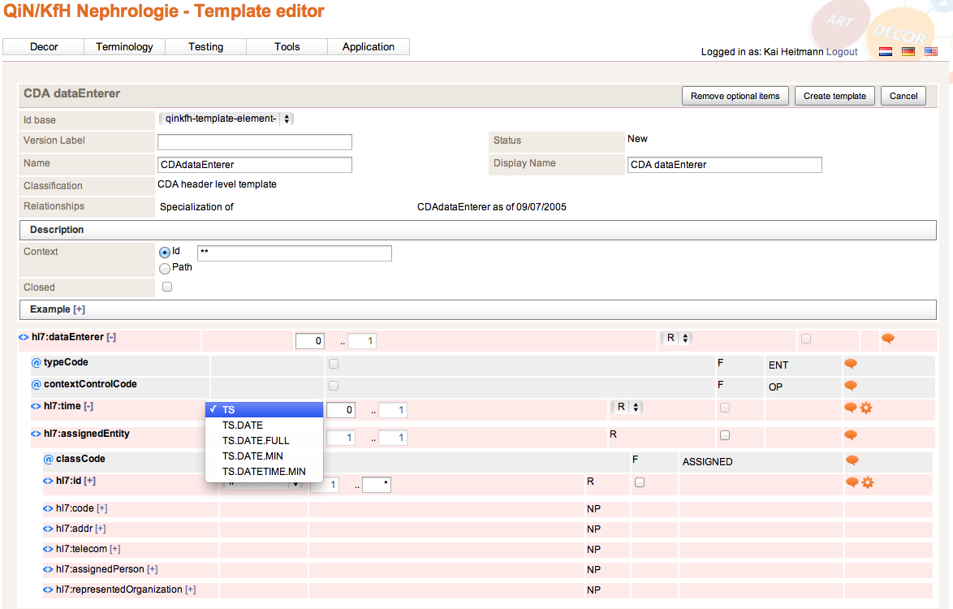
Update ART-DECOR

Slide 11
HL7 Working Group Meeting Atlanta GA (US), May 2013
HL7 Templates
Versioning and Relationships
Questions?

