Slide 1
FHIR Nutrition
Strategy Discussion
Discussion with FHIR Resources
Patient Care WG
December 7, 2017
Paul Adams (CBORD), Ben Atkinson (Harborview Medical Center –Seattle, WA), James Allain
Lindsey Hoggle (Academy of Nutrition and Dietetics)
Notes:
Good afternoon, this is Lindsey Hoggle, Director of Nutrition Informatics at the Academy. My role these past 6 years has been to advocate for nutrition inclusion in health IT standards, policy and criteria generated by the HITECH Act – Medicare/Medicaid EHR Financial Incentive Program.

Slide 2
FHIR Resources for Nutrition - Background
Several Groups (Transformative Med, CBORD, James Allain, Crowd Health) have been working towards using a Nutrition Intake-type resource in FHIR.
OO FHIR Group has also been part of the discussion.
Patient Care requested a Gap Analysis for possible uses of other resources.
FHIR Resource -“NutritionIntake”: Is it similar to a medication statement?
Can Observation be used?
How is this being handled in V2 (as point of reference)? V2 mentions intake observations with LOINC bindings
Can Clinical Impression be used for nutrition Assessment?

Slide 3
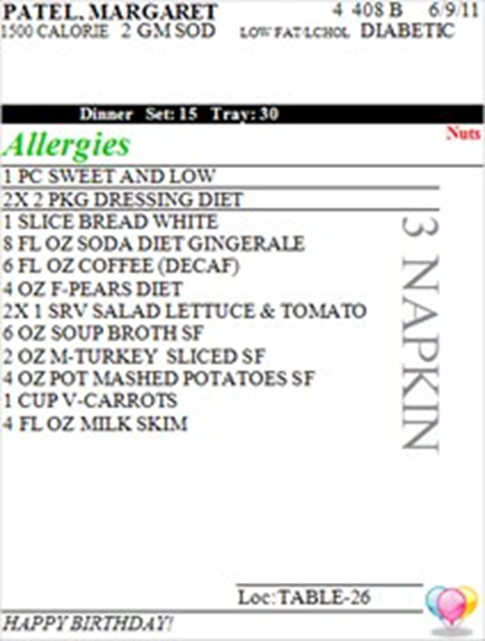
Use Case 1
Purpose: record the % of each food consumed on a tray and provide nutrition data for each food.
Collected data would drive insulin administration in LTC patient with Diabetes
Food/meal intake data (to map in FHIR)
Patient Specific Menu (food allowed for patient)
Meal (breakfast, lunch, dinner, b/w meal snack)
Date/time of meal arrival
Portion /unit of measure and quantity of each food sent
Continued….

Slide 4
Continued…Data Needed
Purpose: record the % of each food consumed on a tray and provide nutrition data for each food.
Food/meal intake data (to map in FHIR)
4. Date/time consumed
5. Estimated intake or recorded food consumed by meal (made by diet tech, nursing staff or self-reported)
May need preparation techniques (depends on the source of this data)
Referenced nutrient composition source item (USDA, INFOODS, Other) (multiple nutrients and quantities)
Nutrient data would likely be sent from a food/nutrition system (ie: CBORD or Fitbit or similar) to the EHR. So in this case there wouldn’t
be the need to have Prep Techniques (baked vs fried for example). CBORD (or similar) would just send the nutrients associated w/ that food item.

Slide 5
Use Case 2
CrowdHealth/R&D Engineering (Antonio DiNegro)
High level objectives:
5 portion of fruit OR vegetables per day.
No more than 30% of fats per day.
Maximum 1 sweet per week.
Meal-by-meal plan
Food diary item
www.eng.it

Slide 6
FHIR Observation
Limitations if using for Nutrient Intake:
Issue of having many foods with many nutrients and nutrient values for a tray intake observation - the observation seemed to be the tray, and bundling all the foods seemed to complicate the case. Food items 0:*
Considerable transition code would be needed to group a set of observations and assign consistent properties (e.g. delivery time).
Extensions to Observation necessary, which would have some data repeated unnecessarily.
Business logic would be required to prevent unwanted updates to a sub-part of a grouping.
For Nutrition Care Process components, there is a need to separate out by category to use it) data is flowing thru it e.g. Menus/Intake –

Slide 7
Nutrition Intake Example
Need query to get entire set in one “chunk”
Lunch (date) – [tray]
Delivery date/time (derive when they ate this – between 11 AM and Noon)
(glycemic control needs this graphed across the day/week/month and mapped to the insulin/medication administration)
Planned or Consumed (estimated intake)
Food 1 (unit) – Milk, Skim
Qty 8 fl oz
% consumed – 50%
Nutrient 1 (value - unit), e.g., Calories (kcal)
Nutrient 2 (value – unit)
Many more . . .
Food 2 (unit)
Qty consumed
Nutrient 1 (value - unit)
Food 3
Qty consumed
Nutrient 1 (value - unit)

Slide 8
Observation Structure
is not capable as needed for the diet intake. (Array 1 below)

Slide 9
FHIR Resource-Options
What do we need for Nutrition overall for future?
Are there designs that can allow for reuse for other nutrition concepts in the future (then profile it)?
What name should we use?
NutritionServices
NutritionStatement
Propose same resource to use for suggested meal plan (menu) & intake – same structure needed
Formula Administration (enteral/parenteral?)
NCP – Nutrition Dx or nutrition Inventions (non-food related) e.g. education/counseling
What about assessment?
Nutrition Care Process (NCP)

