Slide 1
HL7 Patient Care Workgroup
Care Plan
Domain Analysis Model
Supplementary Overview for CCS Ballot
March 17, 2013
HL7 Care Plan Initiative Project
http://wiki.hl7.org/index.php?title=Care_Plan_Project

Slide 2
Model Status Notes:
The informative ballot for the Care Plan DAM is planned for September 2013
  This model is subject to change
  We can include your feedback to make it better
  This is a preview in support of CCS which is fully expressed by the Care Plan model
Other Notes:
Enumerations are used extensively in the model to illustrate possible sample domain value sets.
The enumerations could be represented as Codes in an information model derived from the DAM.
The latest version of this power point at HL7 wiki:
http://wiki.hl7.org/index.php?title=File:Care_Plan_Model_Overview.pptx
Care Coordination Service Project Pages:
http://wiki.hl7.org/index.php?title=Care_Coordination_Service
http://wiki.hl7.org/index.php?title=Care_Coordination_Business_Scenarios
http://wiki.hl7.org/index.php?title=Care_Coordination_Capabilities

Slide 3
Workgroup Contributors
Laura Heermann Langford PhD RN (project co-lead)
Stephen Chu, MD (project co-lead, PCWG Chair)
Susan Campbell PhD, RN-BC, CPHQ, CCM, CIC
Kevin Coonan MD
Russell Leftwich MD
Iona Thraen PhD, ACSW
Jon Farmer
Enrique Meneses (modeling facilitator)

Slide 4
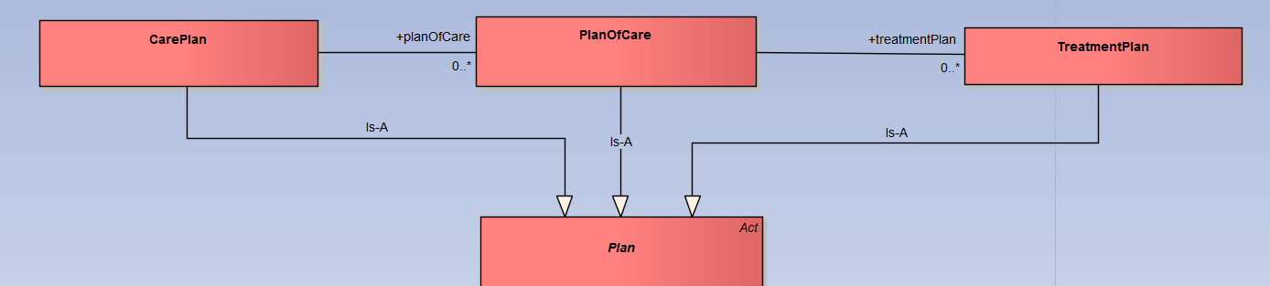
Some definitions:
Care Plan, Plan Of Care and Treatment Plan
"A care plan integrates multiple interventions proposed by multiple providers for multiple conditions.“ The care plan may include multiple plans of care to provide a patient centric, multi-specialty, comprehensive perspective.
"A plan of care [is] proposed by an individual clinician to address several conditions “. It supports specialty specific plans.
A Treatment Plan is used to target a specific condition.
The model below illustrates the use of inheritance of shared features from an abstract Plan class.
"The Care Plan represents the synthesis and reconciliation of the multiple plans of care produced by each provider to address specific health concerns. It serves as a blueprint shared by all participants to guide the individual’s care. As such, it provides the structure required to coordinate care across multiple sites, providers and episodes of care. "
The care plan "support['s] collaboration across care settings and providers, and allows for and can encourage team based care."
The "Care Plan and Plan of Care share the universal components: health concern, goals, instructions, interventions, and team member. "
-- Reference S&I LONGITUDINAL COORDINATION OF CARE WORK GROUP (LCCWG) Gloassary (v24)

Slide 5
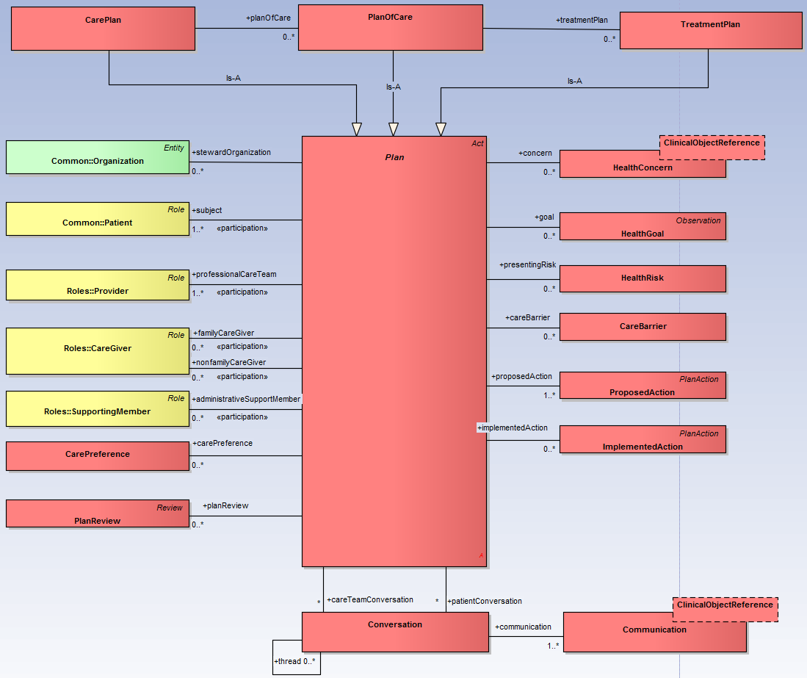
Plan Structure Overview
Top Level Model Structure
** Attributes, some classes and associations hidden for this illustration
General Definition: A “list of steps with timing and resources, used to achieve an objective. See also strategy. It is commonly understood as a temporal set of intended actions through which one expects to achieve a goal. “ Wikipedia
Plan Types:
Care Plans, Plans of Care, Treatment Plans
** The abstract plan is a modeling technique to represent shared components.
The Model Captures:
Who - Patient, Care Team, Family, other Support Individuals...
Why – Concerns, Risks and Goals
What – Proposed and Implemented Actions, Interventions, Instructions, Outcome Observations, various types of Reviews
When - Effective times, completion times, update times
Where –Steward organization, place of service for interventions

Slide 6
Plan Attributes
Descriptive Attributes
displayName – descriptive display name for the plan
clinicalSpecialty – specifies zero or more specialties representing the topic of the plan.
confidentiality – specifies the plan’s confidentiality level
State Attributes
planStatus – plan stage lifecycle status
Temporal Attributes
createDate – specifies when the plan was created
effectiveDate – specifies the start of the plan implementation
completeDate – specifies when the plan becomes inactive
lastUpdateDate – specifies the last date/time the plan was changed
Information Management Attributes
id – unique identifier for the plan
version – change or difference indicator in the defining plan elements (concern, goal, risk, proposed actions)
  Implementation and tracking does not change the version of the plan types
planClass – a class code (Care Plan, Plan of Care, Treatment Plan)
The Plan abstract class is specialized by CarePlan, PlanOfCare and TreatmentPlan.
The attributes are shared by all subclasses of the Plan.

Slide 7
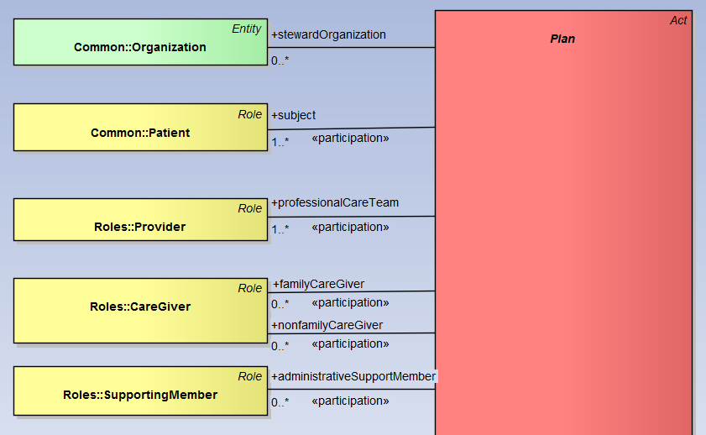
Plan Participants
- Who is involved?
The Plan structure directly references principal collaborators guided by a shared care plan.
Please note that the PlanAction and Communication classes also capture corresponding participants (e.g. an action has a place of service and a communication has participants)
These participations are illustrated later in the action and communication model.
The plan is continuously unfolding through the care process. New participants join to collaborate on care and some leave.
Participants are actively engaged through constant communication which in turns alters the state of the plan’s content.
Steward Organization: Organizations accountable for maintaining some aspect of the care plan. This may be more than one organization as the plan may span the continuum of care.
Patient: the subject of care is an active participant through the unfolding of the plan. Their preferences are captured and they agree/review proposed care. Cardinality is 1 or more to support group therapy, etc.
Provider:
Licensed independent practitioner (LIP) members of the care team such as physicians and nurses.
Care Giver:
Non-credentialed members of the care team. This may include professional or family members with care responsibilities.
Supporting Member:
Clerical, administrative or financial support individuals.

Slide 8
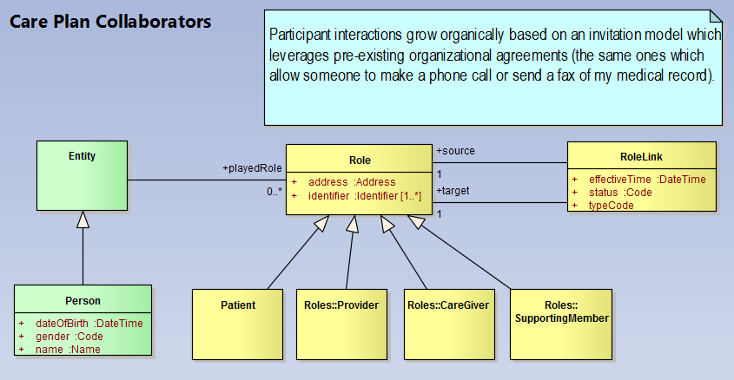
Plan Participant Relationships
Patient, Provider, Caregiver
Roles specify the plan’s interventional and observational action participants
Role relationships represent provider interaction paths and form the patient’s care circle
Relationships are key for a collaborative view of care coordination (see HL7 CCS)

Slide 9
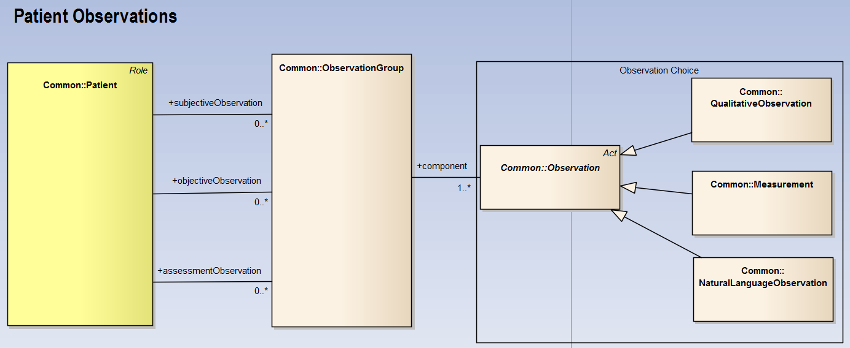
Supportive Observations
Observations support the Planning process
Observations are made before establishment of the “plan”
  E.g. Subjective and objective observations support assessment and screening processes
Observations are made after establishment of the “plan”
  E.g. Observation outcomes are captured as a result of interventions
  E.g. Observation are captured to determine follow up care

Slide 10
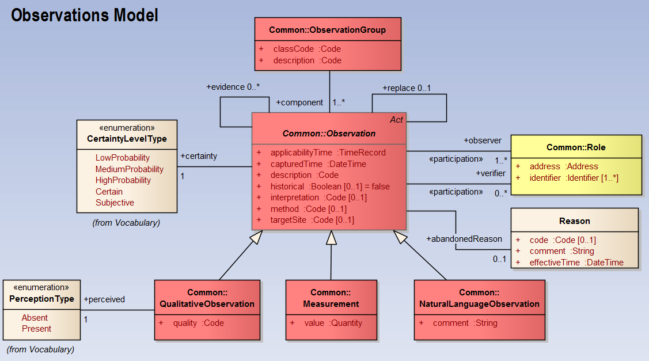
General Observations Model

Slide 11
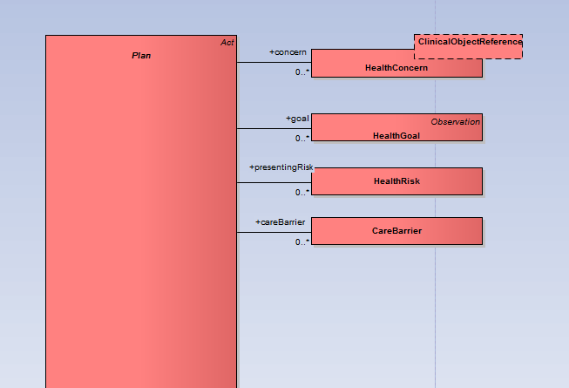
Reasons for the Plan
Why establish a plan?
A “Plan” is established due to either patient concerns, clinically significant risks or simply due to patient well being goals (in which case there may not be a concern or risk).
Barriers are modifier reasons and may introduce non-clinical actions to remove blocks to patient care goals .
Health Concerns
Concerns are used to track current non-optimal physical or psychological situations drawing the patient to the health care system. These may be from the perspective of the care team or from the patient. A concern pertains to some recorded clinical object.
Health Risks
Risks represent potential concerns to the patient’s health. They are captured in order to monitor and mitigate the manifestation of a future concern. Risks may be indicated by research evidence or they may capture a provider’s judgment.
Health Goals
Goals represent concrete targets to reduce or eliminate concerns or risks. A Goal may exist in the absence of concerns or risks. For example, a patient may have a goal to improve their fitness level.
Care Barriers
A barrier may block individual goals, actions or may block the progression of the entire care plan, plan of care or treatment plan. Barriers are situations outside the health care system which nonetheless reduce or block quality of care (and also increase cost.)

Slide 12
Health Concern Attributes
Attributes
description – name or label for concern. The label may be derived from the clinical context it pertains to.
effectiveTime – the time the concern is noted
expressedBy – the individual noting the concern
reason – reference to clinical context pertaining to the concern. These could be conditions, diagnosys, symptoms, allergies, adverse reactions, a family history observation, etc….
resolvedTime – the date/time the concern ceases to be an issue for the patient
Todo reconcile with current model from patient care working group.

Slide 13
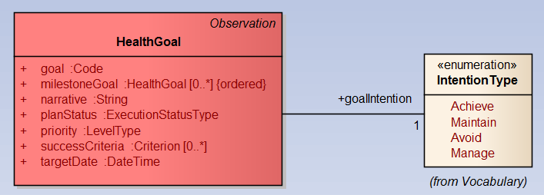
Health Goal Attributes
Attributes
goalIntention – qualifies the goals as something to achieve, maintain, manage or avoid
  E.g. For late stage diabetes the only path may be to simply manage or control the condition.
goal – names or describes the goal
narrative – captures comments or notes about the goal
priority – indicates the precedence to use for care planning purposes.
planStatus – indicates the implementation stage for the goal and related plan components.
targetDate – desired target date for meeting the goal
successCriteria – defines criteria which must be met to determine goal achivement
mileStoneGoal Association
A high level goal may consist of multiple sub-goal milestones which specify achievable intermediary targets.
A health goal specifies a future target or achievement towards which the effort of care planning and execution is directed. The plan always has at least one goal.

Slide 14
Goal Associations
A goal addresses a HealthConcern
AcceptanceReview - A goal must be understood, acknowledged and accepted by the patient and his or her providers and care givers
A goal is the target of PlanAction(s)
A goal may be blocked by a CareBarrier
Interventions have outcomes which indicate progress towards the goal (outcome Observation and ActionOutcomeReview)

Slide 15
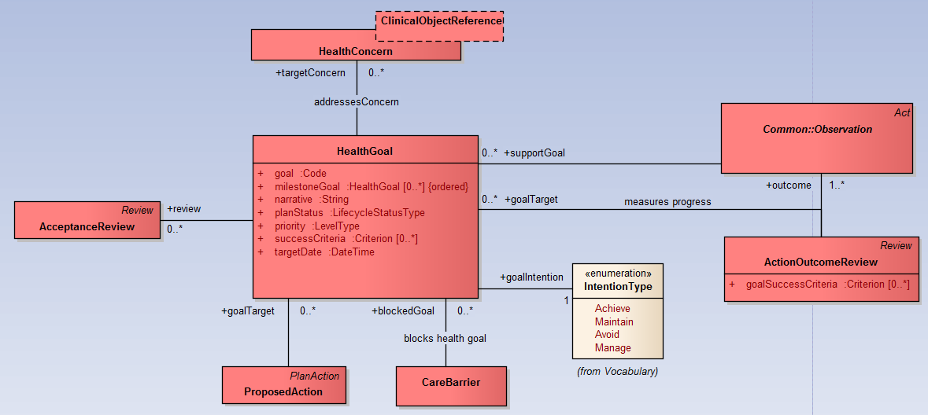
Goal Associations

Slide 16
Health Risk Attributes
Attributes
code – names or describes the risk
riskFactor – category for the risk
effectiveTime – time at which the risk is identified
observer – individual who identified the risk
levelOfRisk – a risk is clinically significant but the level may be low, medium or high depending on the overall health of the patient. E.g. new genetic tests may show I have a gene which strongly predisposes me to a future disease. The risk may be low given my lifestyle but patient and care givers may want track closely.
resolvedTime – the date the risk is no longer a threat to the health of the patient
Risks represent clinically significant potential concerns to the patient’s health. They are captured in order to monitor and mitigate the manifestation of a future concern. Risks may be indicated by research evidence or they may capture a provider’s judgment.
There are multiple sources of risks:
A patient may be predisposed to certain risks due to genes, lifestyle or chronic conditions they currently have.
A risk may be introduced by a provider after weighting the benefits of a given treatment. In this case the risk is taken given the probability of the benefit is much greater.
The risk in this case is captured so that interventional activities can be taken to ameliorate the risk and track it in order to avoid the unwelcome state of health
In this later case, risks could be caused by interventional PlanAction(s) contained within a single Plan of Care or they may be caused through the interaction between multiple Plan(s)OfCare

Slide 17
Care Barrier Attributes
Attributes
barrierType – names or describes what the barrier is
effectiveDate – date at which the barrier was discovered
observer – individual who identified the barrier
comments – free form commennts related to the barrier
resolvedDate – the date issues related to the barrier are resolved and at which point the barrier is no longer relevant
Barriers represent non-clinical situations which can be potential, known, or encountered during the execution of the plan.
A barrier may block individual actions or may block the progression of the entire care plan, plan of care or treatment plan. Awareness of barriers allows the care team to address any issues impeding patient care.

Slide 18
Capturing Patient Preferences
Attributes
expressedBy
The source of the preference (e.g. patient, mother/father/guardian or legal care taker).
preference
An ideally coded preference but codes will always gracefully degrade to text as systems and standards evolve.
comments
A free text note with relevant information about the preference.
effectiveDate
The date/time the preference goes into effect for consideration by the care team.
activationCriteria
A computable criteria expressing conditions which trigger the use of the preference. In our example, the criterion may be the order for the undesired medication.
CarePreference
A care preference is expressed by the patient, custodian or care taker responsible for the patient in order to influence how their care is delivered. It may express either cultural or personal preferences.
Patient preferences impact how the plan is personalized to respect patient choices.
Example:
A patient desires to use a lower dose of a medication or completely avoid a specific medication. This preference alters the intervention choices made by the care team.
Discuss: Using preferences to capture advanced directives

Slide 19
Plan Reviews
Various types of review are conducted during planning and plan implementation. The model captures:
Acceptance Review
Acceptance reviews capture understanding and agreement to adopt a proposal for health goals, interventional actions or the plan itself. E.g. Upon review of the goals and planed actions a care manager (e.g. nurse case manager, social worker, physical therapist, pharmacist), PCP, nurse and patient will indicate understanding and acceptance of the Care Plan. Acceptance reviews may be used to indicate a provider’s authorization to perform an intervention and another’s provider acknowledgement.
Action Outcome Review
An action outcome review measures the result of individual implemented action (observational or interventional) against goal success criteria. The action outcome review might address only a subset of goal success criteria.
Goal Review
Goal reviews reference multiple action outcomes reviews which support overall assessment of a HealthGoal.
Plan Review
Plan reviews are performed at periodic intervals to assess the overall consistency, appropriateness, completeness and effectiveness of the plan. The plan review includes comprehensive review of all the goals.

Slide 20
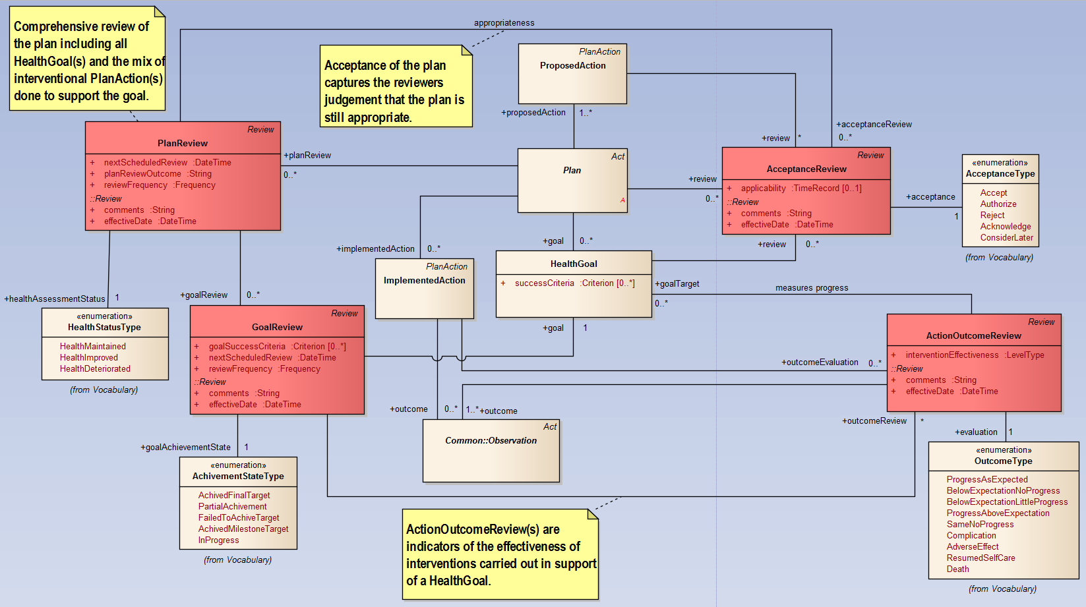
This model fragment illustrates relationships between the various Review acts and Plan, HealthGoal, ProposedAction, ImplementedAction and outcome Observation.
**Some associations hidden for illustration purposes.

Slide 21
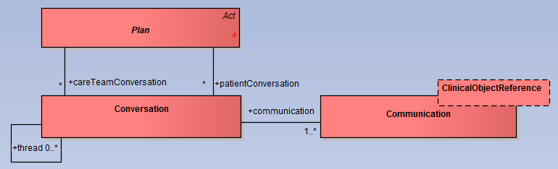
Plan Communications
Communications may be initiated during a referral, a care transition
Communications may be the result of an important questionnaire completed by the patient
Communications may be the result of a patient’s diary notes (e.g. self monitoring of behavior or diet)
Communications may be the result of a patient’s question to his or her PCP via secure messaging
Communications happen between providers and care givers collaborating on the patient care coordination.
In all these cases a Communication alters the plan and drives the unfolding process of care.
Conversation
A conversation organizes individual communications in a meaningful manner for the benefit and understanding of care plan stakeholders.
Communication
Communication is ongoing during care coordination. Care team communications is what causes the unfolding of the plan as new participants join, propose actions, change goals, record interventions, review outcomes and assess effectiveness of individual actions and of the overall plan.
A communication may pertain to an element of the care plan or the care record and reference the specific semantic context.

Slide 22
Putting the Conversations in Context
Communications may be free form
But they may also pertain to an aspect of the structured context of Care Plans, Plans Of Care, Treatment Plans…
They may even pertain to Care Record elements (e.g. a communication about medications).
These associations are optional but when possible they put the conversation in context to facilitate care coordination

Slide 23
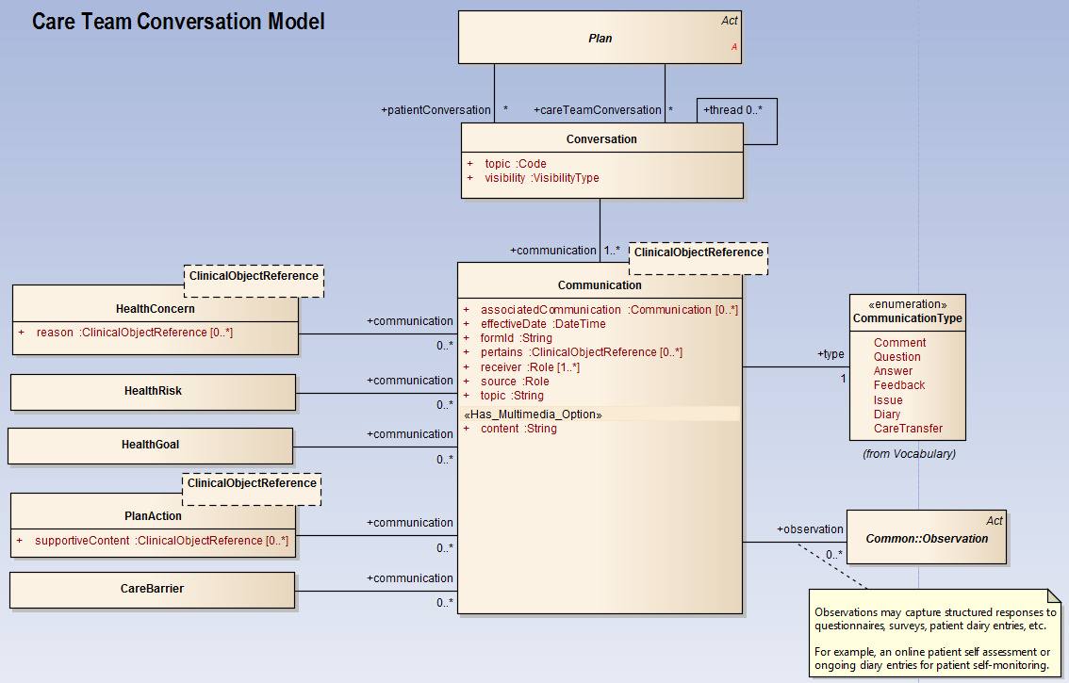
Conversation in Context

Slide 24
Plan Actions
The Care Plan, Plan of Care and Treatment Plan is realized through the:
  Proposal of observational and interventional actions
  Implementation of proposed actions
  Reviews and Tracking of the execution status
The PlanAction captures supporting resources
  Human, assets, consumable and service resources
The PlanAction indicates criteria necessary for implementation

Slide 25
Plan Actions
- Propose
- Implement
Start, Complete, Suspend, Abandon
Proposed Action
A proposal to perform an action towards the achievement of the patient’s goal, in support of a patient health concern, risk or care barrier.
May require an acceptance review to indicate understanding, acknowledgement or authorization to carry out the proposal
May specify criteria required for implementation
Implemented Action
Realizes a ProposedAction but may also exist without a proposal
Captures performers and outcome reviewers
Captures place of service
Links to outcome observations
Indicates resources allocated in support of implementation
Proposed or Implement Actions
May be suspended for a period of time (e.g. due to resource constraints)
May be abandoned (e.g. due to impending risks, or current barriers)
May reference supportive clinical context
May consist of multiple steps optionally determined based on Decision points
Resource Allocation
Captures resource requirements for proposed actions
Captures utilization once action is implemented
Plan actions express what is to be done, by whom, where and constraints which must be met for execution.
Examples:
Diagnostic tests
Preventive procedures
Surgical interventions
Medication administrations
Vaccinations
Treatments
Consults
Physical therapy
Counseling
Patient Education
Care Transfer, Referral
Patient diary action
Patient questionnaire action
Etc..

Slide 26
Plan Action Attributes
Attributes
classification - indicates the activity grouping (e.g. medication order, lab order, medication administration, patient education, etc.)
description - names the specific activity (e.g. digoxin order, diabetes education)
supportiveContent – references clinical detail related to activity
applicability - the timeframe for which the action applies. It may be null if the action is not bound by a timeframe.
frequency - indicates how the action is to be repeated over time
startDate - the start date/time of the activity
endDate - the end date/time of the activity
precondition - indicates criteria which must be met before activity can start
postCondition - indicates criteria which must be true when the activity finishes
actionStep (Decision) - Used to indicate independent activity steps into
The PlanAction specifies shared characteristics inherited by its ProposedAction and ImplementedAction subclasses.

Slide 27
Plan Action Resources
Successful execution of any plan requires resources. Proposed actions indicate required resources and implemented actions indicate the resources actually used.
The achievement of plan actions requires allocation of human, asset, consumable and service resources.
AssetAllocation
  Represents human assets as well as equipment, rooms, etc. The asset is allocated for a period of time and indicates it’s credentials or certifications.
ServiceAllocation
  Supports allocation of services required to implement an activity
ConsumableAllocation
  Consumables represent medications, gloves, syringes and other expendable materials.
  A consumable allocation indicates the required quantity of the expendable material.

Slide 28
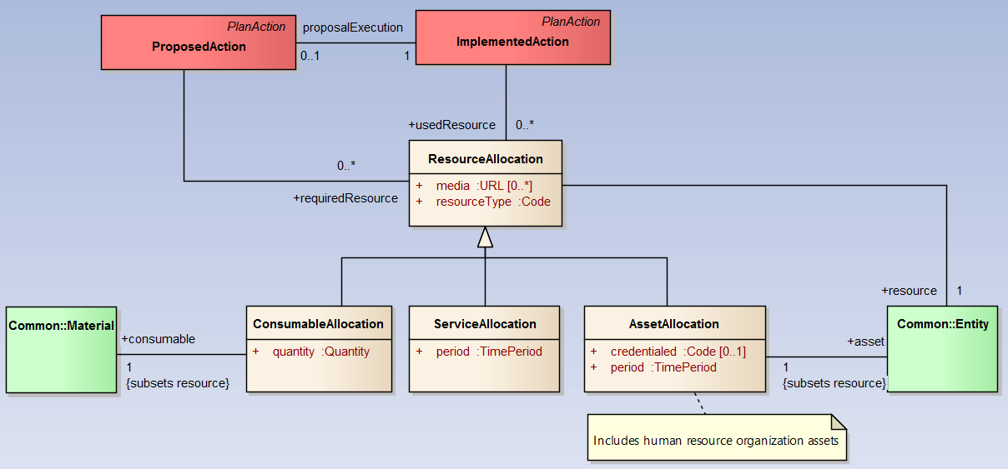
Resource Allocation Model

Slide 29
Detailed Plan actions Model

Slide 30
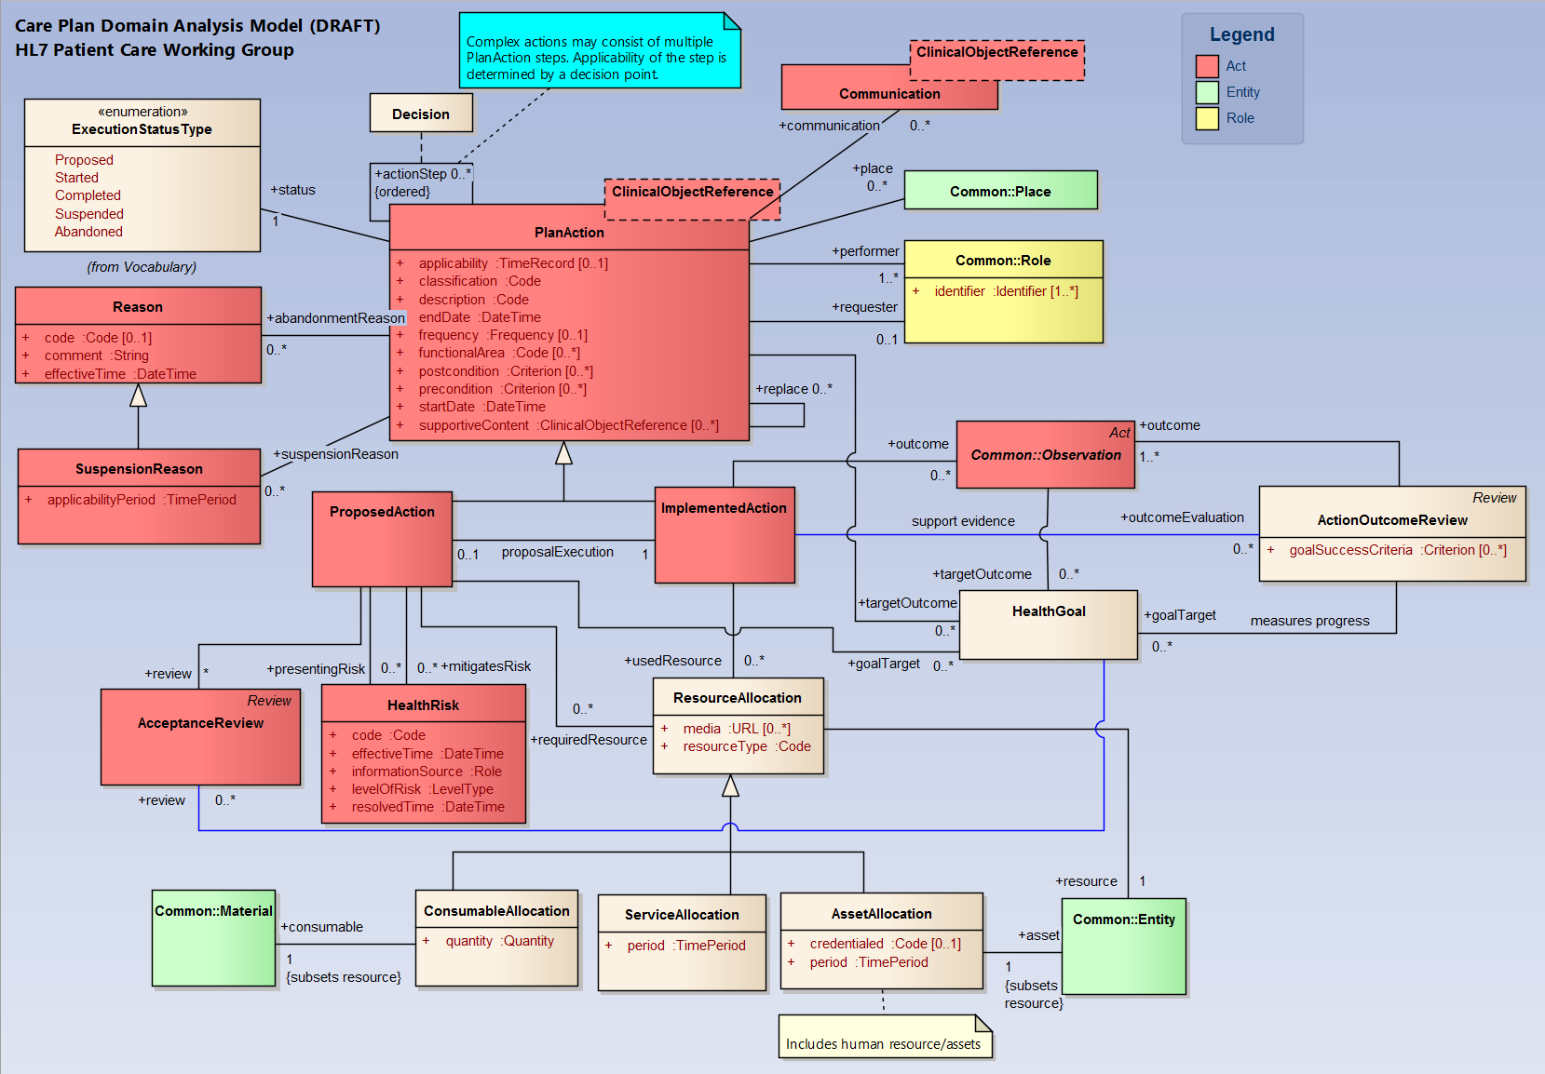

Slide 31
Detailed Care plan model

Slide 32
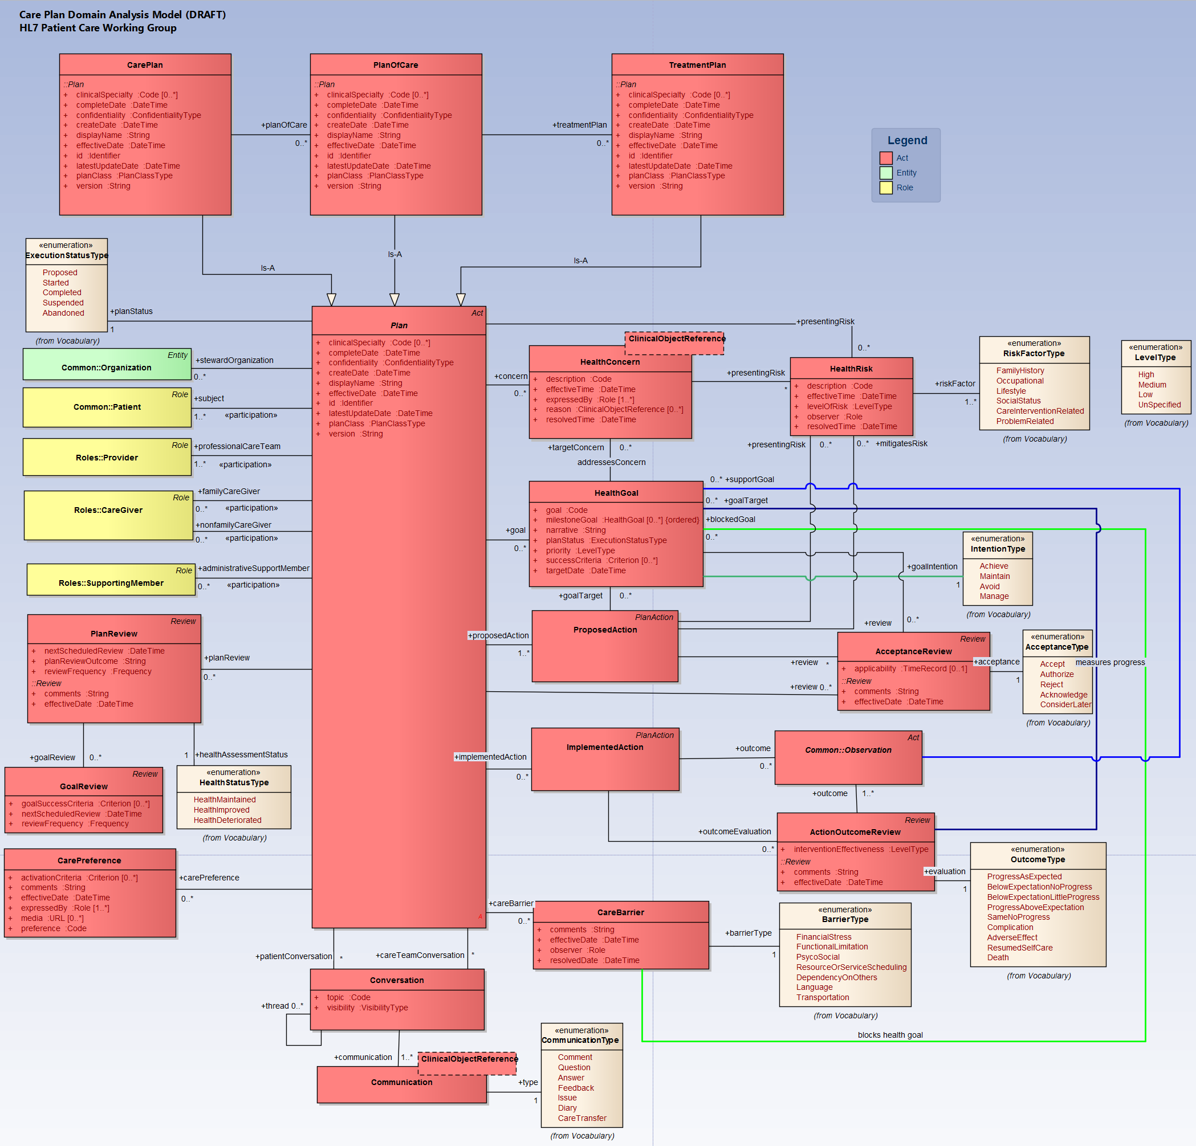
Full resolution diagram at: http://wiki.hl7.org/images/2/24/CpDetailedModelImg.png

