Slide 1
Patient Care Workgroup Care Plan Topic
Taking care of health data
http://bit.ly/HL7PC_Attendees

Slide 2
Agenda
http://bit.ly/HL7PC_Attendees
Patient Care Care Plan Project
Care Plan DAM 2.0
HL7 Care Plan DAM 1.0/FHIR Harmonization
Essential Information for Children with Special Healthcare Needs
HL7 FHIR Care Plan Resource
Social Services new PSS
Evelyn Gallego
Care Plan Survey - Implementations, pilots, proposals
CDA
HL7 C-CDA 2.1 Care Plan Document Template - Lisa Nelson
HL7 CDA R2 Personal Advanced Care Plan Document - Lisa Nelson
IHE QRPH Early Hearing Detection and Intervention (EHDI) Plan of Care- Lisa Nelson
IHE PCC
Dynamic Care Planning Profile- EJ
Update: PlanDefinition/ActivityDefinition
Care Team Managment Profile - EJ
HL7 Clinical Oncology Treatment Plan and Summary - Jeff Brown/Gay Dolin
NCPDP/HL7 Pharmacist Care Plan - Shelly Spiro
Learning Health Systems
Care team project update (Russ/Laura/Emma)
Others
Nutrition Care Plan - just balloted.
LOINC Code

Slide 3
CP Dam 2.0
Orders
Advance Directives
Health Concern – updates
Reconciliation – updates
Care Team – updates
Allergies - updates
Social Determinants of Health
Self Care items
Changes to the diagram as learned from the FHIR harmonization.
Address RIM Nuances
Modeling available in FHIR?
FHIM….
CCS Review – changes?
Add Narrative re: FHIR and the harmonization work.
Add Narrative re: CCDA? Write a paragraph/section to that?
Add:
Definitions of Care Plan, Care Planning (methodology/process/decision making), care coordination….

Slide 4
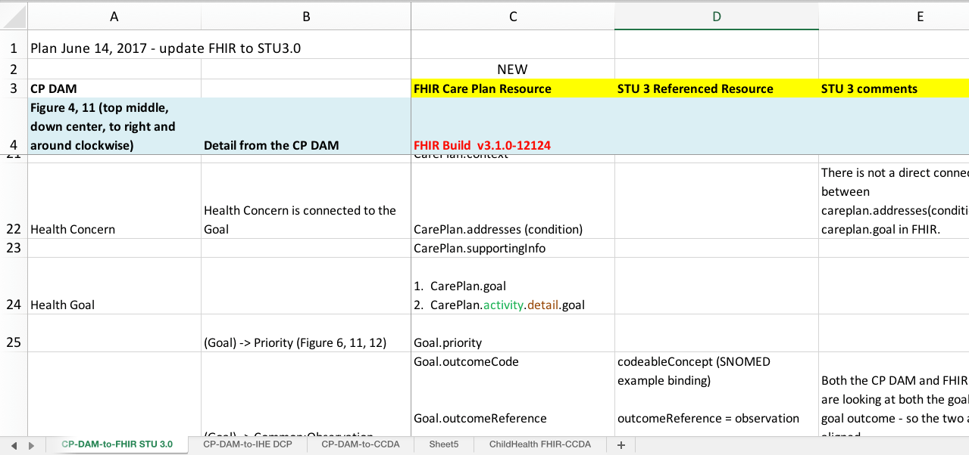
Care Plan
Reconciling CP DAM and FHIR resources in (slow) progress

Slide 5
Essential Information for Children with Special Healthcare Needs Care Plan
Aim to communicate patient preferences/plans in a variety of settings including urgent or emergent care
Modeling selected storyboards in CDA and FHIR
e.g., 7 yo with autism, seizure disorder, on ketogenic diet
Complementary work
Care Team (input from multiple subspecialists)
CDA -> FHIR Mapping
Use cases for the recent Nutrition IG
Clinicians on FHIR
Working toward an implementation (companion) guide w/ example content

Slide 6
Essential Information for CSHN Care Plan Timeline 2018
Progress/feedback on Care Plan calls Wednesday (5pm Eastern)
Plan to include sub-topics on agenda in advance of call
Upcoming topics:
Seizure Action Plan
ED management of metabolic disorder (OTC deficiency)
Nutrition CDA IG assessment & care plan (also reviewed on nutrition call)
Aim to complete existing use cases in CDA Section/Entry and FHIR resources through summer, then Document templates
Decide on type Implementation Guide by this fall
Test examples in Clinicians on FHIR at upcoming WGMs

Slide 7
PCWG Resources Update
AdverseEvent (Thurs Q3)
AllergyIntolerance (Tues Q2/Q3)
CarePlan (Tues Q2/Q3, Thurs Q1)
CareTeam (Thurs Q4)
ClinicalImpression (Mon Q2)
Communication
CommunicationRequest
Condition (Tues Q2/Q3)
FamilyMemberHistory (Tues Q2/Q3)
Flag
Goal (Tues Q2/Q3)
Linkage (Mon Q2)
Procedure (Wed Q1)
FHIR care plan and related resources:
Connectathon track on Saturday and Sunday before WGM week
ClinFHIR on Friday of WGM week

