Slide 1
HL7 Consolidated CDA “Relevant and Pertinent” Project
November 6, 2015

Slide 2
What’s the Issue?
From MU2 clinicians: overly lengthy C-CDAs ➔ cognitive overload, hard to find what they need
“Relevant and Pertinent”
RnP definition: “pertaining or relating directly and significantly to the matter at hand” – improving transitions of care (ToC) for clinicians and patients
Need to understand what specifically should be reduced. What could improve the situation?
RnP recommendations will provide guidance to EHR developers to make future CCDAs as useful and usable as possible
YOUR input will make a difference!

Slide 3
Two Complementary Surveys
Short Survey for individual clinicians who “do” ToC
Organization-specific link
http://goo.gl/forms/lIxMXfWb2c
Goal is to gain clearer understanding of where problems lie
Structured answers intended for quantitative analysis (hundreds or even thousands of responses)
Long Survey for a single consensus group convened to represent an organizational view
https://docs.google.com/forms/d/1N5h4ME873SIuWiISmbG_c6v2RGRa3__p5z5CCbbtR7Q/viewform?usp=send_form
Includes some free form answers intended for qualitative review
Gathers ideas on possible solutions
HL7 White Paper (analysis & recommendations) to be written and balloted in first half of 2016

Slide 4
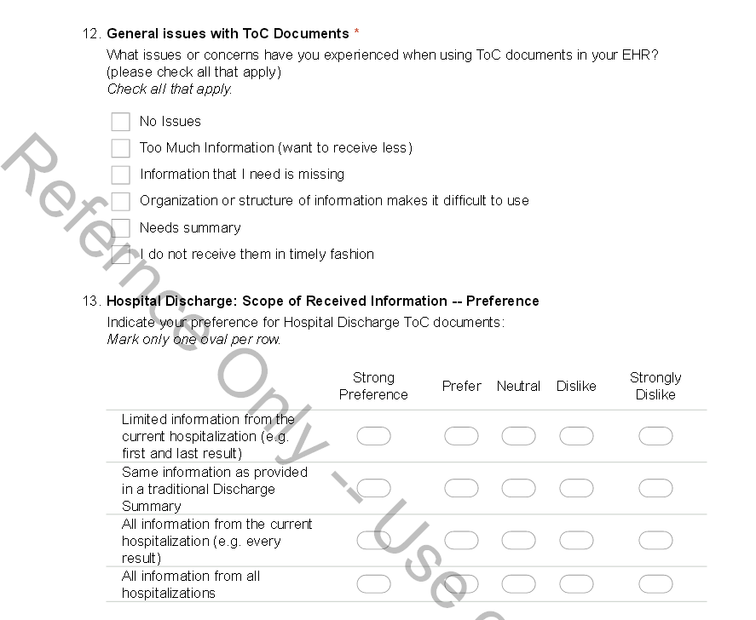
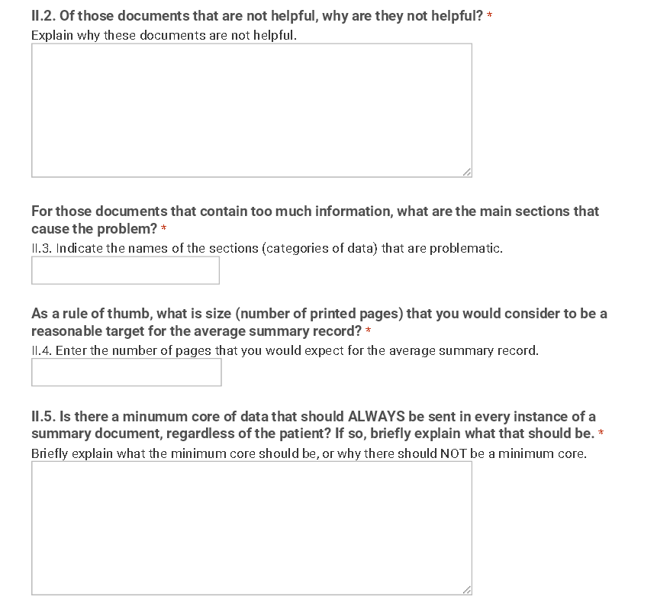
“Preview pdf” References
Short Survey
For clinicians
Long Survey
For organization
Structured responses
Narrative responses

Slide 5
Call to Action!
For Short Survey: Send the link to your members who are clinicians
Sample member communication letter: [Needs to be created and posted on HL7 RnP wiki.]
Each clinician individually submits a Short Survey response
Target completion: end of November 2015
For Long Survey: As an organization, determine how to convene your “consensus group” to discuss the Long Survey questions. Write a set of consensus answers for each question. (May include multiple viewpoints.)
Each organization submits a single Long Survey response
Target completion: end of December 2015
Thank you on behalf of HL7 and future beneficiaries of more usable ToC documents!
“Preview pdf” of the surveys:
Short Survey: http://wiki.hl7.org/images/f/f4/ShortSurvey.pdf
Long Survey: http://wiki.hl7.org/images/7/7b/LongSurvey.pdf

