Slide 1
Reference Domain Analysis Model (RDAM) Mapping
HL7 Project Number 1413
Presented at
HL7 Meeting, Baltimore, MD
29 Sep to 5 Aug, 2018
Current Versions at: http://wiki.hl7.org/images/b/bd/-RDAM-Mapping_Immunization-Pilot Paper_Sep2018.DOCX
http://wiki.hl7.org/images/c/cd/-RDAM-Mapping_Immunization-Pilot_Brief_Sep2018.PPTX
Presented by:
Stephen.Hufnagel.HL7@Gmail.com facilitator
Incorporating Feedback From:
CIC, PHER, EHR, CQI, CDS, CIMI, STRUCDOC, O&O, M&M, VOCAB, SOA HL7 Workgroups and ArB
2018-09-11 DRAFT
See Notes Page
Notes:
CHRONOLOGY:
2001 HL7 EHR WG start on EHR-S FM
2008 Federal Health Information Model start
2011 Clinical Information Model Initiative (CIMI) start
2016-01-16 CIMI Sponsored HL7 Investigative Study start
The Jan-Sep 2016 CIMI-Sponsored HL7 CIMI-FHIM Integration Investigative-Study includes: The Open Group Healthcare Forum, HL7 CIMI WG, HL7 EHR WG and HL7 CIC WG
2016-03-01 CIMI-FHIM Integration Task Force
2016-08-15 “CIMI-FHIM-SOLOR-CQF Integration” Preliminary Report
2016-08-17/18 Health Interoperability and Exchange Alliance (HIEA) Technical Forum
Health Interoperability and Exchange Alliance (HIEA) Technical Forum
Topic: Information Modeling: Foundation to Semantic Interoperability
C0-Sponsors: ONC OST, FHA, IPO DOD VA
This Health Interoperability and Exchange Alliance (HIEA) Technical Forum on “Information Modeling: Foundation to Semantic Interoperability” event was a key component of a mix of collaborative activities. This event had key stakeholders coming together under the facilitation of the DoD/VA IPO ONC Liaison, Nona Hall, BSN, MA who on behalf of the co-sponsors and through the support of the IPO's HIEA Technical Forum showcased this initiative and results to date.
As we go forward, there is logic to stay connected no matter what current and immediate task we are attending to.
2016-09-07 FHA “CIMI-FHIM-SOLOR-CQF Integration” Report PPT-Brief to FHA Federal Partners
2016-09-15 “CIMI-FHIM-SOLOR-CQF Integration” Final Report
2016-09-17 HL7 Meeting in Baltimore, MD
“CIMI-FHIM-SOLOR-CQF Integration” Report PPT-Brief at HL7
HL7 FY2017 “CIMI-FHIM-SOLOR-CQF Integration” Project Scope Statement (PSS) vetted at HL7
2017-2018 FHIM-CIMI Harmonization and refresh of domain models and terminology
"Healthcare IT Computable-Interoperability Strategy --- Methodology to manage data-quality risk by standardizing data In accordance with 21st Century Cures Act, TEFCA and USCDI", HL7 Newsletter, May 2018, P16-18, http://www.hl7.org/documentcenter/public/newsletters/HL7_NEWS_20180523.pdf. The May 2018 article discussed HL7 supporting the Common Data Interoperability (USCDI) agenda across US Office of the National Coordinator (ONC) Trusted Exchange Framework Common Agreement (TEFCA) among Qualified Health Information Networks (QHINs) managed by a Recognized Coordinating Entity (RCE).

Slide 2
Executive Summary
Our goal is “to help people live the healthiest lives possible” by enabling a “Learning Healthcare System” supporting areas such as, but not limited to, Precision Medicine.”
This requires data that is computable, usable and interpretable across disparate systems.
Our current-state is unable to deliver on this goal; however, there is a solution.
We have made significant inroad with the exchange of data and standards and their adoption; but, we must return our focus on clear, complete, concise, correct and consistent data and its context (aka semantics) to make additional advancements.
2

Slide 3
IT Objective
Our IT objective is to make the appropriate data available when it is needed, where it needed and how it is needed. We plan to integrate existing models, with semantically-consistent computable-data, including provenance data (who, what, when, where, why, how) across different platforms, e.g., population health, Clinical Decision support, EHR patient documentation systems, etc. using tooling to generate various implementation styles, including HL7 Fast Healthcare Interoperable Resources (FHIR).
Notes:
Our clinical goal is “to help people live the healthiest lives possible.” Our technical goal is to enable “Learning Healthcare Systems” supporting areas such as, but not limited to, Precision Medicine.”
These goals require data that is computable, usable and interpretable across disparate systems.
Our current-state is unable to deliver these goals; however, there is a solution.
Our IT objective is to make the appropriate data available when it is needed, where it needed and how it is needed. We plan to integrate existing models, with semantically-consistent computable-data, including provenance data (who, what, when, where, why, how) across different platforms, e.g., population health, Clinical Decision support, EHR patient documentation systems, etc. using tooling to generate various implementation styles, including HL7 Fast Healthcare Interoperable Resources (FHIR).
Our goal is “To help people live the healthiest lives possible;” where, the foundation of a Learning Healthcare System is accurate, computable, data starting with the integration of CIMI, FHIM, SOLOR, CQF, DAF and other Information Models into a widely used HL7/ISO standard ^{[Stan Huff]} engaging specifically to bolster FHIR Profiles

Slide 4
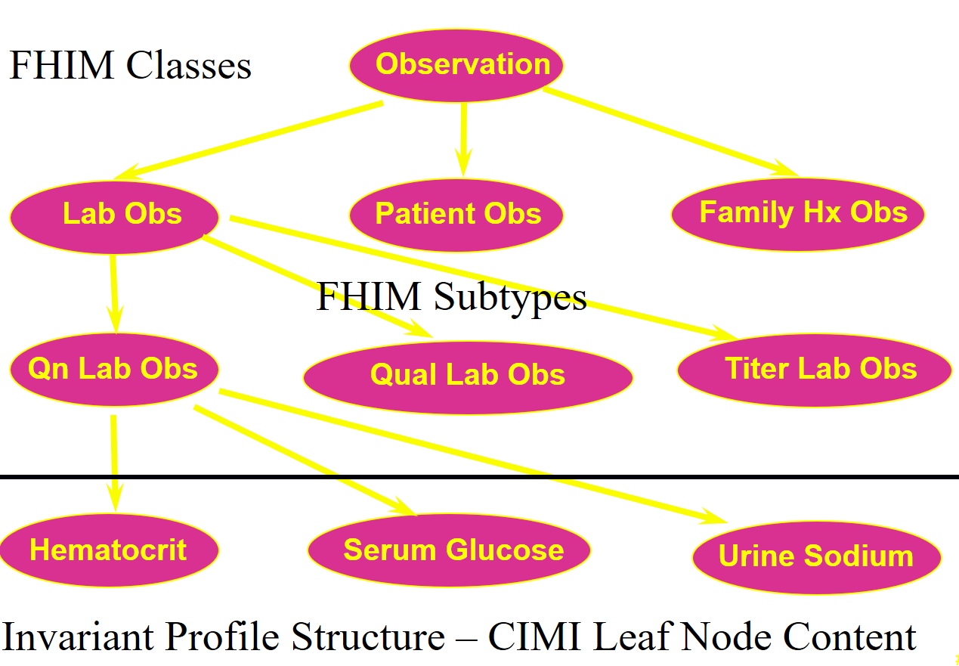
Clinical Example CIMI-FHIM Integration
CQF Knowledge Artifacts
SOLOR Terminology
FHIM Class : CIMI BMM Archetypes
CIMI DCMS
4

Slide 5
Proposed Solution Integrated Model Stack - Each Plays a Role
KNART
KNART
CQM
CQM
KNART
KNART
DCM
DCM
DCM
CQI
C QF
CDS
DCM
DCM
DCM
CIMI
Other
Initiatives
DCM
DCM
FHIM and EHR-S FM
Data Rqmts. and Clinical Context
FHIR US Core and QI Core / QUICK
FHIR Profiles and FHIR Extensions
SOLOR
See Notes Page
Notes:
As shown in this slide, each model contributes to an Integrated Model Stack, the proposed operational architecture involves the definition of clinical knowledge in the form of formally modeled information artifacts that could be used in compose-able health records, care plans and other shared clinical data. As represented in this slide, the combination of SOLOR, FHIM, CIMI DCMs and CQF KNARTs while complementary fulfill a different information modeling contribution.
SOLOR is SNOMED with extensions for LOINC and RXNorm.
FHIM is Federal Health Information Model
CIMI DCMs is Clinical Information Model Initiative Detailed Clinical Model
CQF KNARTs is Clinical Quality Framework Knowledge Artefacts

Slide 6
Technical Summary (Overview) HL7 Reference Domain Analysis Model (RDAM) Mapping Project Number 1413
The RDAM Mapping Immunization Pilot Study maps
the EHR System Functional Model (EHR-S FM) [Ref 1] to the
Federal Health Information Model (FHIM) [Ref 2] within
the EHR-S FM Immunization Functional Profile Spread Sheet [Ref 3].
We address "Solving the Modeling Dilemma as a Foundation for Interoperability" [Ref 4]; where,
This paper describes the RDAM Mapping within a Use-Case Scenario driven
"Emerging CIMI-compliant Software Development Lifecycle (SDLC) Methodology" [Fig 1] for
CIMI-compliant (FHIM, QUICK, CIMI BMM, SOLOR, EHR-S FM) models [Fig 2]
to meet Healthcare Information Technology (HIT) Information Exchange Requirements (IERs).
Use Case Scenario IERs can be specified as Detailed Clinical Models (DCMs) [Ref 5],
Knowledge Artefacts (KNARTS) [Ref 6] and Clinical Quality Measures (CQMs)
expressed as FHIR Structure Definitions (FSDs) [Ref 7],
including QI Core / QUICK (Quality Improvement Clinical Knowledge data model) [Ref 8]
supporting FHIR Clinical Reasoning [Ref 9].
These FSDs can be transformed into consistent HL7 (V2, C-CDA, FHIR) profiles and extensions
used in Healthcare Information Networks' (HINs) test and certification
Enterprise Compliance and Conformance Framework (ECCF) [Fig 3], e.g., TEFCA RCE QHIN [Ref 10].
See Notes Page
6
Notes:
HL7 EHR System Functional Model (EHR-S FM) R2 http://www.hl7.org/implement/standards/product_brief.cfm?product_id=269
Federal Health Information Model (FHIM) Immunization Domain Model http://www.fhims.org/content/_420A62FD03B64295E8200076-content.html
Immunization Functional Profile Mapping Spread Sheet http://wiki.hl7.org/index.php?title=EHR_Immunization_Functional_Profile
Solving the Modeling Dilemma as a Foundation for Interoperability by Berndt Blobel and Frank Oemig, Intl. HL7 Interop Conference (IHIC) 2018 in Portsmouth, UK. https://www.ejbi.org/abstract/solving-the-modeling-dilemma-as-a-foundation-for-interoperability-4614.html
CIMI Detailed Clinical Models https://CIMI.HL7.org
HL7 Knowledge Artefact (KNART) Specification http://wiki.hl7.org/index.php?title=Knowledge_Artifact_Specification
FHIR Immunization Resources https://www.hl7.org/fhir/immunization.html
QI-Core IG http://hl7.org/FHIR/us/qicore/2016Sep/index.html
FHIR Clinical Reasoning Module http://www.hl7.org/fhir/clinicalreasoning-module.html http://wiki.hl7.org/index.php?title=Clinical_Reasoning_Module
HL7 May 2018 Newsletter Article http://www.hl7.org/documentcenter/public/newsletters/HL7_NEWS_20180523.pdf

Slide 7
Models
The CIMI-compliant logical models are built on a standards foundation.
CIMI BMM is based on ISO 13606 and
SOLOR is a SNOMED extension including LOINC and RxNorm using EL++ descriptive logic.
QI Core / QUICK data model and FHIR Clinical Reasoning module are FHIR STU3 & STU4 IGs.
The FHIR Clinical Reasoning module (CQL (Clinical Quality Language), CQF (Clinical Quality Framework), CDS Hooks) provides resources and operations to enable the representation, distribution, and evaluation of clinical knowledge artifacts (KNARTs) such as clinical decision support rules, quality measures, order sets, and protocols. In addition, the reasoning module describes how expression languages can be used throughout the specification to provide dynamic capabilities.
FHIM has over 10 years of clinical input and standards alignment; but, is not HL7 balloted.
EHR-S FM R2 is a normative HL7 and ISO standard.
7

Slide 8
Business Case Summary
Problem: HL7 (V2, C-CDA, FHIR) implementation-and-mapping variability results in 1) semantic inconsistency-and-ambiguity, 2) reduced interoperability and 3) reduced HIT value (patient safety, care quality, low cost) across Federated HINs.
Strategic Goals: Semantic Integrity across
HL7 Product lines and product families (V2, C-CDA, FHIR) TEFCA RCE QHINs
https://www.healthit.gov/sites/default/files/draft-guide.pdf
FHIR US-Core and FHIR QI-Core future normative ballots
http://www.hl7.org/fhir/us/core/
http://hl7.org/fhir/us/qicore/index.html
Approach: Separation of Clinical Statement (syntax, context, terminology, workflow) concerns;
where, CIMI-compliant (FHIM, QUICK, CIMI BMM, SOLOR, EHR-S FM) logical-specification of DCMs and CQMs
are expressed as FSDs for interoperable V2, C-CDA and FHIR implementations.
Value Proposition: CIMI-compliance positively improves semantic integrity
resulting in improved patient value within HL7 cross family scalability (interoperability)
with reduced complexity (cost) across federated HINs, e.g., TEFCA RCE QHINs
8

Slide 9
Plan
Assuming HL7 TSC and HHS ONC concurrence, the RDAM Mapping plan includes extending the immunization pilot study to a full software development lifecycle demonstration using CIMI-compliant model driven development (MDD) tools:
FHIM mapped EHR-S FM defined requirements use-case scenario events-context,
Quality Improvement and Clinical Knowledge (QUICK) data model,
immunization DAM and RDAM review, update and harmonization by PHER clinical workgroup,
DCMs, KNARTs and CQMs expressed as FSDs, using CIMI MDD tools plus
CIMI-compliant V2, C-CDA and FHIR profile and extension generation, using FHIR MDD tools.
Lessons Learned Report and Recommendations.
These next-step tasks support care plan/team (immunization screening, reporting, care delivery and follow-up) and transfers-of-care use-case scenarios.
9

Slide 10
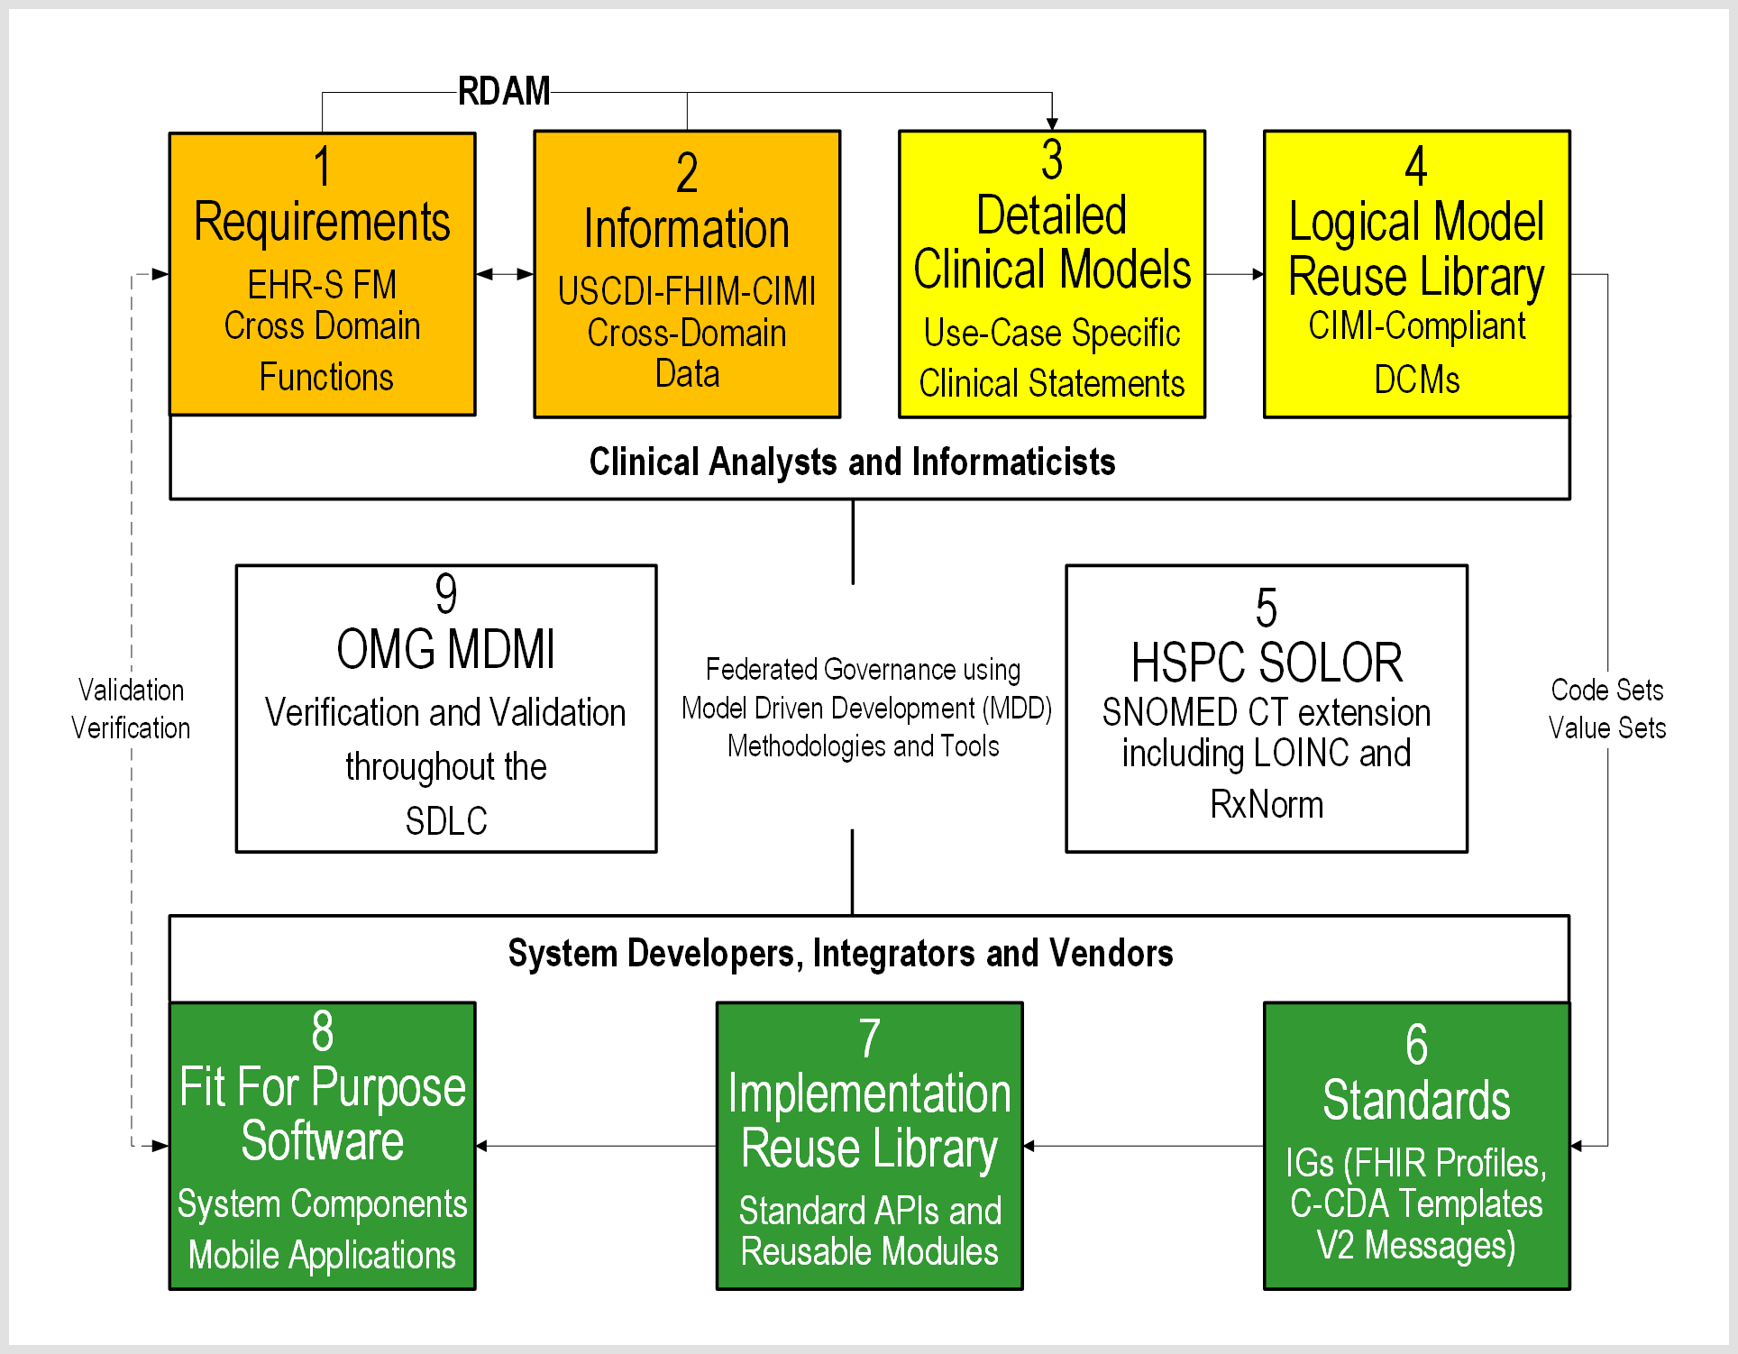
RDAM (FHIM-CIMI-SOLOR, EHR-S FM) STRATEGY AND VALUE PROPOSITION
FIG 1 (CIMI-Compliant Lifecycle Methodology)
See Notes Page
10
See Notes Page
Notes:
As shown in this slide, each model contributes to an Integrated Model Stack, the proposed operational architecture involves the definition of clinical knowledge in the form of formally modeled information artifacts that could be used in compose-able health records, care plans and other shared clinical data. As represented in this slide, the combination of SOLOR, FHIM, CIMI DCMs and CQF KNARTs while complementary fulfill a different information modeling contribution.
SOLOR is SNOMED with extensions for LOINC and RXNorm.
FHIM is Federal Health Information Model
CIMI DCMs is Clinical Information Model Initiative Detailed Clinical Model
CQF KNARTs is Clinical Quality Framework Knowledge Artefacts

Slide 11
RDAM (FHIM-CIMI-SOLOR, EHR-S FM) STRATEGY AND VALUE PROPOSITION
FIG 2 (Models, Models Everywhere …)
See Notes Page
11
Notes:
the proposed CIMI (FHIM, QUICK, CIMI BMM, SOLOR, EHR-S FM) data-quality strategy operationalizes HL7 lessons learned to simplify and improve HL7 governance, products, processes, and reduce healthcare IT costs. The collaboratively developed RDAM will take time to mature across clinical domains; where, CIMI collaboration and compliance, among workgroups, HTA, UTG and HSPC, can positively influence value (patient safety, care quality, cost) by finding inflection points; where, HL7 products and services efficiently and effectively meet HIT developer and clinical user needs.

Slide 12
CIMI CUNUNDRUM (1 of 2)
SITUATION: CIMI's mission is to specify computable semantics within logical models (DCMs, CQMs, KNARTS), ideally specified as FHIR Structure Definitions (FSDs), on the Software Development Lifecycle path to HL7 (FHIR, C-CDA or V2) implementation guides (IGs) and implementation artefacts. Efficient and effective Tools and (sometimes impossible and costly) bi-directional mappings are essential to manage complexity and to empower a deterministic development process for clinical users and implementers. Currently, CIMI-compliant Basic Meta Model (BMM) development of HL7 (FHIR, C-CDA, V2) compliant IGs and implementation artefacts results in a dilemma from which there is no escape because of mutually conflicting data types and value/code sets; where, CIMI compliant logical models must be "transformed" to FHIR, C-CDA or V2 compliant IGs and reusable implementation artefacts, which is a tooling oxymoron.
PROBLEM: "The FHIR and ISO data types are locked down. Backward compatibility rules prevent CIMI from making changes to any of them to the degree necessary to support full interoperability. Similarly, differing choices for value sets are consciously and architecturally driven. V3 has null flavor. FHIR and v2 do not. That impacts value set design. V2 terminology is often a mess because we often didn't understand the ramifications of design choices when we added codes to v2. V3 and FHIR made different choices to address those problems. New HL7 product families are introduced specifically *to* make breaking changes with what's come before" [Lloyd McKenzie].
See Notes Page
12
Notes:
the proposed CIMI (FHIM, QUICK, CIMI BMM, SOLOR, EHR-S FM) data-quality strategy operationalizes HL7 lessons learned to simplify and improve HL7 governance, products, processes, and reduce healthcare IT costs. The collaboratively developed RDAM will take time to mature across clinical domains; where, CIMI collaboration and compliance, among workgroups, HTA, UTG and HSPC, can positively influence value (patient safety, care quality, cost) by finding inflection points; where, HL7 products and services efficiently and effectively meet HIT developer and clinical user needs.

Slide 13
CIMI CUNUNDRUM (2 of 2)
SOLUTION: In the short term, this problem can only be mitigated with mapping; but, is there a practical strategic path forward?
CIMI Product Family? Currently, this seems a nonstarter, while HL7 is on FHIR.
CIMI-compliant FHIR (US Core, QI Core), C-CDA template and V2 version? Is this an HL7 nonstarter?
Three or more CIMI BMM variants for 1) FHIR (US Core, QI Core), 2) C-CDA templates, 3) V2 version? Is this a CIMI nonstarter?
Costly HL7 curated mapping tables for its product family data types and value/code sets, which are inherently non bi-directional?
Directed HL7 Cross family data type and value/code set harmonization is a nonstarter within HL7.
Your Thoughts?
See Notes Page
13
Notes:
the proposed CIMI (FHIM, QUICK, CIMI BMM, SOLOR, EHR-S FM) data-quality strategy operationalizes HL7 lessons learned to simplify and improve HL7 governance, products, processes, and reduce healthcare IT costs. The collaboratively developed RDAM will take time to mature across clinical domains; where, CIMI collaboration and compliance, among workgroups, HTA, UTG and HSPC, can positively influence value (patient safety, care quality, cost) by finding inflection points; where, HL7 products and services efficiently and effectively meet HIT developer and clinical user needs.

Slide 14
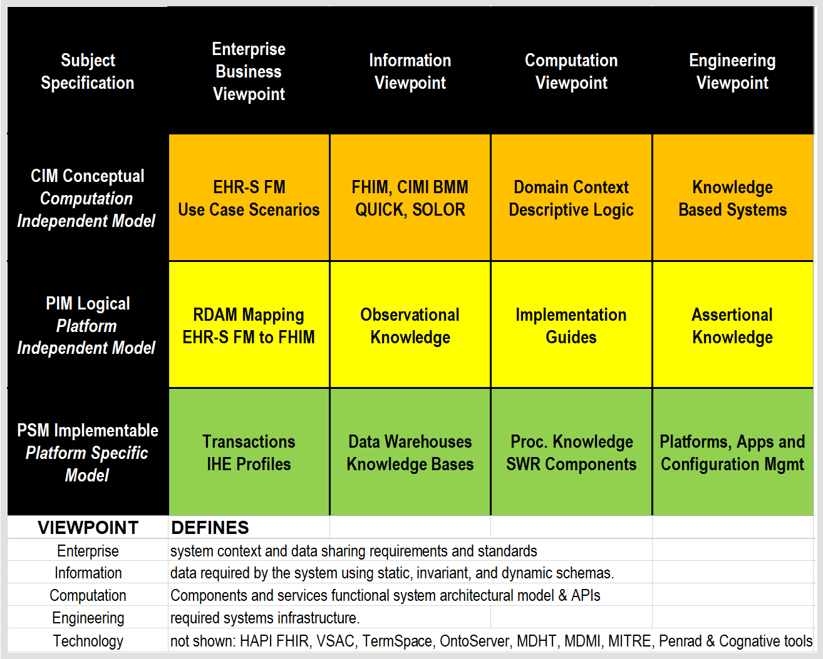
FIG 3 Architectural View (SAIF ECCF)
14
See Notes Page
Notes:
Postscript (Architectural Perspective)
For Healthcare Ontology Cats
SOLOR "Separation of Concerns" Interoperability Specification Stack
Configuration Management (CM): Version, Object ID, STAMP (status, time, author, module, and path), etc.
SOLOR Language and Dialect: assignment of language and dialect information to an identified object.
SOLOR Logical Definition: OWL EL++ with concrete domains, e.g., properties like weight, name, or age, having concrete values such as integers or strings, with built-in predicates, such as ≤ or =.
Assertional Knowledge that does not depend on a statement model. Layer 4 enables a sharable knowledge base built on a common layer 2-3 language and logic.
An example might be "aspirin may be used to treat headache".
EHR examples might include patient defined problems or clinician defined diagnoses.
Value and code sets, CQMs are a kinds of assertional knowledge, which also live in level 4.
CCDS-USCDI, DEL, CDM, CDE live here too.
Observational Knowledge Statement Model (FHIM Domain Models, CIMI Detailed Clinical Models, FHIR Structure Definitions etc.), based on assessments and evaluations represented as V2, C-CDA or FHIR pre-coordinated Clinical (observation) Input form, which should be bi-directionally mapped to layer 2-3 post-coordinated Request-for and Performance-of Action Analysis Normal Form (ANF), to improve data quality, analytics and reasoning.
Descriptive logic of SOLOR concepts in an ANF schema is a DCM duality
e.g., DCMs, KNARTS, CQMs in ANF are statement models.
Use-case scenarios (EHR-S FM tasks mapped to FHIM) can be represented as an ANF sequence.
Procedural knowledge software scripts, APIs and components, such as IF statement indicates chief complaint of condition, THEN search assertional knowledge for treatments (e.g., medications) that treat condition, and present to user. KNARTs can live here and depend on lower layers. Layer 6 is where reusable knowledge representation and problem-solving methodologies can live (episodic skeletal plan refinement), e.g., assertions with associated observations.
The engineering challenge is to efficiently and deterministically separate the layered concerns.
The Fig 1 methodology can incorporate the CIMI-SOLOR Separation of Concerns Principle expressed within Fig 3 HL7 SAIF ECCF. The ECCF cleanly separates responsibility between a CIMI statement model and a SOLOR encoded terminology for concerns such as encoded action, subject of information (aka Evaluations), and measurement (aka Assessment). SOLOR normalizes and standardizes layers' 2-3 (below) content language, dialect and logical definitions, with a reusable knowledge representation foundation aka SNOMED extension with SNOMED, LOINC, etc. configured into an Analysis Normal Form (ANF) suitable for knowledge based systems.
To help separate the layered concerns, project architectural documentation can be organized into a Fig 3 HL7 SAIF reference model for open distributed processing called Enterprise Compliance and Conformance Framework (ECCF) used for the specification and test of components within federated network platforms; where, the ECCF can be a TEFCA RCE QHIN interoperability test-and-certification architecture.

Slide 15
REFERENCES
HL7 EHR System Functional Model (EHR-S FM) R2 http://www.hl7.org/implement/standards/product_brief.cfm?product_id=269
Federal Health Information Model (FHIM) Immunization Domain Model http://www.fhims.org/content/_420A62FD03B64295E8200076-content.html
Immunization Functional Profile Mapping Spread Sheet http://wiki.hl7.org/index.php?title=EHR_Immunization_Functional_Profile
Solving the Modeling Dilemma as a Foundation for Interoperability by Berndt Blobel and Frank Oemig, Intl. HL7 Interop Conference (IHIC) 2018 in Portsmouth, UK. https://www.ejbi.org/abstract/solving-the-modeling-dilemma-as-a-foundation-for-interoperability-4614.html
CIMI Detailed Clinical Models https://CIMI.HL7.org
HL7 Knowledge Artefact (KNART) Specification http://wiki.hl7.org/index.php?title=Knowledge_Artifact_Specification
FHIR Immunization Resources https://www.hl7.org/fhir/immunization.html
QI-Core IG http://hl7.org/FHIR/us/qicore/2016Sep/index.html
FHIR Clinical Reasoning Module http://www.hl7.org/fhir/clinicalreasoning-module.html http://wiki.hl7.org/index.php?title=Clinical_Reasoning_Module
HL7 May 2018 Newsletter Article http://www.hl7.org/documentcenter/public/newsletters/HL7_NEWS_20180523.pdf
15

