Slide 1
PCORTF Common Data Model Harmonization Project and the Oncology Use case
January 30, 2018

Slide 2
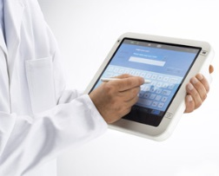
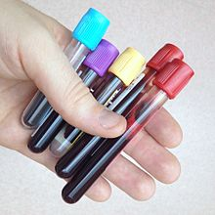
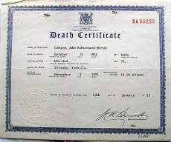
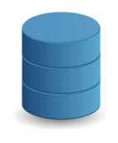
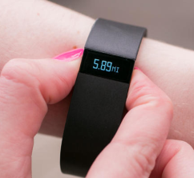
Real World Data: Definition
RWD include data derived from electronic health records (EHRs), claims and billing data, data from product and disease registries, patient-generated data including in home-use settings, and data gathered from other sources that can inform on health status, such as mobile devices.
Claims Data
Electronic Health Records
Laboratory
Results
Real World Data
Registries
Vital Records
Mobile Devices

Slide 3
Real World Evidence: Definition
RWE is the clinical evidence regarding the usage and potential benefits or risks of a medical product derived from analysis of RWD.

Slide 4
RWE: What are the Goals?
Maximize the opportunities to have regulatory decisions incorporate data/evidence from settings that more closely reflect clinical practice
Increase the diversity of populations
Improve efficiencies
Population identification/selection
Reduce duplicative capture of data

Slide 5
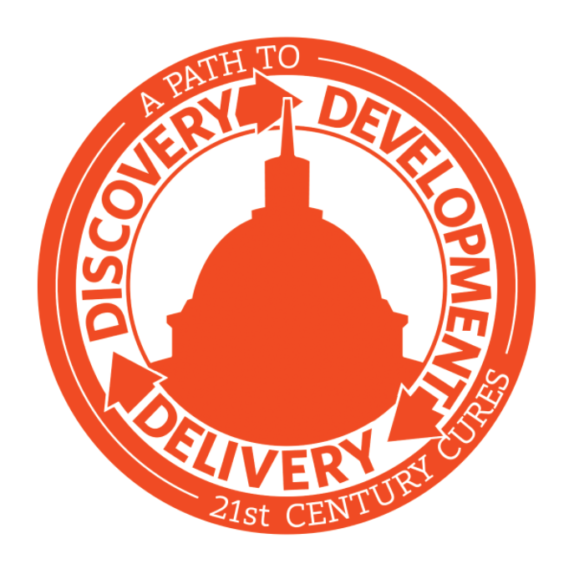
RWE: What are the Expectations?
21St Century Cures
FDA shall establish a program to evaluate the potential use of real world evidence (RWE) to support:
approval of new indication for a drug approved under section 505(c)
satisfy post-approval study requirements

Slide 6
Real World Data Uses for Clinical Trials
Rapidly find large numbers of possible participants with all requirements for clinical trial study:
Health history
Treatment history
Medicine history
Range of demographics
Range of geographies and rural/urban
Rapidly identify sites/clinical investigators
Savings of time and money for manufacturers, clinical investigators, and other stakeholders
Potential to identify additional “off-label” uses for approved drugs

Slide 7
Current State for Real World Data
Thousands of real-world data systems (EHRs, administrative claims data, etc.)
Limited data connection to FDA research systems
Can not effectively conduct large scale real world evidence research

Slide 8
Ideal State for Real World Data
Real-time access to real world data systems accessible to FDA researchers:
Secure
Privacy protected / de-identified
sources retain ownership and control of raw data
Crosses demographics, geography, etc.
Mechanisms to get rapid answers to research questions from pools of millions of patients
Without risk of any privacy breach
Results are de-identified

Slide 9
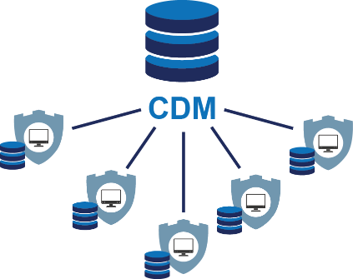
Current State: Limited groups of connected Real World Data systems
Different networks use various sources of healthcare and research data.
Creation of different mini-networks for research
Allows researcher to query (ask question) and simultaneously, receive results from many different sources.
Q
Sentinel
BUT: Each network communicates with different agreed upon methods: “Common Data Model”
A
19 Data Partners*

Slide 10
The current problem with CDMs using International Travel Adapters
Different countries use different “outlets”.
There is a need for travel adapters.
The Solution:
Use a converter between various adapters.
Allow researchers to ask a question once and receive results from many different sources using a common agreed-upon standard structure, or a Common Data Model.

Slide 11
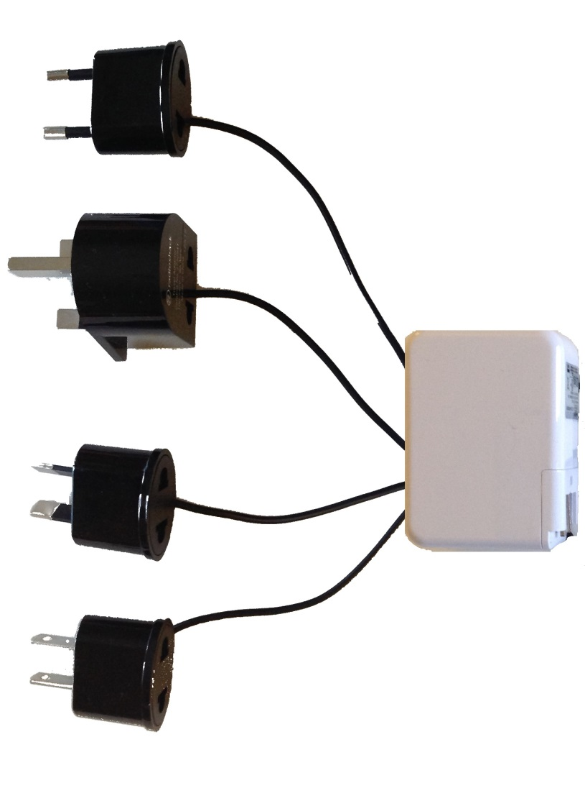
The solution, using the Adapter Analogy
Different countries use different “outlets”.
There is a need for travel adapters.
The Solution:
Use a converter between various adapters.
Allow researchers to ask a question once and receive results from many different sources using a common agreed-upon standard structure, or a Common Data Model.
Sentinel
I2b2/ACT
PCORNET
OMOP

Slide 12
What do we want to do? PCORTF CDM Harmonization Project
Goal:
Build a data infrastructure for conducting research using Real World Data derived from the delivery of health care in routine clinical settings.
Objective:
Develop the method to harmonize the Common Data Models of various networks, allowing researchers to simply ask research questions on much larger amounts of Real World Data than currently possible, leveraging open standards and controlled terminologies to advance Patient-Centered Outcomes Research.

Slide 13
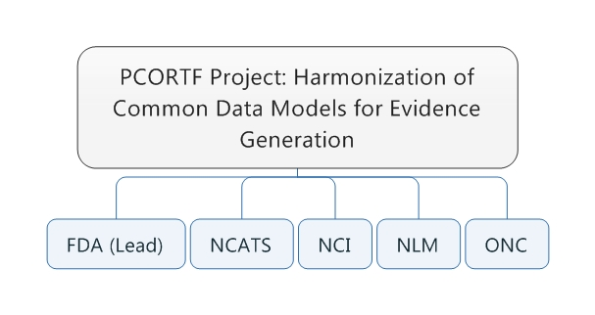
Key Players

Slide 14
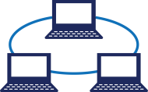
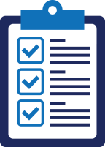
Problems to Solve
Networks of observational data use different CDMs.
Open, consensus-based standards might not be leveraged in these CDMs (ex: CDISC, HL7)
There is a need to facilitate interoperability among these collaborations

Slide 15
Additional Goals of CDM Harmonization Project
1. Develop a general framework (i.e., tools, processes, policies, governance and standards) for the transformation of various CDMs, curation, maintenance and sustainability.
Assess the value of the developed CDM harmonization mechanisms by demonstrating research utility for safety evaluation of cancer drugs that use the body’s immune system (PD1/PDL1 inhibitors) with a focus on patients with autoimmune disorders.
Reuse infrastructure developed by currently-funded OS PCORTF projects (NLM Common Data Elements (CDE) Repository, ….)

Slide 16
Additional Goals of CDM Harmonization Project
Leverage open standards and controlled terminologies to advance Patient-Centered Oriented Research.
Test methods and tools developed by the collaborative on the universal CDM mapping and transformation approach.

Slide 17
Benefits to Public Health and Research
Evaluates potential safety concerns
Supports provisions of 21st Century Cures Act
Supports the Patient Centered Outcomes Research goals
Enhances regulatory decisions by providing reviewers with access to a larger network of RWD data
Supports the goals outlined in the All of us (Precision Medicine Initiative)

Slide 18
Model Mapping and Modeling Activities

Slide 19
Mapping Validation Process Steps
Mapped the Common Data Models (CDMs) to BRIDG 5.0.1
Sentinel - DONE
Patient-Centered Outcomes Research Network (PCORNET) – DONE
Observational Medical Outcomes Partnership (OMOP) – DONE
Informatics for Integrating Biology & the Bedside (i2B2) / Accrual for Clinical Trials (ACT)– Planned

Slide 20
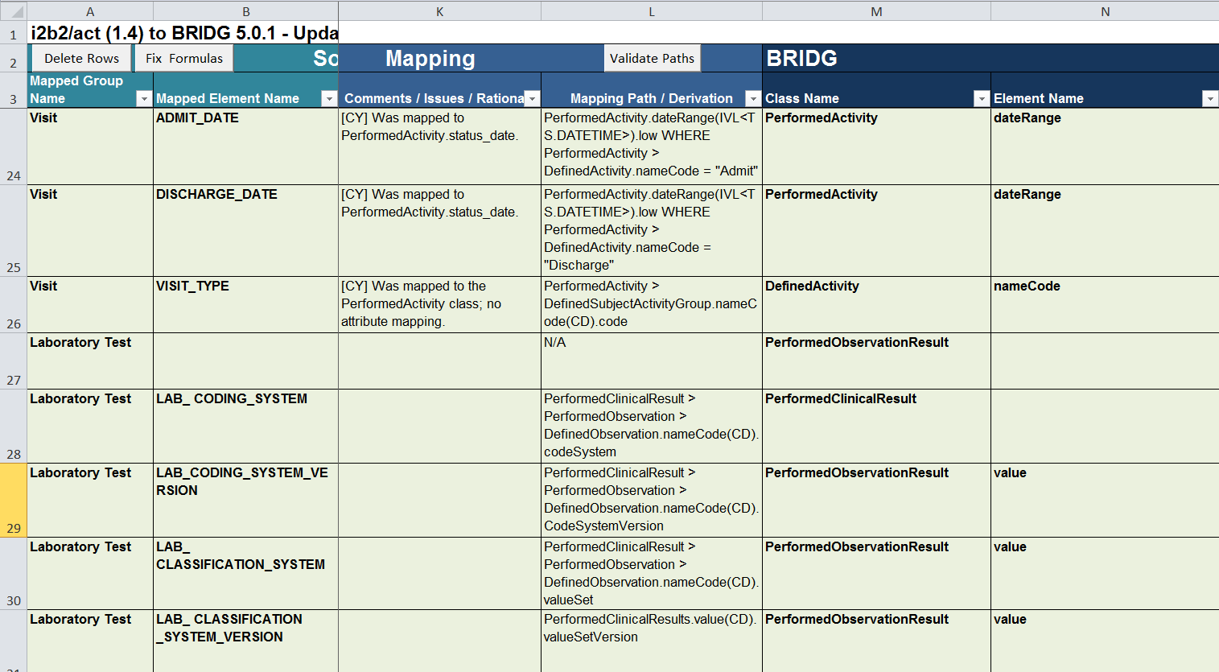
Mapping Spreadsheet – Mapping Path Examples

Slide 21
Mapping Validation Status

Slide 22
Process Of Building The CDMH BRIDG View
Start with the BRIDG Enterprise Architect Project (EAP) file (BRIDG 5.0.1)
Create a new diagram and pull the relevant BRIDG classes and associations into the new BRIDG view (CDMH View)
Based on the BRIDG classes in the mapping spreadsheets of the four (Sentinel, PCORNET, i2B2, OMOP) models.
For each class, display only the attributes that have a mapping in the network models
Bring in supporting BRIDG structures, as needed
Add new classes and attributes to represent the semantics missing in BRIDG as DRAFT extensions
Represented as subtype classes with attributes

Slide 23
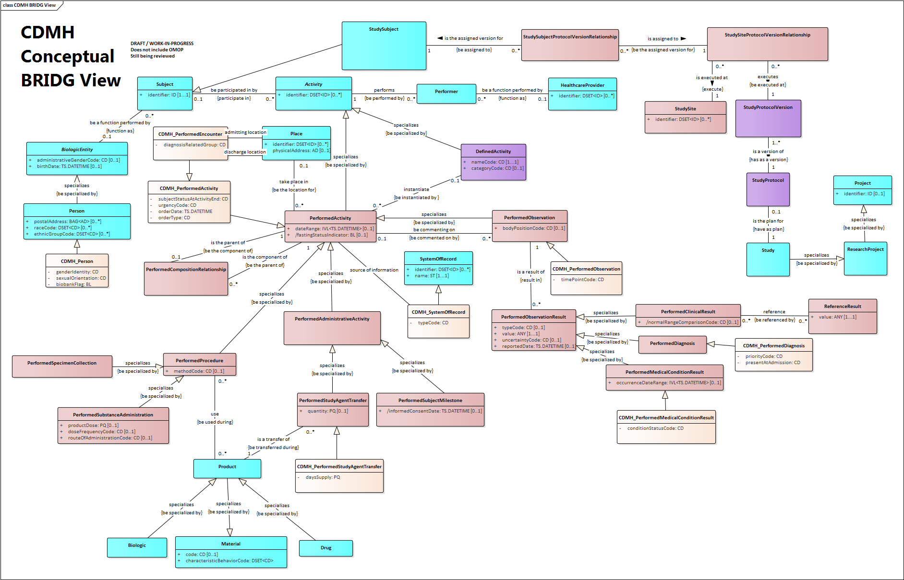
DRAFT CDMH BRIDG View
Clinical
Trial
related
DRAFT / WORK-IN-PROGRESS
CDMH Conceptual BRIDG View
Does Not Include OMOP
-Still Being Reviewed

Slide 24
Next Steps
Complete i2b2/ACT mapping
Complete consolidated 4-model mapping spreadsheet
To ensure consistency in mapping
Update the CDMH Conceptual Model
BRIDG harmonization may result in modifications
Subset of BRIDG model that only shows the classes and attributes that are in scope of CDMH project AND the new classes/attributes that were added to BRIDG as a result of this project
Create CDMH logical model
Develop plan to capture the design decisions
Create CDMH physical model
Create the CDMH physical model to the 4 networks models

Slide 25
Additional deliverables
Mapping showing the BRIDG-based CDMH physical model tables/columns to FHIR STU 3 resources/elements
Mapping showing the BRIDG-based CDMH physical model tables/columns to CDISC SDTM domain and variables
It is likely that not all the attributes in CDMH model will have SDTM mappings
Consider providing feedback to CDISC for the gaps

Slide 26
Thank You

