Slide 1
Summary of FDA and NIST efforts toward metrics and standardization
Content by
Marc Salit & Justin Zook (NIST)
and
Liz Mansfield & Zivana Tezak (FDA)
As delivered by Daryl Thomas

Slide 2
NIST Perspective on standards for genome measurement assurance based on June 14, 2011 meeting

Slide 3
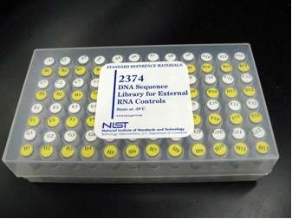
Vision
Reference samples
Sample
Preparation
Sequencing
Variant list,
Performance metrics
Bioinformatics

Slide 4
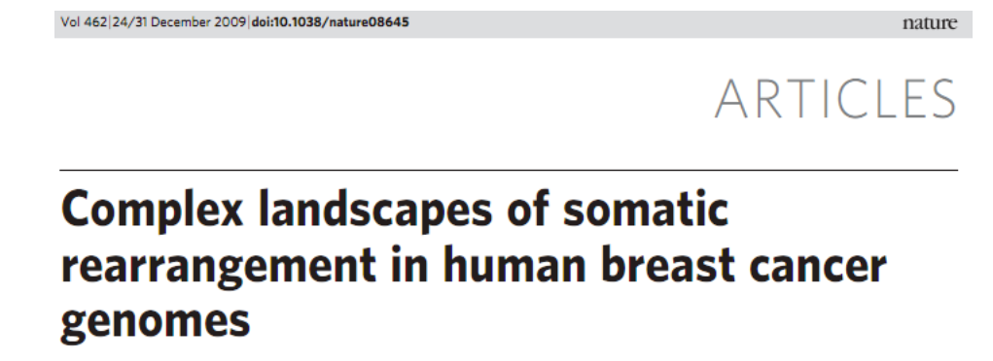
Motivation
Enable translation of ultrahigh throughput sequencing to regulated clinical applications
Select and maintain reference samples
From a single, internationally-recognized source
Stable
Homogeneous

Slide 5
Use cases
Obtain metrics for validation, QC, QA, PT
Determine sources and types of bias/error
“Gold” standard reference genomes
Learn to resolve difficult structural variants
Improve reference genome
Optimize integration of data from multiple platforms
Enable regulated applications

Slide 6
Prospective reference materials (RMs)
Whole genomes
Most likely cell lines from HapMap/1000 Genomes
Artificial external spike-ins with known variants to test specific measurement questions
Reference data on the RMs

Slide 7
Value of a NIST RM
NIST imprimatur as an internationally recognized source of “higher order” RMs for regulatory and commercial purposes
NIST commitment to:
Maintain availability of RM
Maintain data on RM – ongoing aggregation of sequence data to increase accuracy and minimize biases
NIST infrastructure to distribute RM
NIST investment in genomic measurement science
NIST resources to support development of RMs through the NIST SRM working capital fund (ability to distribute reference materials with cost-recovery)

Slide 8
Possible Path to NIST Genomic RM
NIST working capital fund acquires large batch of genomic DNA from Coriell (e.g., NA12878)
NIST evaluates homogeneity of DNA from bottle to bottle
NIST evaluates stability of DNA in each bottle over time
Data aggregation from interlaboratory sequencing of RM – ongoing data aggregation as additional sequencing is performed on the RM
Further NIST measurements of the RM

Slide 9
What NIST has done so far
Organized workshop with sequencing instrument companies in June 2011 to discuss use cases, material selection, and characterization of a NIST RM
Discussions with Coriell about performing a designed experiment to examine sources of variability in cell line immortalization and passaging
Examining use of ERCC SRM DNA or RNA as a spike-in to measure and compensate for systematic sequencing errors and biases
Coordinating with 1000 Genomes Project to use samples they have already sequenced and may sequence deeply in the future
Gaining experience with sequencing methodologies, uncertainty models, and confidence estimates for sequencing
Organizing an open workshop immediately prior to ASHG/ICHG from 1:00-3:30pm on October 11, 2011

Slide 10
FDA Public Meeting - Ultra High Throughput Sequencing for Clinical Diagnostic Applications Approaches to Assess Analytical Validity based on June 23, 2011 meeting

Slide 11
June 23, 2011
All meeting materials, including webcast, transcript, and presentations, available at http://www.fda.gov/MedicalDevices/NewsEvents/WorkshopsConferences/ucm255327.htm

Slide 12
Goals
To gather information from subject matter experts and stakeholders and to start the conversation on the [optimal] approaches for analytical validation of these platforms for clinical use
To accelerate and support introduction of safe and effective diagnostics in public health applications

Slide 13
NGS entering clinical diagnostic use
Expected to bring transformative public health applications
Need for appropriate evaluation strategy, standards, established criteria, novel scientifically agreed-upon approaches for analytical evaluation
Meeting participants pointed that evaluation strategy will need to differ, depending on the clinical application

Slide 14
Use Cases
Targets
gene panels
exomes sequencing
whole genomes
Applications
Hereditary disease
Cancer
Pathogen sequencing

Slide 15
FDA Role
Review approve applications from instrument and assay manufacturers
Analytical and clinical performance of the platform/assay for a specific clinical use (i.e. Intended Use of the assay).

Slide 16
Analytical performance
Assay manufacturers generally need to submit results for FDA review
Accuracy
Precision (repeatability, reproducibility)
Sample type / matrix
Sample preparation / conditions → pre-analytical
Performance around the cut-off
Sensitivity / limit of detection
Specificity (interference, cross-reactivity)
Stability
Potential for carryover, cross-hybridization

Slide 17
Clinical performance
Evaluations include clinical sensitivity, clinical specificity, etc.
Numerous challenges for NGS technologies - e.g., clinical significance of unknown variants.
Clinical validation related questions are important
To streamline discussion, focus of 6/23 meeting was on analytical performance, specifically on accuracy.

Slide 18
Meeting context
Points to keep in mind
This was just first FDA-organized meeting on this topic, and is centered on the technical aspects of WGS/NGS
At this point, it is unclear how to regulate NGS
The questions focused on how sequencing platforms can be analytically evaluated for clinical use as a platform (not necessarily by specific claims)
Not covering clinical validation, clinical significance of findings, incidental findings, etc.

Slide 19
Points of discussion
Approaches to technical performance evaluation of a specific platform
Understanding technical and bioinformatics issues and opportunities

Slide 20
Elevate Accuracy
Discussion topics
What should be evaluation criteria; should there be pre-set bar for specific applications?
Possible methods to compare to?
Specific genomic regions to evaluate as a representative of the whole genome?
What can be used as validation samples?
Pre-analytical issues?
Bioinformatics questions were related to two general topics:
Data analysis and bioinformatics pipeline
Data format and storage

Slide 21
Agenda
Overview of Genomic Sequencing Technologies and Applications
A Stakeholder’s Proposal for the Analytical Validation of Whole Genome Sequencing
Panel Discussion: Technical Performance of a Platform
Public Comments
Bioinformatics Tools for Genomic Sequencing
Panel Discussion: Bioinformatics

Slide 22
Salient comments
Analytical performance requirements are heavily dependant on clinical application (e.g., different for cancer from hereditary disease)
Need to develop
Appropriate reference materials and metrics for validation of SNPs, insertions, deletions, copy number variation, etc.
Flexible approach that accommodates a rapidly evolving field
FDA may need to implement a regulatory model that deviates from its usual path

Slide 23
Next Steps
White paper summarizing workshop discussions and outcomes
Collaborations towards understanding appropriate ways to establish, evaluate, and build regulatory model that will fit NGS-based clinical assays

