Slide 1
Slow-Speed Collision vs. Nuclear Fusion
Standards in AP
JD Nolen
HL7 AP Co-chair

Slide 2

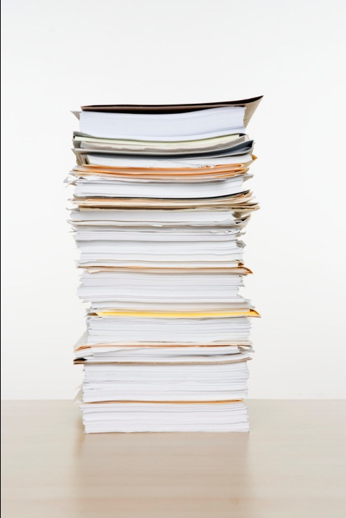
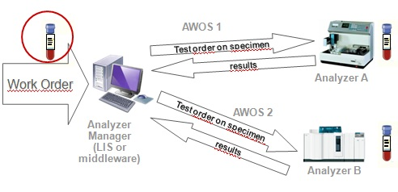
Where are we?
AP WSI Imaging (DICOM)
Specimen/Container Identification
2D Barcode Standardization (CLSI)
Unique Identifier (HL7)
APSR (IHE)
LAW (IHE)

Slide 3
Where can we go?
Complete Case
Interoperability
Unique Identifiers
Standard Formats
Structured Reporting
Standard Model
Standard Interfaces
Instruments and Systems
Standard Task and Processing Workflows and Data

Slide 4
But what about Supplement 145?
We need a unified standard around the storage of whole slide images
This standard powers the digital workflow
But without a standardized, interoperable workflow prior to that, we will struggle

Slide 5
Proposed Plan
Harmonization of Unique ID (HL7) and 2D Barcode (CLSI)
  Already started
  F2F in Baltimore end of March
  AP/O&O HL7 harmonizing Unique ID with Specimen Model….possible informative ballot in September
  Potential “real estate” issue with small format of 2D standard and information in Unique

Slide 6
Proposed Plan cont.
Joint workflow project (HL7, DICOM, IHE)
  Leverage LAW profile to define standard workflows in AP
  Use APSR 2.0 (via HL7 Germany) to build a generic structured report
    Think CDA
    Ability to handle eCC-like data
  Define a standard data format and vocabulary to capture all of the data in the workflow
    Processing, tasks, tracking, etc.

Slide 7
Questions?

