Slide 1
HL7 Clinical Sequencing Symposium Oncology Use Cases
Ellen Beasley, Ph.D. September 14, 2011
VP, Ion Bioinformatics

Slide 2
Overview
Uses and Complexities
what we need to detect
what samples do we need
Workflows
Bioinformatics
Standards Needs

Slide 3
Uses
Identify genetic variants causing tumor formation, progression or therapy sensitivity/resistance
Current applications for sequencing in cancer are not readily identified with existing molecular methods
Over the next 1-5 years, sequencing likely to be employed in instances when traditional tumor profiling fails to definitively select a treatment
Adoption of sequencing methods will be cancer type and stage dependent

Slide 4
Cancer mutations: overview
Most biological variants have been implicated in cancer
Large Scale (Structural; SV)
Deletion, Duplication, Transposition, Inversion
Small Scale
SNP/SNV, STR, microsatellites
Insertion, Deletion, colocalized Ins+Del
Epigenetic
DNA Methylation, Histone modification
RNA
Expression, Splicing, Localization, siRNA, ncRNA
Protein
Translation, Folding, Modification, Localization

Slide 5
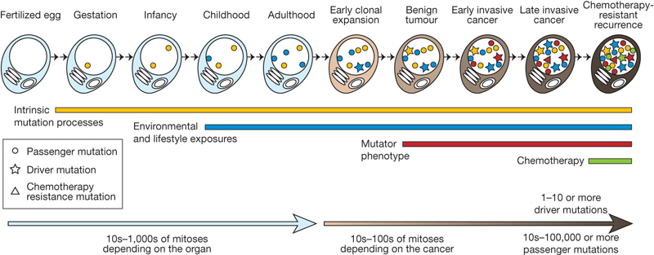
Heterogeneity and Cellularity: Somatic mutation accumulation in life & cancer
MR Stratton et al. Nature 458, 719-724 (2009) doi:10.1038/nature07943

Slide 6
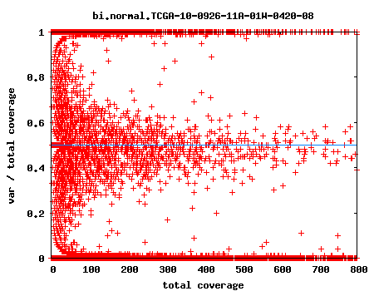
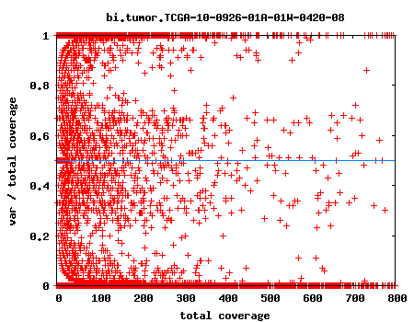
Higher coverage is required for low frequency allele detection in mixtures
Normal
Tumor
Allele ratio
Coverage
Clonality and cellularity varies between cancers and tumor samples
Ability to detect mutations at <25% mixture is important
Courtesy of Richard Gibbs, BCM

Slide 7
Cancer sequencing samples
Tumor:
Formalin-fixed, paraffin-embedded (FFPE) samples
Standard for clinic samples
Usually only tumor sample, no control tissue
Difficult to extract and poor preservation
Fresh/frozen tumor sequencing
Solid tumor sample obtained during biopsy
Less common practice
Paired tumor and control samples:
Solid tumor sample obtained during biopsy
Control either blood and/or adjacent “normal” tissue
For blood tumors, flow-sorted cells may be obtained, normal and diseased

Slide 8
Paired samples for cancer transcriptome
?
Primary cancer tumor
Adjacent normal tissue
Blood cells
Notes:
Challenge of transc. Analysis, adjacent normal generally isn’t (normal)

Slide 9
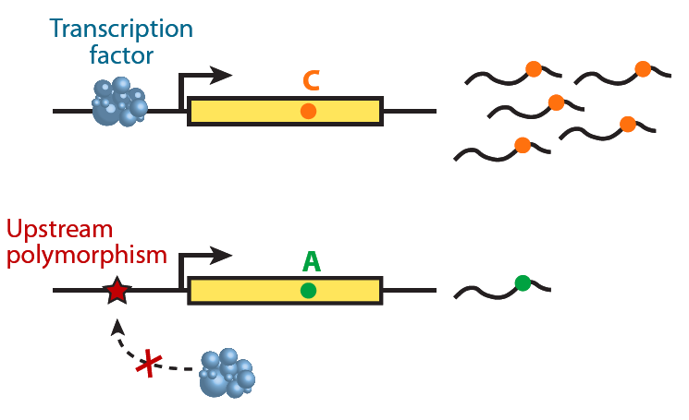
Allelic imbalance in expression
Allelic Ratios
DNA
methylation
N
T
Allelic Ratios
X X X
A
N
T
Transcribed somatic mutations are detectable
Analogous to allelic imbalance between two samples
Problem is to distinguish from clonally amplified library errors

Slide 10
Complexities: Lessons Learned
Heterogeneity within and across tumor types – difficult to identify rules for interpretation
High rate of abnormalities (driver vs. passenger) – prioritization of results becomes a larger challenge than detection
Quality of tissue directly impacts the quality data generated
Large scale data generation requires an analytical pipeline to ensure close to a “real-time” interpretation of the results

Slide 11
Confounding factors & challenges
Sample quality and quantity influences required depth of coverage and power to detect low frequency variants
Pathology report indicating tumor cellularity (ideal >70% cellularity)
SNP array-based methods can be used to estimate cellularity and ploidy to guide/interpret sequencing
Sample availability
Sample availability depends on standard of care
Therefore, sample availability will vary with cancer type and regional treatment norms
Circulating tumor cells could result in mutant alleles showing up in normal DNA sequence

Slide 12
Workflows
Workflow variations
Somatic Tumor / Normal Comparison
Germline / Somatic Comparison
Gene Expression
Bioinformatics

Slide 13
Sample to Reads
FFPE
Deparaffinization
Sample
Reverse
cross-linking
Extraction
Enrichment
Library
Construction
Sequencing

Slide 14
Cancer sequencing formats
Gene Panels (Amplicon/Enrichment) (>500x)
Tens to hundreds of loci targeted, regions where mutants are known to be associated with cancer
Whole Exome (>60x)
Fragment or paired-end approach
Whole Genome (>30X)
Standard single chemistry whole genome approach
Mixed library whole genome approach
Shallow mate (10X) + deep targeted (30X exome) approach
Transcriptome
Single tumor sample
Paired samples
Tumor and adjacent “normal” tissue (best)
Tumor and reference normals

Slide 15
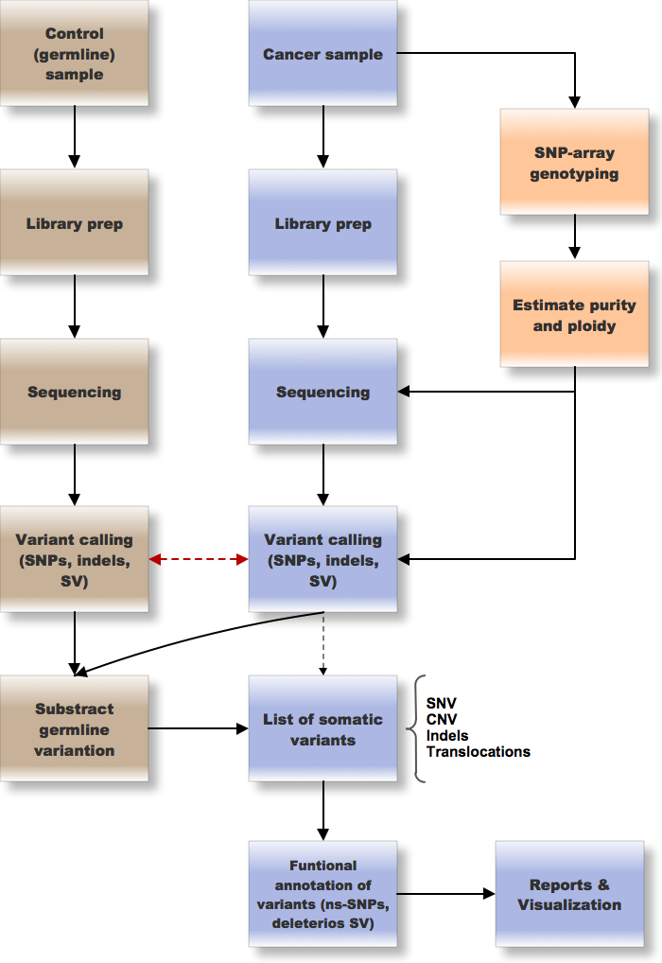
Pipeline for cancer genomics: Tumor + Normal

Slide 16
Transcriptional analysis of cancer
Due to library prep and sequencing biases, most analyses are best carried out as comparisons between two conditions (normal vs tumor)
Normal tissue samples (adjacent) are difficult to obtain
Not indicated in primary tumor resection on normal care, only by special research protocol
Adjacent tissue may not be the same tissue and may be contaminated with cancer cells
Sample amount may be limiting for small tumors
RNA can be degraded
FFPE samples

Slide 17
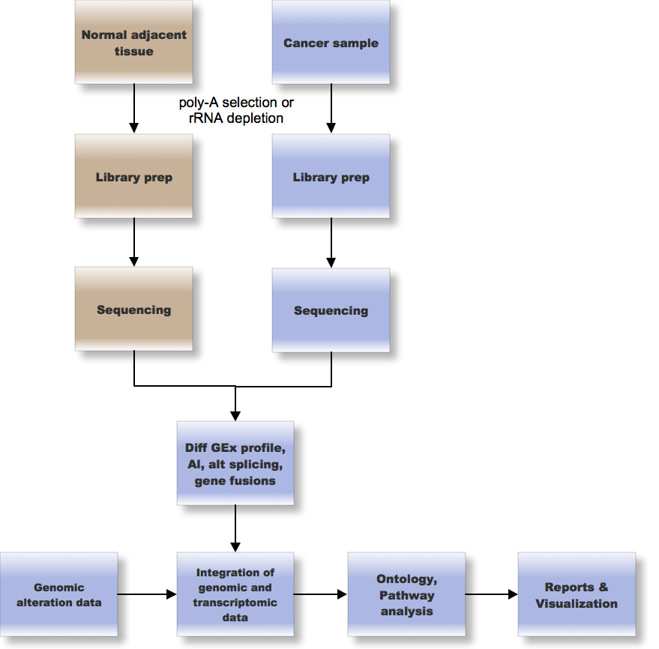
Transcription pipeline for cancer: Tumor and adjacent

Slide 18
Somatic mutations in RNA
Requires high coverage of transcripts
Reduction of redundancy due to clonal amplification of fragments would make this more cost-effective
Analysis needs to work hand in hand with specific library preparation protocol
DNA sequence (tumor and normal) information if available should inform analysis

Slide 19
Bioinformatics
Calls on Instrument
Mapping
Variant Calling
Annotation
Interpretation

Slide 20
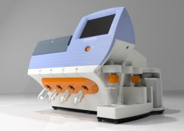
Analysis pipeline
Sample Prep
Map/
Align
Detect
Annotate
Interpret
Generate Data
A standard cancer genome analysis bioinformatics pipeline is needed to discover and report all relevant somatic alterations occurring in a tumor
Alignment or Assembly
Variant detection
Point mutation detection (SNP, SNV)
Small indel (insertions, deletions, colocalized insertion/deletion)
Copy number variation
Structural variation (inversions, translocations, breakpoint resolution)
Detection requirements (for discussion)
99% of mutations as low as 5%; 10% FP?
Tabular reporting and visualization
Graphical presentation

Slide 21
Breadth of transcript analysis tools
Raw read alignment counts across genome and per annotation
Differential gene expression: coding and non-coding
Paired samples
Alternative splicing
Single sample
Paired samples
Novel transcripts (non-coding RNA, exons)
Single sample
Allelic imbalance
Single samples
Paired samples
Gene Fusions
Single sample
Paired sample
Expressed mutations
Single sample
Paired sample

Slide 22
Integrated analyses are more powerful … and more difficult to automate
Integration of point mutation data with structural variation can dramatically change the impact of genomic alterations
Effect of gene dosage is important
Homozygous point mutation or a combination of a mutation within a region of copy number change could destroy a gene activity
Correlation of genomic alterations with gene expression pattern may point to mechanistic significance
e.g. allelic imbalance with CNV; translocations with fusion transcripts
Output of analysis algorithms should facilitate this analysis
Common indexing to genome
Content: e.g. indel sequence provided, etc.
Data formats – need to expand as this unfolds
RNA Editing
Epigenetics (Methylation, Histone modification)

Slide 23
Bioinformatics – Annotation
Most of the annotations are already covered in HL7 CG WG draft documents:
HL7 Version 2 Implementation Guide: Clinical Genomics; Fully LOINC-Qualified Genetic Variation Model, Release 2
May need to extend this to add other relevant annotations (e.g., COSMIC ID)

Slide 24
Bioinformatics – Interpretation
Greatest gap today: interpretation norms, databases and visualization
Most interpretation is expert – integration of data types and knowledge of disease, pathways, drugs, etc.
No approved sets of variant to disease/drug annotations are in common practice
Most interpretive reports are currently unstructured
Utility of interpretive reports would benefit from structure and prioritization

Slide 25
Standards Development Needs
Biology is complex! We’ll need to distinguish between research, translational, and clinical uses to prioritize common clinical uses for standards development
Semantic standards for adding biological/clinical annotations to variants and evidence trails (citations)
Metrics to describe quality/uncertainty of annotations
Structured formats for interpretive reports
In order to learn, genomic data must be integrated with downstream treatment decisions and outcomes

Slide 26
Thank You!
© 2011 Life Technologies Corporation. All rights reserved.
The trademarks mentioned herein are the property of Life Technologies Corporation or their respective owners.
For Research Use Only. Not intended for animal or human therapeutic or diagnostic use.

Slide 28
Appendix
Depth of coverage example – DNA
Depth of coverage example – Somatic DNA
Depth of coverage example – RNA Transcription
Gene Fusion example

Slide 29
Variant calling: DNA
CTGCTAGGCTAGGCTTAGGCATTAGGC
GGACCTGCTAGGCTAGGCTTAGGCATT
ACGTGGTAGGACCTGCTAGGCTAGGCTTAGGCATTAGGCATTGGCTTAC
Prior: 0.0001
Probability: G=0.8
A=0.001
T=0.001
G=0.001
Call: G/G
P-val: 0.1

Slide 30
Variant calling: DNA
GACCTGCTAGGCTAGGCTTAGGCATTA
CTGCTAGGCTAGGCTTAGGCATTAGGC
GGACCTGCTAGGCTAGGCTTAGGCATT
ACGTGGTAGGACCTGCTAGGCTAGGCTTAGGCATTAGGCATTGGCTTAC
Prior: 0.0001
Probability: G=0.7
A=0.01
T=0.001
G=0.001
Call: G/G
P-val: 0.05

Slide 31
Variant calling: DNA
GACCTGCTAGGCTAGACTTAGGCATTA
CTGCTAGGCTAGGCTTAGGCATTAGGC
GGACCTGCTAGGCTAGGCTTAGGCATT
ACGTGGTAGGACCTGCTAGGCTAGGCTTAGGCATTAGGCATTGGCTTAC
Prior: 0.0001
Probability: G=0.7
A=0.01
T=0.001
G=0.001
Call: G/G
P-val: 0.1

Slide 32
Variant calling: DNA
TAGGACCTGCTAGGCTAGACTTAGGC
CGTGGTAGGACCTGCTAGGCTAGACT
GACCTGCTAGGCTAGACTTAGGCATTA
CTGCTAGGCTAGGCTTAGGCATTAGGC
GGACCTGCTAGGCTAGGCTTAGGCATT
ACGTGGTAGGACCTGCTAGGCTAGGCTTAGGCATTAGGCATTGGCTTAC
Prior: 0.0001
Probability: G=0.4
A=0.5
T=0.001
G=0.001
Call: G/A
P-val: 0.01

Slide 33
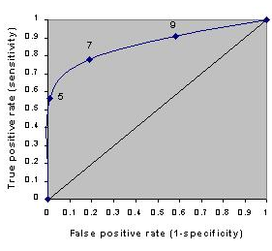
Subtractive calling of somatic mutations
Call variants in normal sample at low stringency
Call tumor at high stringency
Subtract germline variants to produce a list of putative somatic mutation
Low stringency calling
High stringency calling
Trade-off between true positives and false positives in variant calling

Slide 34
Variant Calling: Somatic DNA Mutations
TAGGACCTGCTAGGCTAGACTTAGGC
CGTGGTAGGACCTGCTAGGCTAGACT
GACCTGCTAGGCTAGACTTAGGCATTA
CTGCTAGGCTAGGCTTAGGCATTAGGC
GGACCTGCTAGGCTAGGCTTAGGCATT
ACGTGGTAGGACCTGCTAGGCTAGGCTTAGGCATTAGGCATTGGCTTAC
Germline :
TAGGCTT
TAGGCTT
Priors: G=0.997
A=0.001
T=0.001
G=0.001
Probability: G=0.5
A=0.5
T=0
G=0
Call: A
P-val: 0.001

Slide 35
Variant Calling: Somatic DNA Mutations
TAGGACCTGCTAGGCTAGACTTAGGC
CGTGGTAGGACCTGCTAGGCTAGACT
GACCTGCTAGGCTAGACTTAGGCATTA
CTGCTAGGCTAGGCTTAGGCATTAGGC
GGACCTGCTAGGCTAGGCTTAGGCATT
ACGTGGTAGGACCTGCTAGGCTAGGCTTAGGCATTAGGCATTGGCTTAC
Germline :
TAGACTT
TAGGCTT
Priors: G=0.5
A=0.5
T=0
G=0
Probability: G=0.5
A=0.5
T=0
G=0
Call: No call
P-val: 0.0001

Slide 36
Variant Calling: Somatic RNA Mutations
GACCTGCTAGGCTAGACTTAGGCATTA
Same start point
GACCTGCTAGGCTAGACTTAGGCATTA
GACCTGCTAGGCTAGACTTAGGCATTA
CTGCTAGGCTAGGCTTAGGCATTAGGC
GGACCTGCTAGGCTAGGCTTAGGCATT
ACGTGGTAGGACCTGCTAGGCTAGGCTTAGGCATTAGGCATTGGCTTAC
Probability: G=0.9
A=0.001
T=0.001
G=0.001
Call: G
P-val: 0.01

Slide 37
Variant Calling: Somatic RNA Mutations
TAGGACCTGCTAGGCTAGACTTAGGC
CGTGGTAGGACCTGCTAGGCTAGACT
GACCTGCTAGGCTAGACTTAGGCATTA
GACCTGCTAGGCTAGACTTAGGCATTA
High depth required
GACCTGCTAGGCTAGACTTAGGCATTA
CTGCTAGGCTAGGCTTAGGCATTAGGC
GGACCTGCTAGGCTAGGCTTAGGCATT
ACGTGGTAGGACCTGCTAGGCTAGGCTTAGGCATTAGGCATTGGCTTAC
Probability: G=0.9
A=0.001
T=0.001
G=0.001
Call: A
P-val: 0.001

Slide 38
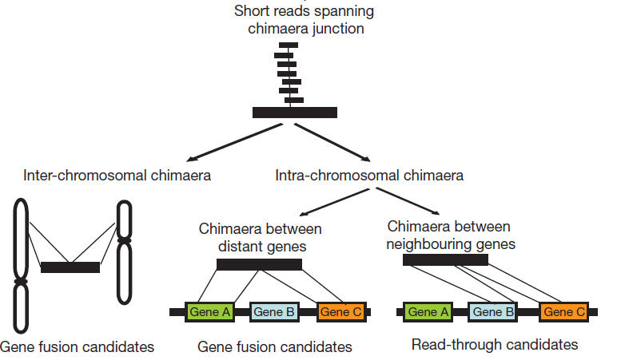
Gene Fusions Transcripts
[Maher 2009]

