Slide 1
Specimen-Related Classes in BRIDG
BRIDG Overview for HL7 O&O WG Conference Call
July 1, 2015
Wendy Ver Hoef
NCI Contractor

Slide 2
Overview Topics
Overview purpose: to give a brief introduction of BRIDG in preparation for future, more detailed discussions between BRIDG and O&O teams
BRIDG Background
  What is BRIDG?
  Project goals
  Stakeholders
  Recent Developments
Brief review of the range of Specimen-related classes in BRIDG
  Key “backbone” (high level) classes for Specimen use cases
  Entities and role classes involved in Specimen-related use cases
  Relevant Material and Product subclasses
  Subset of relevant Defined Activities
  Subset of relevant Performed Activities

Slide 3
BRIDG Overview
BRIDG stands for Biomedical Research Integrated Domain Group Model
Platform for expressing the processes and data concepts of biomedical research in a consistent manner across all the stakeholders.
Shared understanding of domain concepts represented (at present) as a UML class diagram. Hence, the reference to BRIDG as a model, aka a Domain Analysis Model or Domain Information Model
Goal: To produce a shared view of the dynamic and static semantics for the domain of basic, pre-clinical, clinical, and translational research and its associated regulatory artifacts. This domain of interest is further defined as:
  The data, organization, resources, rules, and processes involved in the formal assessment of the utility, impact, or other pharmacological, physiological, or psychological effects of a drug, procedure, process, subject characteristic, biologic, cosmetic, food or device on a human, animal, or other subject or substance plus all associated regulatory artifacts required for or derived from this effort, including data specifically associated with post-marketing adverse event reporting.

Slide 4





BRIDG Overview – Background
BRIDG is a collaborative effort engaging stakeholders from four organizations:
  Clinical Data Interchange Standards Consortium (CDISC)
  US Food and Drug Administration (FDA)
  HL7 BRIDG Work Group (HL7)
  US National Cancer Institute (NCI)
  International Standards Organization (ISO)
BRIDG is a UML Model built in Sparx System’s Enterprise Architect
Recent developments:
  It is now an ISO standard (TC 215) – ISO 14199
  Creation of HL7 BRIDG Work Group in spring 2014
  Release 4.0 in March, 2015 (first release of translational research)
For more detailed information/downloads go to: www.bridgmodel.org

Slide 10
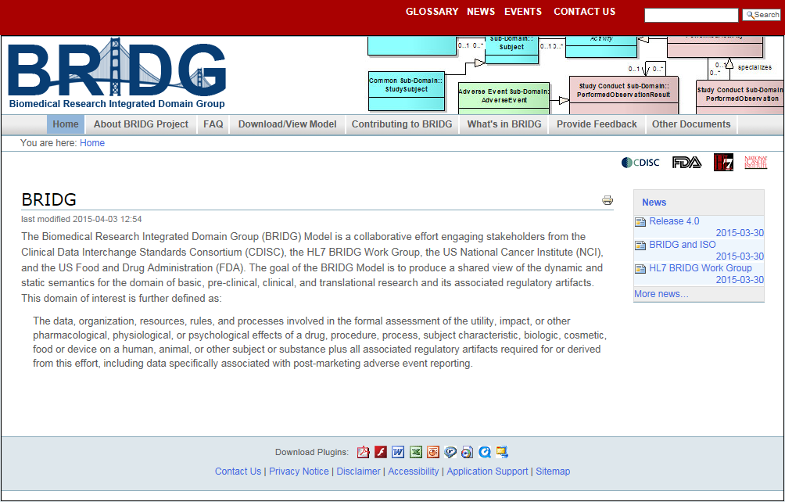
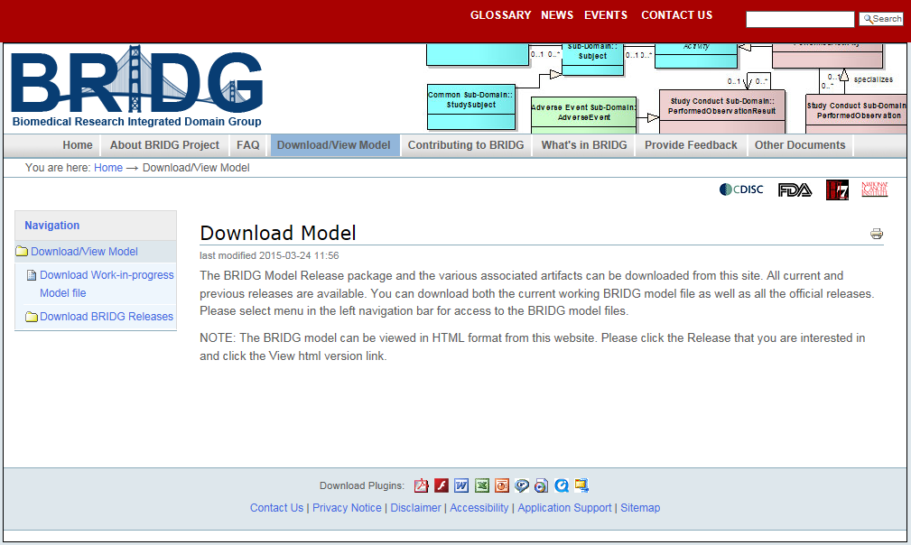
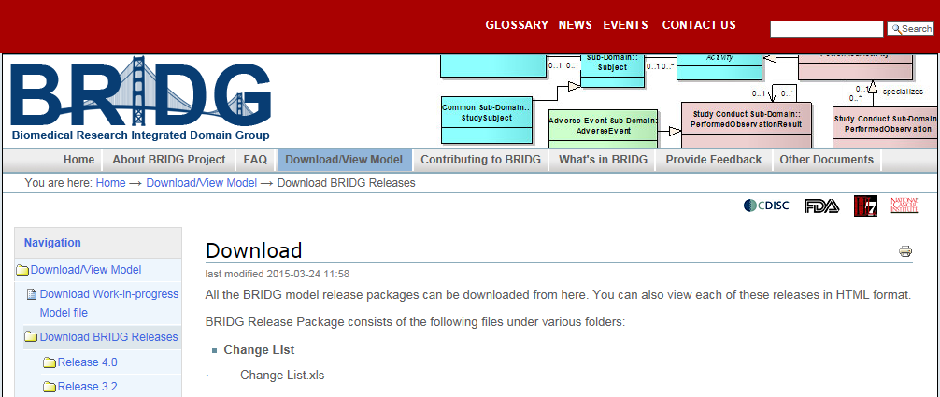
Where to get more info on the BRIDG website
www.bridgmodel.org
The Download/View Model tab allows you to download BRIDG 4.0, the latest official release

Slide 11
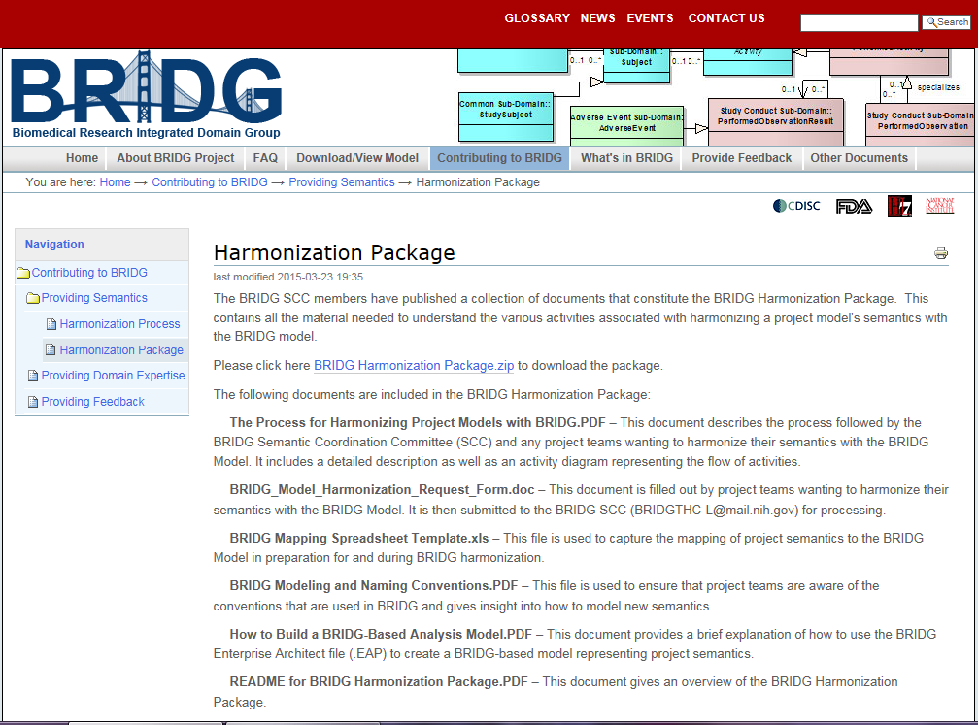
The BRIDG Harmonization Package
Follow the path:
Contributing to BRIDG tab
> Providing Semantics
> Harmonization Package
Contents may be useful in future discussions and work together

