Slide 1
Notes in FHIR
Brett Marquard

Slide 2
Notes in FHIR
Minimal guidance today
Full Agreement FHIR needs specific guidance to exchange notes
Patient Care Work Group considered these resources:
Observation
DocumentReference
Composition
New Notes Resource
Detail of Patient Care discussion: 11/30/2017
Next Step: Patient Care to collaborate with Structured Documents to consider Notes in Composition.

Slide 3
Notes, Notes, Notes
Common Clinical Notes Set
Discharge documentation (8648-8 and/or 18842-5)
Consultation (11488-4)
Imaging narrative (18726-0)
Lab/path narrative
History & Physical (34117-2)
Progress note
Procedures note (28570-0)

Slide 4
Anticipated Note Scenarios
ASCII or XHTML
RTF or PDF
Mixed document - structured FHIR resources, and narrative
Level of Complexity

Slide 5
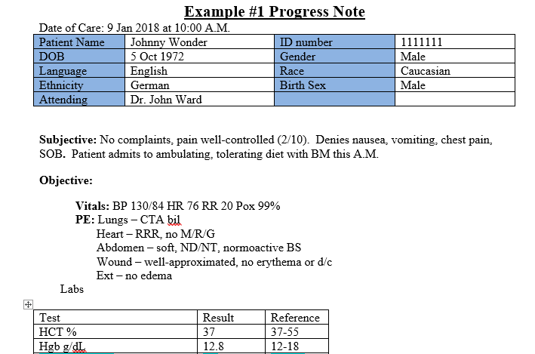
Progress Note

Slide 6
Scenario 1: ASCII or XHTML
DocumentReference
…
Reference a Binary Resource
[base]/Binary

Slide 7
Scenario 2: RTF or PDF
DocumentReference
…
[base]/Binary

Slide 8
Scenario 3: Mixed – structured FHIR resources, and narrative
May have 2:
1 Binary Resource (e.g. C-CDA)
2 Composition
DocumentReference
…
[base]/Binary
[base]/Composition
Notes:
Query for Procedure Note -
Query for Imaging Report –
Still will Binary ‘of report’ because in DiagnosticReport system just use the ‘presentedForm’ which is what you would gewt if you directly grabbed from DiagnosticReport.

