Slide 1
Care Plan (CP) Team Meeting (As updated during meeting)
With meeting notes
NB: Comparison of BPMN and UML added in Appendix
NB: definition of some HL7 terms (e.g. encounter) added in appendix
To join the meeting:
Phone Number: +1 770-657-9270 Participant Passcode: 943377
WebEx link is on the wiki (link below)
André Boudreau (a.boudreau@boroan.ca)
Laura Heermann Langford (Laura.Heermann@imail.org)
Stephen Chu (stephen.chu@nehta.gov.au)
2011-08-03 (No. 19)
Care Plan wiki: http://wiki.hl7.org/index.php?title=Care_Plan_Initiative_project_2011
HL7 Patient Care Work Group

Slide 2
Agenda for August 3rd
NOTE: Our focus up to WGM (week of Sept. 12th) will be on sharpening our definition of what our storyboards should be like, and on preparing one solid SB (perinatology) ready for review by clinical SMEs (not in the CS team). This material will be reviewed during the WGM before starting the validation process.
Minutes of July 20th
Storyboard document introduction
Purpose, scope, guidelines, structure, quality criteria
Perinatology SB (Laura)
New version with multiple events
Next meeting agenda

Slide 3
HL7 v3 September 2011 ballot
Updated 2011-08-03
The September 2011 ballot is available at this link:
http://www.hl7.org/v3ballot/html/welcome/environment/index.html

Slide 4
Agenda for August 17th
Updated 2011-08-03
NOTE: Our focus up to WGM (week of Sept. 12th) will be on sharpening our definition of what our storyboards should be like, and on preparing one solid SB (perinatology) ready for review by clinical SMEs (not in the CS team). This material will be reviewed during the WGM before starting the validation process.
Minutes of August 3rd
Storyboard document introduction (Andre)
Purpose, scope, guidelines, structure, quality criteria
UML use case models (Danny + Laura)
Chronic disease (diabetes)
perinatology
SB formats
Single pre-condition, chain of episodes, post condition
Multiple pre-conditions, chain of episodes, post condition
Next meeting agenda

Slide 5
Meetings During the Summer Period
Updated 2011-07-20
We will move to a meeting every second week until the end of August. Schedule is:
August 3
August 17
Review of Care plan functionalities in EHR-S FM R2 work by the HL7 EHR WG?
August 31st
Decide if we continue with a 2-week schedule
Sept. 7th
Final material for WGM on Sept. 12th

Slide 6
Future Topics
Updated 2011-07-20
Review of EHR-S FM R2 work by the HL7 EHR WG: Aug. 17, tentatively
John Ritter, Sue Mitchell, Pat Van Dyke, Lenel James
BPMN Models for the SB (after SB validation and updates)
Review of the ISO CONTSYS work on care plan aspects
André to contact ISO Lead
Care Plan elements from KP, Intermountain, VA, etc. (Laura)
Requirements (André)
Care Management Concept Matrix update (Susan)
Comparison of care plan contents (Ian, Laura)
To inform the information model
Start of spreadsheet (Laura…)
Overarching term to use (Ian M.)
Care Plan Glossary
Forward plan- first cut

Slide 7
Participants- WGM Meetg of 2011-08-03 p1
Updated 2011-08-03
Name | email | Country | Yes | Notes
André Boudreau | a.boudreau@boroan.ca | CA |  | Co-Lead- Care Plan initiative/HL7 Patient Care WG. B.Sc.(Physics), MBA. Owner Boroan Inc. Management Consultin. Chair, Individual Care pan Canadian Standards Collaborative Working Group (SCWG). Sr project manager. HL7 EHR WG.
Laura Heermann Langford | Laura.Heermann@imail.org | US | Yes | Co-Lead- Care Plan initiative/HL7 Patient Care WG. Intermountain Healthcare. RN PhD,: Nursing Informatics; Emergency Informatics Association, American Medical Informatics Association; IHE
Stephen Chu | stephen.chu@nehta.gov.au | AU | Yes | NEHTA-National eHealth Transition Authority . RN, MD, Clinical Informatics; Clinical lead and Lead Clinical Information Architecture; co-chair HL7 Patient care WG; vice-chair HL7 NZ
Peter MacIsaac | peter.macisaac@hp.com | AU |  | HP Enterprise Services. MD; Clinical Informatics Consultant; IHE Australia; Medical Practitioner - General Practice
Adel Ghlamallah | aghlamallah@infoway-inforoute.ca | CA |  | Canada Health Infoway. SME at Infoway (shared health record); past architect on EMR projects
William Goossen | wgoossen@results4care.nl | NL |  | Results 4 Care B.V. RN, PhD; -chair HL7 Patient Care WG at HL7; Detailed Clinical Models ISO TC 215 WG1 and HL7 ; nursing practicioner
Anneke Goossen | agoossen@results4care.nl | NL |  | Results 4 Care B.V. RN; Consultant; Co-Chair Technical Committee EHR at HL7 Netherlands; Member at IMIA NI; Member of the Patient Care Working Group at HL7 International
Ian Townsend | ian.townend@nhs.net | UK |  | NHS Connecting for Health. Health Informatics; Senior Interoperability Developer, Data Standards and Products; HL7 Patient Care Co-Chair
Rosemary Kennedy | Rosemary.kennedy@jefferson.edu | US |  | Thomas Jefferson University School of Nursing . RN; Informatics; Associate Professor; HL7 EHR WG; HL7 Patient care WG; terminology engine for Plan of care;
Jay Lyle | jaylyle@gmail.com | US |  | JP Systems. Informatics Consultant; Business Consultant & Sr. Project Manager
Margaret Dittloff | mkd@cbord.com | US |  | The CBORD Group, Inc.. RD (Registered Dietitian); Product Manager, Nutrition Service Suite; HL7 DAM project for diet/nutrition orders; American Dietetic Association
Audrey Dickerson | adickerson@himss.org | US |  | HIMSS. RN, MS; Standards Initiatives at HIMSS; ISO/TC 215 Health Informatics, Secretary; US TAG for ISO/TC 215 Health Informatics, Administrator; Co-Chair of Nursing Sub-committee to IHE-Patient Care Coordination Domain.
Ian McNicoll | Ian.McNicoll@oceaninformatics.com | UK |  | Ocean Informatics . Health informatics specialist; Formal general medical practitioner; OpenEHR; Slovakia Pediatrics EMR; Sweden distributed care approach
Danny Probst | Daniel.Probst@imail.org | US | Yes | Intermountain Healthcare. Data Manager
Kevin Coonan | Kevin.coonan@gmail.com | US |  | MD. Emergency medicine. HL7 Emergency care WG.
Gordon Raup | graup@datuit.com | US |  | CTO, Datuit LLC (software industry).
Susan Campbell | bostoncampbell@mindspring.com | US |  | PhD microbiologist. Principal at Care Management Professionals. HL7 Dynamic Care Plan Co-developer
Elayne Ayres | EAyres@cc.nih.gov | US |  | NIH National Institutes of Health. MS, RD; Deputy Chief, Laboratory for Informatics Development, NIH Clinical Center ; Project manager for BTRIS (Biomedical Translational Research Information System), a Clinical Research Data Repository
Gaby Jewell | gjewell@cerner.com | US |  | Cerner Corp,

Slide 8
Participants- WGM Meetg of 2011-08-03 p2
Updated 2011-08-03
Name | email | Country | Yes | Notes
David Rowed | david.rowed@gmail.com | AU
Charlie Bishop | charlie.bishop@isofthealth.com | UK
Walter Suarez | walter.g.suarez@kp.org | US
Peter Hendler | Peter.Hendler@kp.org | US
Ray Simkus | ray@wmt.ca | CA
Lloyd Mackenzie | lloyd@lmckenzie.com | CA |  | LM&A Consulting Ltd.
Serafina Versaggi | serafina.versaggi@gmail.com | US |  | Clinical Systems Consultant
Sasha Bojicic | SBojicic@infoway-inforoute.ca | CA |  | Lead architect, Blueprint 2015, Canada Health Infoway
Agnes Wong | awong@infoway-inforoute.ca | CA |  | RN, BScN, MN, CHE. Clinical Adoption - Director, Professional Practice & Clinical Informatics, Canada Health Infoway
Cindy Hollister | chollister@infoway-inforoute.ca | CA |  | RN, BHSc(N), Clinical Adoption -Clinical Leader, Canada Health Infoway
Valerie Leung | vleung@infoway-inforoute.ca | CA |  | Pharmacist. Clinical Leader, Canada Health Infoway
Luigi Sison | lsison@yahoo.com | US |  | Information Architect at LOINC and at HL7. Enterprise Data Architect at VA. Developing standard for Detailed Clinical Models (DCM), information models for Electronic Health Record (EHR) Diabetes Project, etc.
Brett Esler | brett.esler@pencs.com.au | AU |  | Pen Computer Sys
Catherine Hoang | catherine.hoang2@va.gov | US |  | VA
Hugh Leslie | hugh.leslie@oceaninformatics.com
Seam Heard | sam.heard@oceaninformatics.com
Tom Kuhn |  |  |  | Sr. Systems Architect at American College of Physicians
Carolyn Silzle | Carolyn.silzle@choa.org | US | Yes | American Dietetic Association

Slide 9
Models
Luigi

Slide 10
Modeling Storyboards
After consultation of a few people, we are proposing that for each SB, Business Process Models (BPM) be drafted (using EA) instead of UML diagrams
It is more expressive than the UML
OMG has embraced BPMN. Major trend is toward BPMN
Very user friendly
The BPM will provide both activity and sequence information
The BPM will also allow a minimum of documentation on the actions at the end of each information exchange
Modeling will be started once a SB has been validated and is considered stable and complete for our purpose
If needed, we can prepare UML diagrams.
See Appendix for a comparison of BPMN with UML.
NB: send brief explanation on notation with examples, incl. Ref and sources
NB: provide links to free EA viewer on the wiki. Note: one can produce pdf files as a standard EA output

Slide 11
Storyboards

Slide 12
Proposal to Update Chronic Care Plan SB
Updated 2011-08-03
Edits to chronic disease care plan made by Stephen
Briefly reviewed at conference call
Format:
One single pre-condition (trigger)
Multiple encounters represented as a chain of events: depicting the flow of information (including care plans) between Actors
One single post-condition
Advantage
Remove “repetitiveness” feeling/appearance
Decision:
Stephen to refine SB to more clearly identify inter-related episodes and transitions between episodes
Danny to work on UML use case modeling on revised SB

Slide 13
Storyboards Review
Updated 2011-08-03
Perinatology: Laura
Quick walkthrough
Contents – pretty much done
Issue of “repetitiveness” discussed
Concerns of loss of important details if simplified to single pre-condition, chain of event/episode description, post-condition format
Decision:
Keep format but do some tidy up
Laura and Danny to work on modeling use case diagram based on the extended SB
Compare the use case modeling experiences from two different SB formats
SB formats and modeling experiences/outcomes to be discussed at next conference call (17 August)

Slide 14
Storyboards Review
Updated 2011-08-03
Pending Actions:
Pediatric and Allergy/Intolerance: second draft
See updated Storyboard document
Acute Care Plan Storyboard: Kevin / Danny
Deferred to upcoming meetings
Stay healthy: Laura
Home Care:
Resolve /reconcile 2 versions
Expanded Chronic care

Slide 15
Validation plan
Updated 2011-08-03
Pending actions:
Have document updated with quality criteria (André)
Clean the document / simplify (André)
We need to have the internal review of the SB before going out
We nee to agree on the minimal validation team
Timing
Use perinatology SB
Complete a draft of one SB and intro to SB document (with criteria) reviews by the CPWT: August 17.
Package ready for review at San Diego WGM: Sept 7th

Slide 16
Conclusion

Slide 17
Action Items as of 2011-08-03
Updated 2011-08-03
No. | Action Items | By Whom | For When | Status
 | Revise chronic disease SB to clearly identify related episodes and episode flow/transitions | Stephen | ASAP
 | Tidy up perinatology SB | Laura | ASAP
 | UML model of use cases: chronic disease and perinatology | Danny / Laura | Before 17 Aug
9 | Draft a new PSS and review with project group | André |  | Deferred
10 | Complete a first draft of requirements | André |  | Started
12 | Complete storyboards | Multi |  | Started
15 | Organise and schedule a review of the Care Plan components of the EHR-S FM R2 | André |  | In process. EHR WG agreement received.
16 | Organise and schedule a review of the Care Plan components of ISO ContSys | André
NB: Completed action items have been removed.

Slide 18
Appendix

Slide 19
Storyboard Vetting Process

Slide 20
Storyboard (SB) Validation & Approval
Clarify the guidelines and quality criteria for the Care Plan Storyboard (Care Plan Work Team CPWT)
Assign a PCWT ‘owner’ for each SB (CPWT)
For each SB, identify a validation group (3 to 5) of SMEs that include (CPWT)
At least one physician, one nurse, and one other type of clinician that is described in the SB
Representation from at least 2 countries
Where possible and relevant, include a care coordinator/manager
Obtain agreement to participate from SMEs (SB Owner)
Communicate the criteria and the specific SB to the appropriate group of SMEs (SB Owner)
Obtain individual feedback from the SMEs (SB Owner)
Consolidate feedback and update the SB (SB Owner)
Review the updated SB with the SMEs and the CPWT at a regular meeting (CPWT)
Finalize the SB (SB Owner)

Slide 21
Care Plan Storyboard Guidelines and Quality Criteria
Focused on one typical story, not on exceptions
Focused on the exchange of information about care plan
Identifies what should be a best practice in the exchange of clinical information
Is at the conceptual level, Is architecture, implementation and platform independent
Is written in common clinical term, not in technical or IT terms
Notes:
Make explicit the state transitions?
We will need to clarify the criteria for what is being sent in the information exchange, especially for patients with a long history
Exclude patient profile, referral request
Do not exclude application services related to care plan information exchange
SB SME? MnM, Lloyd, Graham

Slide 22
Storyboard Owners
Updated 2011-08-03
Owners are coordinators for the preparation, review and approval of SB, not experts in the domain
Home Care: André
SMEs:
Acute Care Plan Storyboard: Danny/Kevin
SMEs:
Perinatology: Laura
SMEs:
Pediatric and Allergy/Intolerance: Susan
SMEs:
Stay healthy: Laura
SMEs:
Chronic disease: Stephen
SMEs: Stephen + others

Slide 23
Appendix: BPMN and a Comparison with UML Modeling

Slide 24
Highlights of findings, BPMN vs UML
This is very preliminary and based on the attached material, the result of a quick search
There might better material out there
Conclusion 1: BPMN is valuable for business users in terms of modeling business processes
Conclusion 2: BPMN will not replace UML for the additional modeling needed for specifying system needs

Slide 25
What is BPMN (http://en.wikipedia.org/wiki/Business_Process_Model_and_Notation)
New page
BPMN was developed by Business Process Management Initiative (BPMI), and is currently maintained by the Object Management Group since the two organizations merged in 2005. As of March 2011, the current version of BPMN is 2.0
Business Process Model and Notation (BPMN) is a standard for business process modeling, and provides a graphical notation for specifying business processes in a Business Process Diagram (BPD),^{[2]} based on a flowcharting technique very similar to activity diagrams from Unified Modeling Language (UML).^{[3]} The objective of BPMN is to support business process management for both technical users and business users by providing a notation that is intuitive to business users yet able to represent complex process semantics. The BPMN specification also provides a mapping between the graphics of the notation to the underlying constructs of execution languages, particularly Business Process Execution Language.^{[4]}
The primary goal of BPMN is to provide a standard notation that is readily understandable by all business stakeholders. These business stakeholders include the business analysts who create and refine the processes, the technical developers responsible for implementing the processes, and the business managers who monitor and manage the processes. Consequently, BPMN is intended to serve as common language to bridge the communication gap that frequently occurs between business process design and implementation.
Note: specification is available on OMG site:
http://www.omg.org/spec/BPMN/2.0/

Slide 26
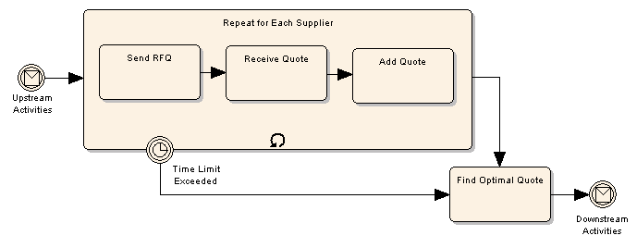
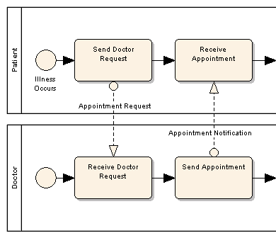
Examples of BPMN (2007)
This diagram illustrates a number of key features of BPMN, specifically the ability to create hierarchical decomposition of processes into smaller tasks, the ability to represent looping constructs and the ability to have external events interrupt the normal process flow.
This diagram illustrates the use of pools to show interacting processes and the way that messages are passed between pools using message flow connectors.
Source: http://www.sparxsystems.com/business_process_model.html

Slide 27
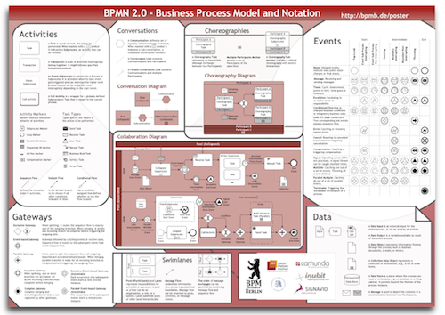
BPMN 2.0 Notation Poster
Source: http://www.bpmb.de/index.php/BPMNPoster

Slide 28
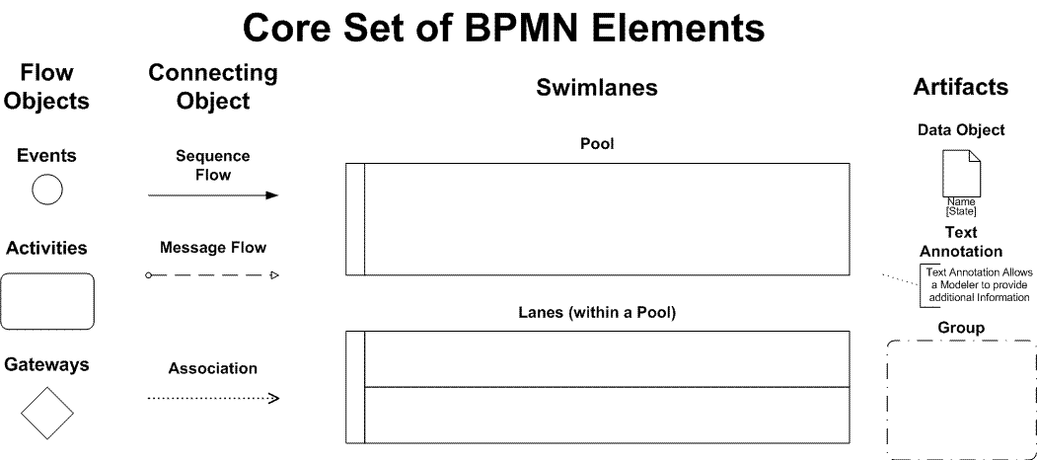
Core Elements of BPMN
Source: http://www.bpmn.org/Samples/Elements/Core_BPMN_Elements.htm

Slide 29
BPMN vs UML
BPMN provides a number of advantages to modeling business processes over the Unified Modeling Language (UML). First, it offers a process flow modeling technique that is more conducive to the way business analysts model. Second, its solid mathematical foundation is expressly designed to map to business execution languages, whereas UML is not. BPMN can map to UML, and provide a solid business modeling front end to systems design with UML.
BPMN and Business Process Management, Owen and Raj, 2003
The examination of how the 21 workflow patterns can be modeled with a Business Process Diagram and an Activity Diagram demonstrated that both notations could adequately model most of the patterns.
Process Modeling Notations and Workflow Patterns-White (IBM)-BP trends 2004
Process modeling should be undertaken in the context of a process framework that defines a number of views that are used to realize different structural and behavioural aspects of the process. One possible approach is the 7-view framework* adopted by the UK. UML can represent all of the seven views considered. BPMN has no direct support for structural views and no concept of modelling requirements.
Process modelling comparison, Simon Perry, BCS- The Chartered Institute for IT , Sept. 2006
* see next page

Slide 30
Process Modelling Framework
One such approach (for process modeling) is a 7-view framework that has been adopted by the BSi – the national standards body for the UK. (Full details of the framework be found in Jon Holt's A Pragmatic Guide to Business Process Modelling.)
Requirements view – captures the requirements of the process and the stakeholders involved
Information view – captures the artefacts (deliverables) that are produced and consumed by the process, and also shows the relationships between the artefacts
Stakeholder view – captures the stakeholders involved in the process
Process structure view – captures the structure and terminology of the process; forms the basis for any kind of mapping between different processes and standards, which is important when performing audits and assessments
Process content view – defines the content of a process in terms of the artefacts and activities that make up that process
Process behavioural view – defines the behaviour of the process: how the activities are sequenced, the artefacts entering and leaving the activities and the stakeholders involved in the process
Process instance view – captures a sequence of processes and defines a scenario that can be used to verify the requirements of the process.
Source: Process modelling comparison, Simon Perry, BCS- The Chartered Institute for IT , Sept. 2006
http://www.bcs.org/content/conwebdoc/6862

Slide 31
Empirical Comparison of the Usability of BPMN and UML Activity Diagrams (ADs)
Some of the findings from the research
UML AD was significantly more effective in the criteria data handling and adequacy
With respect to the modeling of flexible processes, in which self-contained activities should preferably be allowed to run in parallel, UML AD turned out to be superior. The usage of BPMN instead promoted a rather sequential modeling style in which unrelated activities run one after the other.
Another remarkable observation concerns the separation of control and data flow in BPMN, which apparently mislead participants to leave out parts of the data flow. Originally being introduced as a means to separate concerns and reduce the modeling complexity (Weske 2007), this concept turned out to be inferior to a combined flow modeling as present in UML AD.
For practice, the results showed that for business users a higher usability of BPMN compared to UML AD cannot be empirically supported. Although, in literature BPMN is currently often claimed to be more useable (Nysetvold & Krogstie 2005, Weske 2007, White 2004) and even standardization organizations such as the OMG seem to have followed that conclusion, there are indications that BPMN still has shortcomings, which are likely to hinder its efficient adoption by business users in practice. And where business users are unable to use a modeling language adequately, the communication between the various stakeholders is compromised.
Source: An Empirical Comparison of the Usability of BPMN and UML Activity Diagrams for Business Users -ECIS 2010.pdf
Research paper, 18th European Conference on Information Systems: http://web.up.ac.za/ecis/ECIS2010PR/ECIS2010/Content/Papers/0228.R2.pdf

Slide 32
Appendix- HL7 Key terms
This needs to be augmented for our Care Plan needs

Slide 33
Term: Patient encounter
Patient encounter is defined as an interaction between a patient and one or more healthcare practitioners for the purpose of providing patient services or assessing the health status of the patient. A patient encounter is further characterized by the setting in which it takes place; currently HL7 recognizes seven unique patient encounter types:
Ambulatory Encounter - A comprehensive term for health care provided in a facility or setting that provides diagnostic, therapeutic and health maintenance services for persons not requiring stays that exceed 24 hours (e.g. a practitioner's office, clinic setting, or hospital) on a nonresident and non-emergency basis. The term ambulatory implies that the patient has come to the location and is not assigned to a bed. Sometimes referred to as an outpatient encounter.
Emergency Encounter - A patient encounter that takes place at a dedicated healthcare service delivery location where the patient receives immediate evaluation and treatment, provided until the patient can be discharged or responsibility for the patient's care is transferred elsewhere (for example, the patient could be admitted as an inpatient or transferred to another facility.)
Field Encounter - A patient encounter that takes place both outside a dedicated service delivery location and outside a patient's residence. Example locations might include an accident site or at a supermarket.
Home Health Encounter - A patient encounter where services are provided or supervised by a practitioner at the patient's residence. Services may include recurring visits for chronic or terminal conditions or visits facilitating recuperation.
Inpatient Encounter - A patient encounter where a patient is admitted by a hospital or equivalent facility, assigned to a location where patients generally stay at least overnight and provided with room, board, and continuous nursing service.
Short Stay Encounter - A patient encounter where the patient is admitted to a health care facility for a predetermined length of time, usually less than 24 hours.
Virtual Encounter - A patient encounter where the patient and the practitioner are not in the same physical location. Examples include telephone conference, email exchange, robotic surgery, and televideo conference.
Source: HL7 Version 3 Standard: Patient Administration Release 2; Patient Encounter, Release 1 DSTU Ballot 1 - May 2011

Slide 34
Term: Encounter
Encounter
An Encounter (ENC) choice is an interaction between a patient and care provider(s) for the purpose of providing healthcare-related service(s). Healthcare-related services include health assessment.
Note this type of statement covers admissions, discharges and transfers of care, as well as the more usual understanding of a single discrete office visit.
It further deals with a plan for regular visits, such as preventive care during pregnancy, or monitoring of chronic ill patients.
Includes requesting, proposing, promising, prohibiting or refusing an encounter as well as an actual encounter event.
The encounter is a derivative of the RIM PatientEncounter class, used to represent related encounters, such as follow-up visits or referenced past encounters.
Source: HL7 Draft Standard for Trial Use - HL7 Version 3 Standard: Clinical Statement Pattern, Release 1 - Last Published: 12/06/2007 10:24 AM

