Slide 1
Clinical Oncology Treatment Plan and Summary, Release 1
Ballot for May 2013

Slide 2
Meeting Information
When:
January 29, February 5, 19, 26, March 5 (Tuesdays)
5:30-6:30pm EST
February 14 (Thursday)
12:00pm-1:00pm EST
Conference line for all meetings (voice):
Telecom: +1 770-657-9270, Participant Code: 310940

Slide 3
Meeting Information: Web Meeting
When:
Every Tuesday, January 29, 2013 – March 5th @ 5:30-6:30pm EST
When: https://www3.gotomeeting.com/join/455057214
Phone Number: +1 770-657-9270
Participant Passcode: 310940
Meeting ID: 455-057-214
Thursday, February 14, 2013 – 12:00pm-1:00pm EST
When: https://www3.gotomeeting.com/join/170944326
Phone: +1 770-657-9270
Participant Code: 310940
Meeting ID:170944326

Slide 4
Welcome Tuesday, February 5, 2013 – 5:30pm-6:30pm EST
AGENDA
Introductions | 5 min | 5:30 - 5:35
Review of IG Updates | 10 min | 5:35 – 5:45
This week’s templates: Problem Section and Entries (finish) Procedures Section and Entries | 40 min | 5:45 – 6:25
Action Items/Conclusion | 5 min | 6:25 – 6:30
Notes:
Need to update

Slide 5
Goal:
Develop a Clinical Oncology Treatment Plan and Summary document CDA Implementation Guide derived from the American Society of Clinical Oncology (ASCO) Breast Cancer Adjuvant Treatment Plan and Summary

Slide 6
Purpose and Scope
The primary use case for the Clinical Oncology Treatment Plan and Summary document is a summary of a patient’s care during cancer treatment to serve as a form of on-going communication for coordination of care between health care providers while a patient is receiving care.

Slide 7
Purpose and Scope
This project will promote information exchange among cancer care providers (and patients)
Benefit the research and reporting activities which, in turn, support the delivery of care
Reuse existing C-CDA templates and constrain as needed to express of this information where possible
Create new CDA templates as needed
The initial ballot will contain templates required for exchange of the ASCO disease-specific Breast Cancer Adjuvant Treatment Plan and Summary

Slide 8
Requirements Source
Derived from:
Breast Cancer Adjuvant Treatment Plan and Summary

Slide 9
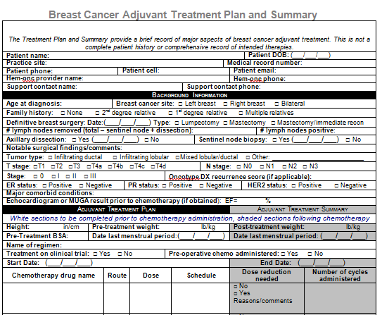
Requirements Source:

Slide 10
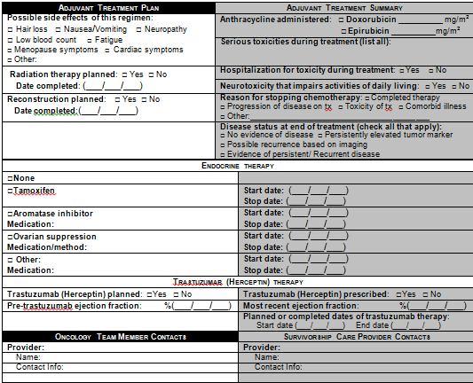

Slide 11
High-level Timelines
Task | Timeframe
Clinical Oncology Patient Transfer Summary Ballot
Content development | October 2012 – March 8, 2013
Ballot period | March 25 – April 29, 2013
Ballot reconciliation | May 6 – June 22, 2013
Finalize and publish | June 22 - July 13, 2013

Slide 12
Meeting Information: Note and Notices
Notes and Notices and changes will be sent through Structured Document Work Group Listserv
HL7 Membership not required
Listserv sign-up: http://www.hl7.org/myhl7/managelistservs.cfm?ref=common
You can use this interface to subscribe or unsubscribe to any of HL7's public lists, or to change your subscription settings
Structured Documents:

Slide 13
Meeting Information:
Meeting Notes and developing IG drafts will also be posted on an HL7 Wiki.
Will be able to access from HL7 homepage: www.HL7.org
Direct link to project wiki:
http://wiki.hl7.org/index.php?title=Clinical_Oncology_Treatment_Plan_and_Summary

Slide 14
Design Considerations

Slide 15
Design
Preliminary draft of each template has been completed
IG Drafts will be posted weekly
Key templates will be reviewed during the stakeholder meetings and edited as needed
(See IG)

Slide 16
Recommended Header Design
Reuse Consolidated US Realm Header

Slide 17
Clinical Statement Design Heuristics
Derived from clinical concepts contained in the ASCO Breast Cancer Treatment Plan and Summary
Model the concept based on how the data element would (or will in the future) be found in an EHR
Stick to the use case: “Communication of cancer care summary and plan information from oncology providers to primary care providers and or patients”
Re-use C-CDA Meaningful Use recommended templates whenever possible
Constrain these templates into new child templates when needed based on requirements and/or vocabulary

Slide 18
Recommendations
What if there are no data?
The data element will not be sent:
“Absence of evidence is evidence of absence”

Slide 19
Clinical Statements to be discussed today:
This week’s templates:
Problem Section and Entries (finish)
Procedures Section and Entries

Slide 20
Issues

Slide 21
Next Steps
Next week’s templates:
Procedures Section and Entries (finish)
Family History Section
Possibly Medications Section including chemotherapy regimen

Slide 22
Thank you!
Contact
Gaye Dolin: gaye.dolin@lantanagroup.com
Zabrina Gonzaga: zabrina.gonzaga@lantanagroup.com
Yan Heras: yan.heras@lantanagroup.com
Beau Bannerman: beau.bannerman@lantanagroup.com

