Slide 1
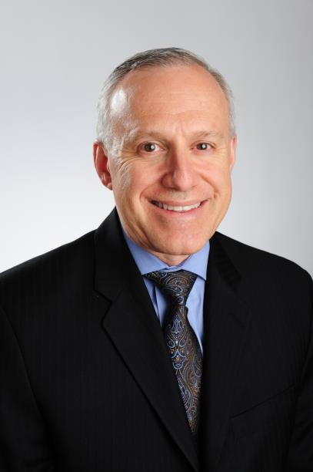
David J. Freedman, DPM, FACFAS, FASPS, CPC, CPMA
Vice-President, Foot and Ankle Specialists of the Mid-Atlantic
Certified Professional coder
Certified Professional Medical Auditor
Compliance Auditor
Codingline Expert
APMA Coding Committee, member and advisor since 2005
A Past President, Maryland Board of Podiatric Medical Examiners
CAC member Maryland
32 years of Coding Experience

Slide 2
Foot and Ankle Specialists of the Mid-Atlantic AKA FASMA
“Reducing Clinician Burden”
-35 Offices Pennsylvania, Maryland, DC, Virginia and North Carolina
-59 Physicians

Slide 3
Goal: We should be trying to spend the vast majority of our time interacting with patients
FACT - Interaction ≠ EHR

Slide 4
ISSUE: Try to do a lot of charting in the room, struggling to keep eye contact so my patient's don't feel ignored by the computer. Only way to maintain eye to eye contact requires the physician to fulfill all EHR requirements that night. Current Solution: all EHR components must be completed to close out a note, physicians are not happy. Future Solution: allow wearable device that records each session digitally, no more charting except changes and eRx.

Slide 5
ISSUE: I stay at work until 6 o'clock every evening PLUS usually have to either try to conclude in the evening or more commonly wake up quite early to finish. Current Solution: No choice too many mandates to be completed. Future Solution: allow wearable device that records each session digitally, better quality of life for physicians not staying at the office doing charting or having to spend evenings and weekends charting.

Slide 6
ISSUE: See an average of 28-30 patients daily so it is impossible to keep up. EHR has reduced the number of patients that was able to see prior to EHR. The clicking on items just for MIPS or Medicare/insurance documentation adds time as well. EHR and the new generation of medicine has reduced my free time to 2 hours daily for meals, exercise and relaxation. Thank God I am at the sunset of my career. Current Solution: No choice too many mandates to be completed. Future Solution: allow wearable device that records each session digitally, better quality of life for physicians not staying at the office doing charting or having to spend evenings and weekends charting.

Slide 7
ISSUE: EHR demands must be curbed at some point OR future burn out % for all physicians will climb further lessening patient access to high quality medical care. ISSUE: EHR has had in immense impact on my life personally. Current Solution: No choice too many mandates to be completed. It is effecting physicians lives! Future Solution: Prior to EHR, physicians were more efficient dictating notes, had better patient eye to eye contact just documenting findings and advice took a lot less time if we can allow wearable devices that records each session digitally = better quality of life for physicians not staying at the office doing charting or having to spend evenings and weekends charting. It is feared we will never put that genie back in the bottle!

Slide 8
ISSUE: The most functional physician "with EHR" interactions with our patients are those where the physician used his computer only to reference prior labs during the face to face encounter OR those where the physician employed a scribe. Possible Solution: Most physicians cannot afford a scribe. The clinical relevance of necessary data to help insurance companies and government analyze patient demographics and disease require “extra staff” and “physician time” It is now the time that CMS and Private insurance industry become mandated to reimburse for this option as data collection has created financial issues practicing medicine.

Slide 9
ISSUE: Our specialty requires review of multiple systems at each visit. Failing to document pertinent positive and negative findings during the face to face time is inevitable and you need to sketch of a plan while in the room invites not remembering what to write in the chart when you return to it later in the day. This creates less than accurate charting. Current Solution: No choice too many mandates to be completed. Future Solution: allow wearable device that records each session digitally, provides not missing any aspects of the charting.

Slide 10
ISSUE: Interacting with the computer while trying to engage the patient, steer the conversation toward identifying the pathology and designing a treatment plan becomes a balancing act. Current Solution: No choice too many mandates to be completed. Future Solution: allow wearable device that records each session digitally, better quality of life for physicians not staying at the office doing charting or having to spend evenings and weekends charting. Recording real time the session and interactions with patient.

Slide 11
Layered on top of working on a computer in front of the patient is an awareness that we are failing to make a personal connection with the patient . In turn it has a negative consequence for the provider. Many patients now either feel compelled or are invited to offer their opinions about the visit in a social media environment. Performance measures are being collected which allow patients to rate their physician visit. Current Solution: No choice too many mandates to be completed. Future Solution: allow wearable device that records each session digitally, better quality of life for physicians yields better interaction which in turn yields best possible ratings in social media.

Slide 12
ISSUE: As one of the attendings I trained under said, "we haven't changed what we have always been doing, we just click more boxes and populate more information so the notes look like were doing more." its not the worst part of the job, but it detracts away from what we love doing, and burdens free time more! Current Solution: No choice too many mandates to be completed. Future Solution: allow wearable device that records each session digitally, better quality of life for physicians yields better interaction which will not detract from practicing medicine.
Notes:
There is too much on this slide.. I would recommend breaking it up into one slide per issue.

Slide 13
Fast Facts: 1) Providing medicine has become a combination of practicing the “healing arts” and mastering the “performing arts”. 2) We spend significant more money supporting IT than ever especially as our group continues to grow. 3) Security has become a major issue and there is no fullproof iron clad secure system no matter how fantastic the security world is. Cuurently it throws all the risk to the physicians, this is plainly unfair! 4) BEST PART OF EHR: IT HAS GIVEN US A VALUABLE TOOL-Electronic RX is incredible and time saving and patient care pertinent.

Slide 14
Fast Facts: 5) That all systems can't communicate is intolerable and defeats the whole purpose of communication between doctors/entities electronically. We need to move data that is straightforward bidirectionally. 6) The most efficient system ever used was dictation/transcription with an ideal system would involve computer generated (ie: Dragon) dictation (to keep cost of trans down) with bullet prompts for the required data points in a SOAP format.

Slide 15
FASMA’s Group solution: Best solution is stop traditional note taking, switch to office based video office visits A) It eliminates the doctor having to chart notes as the entire interaction being recorded. B) It is precise and leaves no doors open as to what treatment(s) were done after examining the patient. C) An option is a wearable device that records each session digitally, better quality of life for physicians yields better interaction which will not detract from practicing medicine.

Slide 16
Contact Information email: dfreedman@footandankle-usa.com contact: (301) 598-0130 address: 3801 International Drive Suite 204 Silver Spring, MD 20906
Notes:
You have about 8 minutes.
It will take the same amount of time to go over all the issues whether they are 1 issue per slide or many issues per slide
Break it up into one issue per slide, practice the presentation and see how long it takes you. If you can get it all done in about 8 minutes Great, if not focus on the most important points and we will make sure all the points get into the spreadsheet.

