Slide 1
NCCN Templates: Hierarchical Action Levels within a PlanDefinition FHIR Resource
Peter Lamb
August 2017

Slide 2
Overview
NCCN Templates make use of the PlanDefinition resource within FHIR
PlanDefinition has a data element called action, which is an action defined by the plan
action also has an action data element, meaning that sub-actions can be contained within an action. The behavior of an action determines the functionality of sub-actions. For example, a selection behavior of “at-most-one” indicates that of the sub-actions, at most one may be chosen as part of realizing the action
NCCN Templates make extensive use of actions to express optionality that is contained within complicated regimens
This presentation highlights how NCCN Templates use the action data element, and includes specific examples of each use case
This presentation also highlights the relationship between PlanDefinition & ActivityDefinition resources, as ActivityDefinitions are also used in NCCN Templates

Slide 3
PlanDefinition: Hierarchical Action Levels
regimen option
regimen part
cycle definition
regimen entry group
regimen entry
dosage instruction group
dosage instruction

Slide 4
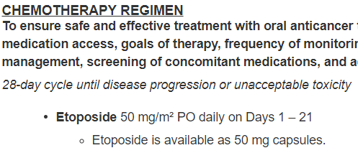
Hierarchical Action Levels (cont.)
To be clear, every template (even the most simple ones) will have at least one of every action level
For example, SCL17 (below) has one of each hierarchical action level
Template: SCL17

Slide 5
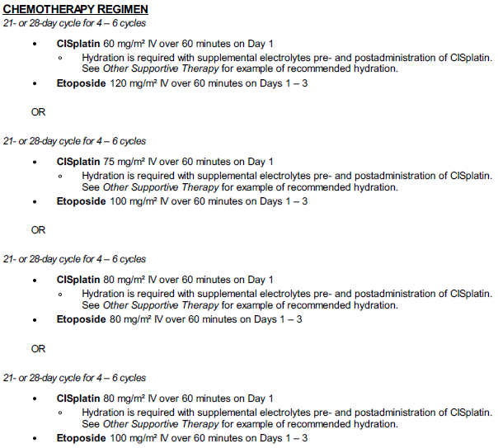
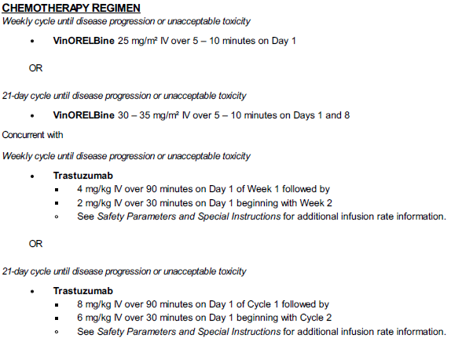
Level 1: regimen option
This level is for the “parent-most” level of optionality contained within a template, introduced with ORs
Template: SCL1
Template: BRS59
Option 1
Option 1
Option 2
Option 2
Option 3
Option 3
Option 4

Slide 6
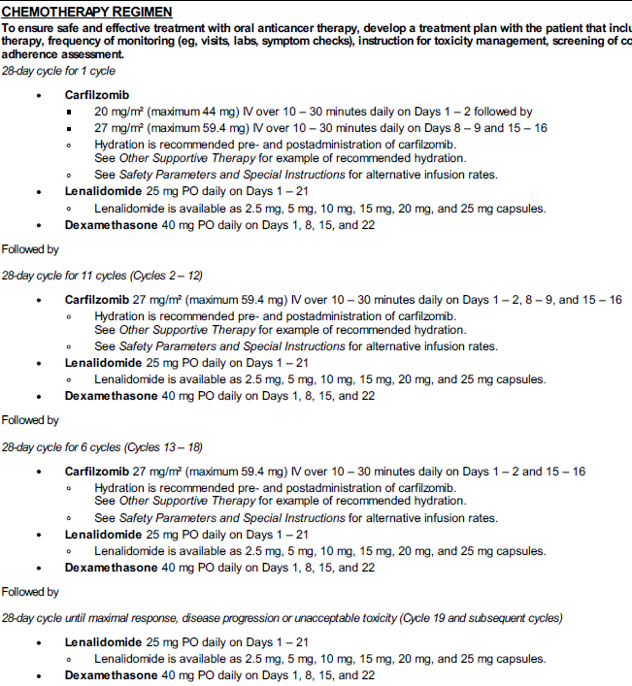
Level 2: regimen part
This level can expand a regimen option, introduced with phrases like “concurrent with” or “followed by”
Template: MUM60
Template: BRS59
Part 1
Part 1
Part 2
Part 2
Part 3
Part 3
Part 4
Part 4

Slide 7
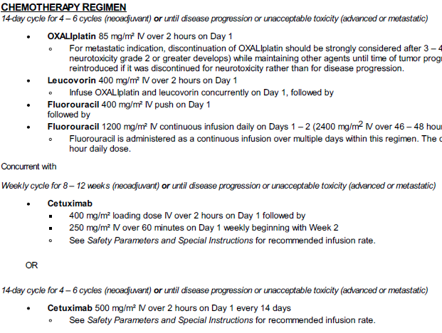
Level 3: cycle definition
This level can expand a regimen part, introduced with ORs in the cycle definition
Template: REC54
Cycle Def 1
Cycle Def 2
Template: DBL2
Cycle Def 1
Cycle Def 2
Cycle Def 3
Cycle Def 3
Cycle Def 4
Cycle Def 5
Cycle Def 6

Slide 8
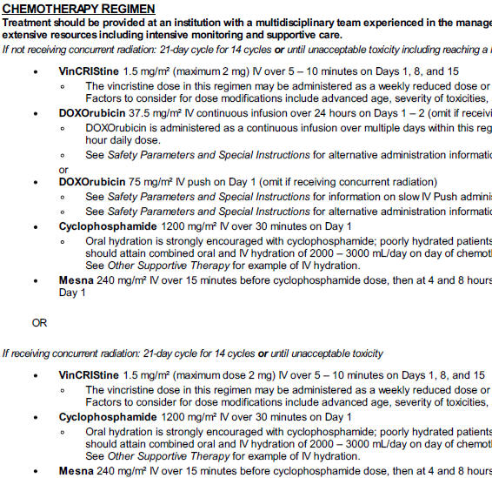
Level 4: regimen entry group
When an agent includes optionality, introduced by an OR between the same agents
Template: RHAB2
Total # of regimen entry groups =
1 reg option x 1 reg part x (2 cycle defs x 4 reg entry groups) = 8
+
1 reg option x 1 reg part x (2 cycle defs x 3 reg entry groups) = 6
= 14
reg entry groups
Dox combined into a single Reg Ent Group

Slide 9
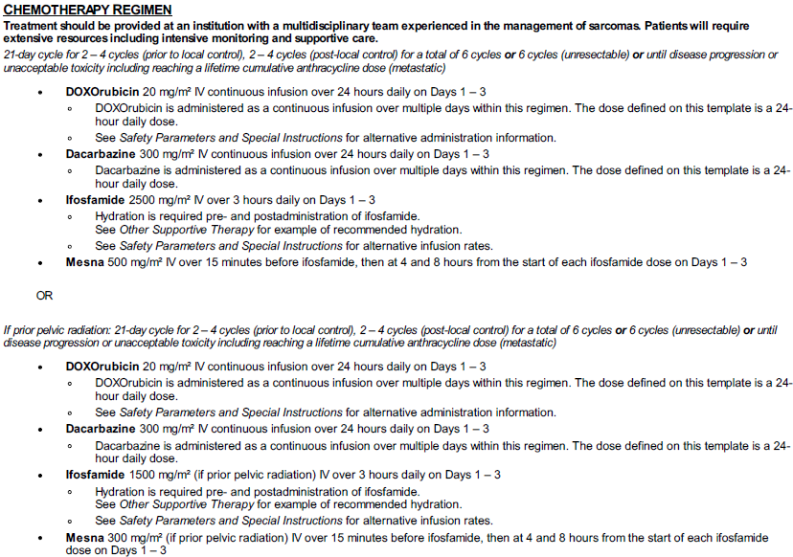
Level 5: regimen entry
An agent in the template (bolded agent name, e.g. DOXOrubicin)
Total # of regimen entries=
1 reg option x 1 reg part x (2 cycle defs x 5 reg entries) = 10
+
1 reg option x 1 reg part x (2 cycle defs x 3 reg entries) = 6
= 16
reg entries
Template: RHAB2
Total # of regimen entries=
1 reg option x 1 reg part x (3 cycle defs x 4 reg entries) = 12
+
1 reg option x 1 reg part x (3 cycle defs x 4 reg entries) = 6
= 24
reg entries
Template: SOT3

Slide 10
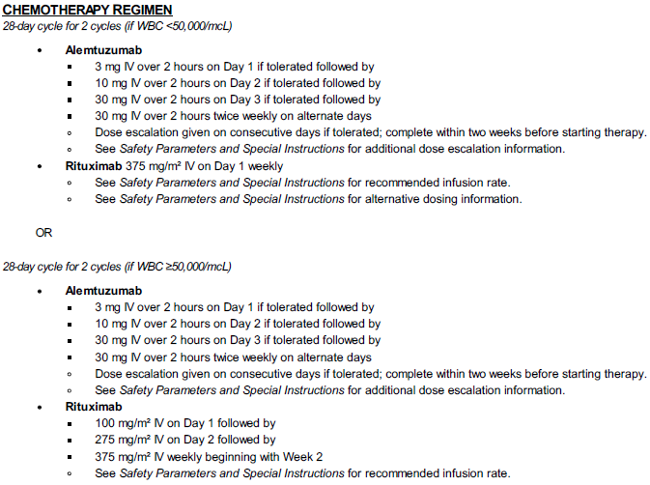
Level 6: dosage instruction group
When an agent includes dosage optionality (for agents with optionality, this is displayed as a bulleted list using the ▪ symbol), each option will be included within its own dosage group
Template: CLL29
Template: MUM60
11 regimen entries, 12 dosage instruction groups
4 regimen entries, 12 dosage instruction groups

Slide 11
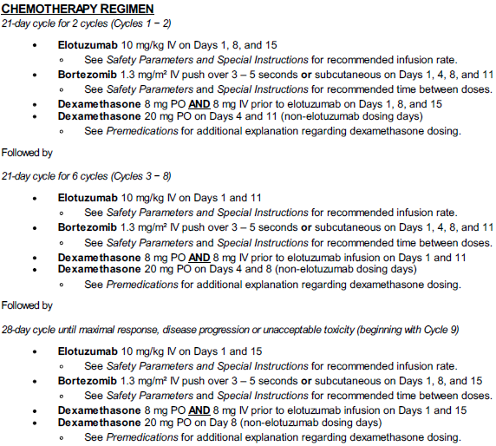
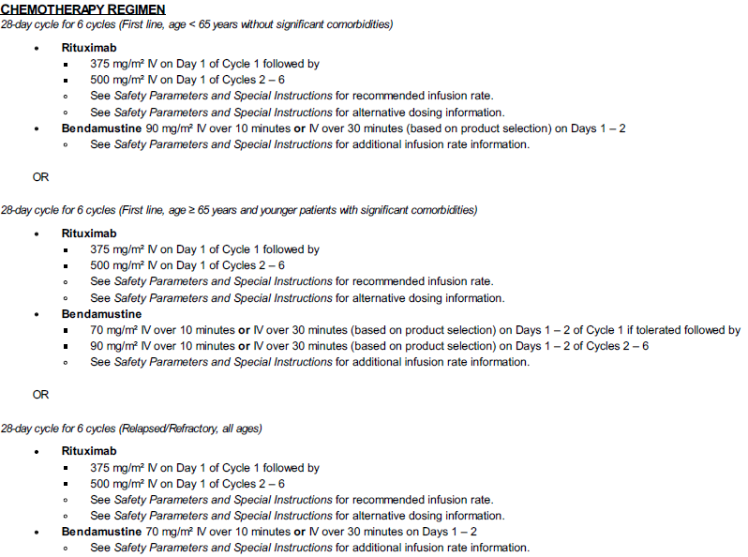
Level 7: dosage instruction
Covers dosage optionality such as route or infusion time
At this “child-most” level this is a single agent and its dosage
10 dosage instruction groups, 14 dosage instructions
12 dosage instruction groups, 15 dosage instructions
Template: CLL22
Template: MUM64

Slide 12
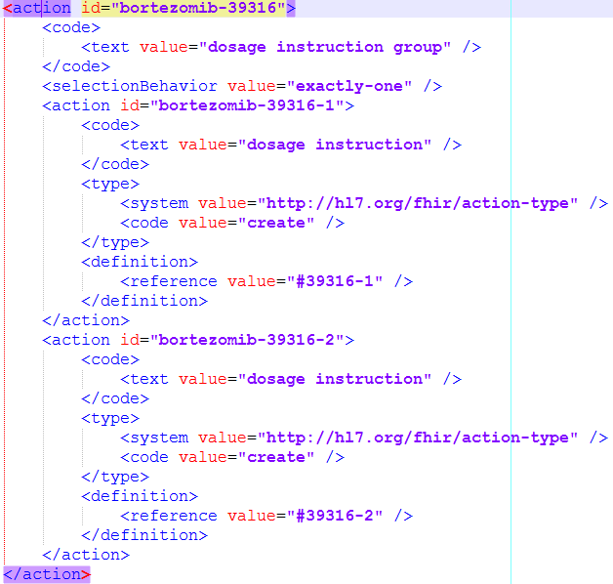
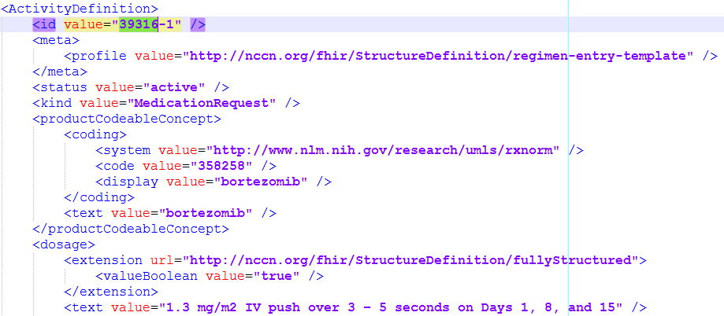
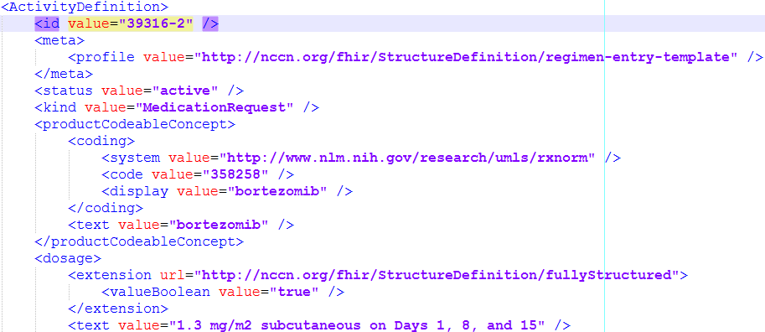
Relationship to ActivityDefinition
The action data element in a PlanDefinition has a data element called definition, which is a description of the activity to be performed
An action definition is of type Reference, and can either reference an ActivityDefinition or a PlanDefinition
In NCCN Templates, action definitions at the “child-most” dosage instruction level include a definition data element, and it is of type ActivityDefinition (note that the ActivityDefinition is of kind MedicationRequest)
In NCCN Templates, the actions within a PlanDefinition include internal references to ActivityDefinitions; this is denoted by the hashtag (#) sign before the action definition reference value
This tells FHIR to look for the reference ActivityDefinition here in the same file and not somewhere else on the server
Template: MUM64

