Slide 1
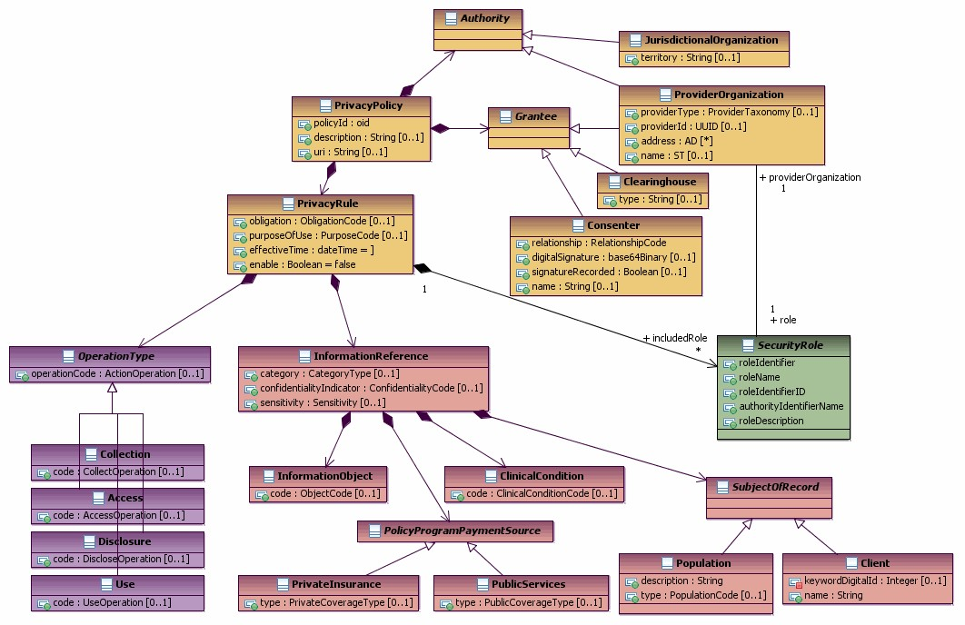
Why consent needs three vectors using HCS vocabulary (using: Figure 1.3: Privacy Policy Structure Overview Diagram)
Use Context
(allowed compartment, allowed use purpose)
Use Actions
(Obligations,
Advice,
PurposeOfUse restrictions)
Note missing
ABAC support
Data Context
(sensitivity, confidentiality,
Integrity,
Collection purpose)

