Slide 1
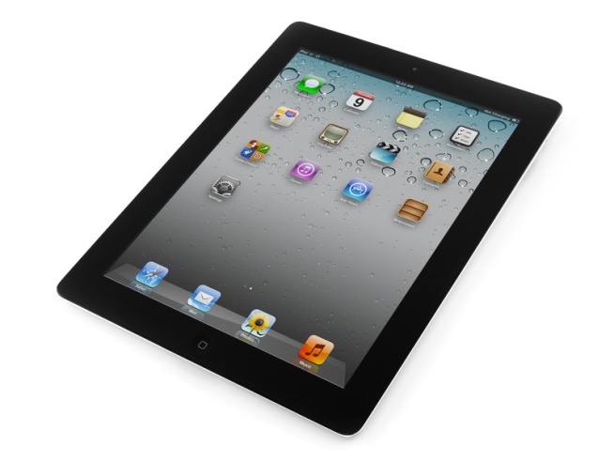
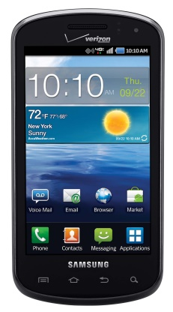
Consumer Mobile Health Application Functional Framework (cMHAFF) Overview and Update
Mobile Health
September 2017
HL7 San Diego WGM

Slide 2
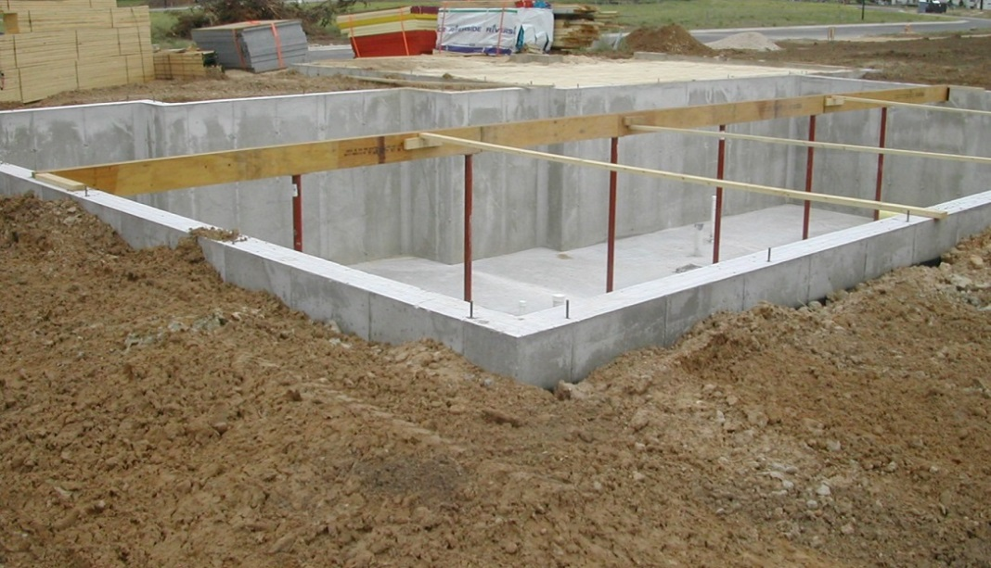
cMHAFF Scope and Goals
Provide a framework for assessment of the common foundations of mobile health apps
Product Information (disclosures/transparency)
Security
Privacy/consent/ authorization
Risk assessment/analysis
Data access privileges
Data exchange/sharing
Usability & Accessibility
Assessment could include attestation, endorsement, testing, voluntary or regulatory-driven certification
Out of scope: specific clinical content or functionality
Notes:
cMHAFF is scoped towards general-purpose standards and guidelines that span most mobile apps, such as privacy, security, data export, and transparency.
Because of the huge range of potential functionality, cMHAFF does not attempt to provide specific guidance for functionality, such as data and capabilities for disease management, fitness, etc.
Assessment methods are to be determined, but most likely private sector testing, endorsement, and certification, rather than regulation.

Slide 3
Why cMHAFF? What’s the Need?
Target Audience: mobile health app developers needing guidance on building apps
Beneficiaries: consumers, providers, caregivers
Consumers need protection, transparency and assurance regarding mobile apps. Some examples:
What does the app do? What evidence supports it?
What security protections exist behind that “cloud?”
Can I comprehend, or even find, privacy policy and terms of use?
Who can the app share data with?
What does the app know about me (location, microphone, camera, contacts, etc.), and what can it do on my device?
Can I access my app data like I can under HIPAA?
What happens to my data if I delete an app?
Notes:
To refresh your memory on why this project exists, we believe there are unmet needs that exist in the marketplace, as health IT is increasingly moving to mobile delivery platforms, for consumers as well as clinicians. There is much attention at the Federal level as well, including ONC and FTC, on the need for better guidance for MH apps.
While some of the results of cMHAFF may benefit clinicians as well, its scope of guidance is targeted towards developers who build mobile apps for consumers, while the benefiiciaries of apps following that guidance should be the consumers who use those apps. And, of course, if assessment programs arise such as voluntary certification or endorsements, cMHAFF can be a baseline for those.

Slide 4
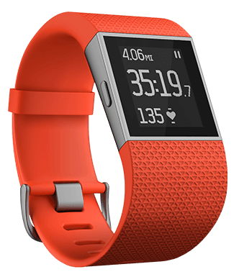
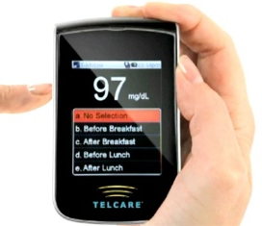
cMHAFF Exemplar Use Cases

Slide 5
EHR-Integrated Use Case “C”
A diabetes management app allows a consumer to collect blood sugar readings through a Bluetooth-enabled glucometer. A healthcare provider offers the app to enable the patient’s blood sugar to be captured through devices, rather than relying on manual entry by the patient, and to electronically transmit the readings to the patient’s physician, rather than using paper or FAX. Activity data are collected through an activity tracker, and a consumer can open the app to record meals and snacks to enable estimates of caloric consumption. Collected data is automatically “pushed” to a third-party cloud-based platform. The patient is aware of the cloud, though not familiar in detail with how data are protected in transit or storage. When a consumer views information in the app, which shows daily glucometer readings and related information, this information is “pulled” in but does not persist on the smartphone when the app is closed. It is also possible for the consumer to directly enter blood sugar readings (e.g., if Bluetooth connection is not working). From the cloud platform, consumer information is “pushed” to a provider’s Electronic Health Record (EHR), where it is accepted as Patient Generated Health Data (PGHD), according to the preferences of the patient and the policies of the provider. From the EHR, a physician can define logic to assess blood sugar readings such that the consumer is alerted through the app when a measurement is out of range, or when a set number of high or low readings are noted within a prescribed period of time.

Slide 6
cMHAFF Sections and App Life Cycle
App Development and Support
❐ Regulatory Considerations  Risk Assessment and Mitigation  Usability Assessment  Customer Support
Consumer Use of App
Product Information
Launch app, establish account
Authentication
Authorization/ consent for data collection/ use
Data exchange/ interop
Data provenance/ authenticity
Security for data at rest & in transit
Pairing or syncing with user devices
Notifications and Alerts
Product Upgrades
Audit
App and Data Removal

Slide 7
Changes Since May
Updates from review of European guidelines
Main New/Expanded Content Areas
Product Information: General, Payment, Evidence/Credentials, Limitations & Warnings
Data exchange and interoperability
Data sync across devices
Customer/Technical Support
Expanded Security Risk Analysis
Much more extensive references

Slide 8
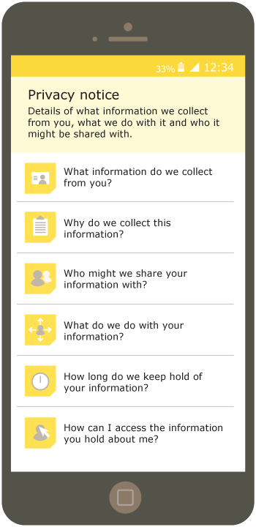
Informing Consumers
Disclosures
Evidence
Limitations
Contents

Slide 9
European Guidelines Added
French mHealth Good Practice Guidelines
German Mobile Health Assessment Criteria
Andalusian App Recommendations
U.K. Device Guidance
Finland PHR Cert Criteria
Other EU initiatives

Slide 10
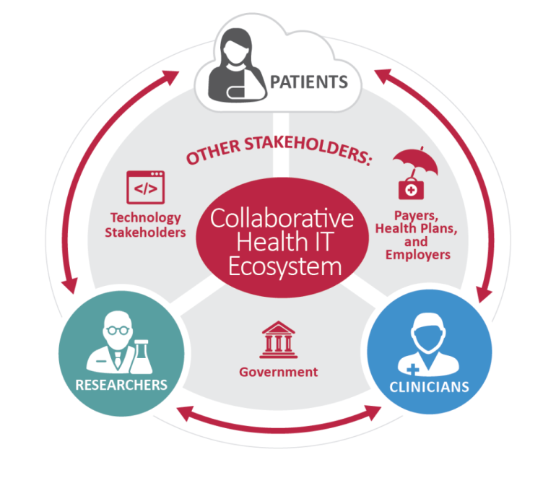
Related U.S. & Global Industry Efforts
OWASP Mobile Top 10
Security Risks
ONC ISA Task Force
and PGHD Whitepaper
FTC/FDA/OCR Mobile App Developer Guidance Tool
on
Notes:
Some of the many industry efforts being tracked, and publications being referenced, are referenced here. cMHAFF does not intend to reinvent the wheel, but rather to reference authoritative sources of requirements, use cases, standards, guidance, and best practices where they exist, such as:
NIST threat catalog and many other publications
HITRUST Alliance risk assessments and security frameworks
OWASP Mobile Top 10 Security Risks and mitigations
FTC’s interactive tool for mobile app developers (co-sponsored by FDA and Office of Civil Rights)
SMART on FHIR
ISA Task Force Consumer Use Cases
ONC/Accenture White Paper on a Policy Framework for Patient-Generated Health Data (PGHD)

Slide 11
cMHAFF Invitation
It’s a major opportunity in an exploding space: get in on the ground floor!
Action is under way around the world – people are ready!
Heading for January 2018 STU ballot
Help us “right-size” our approach to address gaps without stifling innovation or being too complex or prescriptive
Help HL7 collaborate well with the public and private sectors
Notes:
The previous ballot was comment-only, so while we have reconciled all comments, we have leeway to make whatever changes or additions are appropriate to create a viable standard.

Slide 12
Project and Contact Info
cMHAFF meetings are Thursdays at 3pm Eastern
GoToMeeting https:/www.gotomeet.me/dtao
Phone 770-657-9270, passcode 465623
Project Leads: David Tao / Nathan Botts
Join us to move cMHAFF forward!

