Slide 1
Mobile Health WG Focus:
How to capture health data from a device, and transmit
The data to Populate the patient’s EHR or PHR
Electronic Health Record
3G / 4G
Mobile Internet
WiFi
Inputs
Audio
Mobile Communication
Device
(phone / tablet / PC /
Embedded system)
data
Video
Circuit Switched Network
(PSTN)
Personal
Health
Record
Data
data
Health Care Device
Health Care Device
Health Care Device
Health Care Device
Health Care Device(s)
Zero or More
As Needed

Slide 2
Any State or Private HIE
Mobile
Device
Nationwide
HIE
3G / 4G
Mobile Internet
WiFi
Fetch data from
Hospital EHRs
Health Information
Exchange(s)
Personal
Health
Record
Any
Provider
EHR
Capture Data
From Mobile
Devices
Hospital
EHR
Hospital
EHR
Hospital
EHR

Slide 3
Audio / Video Capture Basics
Render
To User
(Display)
Raw
Video
Data Capture
Camera
Codec
Store to
File
Raw
Audio
Data Capture
Stream
Network
EHR
or
PHR

Slide 4
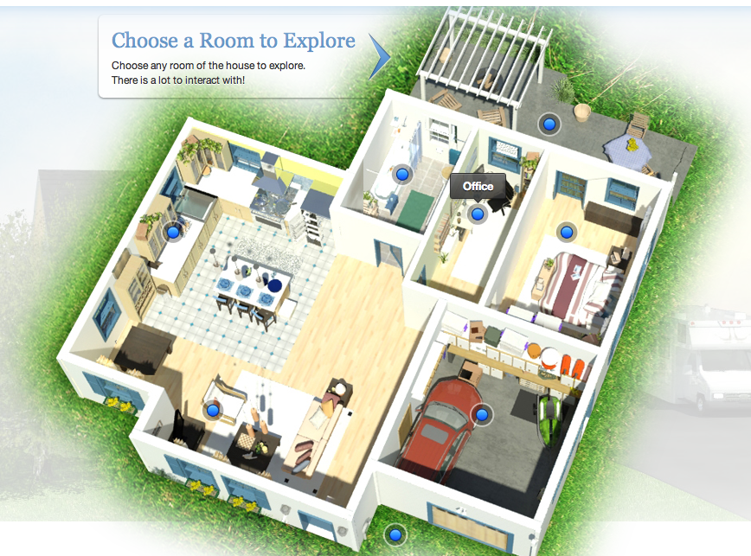
3G / 4G
Mobile Internet
WiFi

