Slide 1
Emergency Care Work Group
Co-chairs
Laura Heermann Langford, RN, PhD
Laura.Heermann@imail.org
Jim McClay, MD jmcclay@unmc.edu
Dominik Brammen, MD dominik.brammen@aktin.org

Slide 2
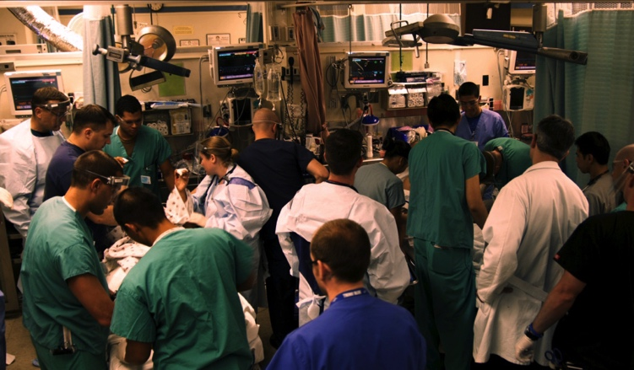
Other items

Slide 3
Work Group Purpose
Bring the unique understandings and perspectives of the emergency health care enterprise to the HL7 standards process.
Effective function of emergency care is mission critical to the entire healthcare system
Emergency care represents care-settings quite unique from all others, this group seeks to be a reliable source of information r.t Emergency Care and support for the HL7 standards mission.

Slide 4
ECWG Platform Strategy

Slide 5
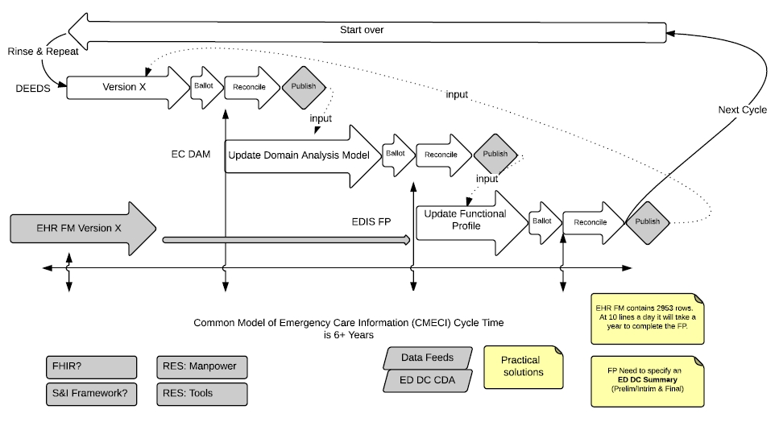
Emergency Care Approach

Slide 6
ECWG Projects
Data Elements for Emergency Departments (DEEDs) 1.0– update the published version to make it international
McClay JC, Park P, Janczewski M, Langford L; Standard for Improving Emergency Information Interoperability: The HL7 Data Elements for Emergency Department Systems (DEEDS). J Am Med Inform Assoc (2015) 22 (3): 529-535
Functional Profile 2.0 -- next
Domain Analysis Model – resolving model issues prior to publishing – Published end of 2015

Slide 7
Project Name | Brief Description | Status/Progress Report | Schedule of Meetings
DEEDS 1.2 and beyond | This is an iterative project with multiple comment only and informative ballot cycles planned to move DEEDS 1.0 to DEEDS 2.0 to meet the needs of current terminology and information modeling needs. Current efforts surround the inclusion of data elements identified by Germany as relevant to the body of work | Current meeting work | Every other Thursday 4:00pm US Eastern.
ED Functional Profile 2.0 | This project will update and revise the EDIS FP version 1.0 published in 2007, and will conform to the HL7 Electronic Health Record-Systems Functional Model v 2.0 (EHR-S FM) . The EDIS-FP will provide functional data standards and related conformance criteria for EHR systems specific to the needs of the hospital-based emergency departments and the emergency care enterprise in the United States. The EDIS FP will provide functions necessary for both civilian and military emergency care. | Early Development | Not currently scheduled.
EC Domain Analysis Model | The scope of this project is to create a Domain Analyses Model (DAM) for Emergency Care. The initial scope include in-hospital emergency care. The intent of this Domain Analysis Model is to create the general foundation of the Emergency Care domain for use by more detailed future projects. | About to be published | Not currently scheduled

Slide 8
Collaborative Projects
Trauma DAM – CIC
Essential Documentation for Children with Special Needs – Child Health/PCWG
Health Concern – Patient Care
FHIR Resources – Patient Care
Clinicians on FHIR
EMS DAM – CIC
OASIS TEP - PHER

Slide 9
Meetings this week
Monday – Q2 Joint Report
Tuesday
Q1 – Joint with PC, CIMI, FHIR-I
Q2 – ECWG Meeting
Q3 – Joint with SD, AID, ARB, BR&R, CS, Conformance, Educaiton, EST, FM, ITS, MnM, V2 publishing, SGB, Templates
Wednesday
Q1 – ECWG Meeting
Q4 – ECWG Meeting
Thursday
Q3 – ECWG Meeting

Slide 10
Where help is needed
Calls:
Every other Thursday, 1600 ET.
Call in information found at http://www.hl7.org/Special/committees/emergencycare/index.cfm
Web sharing details - to be announced via email notice to ECWG listserv
Notes:
Slide 1: WG Name and leadership
Slide 2: Purpose
Slide 3: Active projects/purpose/where they are in process
Slide 4: Completed projects that may be of interest
Slide 5: Conference Calls; email addresses; list servs; where to reach for more information

Slide 11
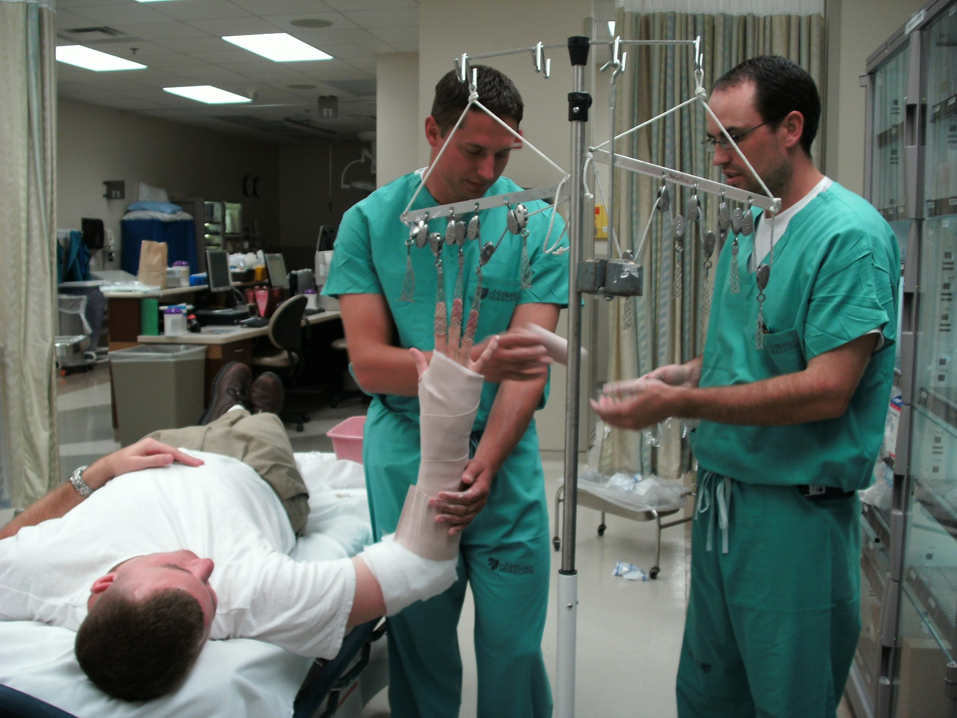
We have our hands full…

