Slide 1
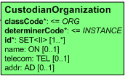
CustodianPersonChoice
Patient
0..1 onBehalfOfPerson
Need to determine
New name for agent
0..1 representedPatient (?)
CustodianChoice
1..1 agentPerson (?)
AGNT
Custodian:
A person, organization or device
that is in charge of maintaining
the information.
1..1 representedCustodianOrganization

