Slide 1
Review of Infoway’s COPD* Use Case for Care Plan Business Requirements
Includes discussion notes by HL7 Care Plan group (slides 9 and 10)
Sasha Bojicic, Canada Health Infoway
Ron Parker, Canada Health Infoway
2011-03-14 Updated with HL7 Care Plan group discussion on 2011-03-16
* Chronic Obstructive Pulmonary Disease
HL7 Patient Care Work group

Slide 2
Objectives
Discuss Care Plan business requirements (contents and scope) using Infoway’s Chronic Obstructive Pulmonary Disease (COPD) patient use case
Ref: Canada Health Infoway COPD use case - v2a.doc

Slide 3
Context of COPD Use Case Discussion with Infoway
Notes provided by Infoway

Slide 4
Context for Infoway’s COPD Use Case
The use case was developed in support of the next evolution of the Electronic Health Record System (EHRS) Blueprint in Canada
The 4 use cases developed in this context were used to identify patterns related to appointments, decision support, wait times, and use of personal health record solutions
They are not to be seen as clinical case studies
Nevertheless, they were validated with groups of physicians, nurses and pharmacists
The level of detail is appropriate for technology architecture purposes
It may not be detailed enough for a clinical team to engineer workflow and process (more work needs to be done)

Slide 5
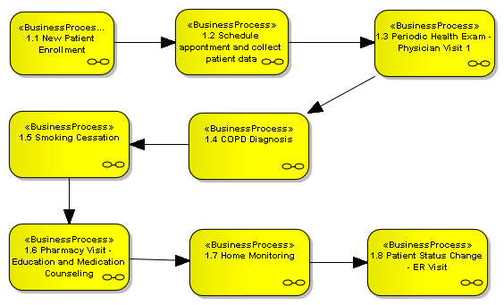
COPD Use Case- Encounters
NB: the following encounters represent a sample of all the encounters that could occur for a COPD case

Slide 6
Care Plan Definition / Scope (Infoway)
The Care Plan begins after the diagnosis
There may be other clinical patterns / pathways in order to achieve the diagnosis, but we don’t consider this to be part of the care plan
The Care Plan describes a clinical goal and set of desired outcomes for a client / patient
It outlines the roles, care settings, different events (and their status) and the roles to deliver services for this purpose
The Care Plan is not a substitute for the client / patient’s Electronic Health Record
We don’t use the Care Plan to document “everything”
The Care Plan is forward looking and is goal and action oriented, it is not a Patient Care Summary

Slide 7
Care Plan Lifecycle (Infoway)
A Care Plan is created and amended over time
Can start with a ‘preset plan’ that is then adjusted by the provider based on the patient context and care specifics
The goals and desired outcomes are typically established by one particular provider-in-a-role (nursing assessor or family physician for example)
Amendments can be made by any provider delivering services for the client / patient
Each change or amendment results in a new version of the plan
The care plan is organic
The Care Plan reflects intended and actual real-world events
Once an event is scheduled, it exists “outside” of the care plan
The Care Plan is updated (versioned) to reflect the progress against the plan

Slide 8
Patient Care Work Group Discussion Notes
2011-03-16

Slide 9
Discussion- 2011-03-16 -p1
We can have a care plan in a prevention mode
Don’t need a diagnosis or a pathology to have a care plan
Historically, care plan were pathology related, but thinking is evolving
Can have a risk-of, a symptom, potential-for, or a health-maintain plan (e.g. old age person has a plan to prevent falls)
Care plan can be a healthy-living plan
Start with a goal
Goal may not be problem driven: e.g. maintain your health, prevent family historical health problems,
Include medical and non medical tasks
Infoway looked at the care plan in the context of shared health record
What are the functionalities required
There may not be a shared EHR in a given context

Slide 10
Discussion- 2011-03-16 -p2
Do we have an issue if there is no problem that drive the goal and care plan?
Must we have a problem (negative connotation) and a goal?
A reason is required, or a concern
Hence: one or more reasons, one or more goals and associated plans
CONCLUSION: A health reason leads to a goal which leads to a care plan
Reason may be preventive, curative, or maintenance

