Slide 1
Clinical Status and related topics 2017-05-11 update
Stephen Chu, PCWG
Notes:
Thanks to inputs from:
Russ Leftwich, Rob Hausam, Lisa Nelson, Emma Jones, Michelle Miller, Laura Heermann Langford, and Elaine Ayres

Slide 2
Agenda
Drivers and history for the topics
Clinical status term set
Clinical confirmation status values
Further discussions
Related concepts/topics
Health status
Clinical course
Clinical staging and stages
Tumours grading
Object/Workflow status
Included for those
who are interested
in exploring these
Topics
(see appendix slides
for details)

Slide 3
Objectives
The objectives of contents of this slide deck are:
To create a clinicalStatus value set for use in FHIR clinical resources, e.g. Condition and Allergy/Intolerance
To create a harmonised clinicalStatus value set for use in C-CDA
To propose a clinicalStatus value set for consideration by the International Patient Summary project

Slide 4
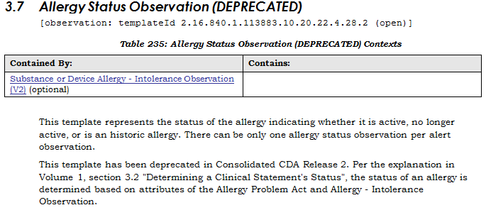
Drivers
Efforts began in 2014 to restore two templates deprecated by Structured Document WG:

Slide 5
Drivers
Fast Health Interoperable Resources (FHIR) (v1.9.0) – AllergyIntolerance and Condition defined elements to represent status:
Notes:
FHIR Current Build v1.9.0 (as of 23 January 2017)

Slide 6
Drivers
January 2017 WGM – joint meeting PCWG-SDWG meeting (Thursday Q2) discussion:
C-CDA R2.1 – will include a new Clinical Status template for optional use
http://wiki.hl7.org/index.php?title=January_2017_WGM_San_Antonio,_Jan_14_to_Jan_20
Need to provide/recommend a harmonized “Clinical Status” value set for use in C-CDA IG, FHIR and other relevant clinical models
To differentiate clinical status from workflow/object status
See Slides 26 – 31 for more details

Slide 7
Clinical Status
Status:
A specific state of a condition, problem, disease; such as emotional status
Clinical:
Related to the observed symptoms, state or course of a disease
Related to the beside treatment of a patient
Clinical status:
A specific state of a patient’s condition, problem or disease determined through observation and assessment made by a health care professional
Examples of clinical status:
Pulmonary tuberculosis – clinical status = active; inactive
Rheumatoid arthritis – clinical status = active, in remission, relapse

Slide 8
Condition/Disease States
Genetic predisposition
At risk
Disease States
Environmental
predisposition
Clinical status
Clinical course
subclinical
Acute
Active
Inactive
Chronic
Chronic
progressive
Recurrence
Resolved
Remission
Acute
exacerbation
(Acute on
chronic)
Relapse
Decompensation
Controlled
Progressive
Resolved
with
sequelae
End-stage
Resolved
without
sequelae
Well-controlled
Poorly-
controlled
Stabilised
Notes:
This mindmap contains a mixture of clinical course and clinical status terms. Colour coded terms are currently in FHIR Condition.clinical status value set (FHIR Build v1.9.0 as of 2017-02-27)
Note – “stabilised” can be treated as synonym of “well-controlled” for now.

Slide 9
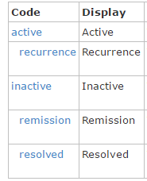
Clinical status value set
Conditions, Diagnosis, Problems
At risk
Active
Controlled
Well controlled
Poorly controlled
Stabilized
Refractory (??? Use pre-coordination, e.g. refractory schizophrenia – see foot notes)
Relapse
Recurrence
Inactive
Remission
Resolved
FHIR Condition.clinicalStatus code values
FHIR Change Requests #13025
2017-03-16 PCWG FHIR Conference call:
Added “relapse” as a child of “active”
FHIR Change Requests #13026
2017-03-23 PCWG-FHIR call:
Added “controlled” and “poorly controlled”
Notes:
Recurrence = the re-occurrence or repetition of a previously resolved condition, e.g. recurrence of acute asthma, urinary tract infection, pancreatitis, conjunctivitis, periodontitis, vaginal or rectal prolapse (after surgery), Crohn’s disease after ileocolectomy (recurrence may happen in up to 80% of patients after surgery) etc
Relapse = the return of a disease, or signs and symptoms after a remission or a period of improvement. Relapse also refer to returning to the use of addictive substances behaviour (source: National Cancer Institute). The Australian Federal Department of Health definition of “relapse” (of mental health problems) = “It is used most commonly within a medical context, where it is a word that is clearly understood by health practitioners to mean returning to a diagnosable state of mental illness”. The term is commonly used to describe the relapsing state of relapsing-remitting diseases such as [breast] cancer, multiple sclerosis, rheumatoid arthritis, systemic lupus erythematosus, bipolar disorder, [psychotic relapse of] schizophrenia, etc
Controlled (well controlled) = the condition is adequately or well managed such that the recommended evidence-based clinical outcome targets are met, e.g. for diabetes – the targe HbA1c for Type 2 DM is =< 6.5% (American Diabetes Association), =<6.5% or 48mmol/mol (Australian Diabetic Society 2015 position statement); Systolic BP =<140, Diastolic BP =< 90; Stage 1 COPD targets: FEV1/FVC <70; FEV1=>80% of predicted
This concept is used to described clinical state of conditions such as diabetes, hypertension, congestive heart failure, asthma, COPD, etc
Poorly controlled = the condition is inadequately/poorly managed such that the recommended evidence-based clinical outcome targets are not met [Patient non compliance can be a contributing factor]
Refractory/Refractoriness = a pathological state or characteristic in which a condition/disease is stubbornly resistant to various forms of treatment or even multiple intensive therapies with unfavourable outcome and diminished likelihood of achieving remission. The concept is used in cancers (e.g. refractory non-Hodgkin lymphoma, refractory large B-cell lymphoma, refractory ovarian cancer, refractory neuroblastoma), Refractory Anaemia with Excess Blasts in myelodysplastic syndrome, refractory celiac disease, refractory schizophrenia (occurs in 30% of schizophrenia), refractory heart failure, etc. [Patient non-compliance is unlikely to be a contributing factor – see literatures on cancer drug resistance]
Refractory rheumatoid arthritis definition: = patients who had experienced treatment courses (with at least one biological) over a minimum of 18 months since diagnosis without reaching the treatment goal of low disease activity or remission (defined by a Simplified Disease Activity Index, SDAI). http://acrabstracts.org/abstract/the-good-the-bad-and-the-ugly-refractory-rheumatoid-arthritis-in-2016/
Remission in Type 2 Diabetes - A short course of intensive lifestyle and drug therapy achieves on-treatment normoglycemia and promotes sustained weight loss. It may also achieve prolonged, drug-free diabetes remission and strongly supports ongoing studies of novel medical regimens targeting remission (Source: Piloting a Remission Strategy in Type 2 Diabetes: Results of a Randomized Controlled Trial – Journal of Clinical Endocrinology & Metabolism, 15 March 2017 https://doi.org/10.1210/jc.2016-3373)

Slide 10
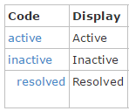
Clinical status value set
Allergy/Intolerance
At risk
Active
Controlled
Well controlled
Poorly controlled
Stabilized
Refractory (??? Use pre-coordination, e.g. refractory schizophrenia – see foot notes)
Relapse
Recurrence
Inactive
Remission
Resolved
FHIR Allergy/Intolerance.clinicalStatus
code values
19 May 2017:
Condition is a present or past state Allergy/intolerance is a propensity to future reactions They do not have the same or even analogous clinical status value sets.
Source: Dr Russ Leftwich
Notes:
Recurrence = the re-occurrence or repetition of a previously resolved condition, e.g. recurrence of acute asthma, urinary tract infection, pancreatitis, conjunctivitis, periodontitis, vaginal or rectal prolapse (after surgery), Crohn’s disease after ileocolectomy (recurrence may happen in up to 80% of patients after surgery) etc
Relapse = the return of a disease, or signs and symptoms after a remission or a period of improvement. Relapse also refer to returning to the use of addictive substances behaviour (source: National Cancer Institute). The Australian Federal Department of Health definition of “relapse” (of mental health problems) = “It is used most commonly within a medical context, where it is a word that is clearly understood by health practitioners to mean returning to a diagnosable state of mental illness”. The term is commonly used to describe the relapsing state of relapsing-remitting diseases such as [breast] cancer, multiple sclerosis, rheumatoid arthritis, systemic lupus erythematosus, bipolar disorder, [psychotic relapse of] schizophrenia, etc
Controlled (well controlled) = the condition is adequately or well managed such that the recommended evidence-based clinical outcome targets are met, e.g. for diabetes – the targe HbA1c for Type 2 DM is =< 6.5% (American Diabetes Association), =<6.5% or 48mmol/mol (Australian Diabetic Society 2015 position statement); Systolic BP =<140, Diastolic BP =< 90; Stage 1 COPD targets: FEV1/FVC <70; FEV1=>80% of predicted
This concept is used to described clinical state of conditions such as diabetes, hypertension, congestive heart failure, asthma, COPD, etc
Poorly controlled = the condition is inadequately/poorly managed such that the recommended evidence-based clinical outcome targets are not met [Patient non compliance can be a contributing factor]
Refractory/Refractoriness = a pathological state or characteristic in which a condition/disease is stubbornly resistant to various forms of treatment or even multiple intensive therapies with unfavourable outcome and diminished likelihood of achieving remission. The concept is used in cancers (e.g. refractory non-Hodgkin lymphoma, refractory large B-cell lymphoma, refractory ovarian cancer, refractory neuroblastoma), Refractory Anaemia with Excess Blasts in myelodysplastic syndrome, refractory celiac disease, refractory schizophrenia (occurs in 30% of schizophrenia), refractory heart failure, etc. [Patient non-compliance is unlikely to be a contributing factor – see literatures on cancer drug resistance]
Refractory rheumatoid arthritis definition: = patients who had experienced treatment courses (with at least one biological) over a minimum of 18 months since diagnosis without reaching the treatment goal of low disease activity or remission (defined by a Simplified Disease Activity Index, SDAI). http://acrabstracts.org/abstract/the-good-the-bad-and-the-ugly-refractory-rheumatoid-arthritis-in-2016/
Remission in Type 2 Diabetes - A short course of intensive lifestyle and drug therapy achieves on-treatment normoglycemia and promotes sustained weight loss. It may also achieve prolonged, drug-free diabetes remission and strongly supports ongoing studies of novel medical regimens targeting remission (Source: Piloting a Remission Strategy in Type 2 Diabetes: Results of a Randomized Controlled Trial – Journal of Clinical Endocrinology & Metabolism, 15 March 2017 https://doi.org/10.1210/jc.2016-3373)

Slide 11
Clinical status value set
Definitions:
Active – The subject is currently experiencing the symptoms of the condition or there is evidence of the condition
Well controlled – The subject's condition is adequately or well managed such that the recommended evidence-based clinical outcome targets are met
Poorly controlled – The subject's condition is inadequately/poorly managed such that the recommended evidence-based clinical outcome targets are not met
Recurrence – the subject is experiencing a re-occurrence or repeating of a previously resolved condition
Example: recurrence of (previously resolved) urinary tract infection, pancreatitis, cholangitis, conjunctivitis
Relapse – the subject is experiencing a return of a condition, or signs and symptoms after a period of improvement or remission
Examples: relapse of cancer, multiple sclerosis, rheumatoid arthritis, systemic lupus erythematosus, bipolar disorder, [psychotic relapse of] schizophrenia, etc
Inactive – The subject is no longer experiencing the symptoms of the condition or there is no longer evidence of the condition
Remission – The subject is no longer experiencing the symptoms of the condition, but there is a risk of the symptoms or condition returning
Resolved – The subject is no longer experiencing the symptoms of the condition and there is a negligible perceived risk of the symptoms returning
Notes:
PCWG-FHIR conference call 2017-03-12 summary:
It is possible for the “well-controlled” and “poorly-controlled” clinical status values to be precoordinated with the condition into a single code. Examples include: 641000119106 (Intermittent asthma well controlled), 444110003 (Type 2 diabetes mellitus well controlled). If implementers include precoordinated terms in the condition value set and the precoordinated concepts are used in condition.code. It was agreed to add to Condition.clinicalStatus a comment stating that "It is possible that the well-controlled or poorly-controlled clinical status could alternatively be conveyed via a pre-coordinated Condition.code"
Discussions: if “well controlled” or “poorly controlled” status values are precoordinated into the condition, the Condition.clinicalStatus value can be “active”, or “remission”, “relapse”, etc. (e.g. Poorly controlled asthma or poorly controlled Type 2 DM, clinicalStatus value can be “active”) For condition such as “well-controlled obesity” or “poorly-controlled obesity”, the clinicalStatus value may also include “resolved” if patient successfully return to normal ideal body weight for sex and height and manages to stay on target.
Discussions: question was raised whether it is useful to add “well-controlled” and “poorly controlled” values to the clinicalStatus value set, given the small number of conditions that may use these two values. It was agreed that: while the number of conditions may be small, these two values are very commonly used in a number of highly prevalent chronic conditions, e.g. asthma, diabetes, hypertension, and behavioural problems such as bipolar mood disorders and schizophrenia. (Post 2017-03-23 conference call note – a search on SNOMED CT confirms that the two values are not precoordinated into a number of very common conditions, e.g.: bipolar disorders, schizophrenia, hypertension, congestive heart failure, etc. Inclusion of these values will provide clinical users with the terms required to describe the clinical status appropriately)
Post 2017-03-23 conference call note – a SNOMED CT search uncover some terms that include precoordination of the concept “controlled” with the condition. Examples: 231481003 (Controlled drug dependence), 300996004 (Controlled atrial fibrillation). This issue will need to be addressed later. But is likely to be deferred until there are sufficient implementation examples to support another change proposal.

Slide 12
Clinical status values: other examples
Remission (cancers and mental illnesses)
Remission
Partial remission
Full/complete remission
Substance dependence:
Early partial remission
Early full remission
Sustained partial remission
Sustained full remission
Relapse
Relapse after partial remission
Relapse after full remission
Note:
These are example values extracted
from literature and real clinical data
However, they are not considered for
inclusion in the clinicalStatus value set

Slide 13
Clinical confirmation status
Differential
Suspected
Ruled out
Reconciled
Refuted
Entered in error
Confirmed
Unconfirmed

Slide 14
Appendix
There are a number of related concepts that commonly trigger questions on, e.g. how they differ from “clinical status”? And how are these concepts are used?
Health status
Clinical course
Clinical staging and stages
Tumours grading
Object/Workflow status
The following slides provide an overview of these concepts for those who are interested

Slide 15
Related topics
In the course of discussions on clinical status, questions have been raised about these topics
They are included for interested parties as supplementary information
Clinical status and related topics
Health status
Clinical course
Clinical staging and stages
Tumours grading
Object/Workflow status

Slide 16
Related topics
A number of related concepts that are raised during clinical status discussions include:
Clinical course
Clinical staging and stages
Tumour grading
Health status
There are needs to
Clarify how these concepts are used clinically
Identify relevant term sets to support implementation

Slide 17
Health Status
It is a state of a person’s physical, mental and social wellbeing
Physical health status
Mental health status
Social health status
Takes into account the impact of symptoms, diseases and socio-economic burden on a person’s function and quality of life
Reference: Measuring Health Status, Cambridge University Press, 2010, ISBN: 978-0-521-73983-2

Slide 18
Clinical Course
Describes the trajectory or how a condition/disease change over time from time of diagnosis to resolution or progression to end stage/death
Examples:
Clinical course of heart failure
Pre-heart failure → early heart failure → late/advanced heart failure → end stage heart failure
Anthrax
Bacteraemia → sepsis → severe sepsis → shock

Slide 19
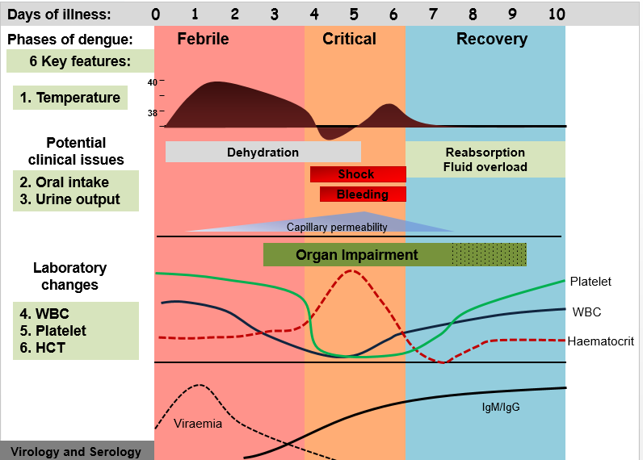
Clinical course:
Dengue fever
Source: WHO

Slide 20
Clinical Staging and Clinical Stages
No authoritative general definition identified through extensive search
This definition is adapted from a number of sources including Staging definitions for conditions such as cancers and other chronic conditions (e.g. heart failure, COPD, behavioural disorders …)
Staging: a model applied to conditions that have a course or pathway of illness (e.g. cancer and other chronic conditions) to determine the extent (stage) that a disease has developed in a patient
Aim is to match the most appropriate intervention to the stage of the illness to ensure safe and best possible outcomes
Ultimate aim is to reduce/slow disease progression

Slide 21
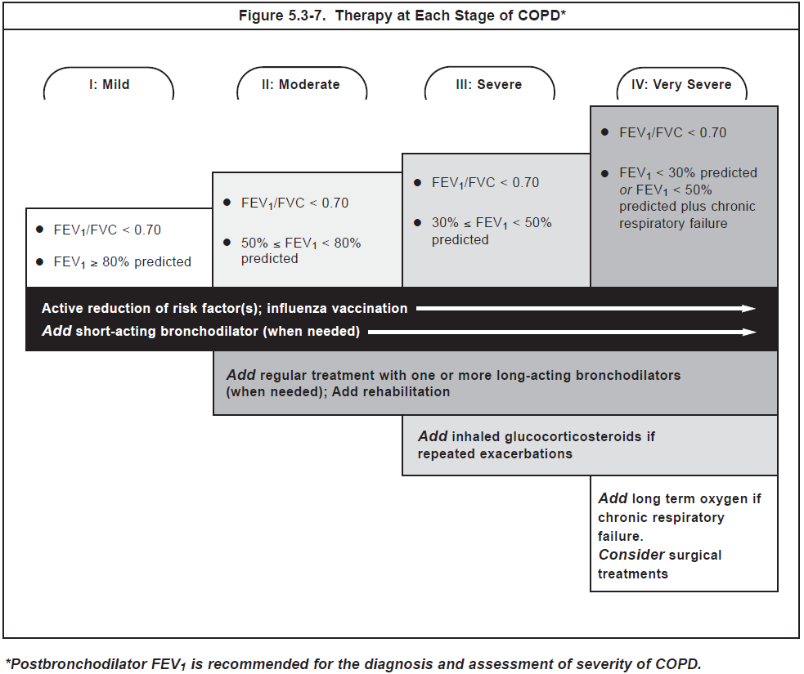
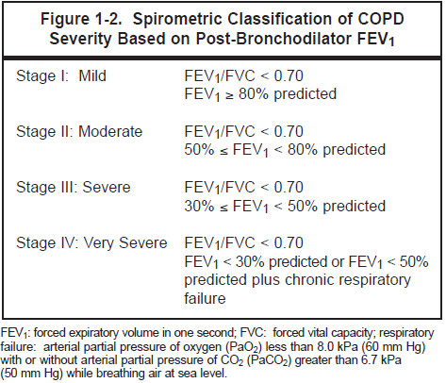
Clinical Stages:
COPD
Source: WHO

Slide 22
Tumours staging and grading
Staging is a way of describing or classifying a cancer based on the extent of cancer in the body. The stage is often based on the size of the tumour, whether the cancer has spread (metastasized) from where it started to other parts of the body and where it has spread.
Grading is a way of classifying cancer cells. The pathologist gives the cancer a grade based on how different they look from normal cells (differentiation), how quickly they are growing and dividing, and how likely they are to spread. Doctors sometimes use the grade of the cancer to figure out how slowly or quickly the cancer may be growing
Source: http://www.cancer.ca/

Slide 23
Tumours staging: TNM System
Cancer Staging: the TNM system:
The T refers to the size and extent of the main tumor. The main tumor is usually
called the primary tumor.
The N refers to the number of nearby lymph nodes that have cancer.
The M refers to whether the cancer has metastasized. This means that the
cancer has spread from the primary tumor to other parts of the body.
Source: NCI

Slide 24
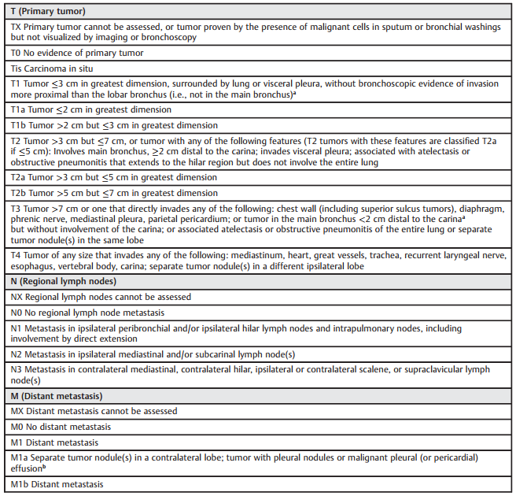
The TNM Staging
Guide
(7th Edition)

Slide 25
Tumour Grading
Tumour Grading systems differ depending on the type of cancer. In general,
Tumours are graded as 1, 2, 3, or 4, depending on the amount of abnormality.
In Grade 1 tumors, the tumor cells and the organization of the tumor tissue
appear close to normal. These tumors tend to grow and spread slowly.
In contrast, the cells and tissue of Grade 3 and Grade 4 tumors do not look like
normal cells and tissue.
Grade 3 and Grade 4 tumors tend to grow rapidly and spread faster than tumors
with a lower grade.
If a grading system for a tumor type is not specified, the following system is
generally used (1*):
GX: Grade cannot be assessed (undetermined grade)
G1: Well differentiated (low grade)
G2: Moderately differentiated (intermediate grade)
G3: Poorly differentiated (high grade)
G4: Undifferentiated (high grade)
Source: www.cancer.gov

Slide 26
Tumour Grading: breast tumours
Breast cancer: the Nottingham grading system is often used (also called the
Elston-Ellis modification of the Scarff-Bloom-Richardson grading system), which
grades breast cancer based on the following features:
Tubule formation: how much of the tumor tissue has normal breast (milk) duct
structures
Nuclear grade: an evaluation of size shape of the nucleus in the tumor cells
Mitotic rate: how many dividing cells are present, which is a measure of how
fast the tumor cells are growing and dividing
Each of the categories gets a score between 1 and 3; a score of “1” means the
cells and tumor tissue look the most like normal cells and tissue, and a score
of “3” means the cells and tissue look the most abnormal. The scores for the
three categories are then added, yielding a total score of 3 to 9.
Three grades are possible:
Total score = 3–5: G1 (Low grade or well differentiated)
Total score = 6–7: G2 (Intermediate grade or moderately differentiated)
Total score = 8–9: G3 (High grade or poorly differentiated)
Source: www.cancer.gov

Slide 27
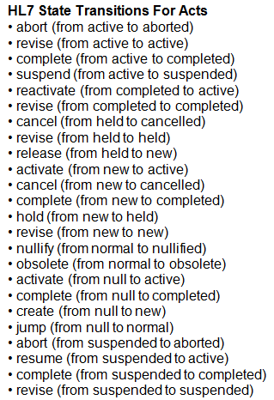
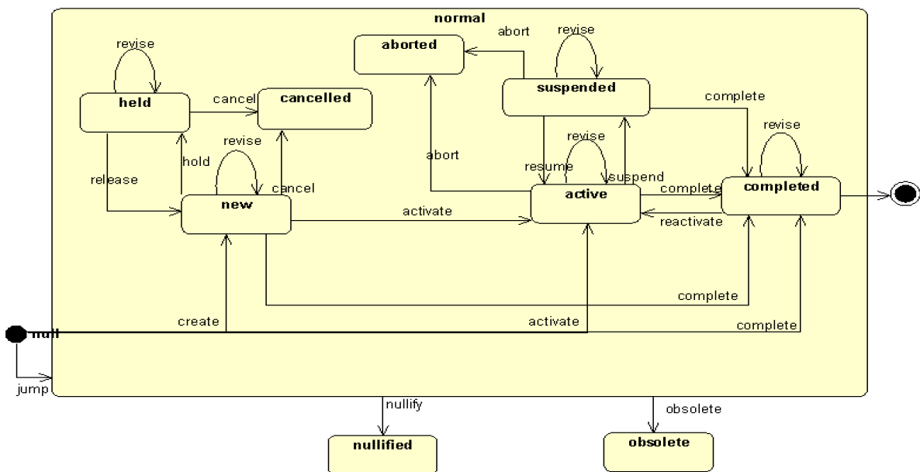
Object/workflow status
Class/Object/ACT states
The behavioral aspect of a class in HL7 is defined in a State Diagram
Interactions between these classes are sometimes motivated by change in the state of a class and may result in the change in the state of another

Slide 28
Class/Object/ACT states
These workflow/object state
transition values are inadequate
and inappropriate for
representing the complex
clinical status

Slide 29
ACT.statusCode
statusCode values represent workflow / object states
Extract from a “Life Cycle and Object State Transition” document published on 4 April 2011:
Under the rules set out in the HL7 RIM, classes have statusCodes, which means that an object (i.e. an instance of a class) may have a defined state
At any time an object with a defined state machine has a specified state drawn from a fixed repertoire of states defined for its class. The state of the object is changed by events that act on the object; each event is drawn from a fixed repertoire of events defined for its class and has an associated rule specifying the new state of the object given the state of the object at the time of the event

Slide 30
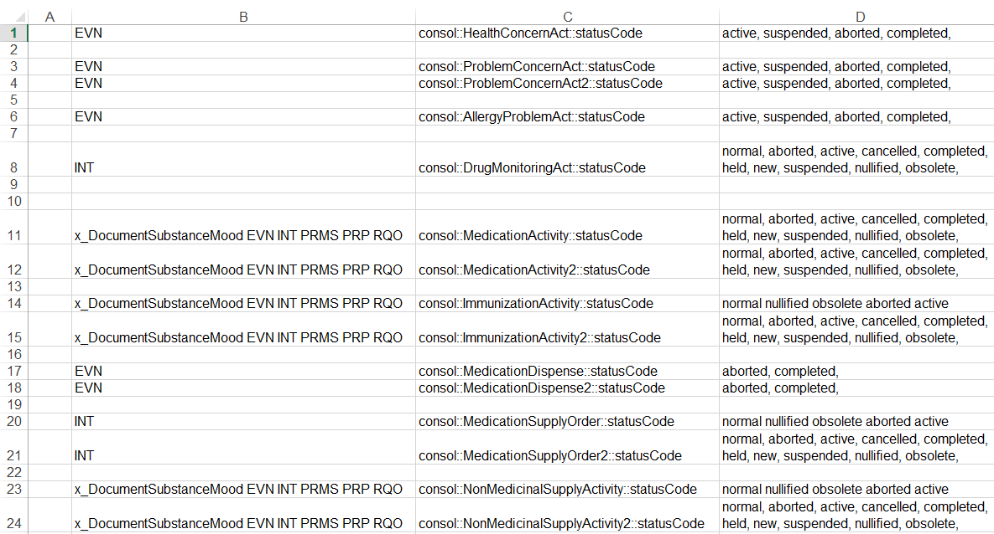
ACT.statusCode

Slide 31
FHIR – ACT/workflow status
(FHIR Build v1.9.0)
Work flow status

Slide 32
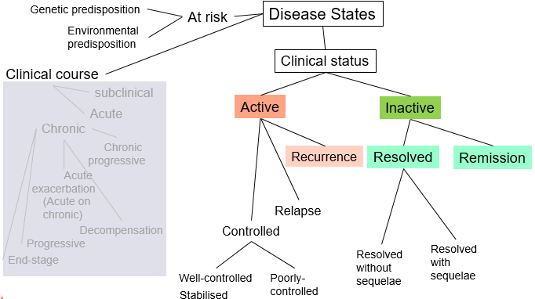
Clinical status vs workflow status
The workflow / object state transition / ACT.statusCode are designed to support workflow use cases
They are inappropriate for representing the complex clinical status and should be treated differently

Slide 33
Further discussions

