Slide 1


Trifolia Workbench
HL7 Release

Slide 2
Trifolia Workbench Goals
Facilitate the authoring and localization of CDA templates
Provide a searchable / browseable repository of CDA templates
Extend the functionality based on the requirements of the HL7 community

Slide 3





Trifolia WorkBench
Consolidation Project Edition, HL7 Release 1
Provide with this release:
  Structured Template Entry Tool
    Enter, review, manage, and localize/update CDA templates
  Template Repository
    Centralized database for template management
  CDA Templates
    Close to 70 (soon to be over 100) clinical templates from the HL7 Consolidation Project at your fingertips
  Publishing Tool
    Share your templates with your organization and the world
  Documentation
  Support
    Limited Support for this software can be obtained by sending an email to tools@lantanagroup.com

Slide 4

Trifolia Workbench Architecture
Repository
Server
Authoring
Client
Publishing
Client

Slide 5
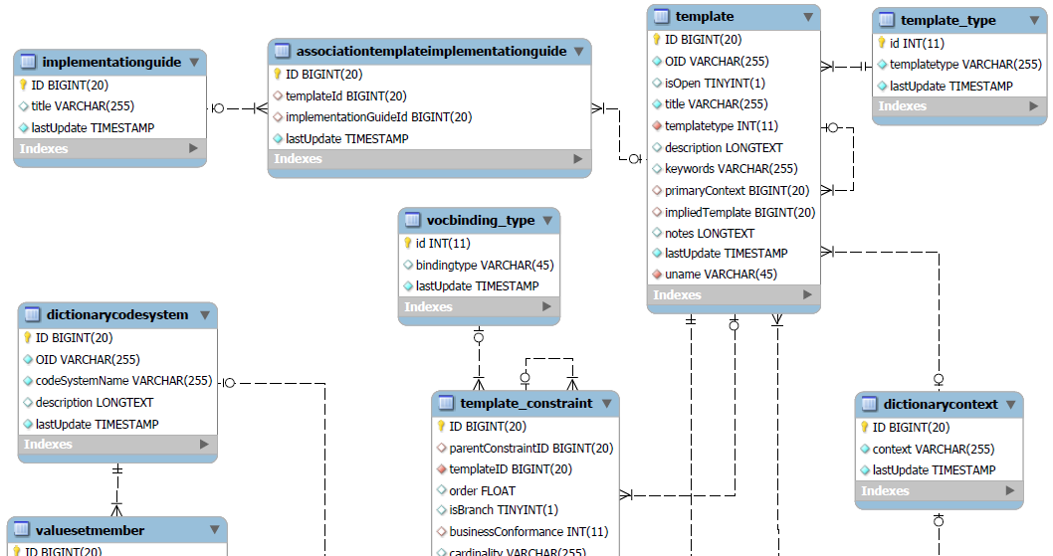
Trifolia Workbench Repository Schema
Notes:
Show full schema picture from PDF.

Slide 6
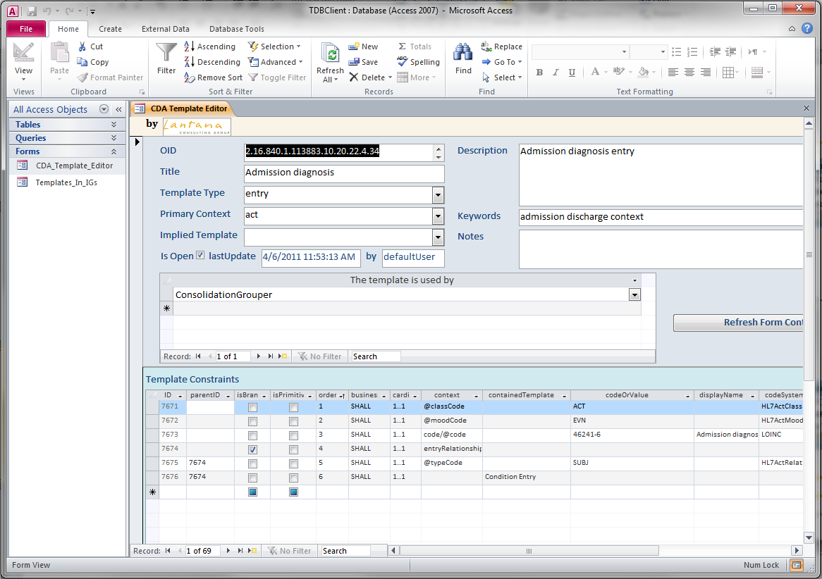
Trifolia Workbench Authoring Client
Notes:
.

Slide 7
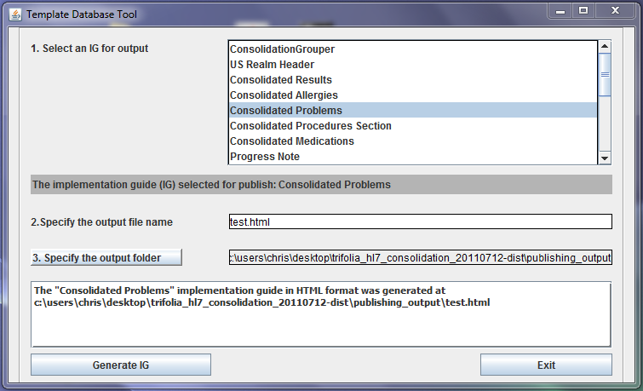
Trifolia Workbench Publishing Client

Slide 8

Trifolia WorkBench
  Add-ins from Lantana Group
    Schematron generation
    greenCDA support under development

Slide 9
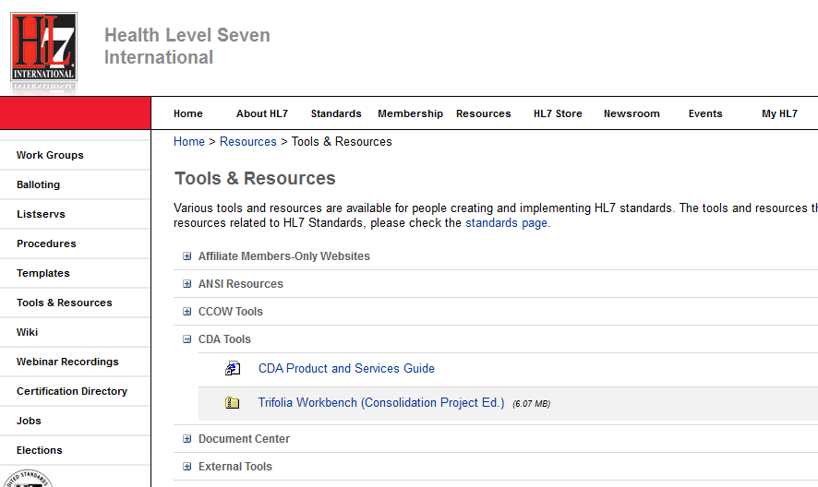
Getting the Software..
http://www.hl7.org/participate/toolsandresources.cfm

Slide 10
Trifolia Workbench
Demonstration

