Slide 1
FHIR Adverse Event Resource
HL7
San Diego WG Meeting
Thursday, Q3
September 14, 2017

Slide 2
Agenda
Review of project to date
Biomedical RR to Patient Care
Issues for discussion
Representation of adverse reaction
FHIR Trackers
Next steps
Project management

Slide 3
HL7 project artifacts
Project Number 1240
FHIR Resource Proposal approved by FHIR Management Group (FMG)
Project artifacts
PC wiki
Meeting minutes and presentations
Use Cases
References

Slide 4
Project Participants
FDA
NIH
AHRQ
Practitioners/Academia
Research
Patient Safety
National Patient Safety Foundation
Pharma
EHR vendors
Informatics Solution Vendors

Slide 5
Standards Reviewed
ICSR
Medwatch 3500 and 3500A
CFSAN CAERS
BRIDG
AHRQ Common Formats

Slide 6
Definitions
The Institute for Healthcare Improvement : Unintended physical injury resulting from or contributed to by medical care (including the absence of indicated medical treatment), that requires additional monitoring, treatment, or hospitalization, or that results in death.
BRIDG: Any unfavorable and unintended sign, symptom, disease, or other medical occurrence with a temporal association with the use of a medical product, procedure or other therapy, or in conjunction with a research study, regardless of causal relationship.

Slide 7
Use Cases (abridged)
Adverse Event
Drug*
Biologic
Device*
Vaccine
Medical Food*
Dietary Supplement*
Herbals
Food
Cosmetics
Reporter variations
Healthcare Reported
Patient Reported
Manufacturer Reported
Veterinary Reported
Supply Chain
Medication Reconciliation*
Product Problem (device)*
Product Quality (office of pharmaceutical quality)
5. Product Use Error
Wrong dose*
Package insert error*
Wrong technique*
Wrong route of administration*
Wrong rate*
Wrong duration*
Wrong time*
Expired drug*
6. Problem with use of Medication from Different Manufacturers
7. Protocol Adverse Event with IND
Serious Adverse Event
Unanticipated Problem* (Consider international terminology)
8. Patient Safety Incident*
9. Patient Safety Near Miss*
10. Patient Safety Unsafe Condition*
* = use case detailed

Slide 8
Reaction
Issue (old FHIR Tracker) (#11021)
Discuss relationship of Adverse Reaction to
Allergy Intolerance
Adverse Event
Currently adverse reaction part of Allergy Intolerance Resource
Options
Add adverse reaction data elements to AE resource
Create separate adverse reaction resource
Have Allergy Intolerance reference AE resource
Use Condition or Observation instead
Outcome - use Condition resource

Slide 9
Causality
Use concept of “Suspect Entity”
Reference other FHIR resources
Substance
Medication
MedicationAdministration
MedicationStatement
Device
Do we need to add others?
Allows for establishing assessment, assessment method and product relatedness

Slide 10
FHIR Trackers
GF#13302 Vocabulary issues with AdverseEvent
GF#13310 Patient medical history
GF#13698 AdverseEvent.suspectedEntity.instance should allow CodeableConcept
Need to add “Reporter” data elements

Slide 11
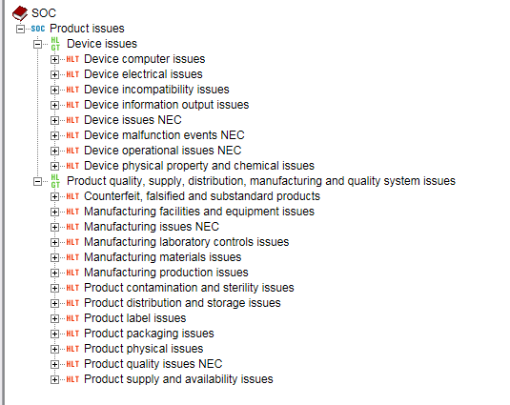
Category Coding – GF #13302
SNOMED CT – no obvious codes
MedDRA

Slide 12
Severity vs. Seriousness
Severity of event - mild/moderate/severe
Serious Adverse Event (SAE) Reporting
The FDA and ICH SAE definition was used in all studies (protocols and case report forms)
An SAE is defined as any adverse drug experience occurring at any dose that results in any of the following outcomes:
Life-threatening
Death
Hospitalization/prolongation of hospitalization
Congenital anomaly
Persistent or significant disability/incapacity
Required intervention to prevent permanent impairment/damage

Slide 13
GF #13310
Mostly resolved – but should medical history be changed to “supporting info”?
GF#13310

Slide 14
SuspectEntity should be a Codeable Concept – GF #13698
Much of the time, suspect products will simply be identified by their codes. It shouldn't be necessary to go to a separate resource to capture these details (and in some cases, systems may not even know if the code is for a device, a drug or some other substance). Having a choice between CodeableConcept|Reference(whatever) as a type is a common convention. So rename to instance[x] and expand the type.

Slide 15
Other Key Concepts
References to other resources to establish medical history
Reference to ResearchStudy for protocol
Note references to AE resource by DetectedIssue

Slide 16
Next Steps
Topic part of Thursday 5 PM ET meetings
Project ownership

