Slide 1
HL7 RDAM Mapping Project #1413
Immunization Pilot Study
Presented at
HL7 Meeting, Baltimore, MD
29 Sep to 5 Aug, 2018
Slides: http://wiki.hl7.org/images/c/cd/-RDAM-Mapping_Immunization-Pilot_Brief_Sep2018.PPTX
White Paper: http://wiki.hl7.org/images/b/bd/-RDAM-Mapping_Immunization-Pilot_White_Paper_Sep2018.docx
Presented by:
Stephen.Hufnagel.HL7@Gmail.com , facilitator
Incorporating Feedback From:
HL7 CIC, PHER, EHR, CQI, CDS, CIMI, STRUCDOC, O&O, M&M, VOCAB, SOA, DevicesOnFHIR WGs & ArB
See Notes Page
Notes:
CHRONOLOGY:
2008 Federal Health Information Models start
2011 Clinical Information Model Initiative (CIMI) start
2016-01-16 CIMI Sponsored HL7 Investigative Study start
The Jan-Sep 2016 CIMI-Sponsored HL7 CIMI-FHIM Integration Investigative-Study includes: The Open Group Healthcare Forum, HL7 CIMI WG, HL7 EHR WG and HL7 CIC WG
2016-03-01 CIMI-FHIM Integration Task Force
2016-08-15 “CIMI-FHIM-SOLOR-CQF Integration” Preliminary Report
2016-08-17/18 Health Interoperability and Exchange Alliance (HIEA) Technical Forum
Health Interoperability and Exchange Alliance (HIEA) Technical Forum
Topic: Information Modeling: Foundation to Semantic Interoperability
C0-Sponsors: ONC OST, FHA, IPO DOD VA
This Health Interoperability and Exchange Alliance (HIEA) Technical Forum on “Information Modeling: Foundation to Semantic Interoperability” event was a key component of a mix of collaborative activities. This event had key stakeholders coming together under the facilitation of the DoD/VA IPO ONC Liaison, Nona Hall, BSN, MA who on behalf of the co-sponsors and through the support of the IPO's HIEA Technical Forum showcased this initiative and results to date.
As we go forward, there is logic to stay connected no matter what current and immediate task we are attending to.
2016-09-07 FHA “CIMI-FHIM-SOLOR-CQF Integration” Report PPT-Brief to FHA Federal Partners
2016-09-15 “CIMI-FHIM-SOLOR-CQF Integration” Final Report
2016-09-17 HL7 Meeting in Baltimore, MD
“CIMI-FHIM-SOLOR-CQF Integration” Report PPT-Brief at HL7
HL7 FY2017 “CIMI-FHIM-SOLOR-CQF Integration” Project Scope Statement (PSS) vetted at HL7

Slide 2
Executive Summary (Status) HL7 Reference Domain Analysis Model (RDAM) Mapping Project Number #1413
This brief is a discussion baseline for the SEP19 HL7 WG meeting.
The RDAM project #1413 is scoped to map the EHR-S FM to FHIM.
For Sep2018, the EHR-S FM immunization profile was mapped to FHIM
demonstrating the mapping process and
producing an object-oriented logical information model (LIM)
The OO LIM is a precursor to a Service Oriented Architecture (SOA) suitable for
federated Healthcare Information Networks (HINs), such as the TEFCA RCE QHINs.
The potential value proposition of CIMI-compliant (FHIM, CQF, CIMI-BMM, SOLOR) SOA is consistency, requirements traceability and improved computable semantic interoperability across HINs.
Notes:
HL7 EHR System Functional Model (EHR-S FM) R2 http://www.hl7.org/implement/standards/product_brief.cfm?product_id=269
Federal Health Information Model (FHIM) Immunization Domain Model http://www.fhims.org/content/_420A62FD03B64295E8200076-content.html
Immunization Functional Profile Mapping Spread Sheet http://wiki.hl7.org/index.php?title=EHR_Immunization_Functional_Profile
Solving the Modeling Dilemma as a Foundation for Interoperability by Berndt Blobel and Frank Oemig, Intl. HL7 Interop Conference (IHIC) 2018 in Portsmouth, UK. https://www.ejbi.org/abstract/solving-the-modeling-dilemma-as-a-foundation-for-interoperability-4614.html
CIMI Detailed Clinical Models https://CIMI.HL7.org
HL7 Knowledge Artefact (KNART) Specification http://wiki.hl7.org/index.php?title=Knowledge_Artifact_Specification
FHIR Immunization Resources https://www.hl7.org/fhir/immunization.html
QI-Core IG http://hl7.org/FHIR/us/qicore/2016Sep/index.html
FHIR Clinical Reasoning Module http://www.hl7.org/fhir/clinicalreasoning-module.html http://wiki.hl7.org/index.php?title=Clinical_Reasoning_Module
HL7 May 2018 Newsletter Article http://www.hl7.org/documentcenter/public/newsletters/HL7_NEWS_20180523.pdf

Slide 3
Executive Summary (Lessons Learned) HL7 Reference Domain Analysis Model (RDAM) Mapping Project Number #1413
The RDAM project fits within the emerging CIMI methodology's "happy path"; where the CIMI value proposition is consistency and requirements traceability across implementations.
Based on recent WG peer review feedback, a conclusion section was added. It presents the pragmatic "Interoperability Conundrum" lesson learned of immutable inconsistencies across standards; where, data (granularity, pre/post coordination, types, value/code sets, metadata) variations negatively impact Healthcare IT value (patient safety, care quality, cost).
SOLOR has the potential to improve this situation.
Notes:
HL7 EHR System Functional Model (EHR-S FM) R2 http://www.hl7.org/implement/standards/product_brief.cfm?product_id=269
Federal Health Information Model (FHIM) Immunization Domain Model http://www.fhims.org/content/_420A62FD03B64295E8200076-content.html
Immunization Functional Profile Mapping Spread Sheet http://wiki.hl7.org/index.php?title=EHR_Immunization_Functional_Profile
Solving the Modeling Dilemma as a Foundation for Interoperability by Berndt Blobel and Frank Oemig, Intl. HL7 Interop Conference (IHIC) 2018 in Portsmouth, UK. https://www.ejbi.org/abstract/solving-the-modeling-dilemma-as-a-foundation-for-interoperability-4614.html
CIMI Detailed Clinical Models https://CIMI.HL7.org
HL7 Knowledge Artefact (KNART) Specification http://wiki.hl7.org/index.php?title=Knowledge_Artifact_Specification
FHIR Immunization Resources https://www.hl7.org/fhir/immunization.html
QI-Core IG http://hl7.org/FHIR/us/qicore/2016Sep/index.html
FHIR Clinical Reasoning Module http://www.hl7.org/fhir/clinicalreasoning-module.html http://wiki.hl7.org/index.php?title=Clinical_Reasoning_Module
HL7 May 2018 Newsletter Article http://www.hl7.org/documentcenter/public/newsletters/HL7_NEWS_20180523.pdf

Slide 4
Executive Summary (Recommendations) HL7 Reference Domain Analysis Model (RDAM) Mapping Project Number #1413
The recommended HL7 Sep18 WG discussion questions are:
How do we operationalize the emerging CIMI-compliant (strategy, technologies, methodology, tools, value proposition) to meet "CIMI's mission to improve the interoperability of healthcare systems through shared implementable clinical information models.
(A single curated collection.)"? …
Currently, a CIMI-compliance tooling oxymoron, e.g., CIMI-compliant DCMs, CQMs and KNARTS mapped to FHIR, C-CDA and V2 compliant implementation guides, using non-bidirectional mappings.
Considering the interoperability conundrum, what CIMI-BMM modifications are sufficient for efficient and effective CIMI-compliant tooling to generate semantically interoperable V2, FHIR, C-CDA, NIEM, etc.?
Notes:
HL7 EHR System Functional Model (EHR-S FM) R2 http://www.hl7.org/implement/standards/product_brief.cfm?product_id=269
Federal Health Information Model (FHIM) Immunization Domain Model http://www.fhims.org/content/_420A62FD03B64295E8200076-content.html
Immunization Functional Profile Mapping Spread Sheet http://wiki.hl7.org/index.php?title=EHR_Immunization_Functional_Profile
Solving the Modeling Dilemma as a Foundation for Interoperability by Berndt Blobel and Frank Oemig, Intl. HL7 Interop Conference (IHIC) 2018 in Portsmouth, UK. https://www.ejbi.org/abstract/solving-the-modeling-dilemma-as-a-foundation-for-interoperability-4614.html
CIMI Detailed Clinical Models https://CIMI.HL7.org
HL7 Knowledge Artefact (KNART) Specification http://wiki.hl7.org/index.php?title=Knowledge_Artifact_Specification
FHIR Immunization Resources https://www.hl7.org/fhir/immunization.html
QI-Core IG http://hl7.org/FHIR/us/qicore/2016Sep/index.html
FHIR Clinical Reasoning Module http://www.hl7.org/fhir/clinicalreasoning-module.html http://wiki.hl7.org/index.php?title=Clinical_Reasoning_Module
HL7 May 2018 Newsletter Article http://www.hl7.org/documentcenter/public/newsletters/HL7_NEWS_20180523.pdf

Slide 5
Executive Summary (CIMI Models)
CIMI-compliant (FHIM, QUICK, CIMI BMM, SOLOR, EHR-S FM) are built on a standards foundation.
CIMI BMM is based on ISO 13606 and
SOLOR is a SNOMED extension including LOINC and RxNorm using EL++ descriptive logic.
QI Core / QUICK data model and unified FHIR Clinical Reasoning module (CQL (Clinical Quality Language), CQF (Clinical Quality Framework), CDS Hooks) are FHIR Standards for Trial Use (STU3 and STU4) Implementation Guides.
The FHIR Clinical Reasoning module provides resources and operations to enable the representation, distribution, and evaluation of clinical knowledge artifacts (KNARTs) such as clinical decision support rules, quality measures, order sets, and protocols. In addition, the reasoning module describes how expression languages can be used throughout the specification to provide dynamic capabilities.
FHIM has over 10 years of clinical input and standards alignment; but, has not been balloted by HL7.
EHR-S FM R2 is a normative HL7 and ISO standard.

Slide 6
Executive Summary (Proposed Next Steps)
Assuming HL7 TSC and HHS ONC concurrence, the RDAM Mapping next-step plan includes extending the immunization pilot study to a full software development lifecycle immunization demonstration using CIMI-compliant model driven development tools:
1) FHIM mapped EHR-S FM defined requirements use-case scenario events-context defined within the CIMI-FSD tool stack,
2) Quality Improvement and Clinical Knowledge (QUICK) data model,
3) immunization DAM and RDAM review, update and harmonization by PHER clinical workgroup,
4) DCMs, KNARTs and CQMs expressed as FSDs plus
5) CIMI-compliant V2, C-CDA and FHIR profile and extension generation.
These next-step tasks support care team (immunization screening, reporting, care delivery and follow-up) and transfers-of-care use-case scenarios.

Slide 7
Goal
Our goal is “to help people live the healthiest lives possible” by enabling a “Learning Healthcare System” supporting areas such as, but not limited to, Precision Medicine.”
This requires data that is computable, usable and interpretable across disparate systems.
Our current-state is unable to deliver on this goal; however, there is a solution.
We have made significant inroad with the exchange of data and standards and their adoption; but, we must return our focus on the data to make additional advancements.

Slide 8
IT Objective
Our IT objective is to make the appropriate data available when it is needed, where it needed and how it is needed. We plan to integrate existing models, with semantically-consistent computable-data, including provenance data (who, what, when, where, why, how) across different platforms, e.g., population health, Clinical Decision support, EHR patient documentation systems, etc. using tooling to generate various implementation styles, including HL7 Fast Healthcare Interoperable Resources (FHIR).
Notes:
Our clinical goal is “to help people live the healthiest lives possible.” Our technical goal is to enable “Learning Healthcare Systems” supporting areas such as, but not limited to, Precision Medicine.”
These goals require data that is computable, usable and interpretable across disparate systems.
Our current-state is unable to deliver these goals; however, there is a solution.
Our IT objective is to make the appropriate data available when it is needed, where it needed and how it is needed. We plan to integrate existing models, with semantically-consistent computable-data, including provenance data (who, what, when, where, why, how) across different platforms, e.g., population health, Clinical Decision support, EHR patient documentation systems, etc. using tooling to generate various implementation styles, including HL7 Fast Healthcare Interoperable Resources (FHIR).
Our goal is “To help people live the healthiest lives possible;” where, the foundation of a Learning Healthcare System is accurate, computable, data starting with the integration of CIMI, FHIM, SOLOR, CQF, DAF and other Information Models into a widely used HL7/ISO standard ^{[Stan Huff]} engaging specifically to bolster FHIR Profiles

Slide 9
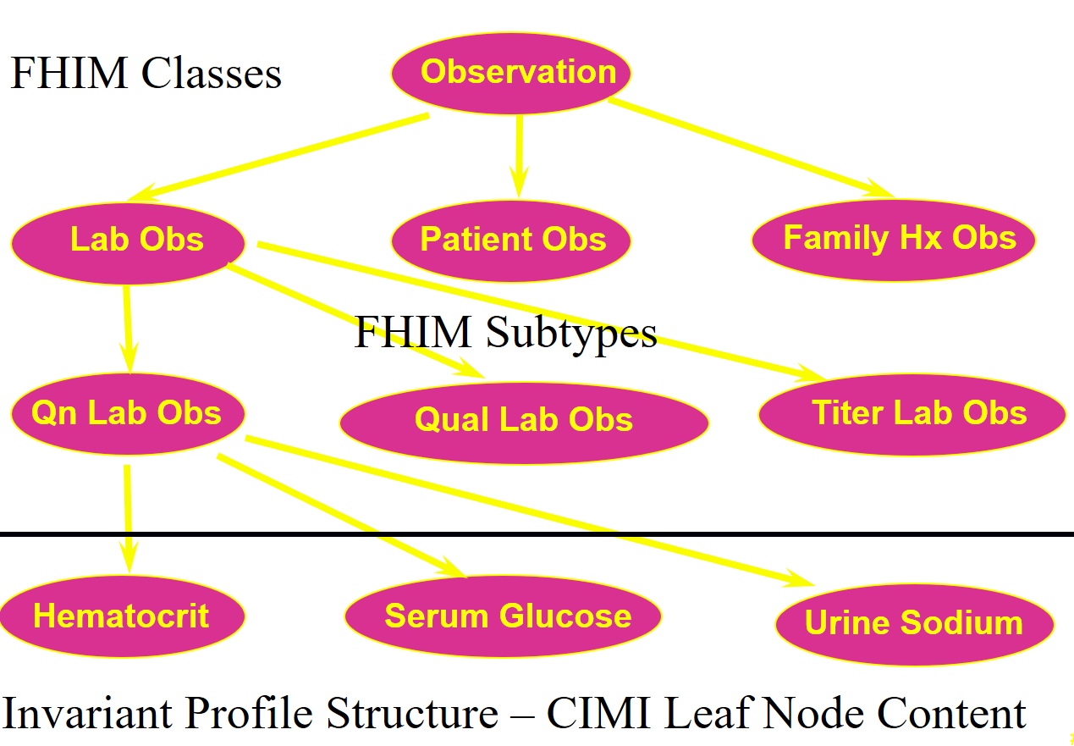
Clinical Example CIMI-FHIM Integration
CQF Knowledge Artifacts
SOLOR Terminology
FHIM Classes
CIMI DCMS

Slide 10
Proposed Solution Integrated Model Stack - Each Plays a Role
KNART
KNART
KNART
DCM
DCM
DCM
DCM
DCM
CQI
C QF
CDS
DCM
DCM
Other
Initiatives
DCM
CIMI
FHIM
DCM
DCM
DCM - Detailed Clinical Models
FHIM – Federal Health Information Model
KNARTS – Knowledge Artifact
SOLOR – SNOMED, LOINC, RxNorm
SOLOR
See Notes Page
Notes:
As shown in this slide, each model contributes to an Integrated Model Stack, the proposed operational architecture involves the definition of clinical knowledge in the form of formally modeled information artifacts that could be used in compose-able health records, care plans and other shared clinical data. As represented in this slide, the combination of SOLOR, FHIM, CIMI DCMs and CQF KNARTs while complementary fulfill a different information modeling contribution.
SOLOR is SNOMED with extensions for LOINC and RXNorm.
FHIM is Federal Health Information Model
CIMI DCMs is Clinical Information Model Initiative Detailed Clinical Model
CQF KNARTs is Clinical Quality Framework Knowledge Artefacts

Slide 11
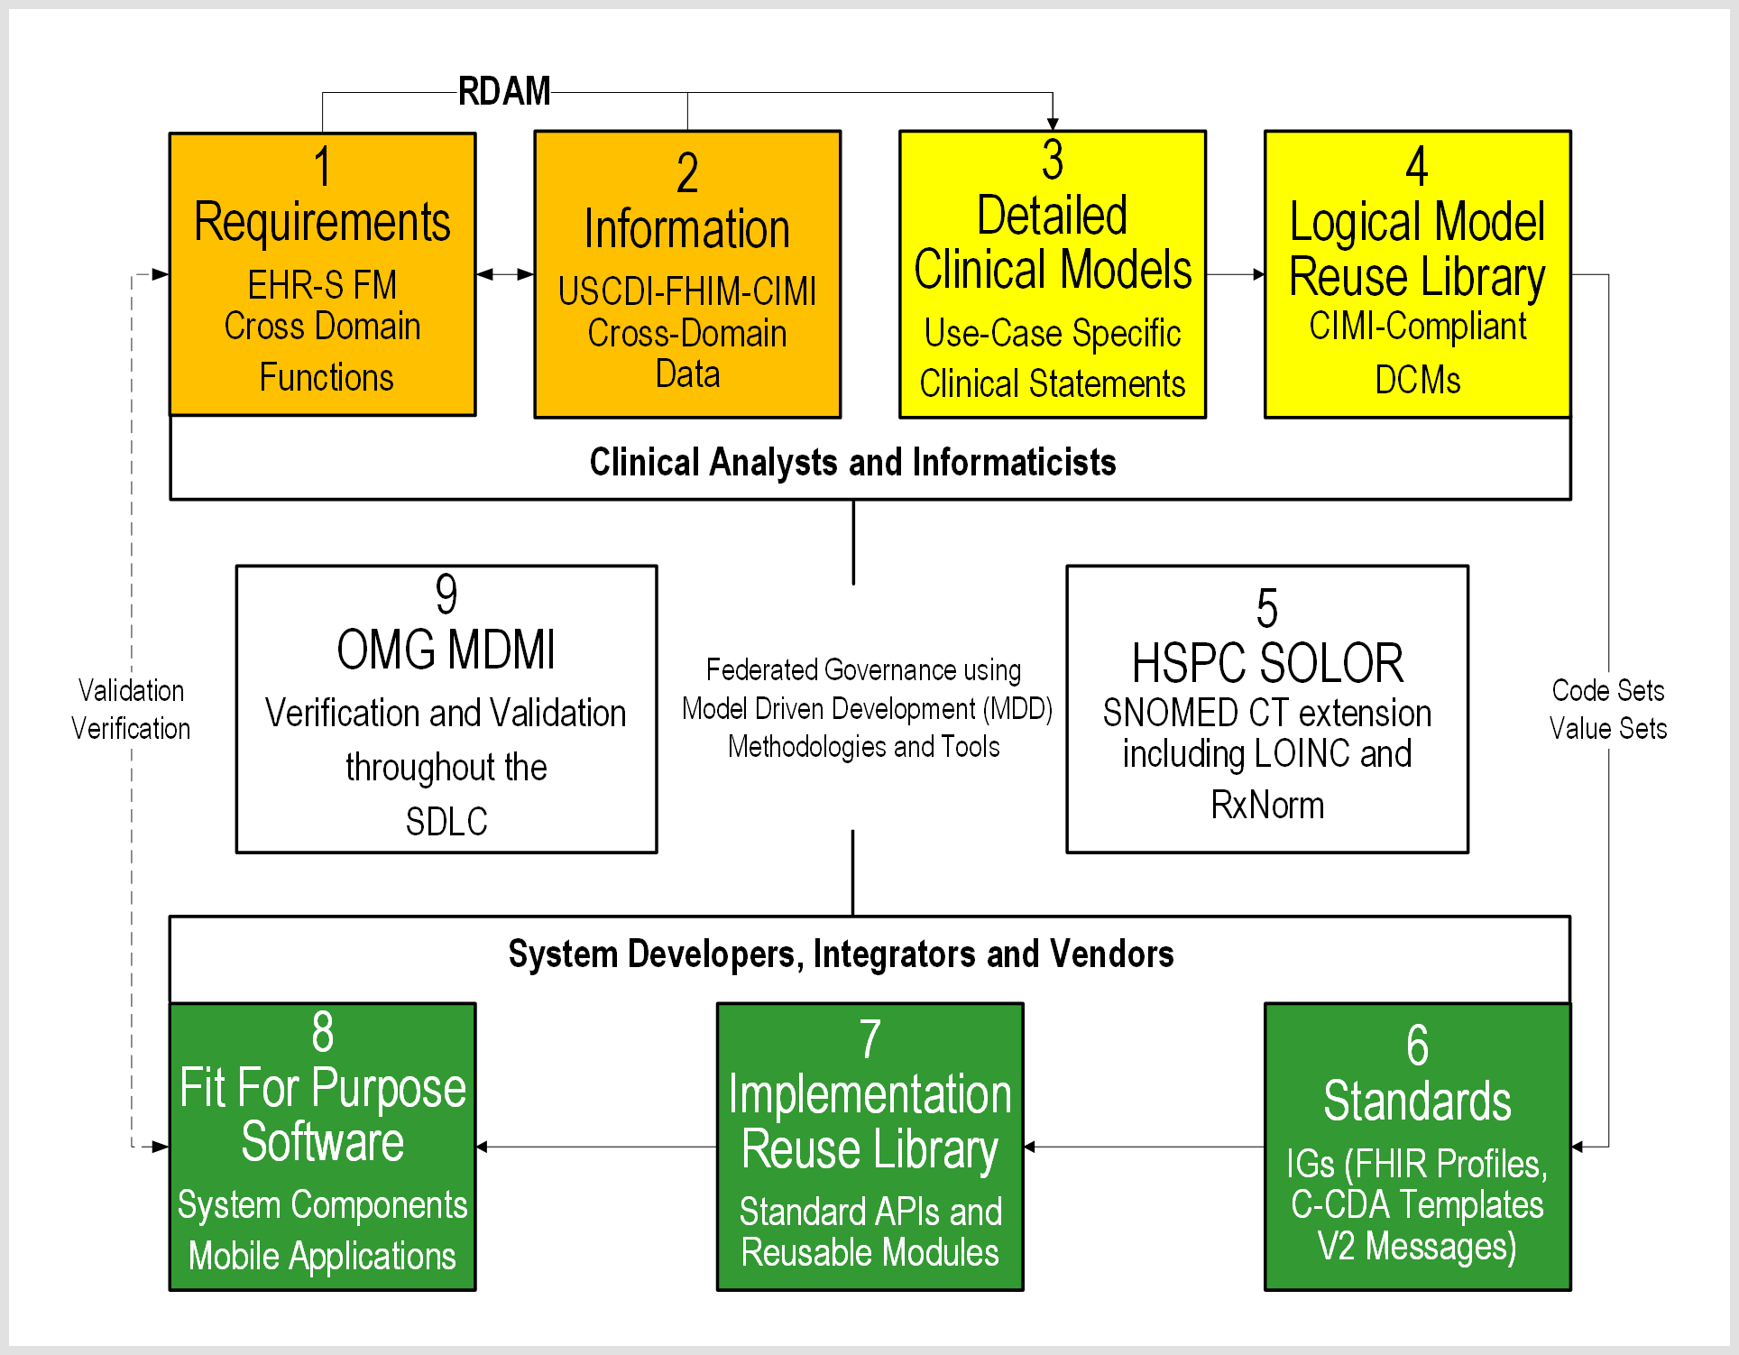
RDAM (FHIM-CIMI-SOLOR, EHR-S FM) STRATEGY AND VALUE PROPOSITION
See Notes Page
Notes:
As shown in this slide, each model contributes to an Integrated Model Stack, the proposed operational architecture involves the definition of clinical knowledge in the form of formally modeled information artifacts that could be used in compose-able health records, care plans and other shared clinical data. As represented in this slide, the combination of SOLOR, FHIM, CIMI DCMs and CQF KNARTs while complementary fulfill a different information modeling contribution.
SOLOR is SNOMED with extensions for LOINC and RXNorm.
FHIM is Federal Health Information Model
CIMI DCMs is Clinical Information Model Initiative Detailed Clinical Model
CQF KNARTs is Clinical Quality Framework Knowledge Artefacts

Slide 12
RDAM (FHIM-CIMI-SOLOR, EHR-S FM) STRATEGY AND VALUE PROPOSITION
See Notes Page
Notes:
As shown in this slide, each model contributes to an Integrated Model Stack, the proposed operational architecture involves the definition of clinical knowledge in the form of formally modeled information artifacts that could be used in compose-able health records, care plans and other shared clinical data. As represented in this slide, the combination of SOLOR, FHIM, CIMI DCMs and CQF KNARTs while complementary fulfill a different information modeling contribution.
SOLOR is SNOMED with extensions for LOINC and RXNorm.
FHIM is Federal Health Information Model
CIMI DCMs is Clinical Information Model Initiative Detailed Clinical Model
CQF KNARTs is Clinical Quality Framework Knowledge Artefacts

Slide 13
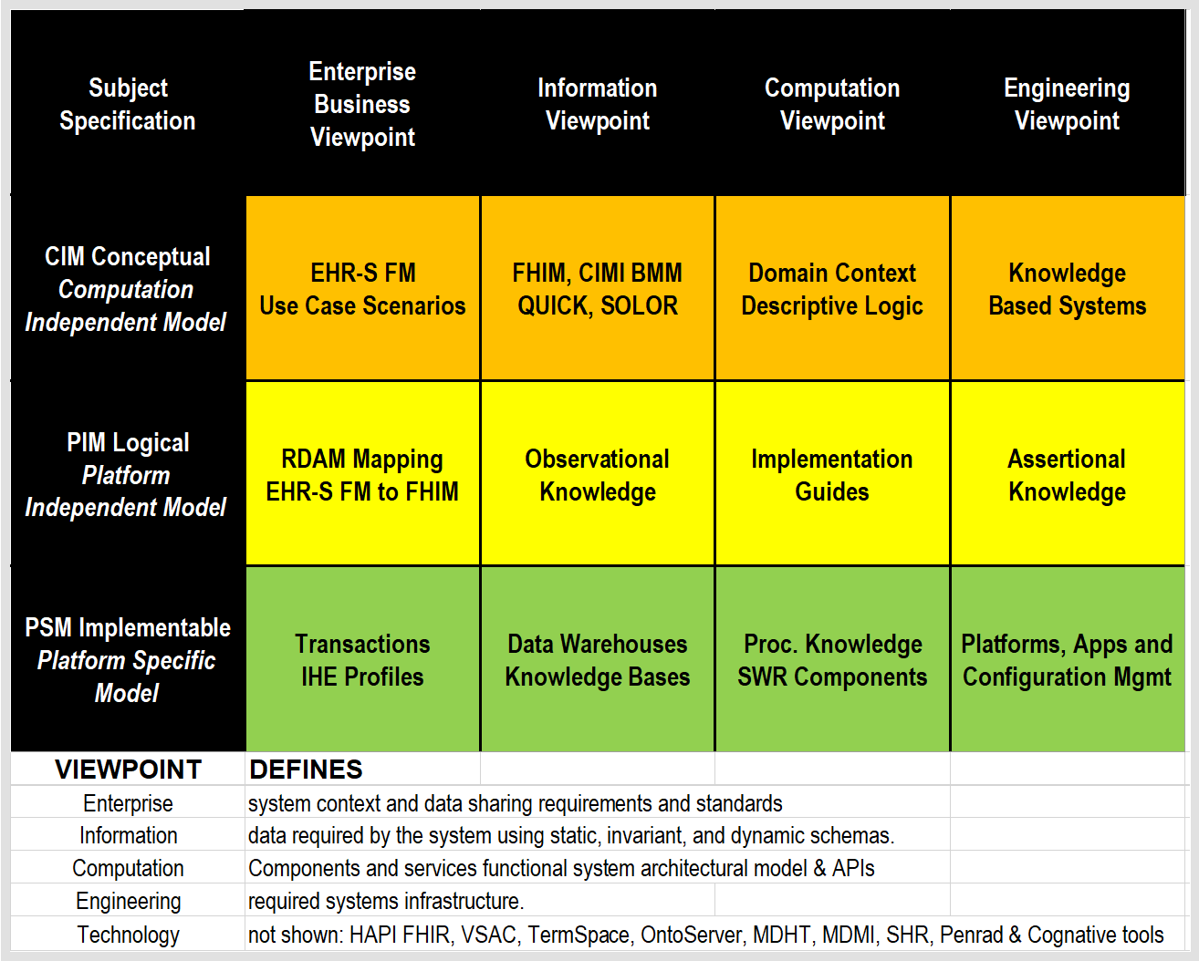
HL7 SAIF ECCF for RDAM (SOLOR, FHIM, CIMI, EHR-S FM)
See Notes Page
Notes:
As shown in this slide, each model contributes to an Integrated Model Stack, the proposed operational architecture involves the definition of clinical knowledge in the form of formally modeled information artifacts that could be used in compose-able health records, care plans and other shared clinical data. As represented in this slide, the combination of SOLOR, FHIM, CIMI DCMs and CQF KNARTs while complementary fulfill a different information modeling contribution.
SOLOR is SNOMED with extensions for LOINC and RXNorm.
FHIM is Federal Health Information Model
CIMI DCMs is Clinical Information Model Initiative Detailed Clinical Model
CQF KNARTs is Clinical Quality Framework Knowledge Artefacts

Slide 14
REFERENCES
HL7 EHR System Functional Model (EHR-S FM) R2 http://www.hl7.org/implement/standards/product_brief.cfm?product_id=269
Federal Health Information Model (FHIM) Immunization Domain Model http://www.fhims.org/content/_420A62FD03B64295E8200076-content.html
Immunization Functional Profile Mapping Spread Sheet http://wiki.hl7.org/index.php?title=EHR_Immunization_Functional_Profile
Solving the Modeling Dilemma as a Foundation for Interoperability by Berndt Blobel and Frank Oemig, Intl. HL7 Interop Conference (IHIC) 2018 in Portsmouth, UK. https://www.ejbi.org/abstract/solving-the-modeling-dilemma-as-a-foundation-for-interoperability-4614.html
CIMI Detailed Clinical Models https://CIMI.HL7.org
FHIR Immunization Resources https://www.hl7.org/fhir/immunization.html
HL7 May 2018 Newsletter Article http://www.hl7.org/documentcenter/public/newsletters/HL7_NEWS_20180523.pdf
QI-Core IG http://hl7.org/FHIR/us/qicore/2016Sep/index.html

