Slide 1
Introduction to the Common REMS Platform
Adam Kroetsch
FDA | CDER
March 1, 2017

Slide 2
What are REMS?
REMS are programs designed to help ensure that drugs with serious risks are used safely
REMS with Elements to Assure Safe Use (ETASU) place certain requirements on healthcare providers and patients to make sure the drug is used safely.
A number of parties play a role in REMS design and implementation:
Document & Design
Review & Approve
Implement
Adopt
Assess
Review & Modify
Sponsor
FDA
Sponsor
Distributors
Dispensers
Institutions
Prescribers
Patients
Sponsor
FDA

Slide 3
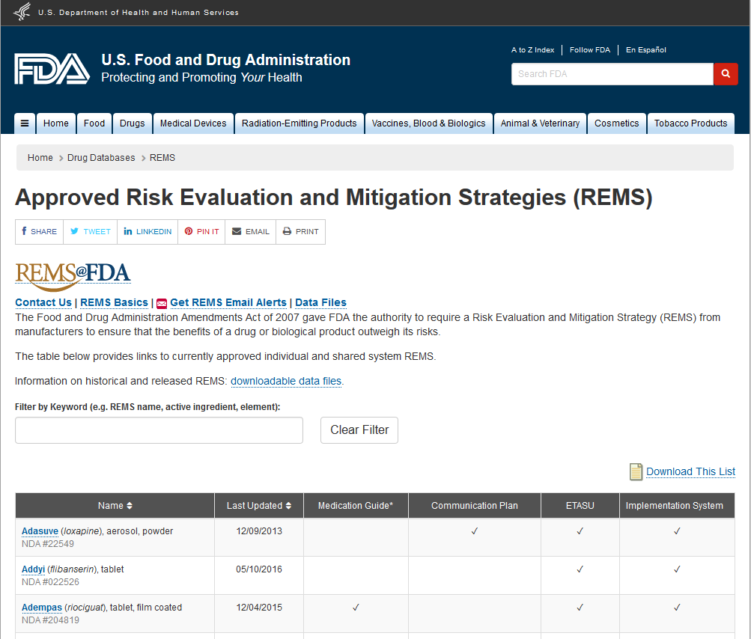
Approved REMS
As of August 2016, there were 75 approved REMS, which addressed 150+ distinct applications.
42 of those 75 REMS have ETASU.
Source: REMS@FDA http://www.accessdata.fda.gov/scripts/cder/rems/index.cfm

Slide 4
REMS tend to work similarly
Prescribers must:
Complete training.
Complete an enrollment form, thereby becoming “certified” to prescribe.
Counsel and educate patients.
Make sure patients agree to participate in the REMS and enroll them if necessary.
Assess or monitor patients to make sure “safe use conditions” are present
Dispensers must:
Complete training.
Complete an enrollment from, thereby becoming “certified” to dispense.
Before dispensing, check that “safe use conditions” have been met: e.g., that the prescriber is certified, the patient is enrolled and that any necessary monitoring has been completed.
Distributors must:
Check to make sure dispensers are “certified to dispense” before shipping the drug.

Slide 5
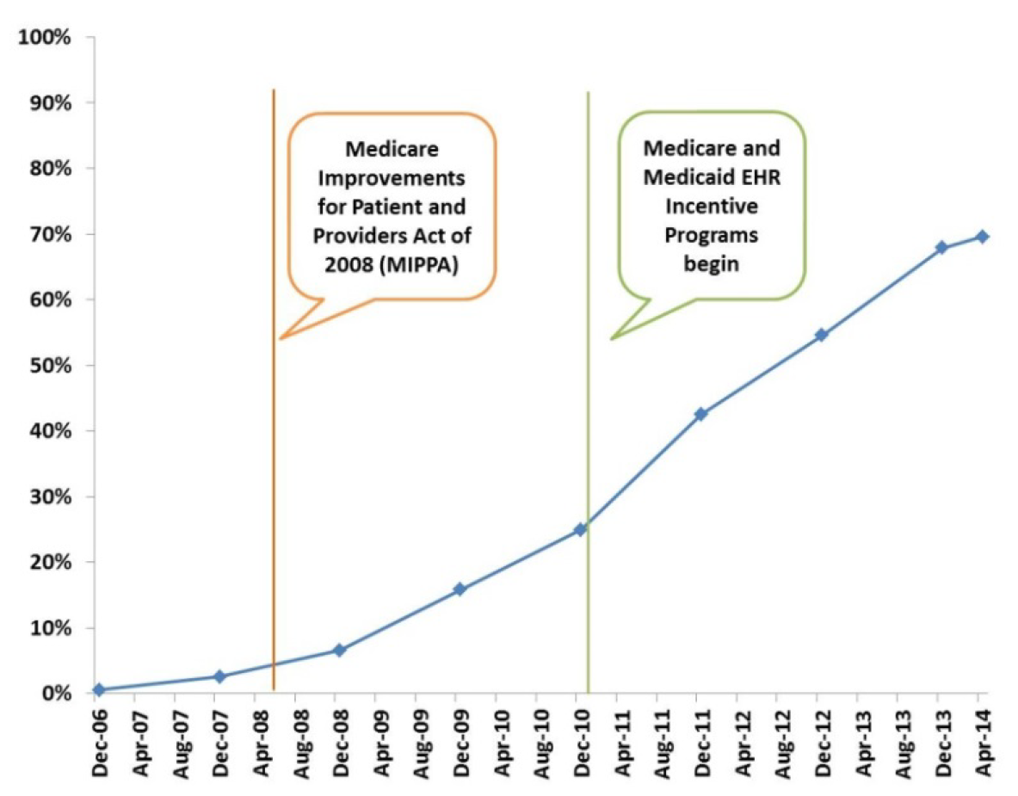
Most REMS have not leveraged health data standards
Percent of physicians e-prescribing using an EHR
First REMS was approved in 2008, when less than 10% of prescribers were e-prescribing (now 70% do so)
Source: E-Prescribing Trends in the United States. Office of the National Coordinator for Health Information Technology (ONC). July 2014. Retrieved from http://www.healthit.gov/sites/default/files/oncdatabriefe-prescribingincreases2014.pdf

Slide 6
REMS have started to use standards
The pharmacist enters claim information into their computer as normal.
The pharmacy system sends this claim to a “switch” who, instead of sending the claim to the insurer, first sends relevant REMS information to a “REMS Administrator”
If safe use conditions are in place, the claim moves on to the insurer. Otherwise, the pharmacist receives an error message

Slide 7
ePrescribing standards
NCPDP has also worked integrate REMS checks into ePrescribing and EHRs to help document safe use conditions.
The system leverages NCPDP’s SCRIPT standard, used for ePrescribing and electronic prior authorization.
The system allows REMS administrators to present prescribers with a “question set” similar to those used in prior authorization.
Prior Authorization Question for Transmucosal Immediate Release Fentanyl (TIRF):
TIRF REMS Patient-Prescriber Agreement Form:

Slide 8
Current Challenges
There has been a great deal of progress in the development and adoption of standards in REMS, but challenges remain…
Many REMS activities and healthcare settings are not addressed by the existing standards
Most REMS have not yet adopted the standards that have been created.

Slide 9
What is the Common REMS Platform?
The platform is really just two things:
A catalog, maintained by FDA, of electronic data standards by which REMS can operate and communicate
A process (both internal and external) for creating or updating standards and having them added to this catalog

Slide 10
The REMS Platform leverages SPL to provide REMS information
SPL data is transmitted from the sponsor to patients, healthcare providers, and the public

Slide 11
Common REMS Platform Vision
SPL can provide the “triggers” needed for health IT systems to send standardized REMS transactions as part of the Common REMS Platform

Slide 12
REMS Platform Process
I. Standards Development
II. Standards Acceptance
III. Standards Adoption
Identify standardization needs and develop use cases
Work with SDOs to develop standards and pilot them
Review developed standards
Add standards to Platform Standards Catalog and SPL Implementation Guide
Develop instructions for integrating standards into REMS
Identify REMS to which the standards apply
Encourage REMS to adopt platform standards

Slide 13
Timeline of Activities
2012: FDA commits to standardizing REMS to reduce their burden on the healthcare delivery system
October 2015: Common REMS Platform Initiative first announced at FDA Public Meeting
June 2016: Duke meeting on “Building a Common REMS Platform”
~May 2017: REMS Platform Standards Needs Assessment to be released

Slide 14
FDA is exploring standards in the following areas
Certification (of HCP)
Complete HCP REMS Acknowledgments and Agreements for Certification
Participate in Training Session
Complete Knowledge Assessment
Enroll in the REMS
Initiation of Treatment
Complete HCP REMS Acknowledgments and Agreements for Initiation of Treatment
Complete Patient REMS Acknowledgments and Agreements for Initiation of Treatment
Screen Patient
Enroll Patient in REMS
During Treatment
Monitor Patient Condition or Health Status
Verify Safe Use Conditions When Prescribing
Obtain REMS Dispensing Authorization
Report Adverse Events

