Slide 1
CIMI/PC: Skin assessment Agenda 12 Sep 2017 (Tue Q1)
CIMI ballot postponed
January target for full skin assessment domain
Revising LOINC panel
Revise DAM?
Requirements spreadsheet under review
Terminology authoring in process
SOLOR / TermSpace demonstration
Granularity issue; “use cases” in process
Process & methodology: Wednesday Q2 @ CIC
Semantic assumptions: Wednesday Q3 @ CIMI

Slide 2
Archetype Graph

Slide 3
Current bindings
Bindings for value sets (range)
Bindings for model semantics (domain)

Slide 4
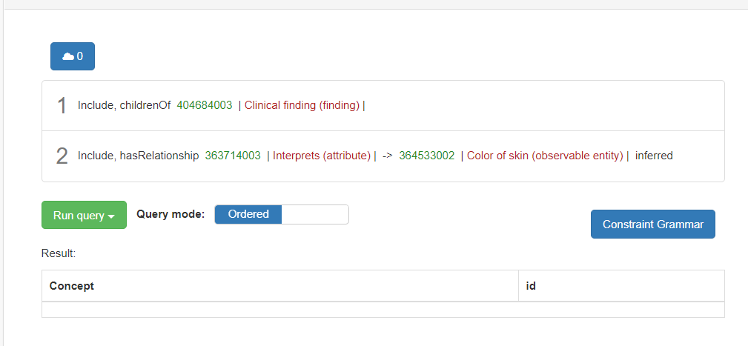
Skin color range 1

Slide 5
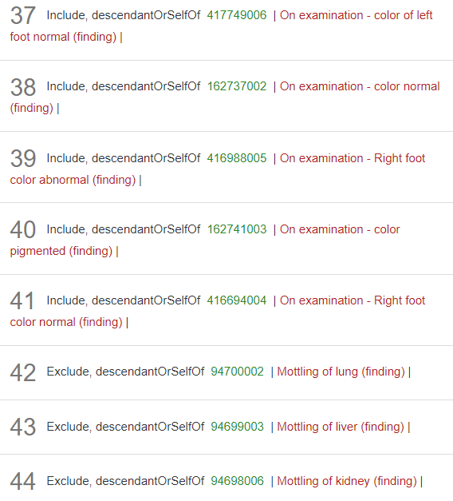
Skin color range 2

Slide 6
Data Quality Issue: Equivalence depends on definition
246090004 |Associated finding (attribute)| =
304229000 |Blue skin (finding)|
246090004 |Associated finding (attribute)| =
404684003 |Clinical finding (finding)|:
363714003 |Interprets (attribute)| = 364533002 |Color of skin (observable entity)|,
280452008 |Interpretation (attribute)| = 405738005 |Blue color (qualifier value)|
<<< 3253007 |Discoloration of skin (finding)| : 363714003 |Interprets (attribute)| = 364533002 |Color of skin (observable entity)|, 363714003 |Interprets (attribute)| = 386053000 |Evaluation procedure (procedure)|, 363698007 |Finding site (attribute)| = 39937001 |Skin structure (body structure)|
Notes:
Presence of sufficient definition
Sufficiency of binary form
Enforcement of use of selected concept (38 ways to say ‘blue skin’)
Residual semantics of unanticipated use cases

