Slide 1
HL7 Nutrition on FHIR – Call Agenda October 31, 2017
Agenda Review
Minutes Review – 10/17/ 2017
FHIR Resource to propose Patient Care – “NutritionIntake”
Nutritional Intake New Resource Proposal Gap Analysis – (Requested by PC)
Request for gap analysis with Observation (why it cannot be used), is it different from a questionnaire? I/O’s (intake/output) came up (but we don’t really have the output piece like is typical with nursing fluid intakes)
Discuss document sent in by Paul Adams (CBORD) on the above.
Other (?)

Slide 2
Challenges with Using Observation for Tray Intake/Meal Intake
Issue is having many foods with many nutrients: need query to get entire set in one “chunk”
Lunch (date) – [tray]
Delivery date/time (derive when they ate this – between 11 AM and Noon)
(glycemic control needs this graphed across the day/week/month and mapped to the insulin/medication administration)
Planned or Consumed (estimated intake)
Food 1 (unit) – Milk, Skim
Qty 8 fl oz
% consumed – 50%
Nutrient 1 (value - unit), e.g., Calories (kcal)
Nutrient 2 (value – unit)
Many more . . .
Food 2 (unit)
Qty consumed
Nutrient 1 (value - unit)
Food 3
Qty consumed
Nutrient 1 (value - unit)
The primary problem with the observation resource we were trying to use was the issue of having many foods with many nutrients and nutrient values for a tray intake observation - the observation seemed to be the tray, and bundling all the foods seemed to complicate the case.
Observation has a lot of stuff flowing through it only separated by category
to be more reusable like for NCP components, a matter of how the data is flowing thru it e.g. Menus/Intake – need to separate out by category to use it)
Data modeling/conceptual differences (Paul/Karen)
Duplication of data across multiple observations (something that groups for the pertinent event), could lead to errors in query – having to build semantics into the query

Slide 3
Future Timeline
What do we need for Nutrition overall for future?
Are there designs that can allow for reuse for other nutrition concepts in the future (then profile it)?
Menu (FHIR profile)
Tray Intake
Formula Administration (enteral/parenteral?)
NCP – Nutrition Dx or nutrition Inventions (non-food related) e.g. education/counseling
What about assessment? (e.g. Clinical Impression)
FHIR Ballot Timelines ? (may ballot)
Selected resources will go normative (not all resources will be normative at same time)

Slide 4
Agenda
Develop Use Cases for food/meal intake data (to map in FHIR) that represent actual intake or recorded food consumed by meal, by date/time with a list of food/beverage items, portion /unit of measure and quantity, % meal consumed (e.g., typical nursing I/O flow sheet data (?), associated nutrients (item detail and/or summary), etc.
Meal (breakfast, lunch, dinner, btw meal snack) – event timing or just a date/time consumed or both
May need preparation techniques (depends on the source of this data)
Referenced nutrient composition source item (USDA, INFOODS, Other)

Slide 5
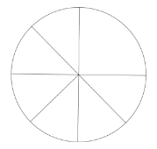
Diet in FHIR
&
CrowdHEALTH project
Conference call – May 10th, 2017
Matteo Melideo, Francesco Torelli, Fabio Melillo, Roberto Pratola, Antonio De Nigro R&D Laboratory, Engineering I.I.
www.eng.it

Slide 6
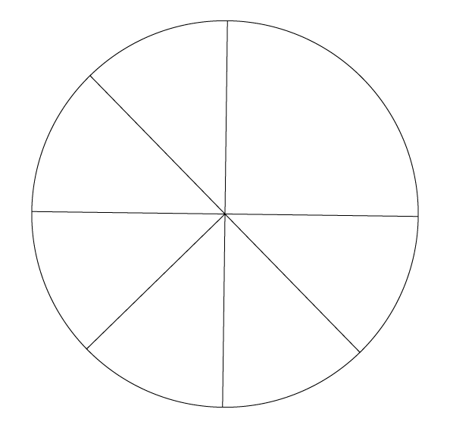
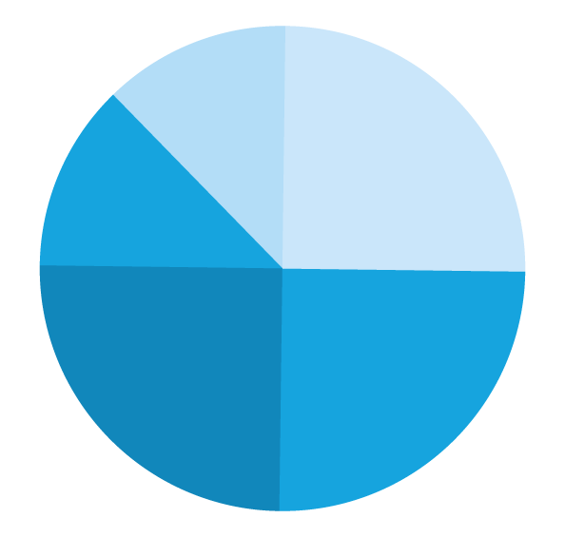
www.eng.it
@EngineeringSpa
Engineering Ingegneria Informatica Spa
gruppo.engineering

Slide 7
Nutrition / ex.: high-level / coarse-grained objectives
5 portion of fruit OR vegetables per day.
No more than 30% of fats per day.
Maximum 1 sweet per week.

Slide 8
Nutrition / ex.: meal-by-meal detailed plan
Monday
BREAKFAST: 200ml milk of and 2 cookies;
LUNCH: 300gr spinach with 1 teaspoon of oil, 1 piece of swordfish, 1 fruit;
DINNER: 400gr of green salad and tomatoes, 4 slices of chicken breast.
Tuesday …
At least 2 liters of water per day

Slide 9
Questions for FHIR contributors
Which FHIR resources to represent the above examples?
meal-by-meal plan: CarePlan ?
food diary item: Observation?
Any recommended code-set / dictionary to specify food diary observations?
Next versions of FHIR: Any plan for
Nutrition information?
Uncertified/personal health records?
Lifestyle and social interactions information?

Slide 10
Nutrition / ex.: coarse-grained & fine grained food diary
Fine grained food diary
BREAKFAST: 100ml milk, 5 cookies
LUNCH: 300gr spinach with 2 teaspoon of oil
150 ml water
Course grained / portion based food diary
DAY: 1 portion of pasta, 1 portion of seasoned vegetables, 4 glasses of water, 2 sweet coffees

Slide 11
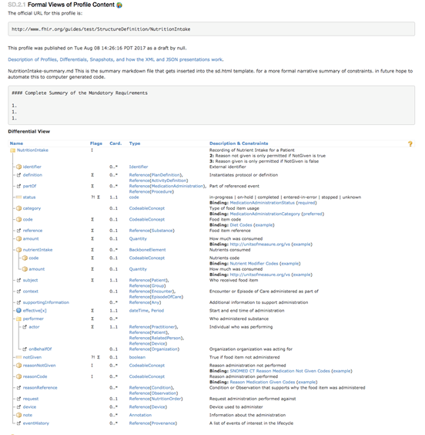

Slide 12
Action Items
James– model new resource in ClinFHIR to do all the NCP areas
Paul – send examples and conceptual data modeling concerns
Review on next Nutrition FHIR in 2 weeks (invite Elaine/Russ to preview on that call before presenting to PC

