Slide 1
BRIDG Adverse Event Sub-domain Summary
Edward Helton, Smita Hastak, Wendy Ver Hoef, Julie Evans
September 2nd, 2016

Slide 2
BRIDG Model Overview
BRIDG – Biomedical Research Integrated Domain Group Model - www.bridgmodel.org
A UML class diagram
Scope is Protocol-driven research and translational sciences research
Provides rigorous definitions for concepts in clinical research and their relationship to each other
Covers Protocol representation, trial design, adverse event, etc.
Collaborative standard developed by CDISC, FDA, HL7, ISO and NCI
BRIDG can enable semantic-based interoperability across the translational domain as well across the various stakeholder standards/projects

Slide 3
BRIDG Adverse Event Sub-domain
Definition:
The Adverse Event sub-domain is intended for those involved in safety related activities; such as detection, evaluation, follow-up and reporting. This includes safety issues involving people or products. It also includes activities during or after a research protocol.

Slide 4
History of BRIDG AE Sub-domain
Contributors to the BRIDG AE semantics
HL7/FDA: Individual Case Safety Report (ICSR message semantics)
NCI: Adverse Event Reporting System (caAERS)
CDISC: SDTM/CDASH AE domain/variables
NIH Federal Adverse Event Task (FAET) Force
Timeline
Majority of AE concepts were added between 2008 – 2010
Updates were made based on additional semantics that came from harmonizing other projects that had some AE concepts

Slide 5
Key Classes in AE Sub-domain
AdverseEvent
AdverseEventSeriousness
AdverseEventOutcomeAssessment
AdverseEventOutcomeResult
CausalAssessment
EvaluatedActivityRelationship
EvaluatedResultRelationship
PerformedProductProblemDiscovery
PerformedProductInvestigation
PerformedProductInvestigationResult
SafetyReportVersion
Note: Sub-domain also contains
supporting classes, such as
Person, Organization, Product,
StudyProtocol, Etc.

Slide 6
Adverse Event Definition in BRIDG
Any unfavorable and unintended sign, symptom, disease, or other medical occurrence with a temporal association with the use of a medical product, procedure or other therapy, or in conjunction with a research study, regardless of causal relationship.
EXAMPLE(S): death, back pain, headache, pulmonary embolism, heart attack
This pdf document lists all the classes and attributes of the BRIDG AE sub-domain

Slide 7
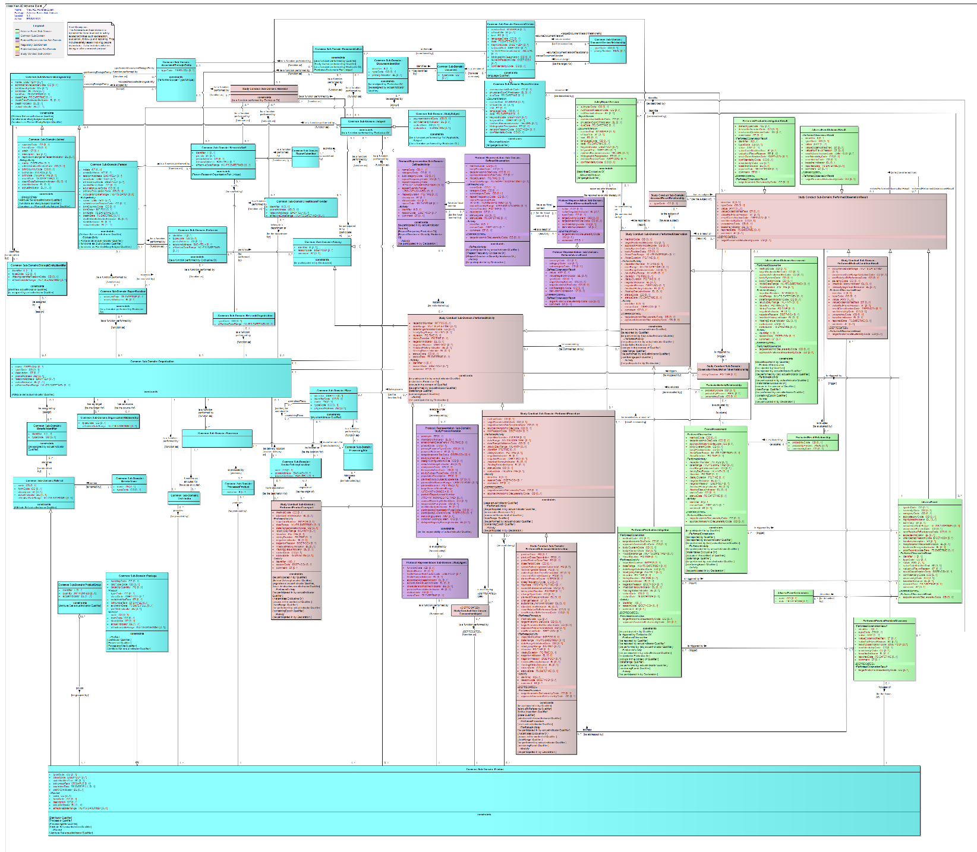
Light green classes are AE related
Adverse Event Sub-Domain Diagram
PerformedObservationResult
PerformedObservation
AdverseEvent
AESeriousness
Person
Organization
Product
7
Notes:
AdverseEvent is a kind of PerformedObservationResult meaning it’s a result of a PerformedObservation activity.

Slide 8
Comments/Questions
ICSR R2 was taken to ISO
FDA’s Clinical Trial Repository is based on BRIDG
BRIDG used as the conceptual model for CTR
Since BRIDG is mapped too CDISC SDTM, CTR was able to leverage that to eventually help with SDTM submissions to FDA – FDA will start receiving SDTM submissions in Dec. 2017
Mitra R has harmonized OMOP with BRIDG model
FDA/Mary Ann Slack released a BRIDG Architecture RFP and she is interested in developing FHIR resources from BRIDG

