Slide 1
Catalog Document and entries

Slide 2
Scope of this effort
Implement some catalog requirements using existing / draft resources
Uncover gaps to decide approach:
Which resources to use
Additional elements missing – for starting discussions

Slide 3
Conveying Catalog Information
Catalog
Metadata
Catalog Info (at “document”)
Catalog attributes…
Catalog attributes
like Validity, context…
Catalog Entry
Type
Elements listed, contextual
and additional info
ItemReference
Item Attributes…
Attributes like status(in this catalog e.g.
deleted, active), additional classification…
RelatedItem
RelationType
Relations between items in
the context of this catalog
RelatedItemReference

Slide 4
Complete Information model

Slide 5
Example: Lab stuff
…
…
.
…
…
.
…
…
..
…
…
…
.
…
…
…
…
…

Slide 6
Example: Devices
…
…
.
…
…
.
…
…
..
…
…
…
.
…
…
…
…
…

Slide 7
Example: Medicines
Medicinal Product
Packaged Medicinal Product
Paracetamol Actadis 500 tab
Paracetamol Actadis 500 tab bx 20
Pharmaceutical Product
Packaged Medicinal Product
Medicinal Product
Paracetamol 500 mg Tablets
Ben-U-Ron 500 tab, Box 20
Ben-U-Ron 500 Tabl
Substance
Pharmaceutical Product
Medicinal Product
Packaged Medicinal Product
Paracetamol
Paracetamol 500 mg Capsules
Ben-U-Ron 500 Cap
Ben-U-Ron 500 Cap
Packaged Medicinal Product
Pharmaceutical Product
Dol-u-ron Forte® 500/30 Cap Box 20
Medicinal Product
Paracetamol 500 mg + Codeine 30 Capsules
Substance
Dol-u-ron Forte® 500/30 Cap
Packaged Medicinal Product
Codeine
Dol-u-ron Forte® 1000/60 Tab, Box 18
Pharmaceutical Product
Paracetamol 1000 mg + Codeine 60 Tablets
Medicinal Product
Packaged Medicinal Product
Dol-u-ron Forte® 1000/60 Tab
Dol-u-ron Forte® 1000/60 Tab, Box 45
Substance
Pharmaceutical Product
Medicinal Product
Packaged Medicinal Product
Diazepam
Diazepam 5 mg Tablets
Valium® 5
Valium® 5, Box 30

Slide 8
How is this presented as resources
N different resource instances
2 Substances
4 Pharmaceutical Products (modeled as---?)
5 Medicinal Products
6 Packaged Medicinal Products
One catalog to List & Link them all
Containing one catalogEntry per each entry:
Identify the resource
Context-sensitive data, relationships

Slide 9
Other concepts (for later)
Local implementations may use local concepts. That is straightforward to derive:
Concept can be a specialization of an existing concept – CTPP, a national “Non-Brand” code
Example: Non-brand includes all products of a given formulation and dose form for a same package size, regardless of brand

Slide 10
Resources
The List resource - enumerates a flat collection of resources and provides features for managing the collection. While a particular List instance may represent a "snapshot", from a business process perspective, the notion of "list" is dynamic – items are added and removed over time. The List resource references other resources. Lists may be curated and have specific business meaning.
The Group resource - defines a group of specific people, animals, devices, etc. by enumerating them, or by describing qualities that group members have. The Group resource refers to other resources, possibly implicitly. Groups are intended to be acted upon or observed as a whole (e.g., performing therapy on a group, calculating risk for a group, etc.). This resource will commonly be used for public health (e.g., describing an at-risk population), clinical trials (e.g., defining a test subject pool) and similar purposes.
The Bundle resource - is an infrastructure container for a group of resources. It does not have narrative and is used to group collections of resources for transmission, persistence or processing (e.g., messages, documents, transactions, query responses, etc.). The content of bundles is typically algorithmically determined for a particular exchange or persistence purpose.
The Composition resource - defines a set of healthcare-related information that is assembled together into a single logical document that provides a single coherent statement of meaning, establishes its own context and that has clinical attestation with regard to who is making the statement. The Composition resource provides the basic structure of a FHIR document. The full content of the document is expressed using a bundle containing the Composition and its entries.

Slide 11
Implementation - Composition
Catalog
Metadata
Composition
Catalog attributes…
Catalog attributes
like Validity, context…
Catalog Entry
Type
ItemReference
Item Attributes…
Attributes like status(in this catalog e.g.
deleted, active), additional classification…
CatalogEntry resource
RelatedItem
RelationType
RelatedItemReference

Slide 12
Implementation - List
Catalog
Metadata
List
Catalog attributes…
Catalog attributes
like Validity, context…
Catalog Entry
Type
ItemReference
Item Attributes…
Attributes like status(in this catalog e.g.
deleted, active), additional classification…
Catalog Entry resource
RelatedItem
RelationType
List??
(didn’t List use to have a “relatedItem” construct)?
RelatedItemReference

Slide 13
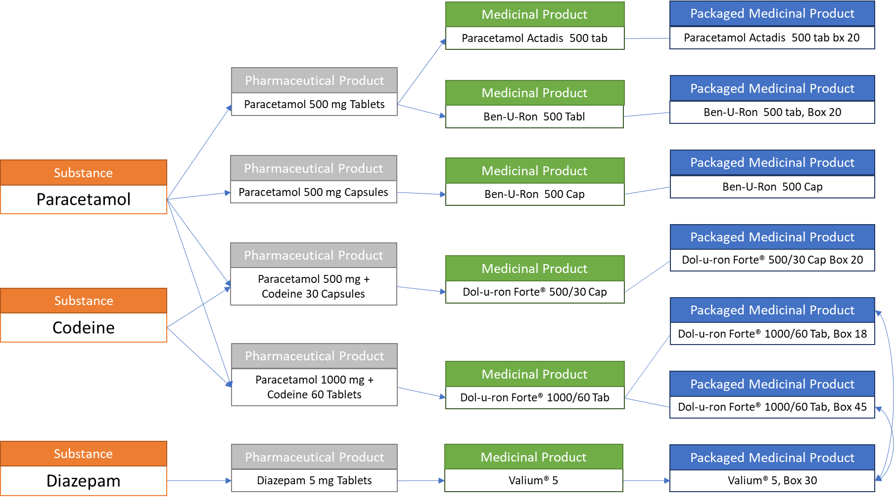
1. Composition contains entries…
{
"resourceType": "Composition",
"id": "2345635345464",
"status": "final",
"type": {"text": "Catalog"},
"subject": "...............",
"date": ".............",
"author": "............",
"title": "2017 Catalog #1",
"section":[
{"entry": {"reference":"catEntry1", "display":"Catalog Entry 1"} },
{"entry": {"reference":"catEntry2", "display":"Catalog Entry 2"} },
{"entry": {"reference":"catEntry3", "display":"Catalog Entry 3"} },
{"entry": {"reference":"catEntry4", "display":"Catalog Entry 4"} },
...
]
}

Slide 14
1. …or List contains entries…
{
"resourceType": "List",
"id": "2345635345464",
"status": "final",
"mode": "snapshot",
"title": "2017 Catalog #1",
{"entry":
{"flag":{"coding":"C001","display":"active"}, "deleted":"false","item":
{"reference":"catEntry1", "display":"Catalog Entry 1"} }},
{"flag":{"coding":"C001","display":"active"}, "deleted":"false","item":
{"reference":"catEntry2", "display":"Catalog Entry 1"} }},
{"flag":{"coding":"C001","display":"active"}, "deleted":"false","item":
{"reference":"catEntry3", "display":"Catalog Entry 1"} }},
{"flag":{"coding":"C001","display":"active"}, "deleted":"false","item":
{"reference":"catEntry4", "display":"Catalog Entry 1"} }}
...
}
}

Slide 15
2. …CatalogEntries …
{
"resourceType": "catalogEntry",
"id": "catEntry1",
"type": {"coding":"C001","display":"medication"},
"referencedItem": {"reference":"sub002","display":"Codeine"},
"status": {"coding":"active","display":"Active"},
"relatedItem": {
"relationType":{"coding":"isIng","display":"Is ingredient for"},
"item":{"reference":"med014","display":"Paracetamol 500 mg + Codeine 30 capsules"}
},
"relatedItem": {
"relationType":{"coding":"isIng","display":"Is ingredient for"},
"item":{"reference":"med015","display":"Paracetamol 1000 mg + Codeine tablets"}
}
}
Pharmaceutical Product
Paracetamol 500 mg + Codeine 30 Capsules
Substance
Codeine
Pharmaceutical Product
Paracetamol 1000 mg + Codeine 60 Tablets

Slide 16
Resources contain the details that are not associated with a specific catalog context
{
"resourceType": "substance":
"id": "subs001",
"code":{"coding":"sub002","display":"Codeine"}
...
}
...
{
"resourceType": "Medication",
"id": “med011",
"code": {
"coding": [{
"system": "http://ema.eu/where_are_the_PhPIDs",
"code": “PhP001",
"display": "paracetamol 500 mg Tablets"
}
]
},
"form": {
"coding": [{
"system": "https://standardterms.edqm.eu/browse/get_concepts/CDF",
"code": "xxxyyyyzzz",
"display": "tablets"
}
]
}
}

Slide 17
Rendered using the structure above
Medication Catalog for prescribing:
Pharmaceutical and Medicinal Products
“Generic”/Active Principle
prescription list
“Generic”/Active Principle
prescription list
Medicinal Product
Packaged Medicinal Product
Each “catalog” retains the relevant resources.
E.g. “Prescription drug” catalog is curated by the hospital and contains only the authorized elements of type Pharmaceutical Products and Medicinal Products – for “generic prescription” and “brand prescription”.
Similar to retaining RxNorm and NDC without needing the “root” substances
Paracetamol Actadis 500 tab
Paracetamol Actadis 500 tab bx 20
Medicinal Product
Packaged Medicinal Product
Ben-U-Ron 500 Tabl
Ben-U-Ron 500 tab, Box 20
Medicinal Product
Packaged Medicinal Product
Ben-U-Ron 500 Cap
Ben-U-Ron 500 Cap
Medicinal Product
Packaged Medicinal Product
Dol-u-ron Forte® 500/30 Cap
Dol-u-ron Forte® 500/30 Cap Box 20
Packaged Medicinal Product
Dol-u-ron Forte® 1000/60 Tab, Box 18
Medicinal Product
Dol-u-ron Forte® 1000/60 Tab
Packaged Medicinal Product
Dol-u-ron Forte® 1000/60 Tab, Box 45
Medicinal Product
Packaged Medicinal Product
Valium® 5
Valium® 5, Box 30

Slide 18
User rendering is not in scope
Once the information is obtained in a standard format, it can be used in any format that is convenient
Medication for prescribing
Pharmaceutical Product Name | Code | Form
Paracetamol 500 mg Tablets | PhP001 | Tablet
Paracetamol 500 mg Tablets | PhP001 | Tablet
Paracetamol 500 mg Capsules | PhP002 | Capsule
Paracetamol 1000 mg + Codeine 30 mg Capsules | PhP003 | Capsule
Paracetamol 1000 mg + Codeine 60 mg Capsules | PhP004 | Tablet
From Pharmaceutical Products
Brand | Code | Available
Paracetamol Actadis | MP001 | N
Ben-U-Ron 500 Cpr | MP002 | Y
Ben-U-Ron 500 Caps | MP003 | Y
Dol-u-ron 500/30 Cap | MP004 | Y
Dol-u-ron Forte® 1000/60 Tab | MP005 | Y
From Medicinal Products

Slide 19
For devices

Slide 20
For Lab stuff

