Slide 1
Combination Codes
Discussion

Slide 2
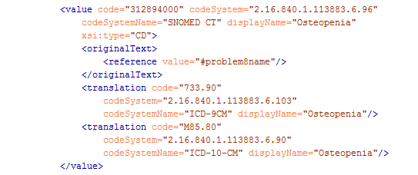
Current Use of TranslationCode in CDA (equivalent only)

Slide 3
Combinatorial Codes - Desire
Vendors/Implementers want a simple way to:
Reliably send in more granular coded information in CDA
That correlates with the way clinicians document problems
That doesn’t require extensive (and unlikely) post-coordination

Slide 4
Combinatorial Codes - Problem
CDA R2 does not allow for the notion of “equivalence” in translationCode (side note: FHIR has this notion*)
OriginalText could house the highly pre-coordinated granular term the clinical saved
But machine readable meaning is lost
Notes:
*http://hl7.org/fhir/2016Sep/conceptmap.html
*http://hl7.org/fhir/2016Sep/conceptmap-definitions.html#ConceptMap.group.element.target.equivalence
*http://hl7.org/fhir/2016Sep/valueset-concept-map-equivalence.html

Slide 5
Combinatorial Codes – Problem – Text example
Local Term: Breast Cancer, stage 1, estrogen receptor positive
SNOMED-CT | 254837009 | Malignant tumor of breast
SNOMED-CT | 416053008 | Estrogen receptor positive tumor
ICD-10-CM | C50.912 | Malignant neoplasm of unspecified site of left female breast
ICD-10-CM | Z17.0 | Estrogen receptor positive status [ER+]

Slide 6
Combinatorial Codes - Problem
Common practice when more than one translationCode exists
Vendor will parse only to first one found
Therefore:
Notes:
*http://hl7.org/fhir/2016Sep/conceptmap.html
*http://hl7.org/fhir/2016Sep/conceptmap-definitions.html#ConceptMap.group.element.target.equivalence
*http://hl7.org/fhir/2016Sep/valueset-concept-map-equivalence.html

Slide 7
Combinatorial Codes – Proposal (Problem Example)
Best available SNOMED CT code is in observation/value
OriginalText captures the text the clinician captured in the EHRs UI
Trading partners could use custom (interface) terminology code OR their local system code/identifier that represents the code for the originalText the clinician captured
This code could be more specific than the best available standardized code but it reflects clinical intent of the clinician
This allows machine computability of more specific term local term in a simple manner
Will communicate more complete information about the patient
If the EHR is able to associate multiple related codes the combined effect would be equal or nearly equal to the local term
Codes would be represented in qualifier/value
Will need a new or find best available code for translation/translation/@code

Slide 8
Combinatorial Codes – Proposal
Notes:
SUMM Summarized by: An act that contains summary values for a list or set of subordinate acts. For example, a summary of transactions for a particular accounting period.
http://www.hl7.org/v3ballotarchive_temp_08B0CDD4-1C23-BA17-0C1CF9B11A2BB964/v3ballot/html/infrastructure/vocabulary/ActRelationshipType.html

