Slide 1
Care Team Value Sets
Improving the way Care Team Members are documented in C-CDA
And Establishing how it will be done in FHIR.

Slide 2
C-CDA: Addressing a fixed need
Participation functionCode
This is where you determine if the clinician is the PCP (or other type of functional role)
Role code
For Clinicians: NUCC Taxonomy– value set could have additional concepts added that are not in NUCC today.
For non-clinicians: Personal and Legal Relationship Role Type Value Set
Other classifications
These could be added on a coded entry to record the care team member information in a NEW Care Team section in the body of the document
Value Set A
Primary Care Physician
Other functional roles…
Value Set B
NUCC concepts
Other support service concepts
Personal and Legal Relationship Roletypes
Value Set C
Another set of concepts to be determined later, as FHIR has the structure to represent them.

Slide 3
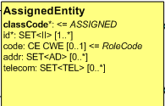
In the header of C-CDA Documents
Value Set A will be
Used here.
Value Set B will be
Used here.

Slide 4
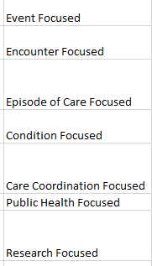
In entries within NEW Care Team section
Can be decided later.
Section.title “Care Team Information”
Section.text
Human readable information
code
Team #1 – Disease Focused – Asthma
Person #1 Contact Info Function (A) Role (B) Specialty? (C)
Person #2 Contact Info Function (A) Role (B) Specialty? (C)
Person #3 Contact Info Function (A) Role (B) Specialty? (C)
Person #4 Contact Info Function (A) Role (B) Specialty? (C)
Value Set B will be
Used here.
sdtc:functionCode
Value Set A will be
Used here.
Team #2 – Coordination Focused
Person #1 Contact Info Function (A) Role (B) Specialty? (C)
Person #2 Contact Info Function (A) Role (B) Specialty? (C)
Person #3 Contact Info Function (A) Role (B) Specialty? (C)
Person #4 Contact Info Function (A) Role (B) Specialty? (C)
Corresponding machine readable information
Entry (one per team) - act with classCode=“PRCP” (provision of care)
[0..1] entryRelationship typeCode=COMP
observation
code indicates “Focus of the team”
value is one of {encounter, episode, condition, coordination, etc.}
[1..*] entryRelationship typeCode=“REFR”
[1..1] act with classCode=“PRCP” one for each care team member
[0..*] entryRelationship typeCode = COMP
observation holding other information
code tells what type of other info
value holds the concept
[1..1] performer
sdtc:functionCode (A)
role code (B)
CareTeam Category
Value Set
Organizer design options
also under consideration

Slide 5
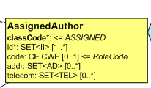
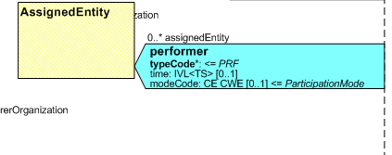
In entries within other sections of C-CDA Documents
Value Set B will be
Used here.
Value Set A will be
Used here.
functionCode
code
sdtc:functionCode
sdtc:functionCode

