Slide 1

Agenda & Updated Meeting Minutes
Care Plan (CP) Meeting
Thursday, September 13, 2012
0800-0930 EDT
With meeting discussion notes
To join the meeting:
Phone Number: +1 770-657-9270
Participant Passcode: 943377#
Laura Heermann Langford (Laura.Heermann@imail.org)
Stephen Chu (stephen.chu@nehta.gov.au)
*Care Plan wiki: http://wiki.hl7.org/index.php?title=Care_Plan_Initiative_project_2011
HL7 Patient Care Work Group

Slide 2
September 2012 Baltimore F2F Agenda
Scheduled for Thursday, September 13 0900-1030 EDT-
Updates on Progress
  Project Scope Statement 651
  Update on SOA and Care Plan Project – Jon Farmer
  Detailed Planning of the Modeling Work to complete the DAM
    Process Models (15 min) Luigi and Enrique
      –Review progress to date
    Information Models (15 Min) –Luigi and Enrique
      Review progress to date
    Detailed Clinical Model for Care Plan – Kevin (10 Min)
  Coordination of Care Plans/Master Care Plan – (~10 Min) Stephen
  Update Proposal from Wales – (10 min) Ann/Stephen
  Collaborative Care – S&I Framework LCC update (Susan)(5 min)
  Relationship to IHE PCC Care Plan – Jon Farmer(5 min)
    Out of time; to be discussed at upcoming conference call

Slide 3
Participants-
Name | email | Country | Yes | Notes
Laura Heermann Langford | Laura.Heermann@imail.org | US | X | Co-Lead- Care Plan initiative/HL7 Patient Care WG. Intermountain Healthcare. RN PhD,: Nursing Informatics; Emergency Informatics Association, American Medical Informatics Association; IHE
Stephen Chu | stephen.chu@nehta.gov.au | AU | X | NEHTA-National eHealth Transition Authority . RN, MD, Clinical Informatics; Chief clinical informatician & Terminologist; co-chair HL7 Patient care WG; vice-chair HL7 NZ
Hugh Leslie | hugh.leslie@oceaninformatics.com | AU | X | Ocean Informatics, Australia
Susan Campbell | bostoncampbell@mindspring.com | US | X | PhD microbiologist. Principal at Care Management Professionals. HL7 Dynamic Care Plan Co-developer
Margaret Dittloff | mkd@CBORD.com | US | X
Susan Matney |  | US | X | PCWG vocabulary facilitator
Enrique Meneses | enrique@careflow.com | US | X
Rosemary Kennedy | Rkennedy@qualityforum.org | US | X
John Farmer | Jon.farmer@thrasis.com | US | X
Chris White | Chris.white@thrasis.com | US | X
Luigi Sison | lsison@yahoo.com | US | X | Information Architect at LOINC and at HL7. Enterprise Data Architect at VA. Developing standard for Detailed Clinical Models (DCM), information models for Electronic Health Record (EHR) Diabetes Project, etc.
Cathy Wilson | catherine.wilson@stjude.org | US | X
Andy Bond | andy.bond@nehta.gov.au | AU | X
Sasha Bojione | sbojione@ritoway.ca |  | X
Stefani Lotti | slotti@invitalia.IT | IT | X
Paul Whitmer | paul.whitmer@imail.org | US | X

Slide 4
Participants-
Name | email | Country | Yes | Notes
Russell Leftwich | ehealth@pobox.com | US | X
Juggy Jagannalthan | juggy@mmodal.com | US | X
Ken Rubin | ken.rubin@HP.com | US | X
Thomas Pole | thomas.pole@vangent.com | US | X

Slide 5
Project Scope Statement 651
Laura Heermann Langford and Stephen Chu
Current RMIM balloted as DSTU
Did not passed due to unresolved negative votes in 2007
Project needs to be withdrawn
Project scope statement 651 needs to be reviewed, revised and resubmitted
Action item:
  Laura and Stephen to work on PSS document and bring it to next conference call for discussion and approval before resubmission

Slide 6
Update: SOA And Care Plan Project
John Farmer and Laura Heermann Langford
  file://localhost/Users/Splash/Desktop/New Files since moving to new computers/HL7/Care Plan docs/Baltimore Fall 2012/Care Coordination Services Overview 2012 09 12.pptx

Slide 7
SOA – CSS Project Discussion Notes
  SOA Care Coordination Services (CSS) project presentation and discussion:
  See presentation slides from Jon Farmer
Discussions:
  Challenges – given the diversity of provider and processes of care, CSS will provide the services required for scheduling and coordination of care processes and resources effectively
  SOA helps bring all these together, using standardised services; determine what functionality is required, and how services enact these functions
  Concern expressed by members – CSS may be too futuristic; vendors not ready; need basic care plan sorted out
  SOA services – takes care of behavioural model -> needs to be done in parallel
  CSS Project scope statement to be completed and approved by January 2013

Slide 8


Care Coordination Service (CCS)
HSSP SOA Specification
Draft Conceptual Overview
Enabling Social Collaboration for Patient Care
HL7 Annual Plenary & WG Meeting
October 2012, Baltimore
Chris White, Jon Farmer, Enrique Meneses

Slide 9
Business Context
A patient moving through the continuum of care
With a Care Plan
Pursuing specific health goals
With progress being measured over time
Care Team Participants
Patient, family, providers, managers, specialists, school nurse, etc.
Want active but controlled participation from a CDS agent, too
Coordination at care transitions is very cumbersome!
The challenge lies in change discussions (e.g. goal adjustments)
The care team composition is constantly in flux

Slide 10
Objective
Enable easy flexible, controlled collaboration around a Shared Master Care Plan
Provide a virtually consolidated Care Plan (CP)
  The CP can be updated (with change logs) from multiple participants
  For those connected , the patient progress, goals, etc. are current at all times
  Spec will include pub/sub binding(s) for storages to get async updates
Easy Flexible Collaboration
  Care team is an association of people … It is inherently social. If foundational sharing agreements are made (not part of spec), then interactions can then grow “organically” by invitations across care settings
  This realization is the foundation of the “Care Coordination Service”
Controlled
  The context of care plan change discussions must be clear
  Advanced conformance profile would require prior-version views of the plan
Notes:
Cross-organizational communication of care plans, especially care plan changes is a hassle if done by documents.

Slide 11
Master CP: Current, Lean, but also Federated
plan or plan fragment
Multidisciplinary
Master Care Plan
EHR
MCP
MCP
MCP
EHR accumulates the care history. The Master Plan does not
A guide to the target health state
  CP owner manages the retention of items of lasting significance
  The master plan may contain sub-plans (comorbid & specialty)
  Its elements (goals, planned interventions, etc.) evolve continuously
A “living object” built for purposeful collaboration
  Participants (clients) stay in-sync “on the same page” at all points in time
  Outlives all episodes, managed as a digest, not an accumulator
  It is “just the plan”, but holds references to summaries, outcomes
Notes:
Good implementation may use rules for auto-inclusion and aging
Let the auidence know that this is all in the “think big” stage and ideas are not fully settled. We want your feedback!

Slide 12
Related HL7 Patient Care Models
CCS Process Model
  Collaborative interactions of evolving care team (invite, propose change, accept …)
  Specifies association of a provider and organization with a patient
  Specifies how to contribute updates to the Care Plan and Care Record
  Specifies how to actively receive update notifications in a decentralized world.
Content – Domain Information Model
  Payloads will be based solely on the PCP’s master CP model that is under development by the HL7 Patient Care Initiative (PCI) Project.
  Expressed in a platform independent form as basis for subsequent bindings such as HL7 FHIR, HL7 CDA and HL7 virtual medical record (vMR) …
  Includes portions of new HL7 patient care model and care record summary model

Slide 13
Synergy with IHE PPOC Profile
Integrating the Healthcare Enterprise, Patient Plan of Care
Process concept is from American Nurses Association (ANA)
The PPOC Profile describes the contribution of Registered Nurses to the plan. The plan includes problem issues (nursing diagnoses), expected healthcare outcomes, implementable interventions, and evaluation of progress toward outcomes based on follow up assessment.
Cycle = Assessment, Nursing Diagnosis, Outcomes Identification, Planning, Implementation, Evaluation
Extends CCD (=HITSP C32) to add info from these steps.
CCD documents are synchronized among participants according to the XDS profile (cross-enterprise document sharing).
There are document-exchange protocol, but there exists no computational model (operation-set) to encapsulate the info
Continued …
IHE_PCC_Patient_Plan_Of_Care_PPOC_TI_-2009-08-10
IHE_PCC_TF_Rev7-0_Vol_1_2011-09-09

Slide 14
To what extent can CCS encapsulate PPOC?
CCS project team will limit its CP models to the CP DAM, which is intentionally driven by its own use cases.
  A critical requirement is to serve as a “master” CP spanning episodes and clinically interrelating clinical risk chains
  Interested in transient plans only to digest relevant impacts
  To meet this purpose, CP DAM (hence CCS) cannot be bound to any CP methodology, even an excellent one (e.g. that of ANA)
After CP DAM modeling covers its own use cases the team will compare with PPOC profile
  No “advance” assurance that models will be harmonized
  But it will be very helpful to define linkages (two-way)
  CCS can likely be a “read” interface for PPOC, but edit not likely

Slide 15
Example Info Model Requirements affecting various process steps
Access the patient preferences and selections in real-time discussion!!
  Actually include patient or (SDM) in all key discussions
  Sensitive to patient’s motivational status and environment
Support controlled changes across transitions
  Emergent and acute care plans are out of scope except insofar as they impact the master plan
Deal with condition Interrelationships
  Comorbid cases , e.g. diabetes + heart failure
  Model the “risk chains” and “common-factor” protocols
Define the scope of items for reconciliation
  Goals, interventions, measures etc.
Notes:
Various conditions raise preference issues – e.g. risk tradeoffs, dietary options, alternative incision sites, life expectancy factors
Comorbid conditions are the toughest to manage and the most expensive to treat

Slide 16
“Care Coordination”
More a “group activity” than a “Job Title!”
Enable participants other than “Care Coordinator” or “Case Manager” to propose changes
Patient is key participant in tailoring of goals & choosing intervention options
Collaboration must be convened faster than system admins can provision users (so old model no good)
If the right persons and the current plan are present, issues can be raised and settled rapidly
Notes:
If somebody objects, point out that any given implementation can and should impose whatever access controls are appropriate according to policy (and block users). But the CCS is not concerned with that.

Slide 17
Usage Scenarios
Guideline-publishing institutions could use a CCS to collaboratively author master care plans for their guidelines
Accountable care organizations (ACOs) could use CCS services to standardize best practices.
A CCS could assist in consolidating comorbid or duplicative care plans - much like a EMPI can support clean-up of MRNs.
Organizations presently taking turns editing care plans in CCD documents could switch to live concurrent editing capabilities
Where a CCS implementation is system of record for care plan, it could be used to generate the CCD Plan of Care section
CCS-enabled EMR applications could manage care plans via CSS to open them up for real-time collaboration
In event of a merger, multiple CCS-enabled installations could integrate care plans simply via URLs (after firewall setup)

Slide 18
Some “Basic” Operations
Initialize and maintain care plans
Author multidisciplinary CPs or CP templates
  Master CP can include its specialist CPs by reference?
Given Dx & Demographics, get CP templates
  Best way to institute best practices on high-risk populations
Activate the CP and Individualize it collaboratively
  Include the patient while setting goals
  An affiliate provider (say, nutritionist) may manage a sub-plan that is virtually or actually consolidated
Get plan

Slide 19
Point-of-Care Operations
Get visit agenda (at start of visit)
    Patient-specific assessments, risk factor discussions
    CDS points out info needed for critical rules
Remote participants read, write plan or subplan
    Specialists may be advising on goal adjustments
    Family or case coordinator may identify special needs
Get order sets and reference materials
    CCS provides content for order entry module
    Medication charts (pros, cons, costs) & InfoButton
Asynchronously
    Participants see the updates appearing on the plan
    CDS could advise & alert at various points

Slide 20
Care Plan Reconciliation
CCS will support “CPR” for fragmented plans
Directly help the care team coordinate plans:
  Harmonize two plans for consistency, trigger change proposal
  Virtualize two plans as one for integrated viewing (peer/not)
  Consolidate two plans, yielding one.
  Refactor modules like disease management protocols that can be defined once (not cloned)
  Cost-saving pattern: Credit tasks across plans (a test we already did in plan A “covers” an upcoming order on plan B)
Who proposes these consolidations?
  Various members edit CP directly; others propose for accept.
  The CDS participant only proposes changes

Slide 21
Example Care Plan Review Session
The CCS is a service that this application is utilizing
Invitations accepted as with any online meeting facility. A change conference could span multiple sessions
Plan(s) of interest are displayed, users can expand or collapse
Permit some or all team members to edit the plan in their specialty but with rationale
DSS may raise its hand if it has something to say
Pass “presenter” rights. Navigate and show proposed changes (automatically highlighted) as others observe
Pieces of patient record should be displayed. CCS is not the server for obtaining it, but CCS could name needed items
App might use a Medication Statement Service (MSS),

Slide 22
CDS Knowledge for the Care Plans
Intelligent and Polite
A Clinical Decision Support Service (CDSS)
    General categories: Infobutton, guidelines, contraindications
    CDS Proposes changes, to be accepted by the human stewards
  Support CP creation & reconciliation (within & across plans)
    Select CP template for patient based on patient factors
    Suggest individualizations (goals & orders)
    Suggest missing activities & rule violations
  Support Point of Care
    Show visit agenda
    If critical rules are lacking inputs, prompt clinician to ask
    Check orders, etc.
  Advice strength, evidence strength – critical for smart and polite CDS
    Each user controls his/her own filters

Slide 23
Terminology Impacts
Could use a Common Terminology Service (CTS2)
Common Terminology Service (CTS2) Applies
Suppose an order in plan 1 is “covered” by a larger order panel in plan 2 that has been recently completed. It should be “credited as done” if it is recent enough.
  A (good) vocabulary may tell us that
  Observation panel 1 includes panel 2
  Observation 1 and observation 2 are of equal diagnostic value for the condition under consideration
Provide understandable “interface” terminologies to both MDs and non-MDs; also alternative natural languages.

Slide 24
Challenges
Keep it simple but powerful
  Get the essential plan constructs and federate well
  Align with CDS (vMR elements) for easy hookup
Seeking more vendors interested in implementing
  If it seems too complex, help us organize it
  It’s shaping up to be a fascinating project!

Slide 25
More Information
The Care Coordination service is a standards development/specification effort being undertaken by HL7, with the expectation that downstream work will be done in collaboration with groups such as the OMG. This project falls under the Healthcare Services Specification Program (HSSP) and will done in collaboration with the HL7 Patient Care work group. http://hssp-carecoordination.wikispaces.com/
Group Leads:
  Enrique.Meneses@careflow.com
  Chris.white@thrasys.com
  Jon.Farmer@thrasys.com

Slide 26
CCS Memory Trick
Key pieces of information model
  Diagnosis, Problems, Risks, Goals, Interventions -> Outcome measures, Relationships
CCS operational concept
  Definitive Plan Reflects Group Input on Revisions

Slide 27
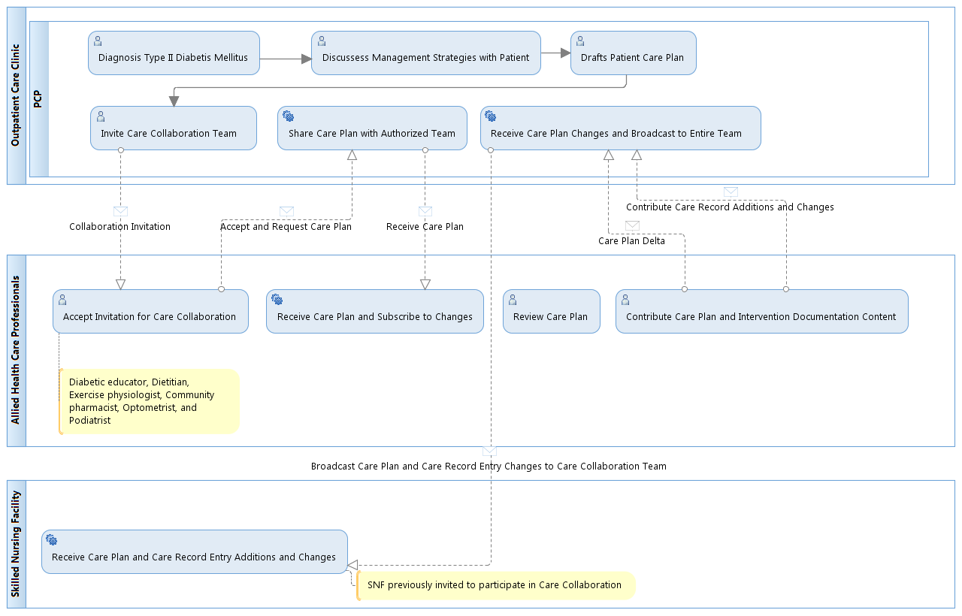
Illustrative Process Model

Slide 28
Guide toward Goals & Focus of Interaction
A stable, comprehensive guide toward goals
  Purpose driven by patient’s health concerns, problems, desires for wellness
  Specifies specific health care goals
  Planned actions for achieving the goals
  Keeps references to Care Record Summaries that document outcomes
A central living object facilitating collaboration
  Its elements (goals, order sets, etc.) evolve continually
  Participants (clients) stay in-sync “on the same page” at all points in time
  It outlives episodes of care (though episodic plans can link with it)
  It “stays put” for its clients even if it is stored in distributed fragments
The care team gathers around it and gets it done
Notes:
Let the auidence know that this is all in the “think big” stage and ideas are not fully settled. We want your feedback!

Slide 29
Process Models
Luigi Sison and Enrique Meneses

Slide 30
Discussion Notes
  Walk through of the care plan process models and information models by Luigi
  Diagrams: attached

Slide 31
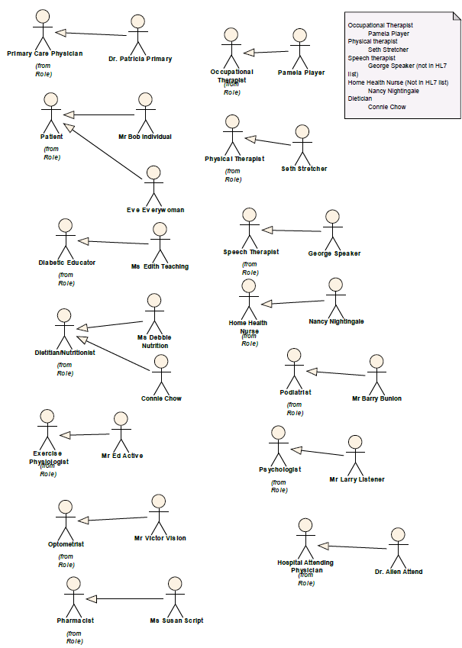
Actors and Roles

Slide 32
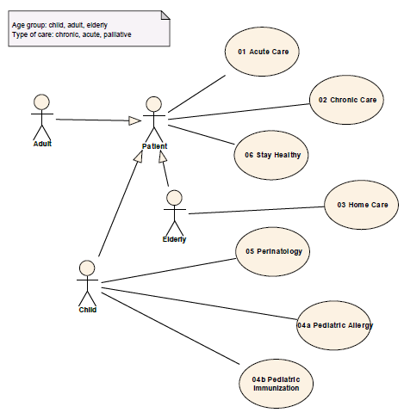
Use Case Diagram (1)

Slide 33
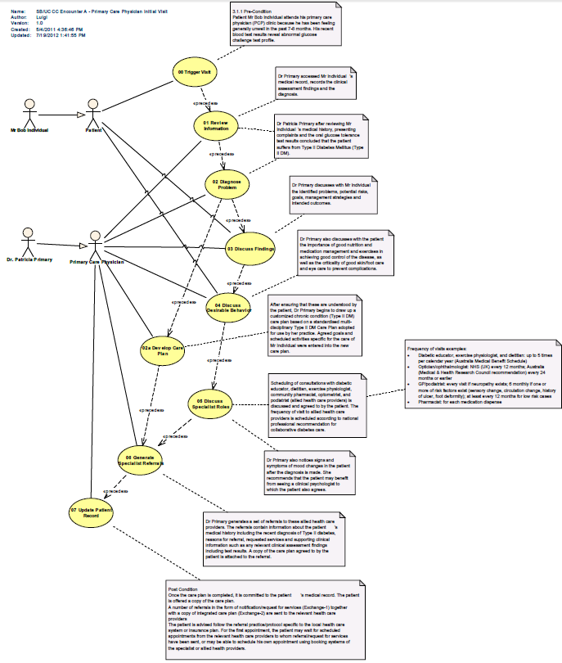
Use Case
Diagram (2)

Slide 34
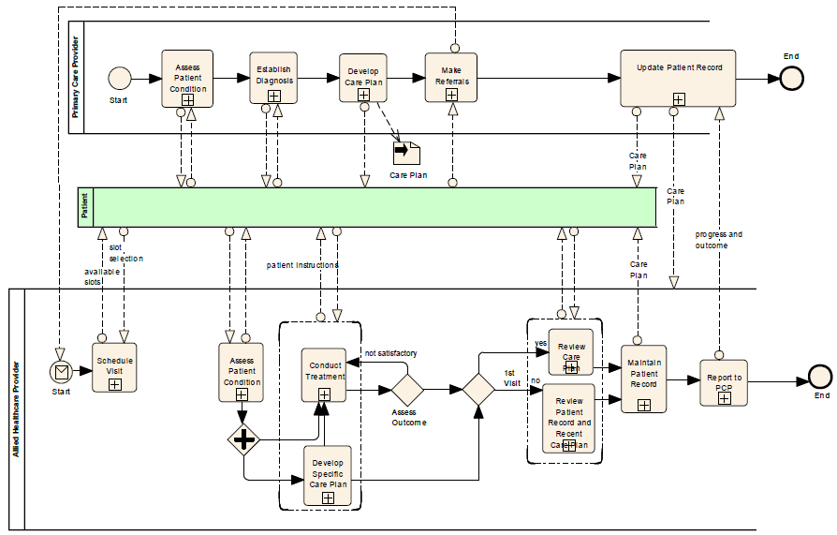
Process Model Diagram (BPMN)

Slide 35
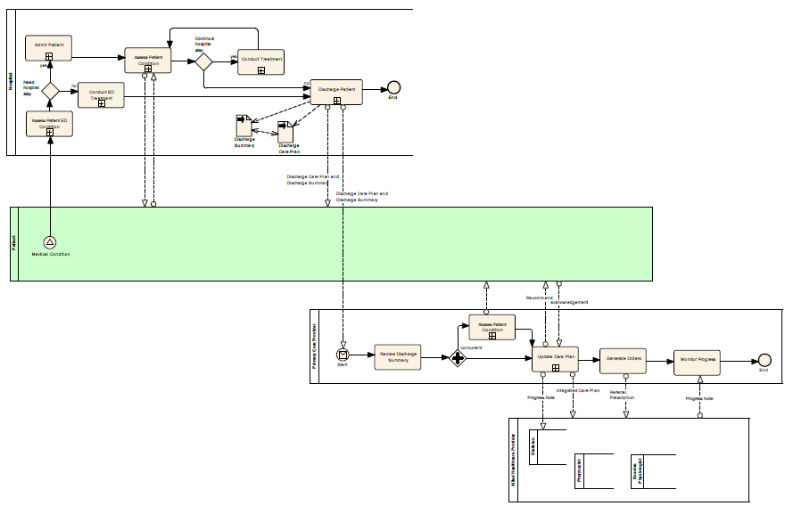
Process Model Diagram (BPMN)

Slide 36
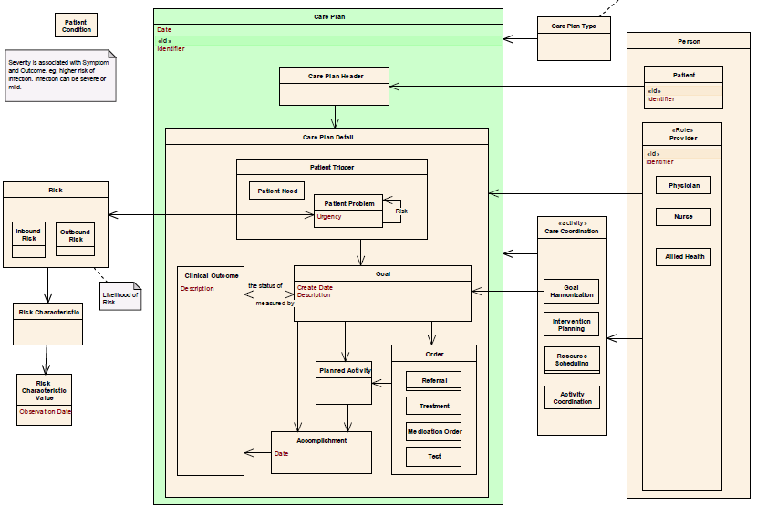
Information Model

Slide 37
Coordination of Care Plans/Master Care Plan
Susan Campbell and Stephen Chu

Slide 38
Discussion Notes
Collaborative project with HSSP SOA
Objectives – develop a set of service profiles to support:
  planning, coordination and delivery of care plans
    Shared/master; domain specific detailed plans; patient engagement and empowerment
  Harmonization of shared and detailed plans
    Goals, planned activities
    Eliminate overlaps; consolidation
  Improve detection of pathway deviations/failures
  Improve awareness and effective management of inbound and outbound risks
    Better decision supports

Slide 39
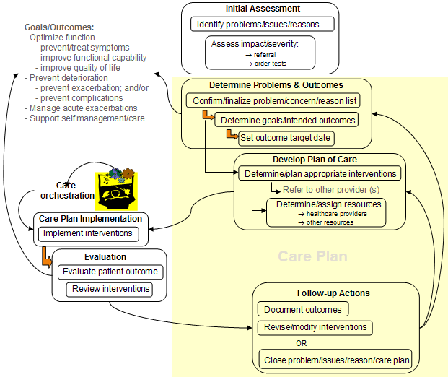
Master and Detail (domain specific) Care Plans
Initial Assessment
Goals/Outcomes:
- Optimize function
- prevent/treat symptoms
- improve functional capability
- improve quality of life
- Prevent deterioration
- prevent exacerbation; and/or
- prevent complications
- Manage acute exacerbations
- Support self management/care
Identify problems/issues/reasons
Care
orchestration
Assess impact/severity:
→ referral
→ order tests
Determine Problems & Outcomes
High Level Shared Care Plan
Confirm/finalize problem/concern/reason list
Problem/concern/reason 1..*
Target goals/outcomes
Planned intervention
Assessed outcome
Determine goals/intended outcomes
Set outcome target date
Develop Plan of Care
Determine/plan appropriate interventions
Care
orchestration
Refer to other provider (s)
Determine/assign resources
→ healthcare providers
→ other resources
Care Plan Implementation
Domain Specific Detailed Care Plan
Implement interventions
Evaluation
Care Plan
Evaluate patient outcome
Review interventions
Follow-up Actions
Document outcomes
Revise/modify interventions
OR
Stephen Chu
12 April 2011
Close problem/issues/reason/care plan

Slide 40
Master and Detail Care Plans: Inbound & Outbound Risks
Diagnosis (e.g. Type 2 Diabetes Mellitus)
[a diagnosis often results in one or more problems for the patient]
[Primary] Problem 1: inability to regulate blood glucose level
Problem 2: urinary problems (resulting from hyperglycaemia)
[polyuria, nocturia]
Problem 3: polydipsia (resulting from excessive urine output)
Problem 4: weight loss (resulting from inability to process calorie from foods)
Problem 5: polyphagia (resulting from hunger effect of increased insulin output to process high blood glucose)
Problem 6: lethargy (resulting from inability to utilise glucose effectively)
Problem 7: altered mental state (resulting from hyperglycaemia, ketoacidosis, etc)
[agitation, unexplained irritability, inattention, or confusion]

Slide 41
Master and Detail Care Plans: Inbound & Outbound Risks
Diagnosis (e.g. Type 2 Diabetes Mellitus)
[a diagnosis often results in one or more problems for the patient]
[Primary] Problem 1: inability to regulate blood glucose level
Problem 2: urinary problems (resulting from hyperglycaemia)
[polyuria, nocturia]
Problem 3: polydipsia (resulting from excessive urine output)
Problem 4: weight loss (resulting from inability to process calorie from foods)
Problem 5: polyphagia (resulting from hunger effect of increased insulin output to process high blood glucose)
Problem 6: lethargy (resulting from inability to utilise glucose effectively)
Problem 7: altered mental state (resulting from hyperglycaemia, ketoacidosis, etc)
[agitation, unexplained irritability, inattention, or confusion]
Goal 1: maintain effective blood glucose control
[fasting = 4-6 mmol/litre]
Intervention 1: diet control (diabetic diet)
Intervention 2: medications
Intervention 3: exercise (if overweight)
Goal 2: maintain HbA1C level =< 7%
Outcome measures
daily BSL measures: pre-prandial reading 4-7mmol/l
post-prandial reading <8.5 mmol/l
HBA1C 3 monthly reading =<7%

Slide 42
Master and Detail Care Plans: Inbound & Outbound Risks
Diagnosis (e.g. Type 2 Diabetes Mellitus)
[a diagnosis often results in one or more problems for the patient]
[Primary] Problem 1: inability to regulate blood glucose level
Problem 2: urinary problems (resulting from hyperglycaemia)
[polyuria, nocturia]
Problem 3: polydipsia (resulting from excessive urine output)
Problem 4: weight loss (resulting from inability to process calorie from foods)
Problem 5: polyphagia (resulting from hunger effect of increased insulin output to process high blood glucose)
Problem 6: lethargy (resulting from inability to utilise glucose effectively)
Problem 7: altered mental state (resulting from hyperglycaemia, ketoacidosis, etc)
[agitation, unexplained irritability, inattention, or confusion]
Goal 1: relief acute symptoms
[polyuria
polydipsia
lethargy
altered mental state …]

Slide 43
Master and Detail Care Plans: Inbound & Outbound Risks
Diagnosis (e.g. Type 2 Diabetes Mellitus)
[a diagnosis often results in one or more problems for the patient]
[Primary] Problem 1: inability to regulate blood glucose level
Problem 2: urinary problems (resulting from hyperglycaemia)
[polyuria, nocturia]
Problem 3: polydipsia (resulting from excessive urine output)
Problem 4: weight loss (resulting from inability to process calorie from foods)
Problem 5: polyphagia (resulting from hunger effect of increased insulin output to process high blood glucose)
Problem 6: lethargy (resulting from inability to utilise glucose effectively)
Problem 7: altered mental state (resulting from hyperglycaemia, ketoacidosis, etc)
[agitation, unexplained irritability, inattention, or confusion]
Risk 1: poor wound healing (resulting from impaired WBC, poor circulation from thickened blood vessels)
[high risk of foot/toe ulcers and gangrene]
Risk 2: increased infection (resulting from suppression of immune system from high glucose in tissues)
[skin, urinary tract]
Risk 3: cardiovascular complications [e.g. hypertension, ischaemia heart disease]
Risk 4: microangiopathy [e.g. retinopathy, nephropathy, peripheral neuropathy]
Risk 5: eye complications [e.g. cataract]

Slide 44
Master and Detail Care Plans: Inbound & Outbound Risks
Diagnosis (e.g. Type 2 Diabetes Mellitus)
[a diagnosis often results in one or more problems for the patient]
[Primary] Problem 1: inability to regulate blood glucose level
Risk 1: poor wound healing (resulting from impaired WBC, poor circulation from thickened blood vessels)
[high risk of foot/toe ulcers and gangrene]
Risk 2: increased infection (resulting from suppression of immune system from high glucose in tissues)
[skin, urinary tract]
Risk 3: cardiovascular complications [e.g. hypertension, ischaemia heart disease]
Increased outbound risks for patients with high CVS risks (e.g. those with family history)
or with existing CVS co-morbidity
Increased inbound risks for patient with arthritis co-morbidity treated with cox-2 inhibitor analgesics
Risk 4: microangiopathy [e.g. retinopathy, nephropathy, peripheral neuropathy]
Increased/high inbound risks for patient with renal infections or
with infections treated with aminoglycoside antibiotics
Risk 5: eye complications [e.g. cataract]
Increased/high inbound risks for patient with increased exposure to sunlights
[agriculture, forestry, fishing, construction industires]

Slide 45
Update: Proposal from Wales
Ann Wrightson and Stephen Chi

Slide 46
Discussion Notes
  Wales NHS provided one high level use case diagram
    See next slide
  No further inputs received
  Update from Wales NHS delegate:
    Care Plan project has been deprioritized

Slide 47
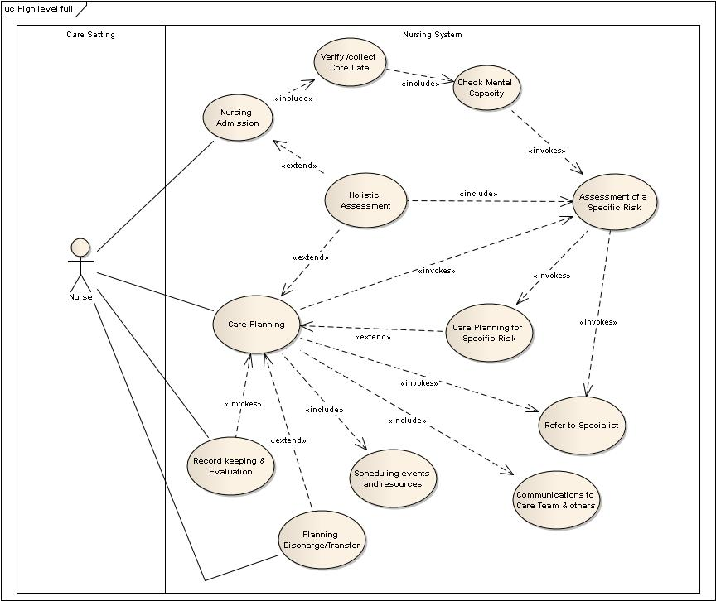
Wales NHS Use Case Diagram

Slide 48
Updates on impactful U.S. Inititives
Susan Campbell and Laura Heermann Langford

Slide 49
Impactful U.S. Initiatives
  Update S&I Framework proposal for Implementation Guide (Tentative 5 min)
  Update IHE PCC Care Plan related – John Farmer/ Laura (Tentative 5 min)
      IHE Profiles
        Care Management Profile – older to be dusted off
        eNS Profile – summary – done, but has little uptake
        PPOC – Patient Plan of Care – done, but has little uptake
        PCCP – whitepaper – John Hilton

Slide 50
Longitudinal Coordination of Care (LCC) Workgroup (WG)
Overview for HL7 Care Planning Workgroup

Slide 51
Overview
LCC WG & Sub-Workgroups
Key Accomplishments of the LCC WG
Key Recommendations from LCC Whitepaper
Care Planning Process and Care Plan Model
LCC WG Proposal to Advance Standards
Interoperable Collaborative Care Plan Attributes
Other LCC SWG Accomplishments:
  LTPAC data elements & transitions
  PAS crosswalks
  C-CDA Implementation Guide

Slide 52
LCC Sub Workgroups (SWG)
Longitudinal Coordination of Care Workgroup
  Providing subject matter expertise and coordination of SWGs
  Developing systems view to identify interoperability gaps and prioritize activities
Longitudinal Care Plan SWG
LTPAC Care Transition SWG
Patient Assessment Summary SWG
Identify standards for an interoperable, longitudinal care plan which aligns, supports and informs person-centric care delivery regardless of setting or service provider
Define data elements for long-term and post-acute care (LTPAC) information exchange using a single standard for LTPAC transfer summaries
Establish the standards for the exchange of patient assessment summary documents
GOALS
*Care Plan will enable providers to create, transmit and incorporate goals, objectives, and outcomes for the benefit of medically complex and/or functionally impaired individuals, their families and caregivers.

Slide 53
Key Accomplishments
LCC Use Case. Outlines three scenarios for health information exchanges between: 1) an acute care hospital and home health agency (HHA); 2) a skilled nursing facility (SNF) and the Emergency Department (ED); and 3) a Physician and a HHA
  Two of the scenarios center on the Home Health Plan of Care (HH-POC), based off CMS 485 form. The HH-POC supports the HHA in providing patient service via MD orders. The HHA and physician exchange information on patient’s evolving condition and needs, and the services the HHA will perform.
LCC Whitepaper. Meaningful Use Requirements For: Transitions of Care & Care Plans For Medically Complex and/or Functionally Impaired Persons. Includes a robust discussion of needs and issues regarding interoperable care plan collaboration and exchange.
  A summary is also available here.
Preliminary Stage 3 MU Recommendations. Provided for July 16, 2012 meeting of Health IT Policy Committee Meaningful Use Subworkgroup #3 (includes comments on proposed Meaningful Use Stage 2 requirements related to care plans)

Slide 54
Key Recommendations from LCC WP
Incorporate requirements for the use of interoperable clinical content, standards, implementation guides in the Stage 3 MU Program
Advance Standards, Implementation Guides, and EHR Certification Criteria to support the ‘care coordination’ recommendations for the Stage 3 MU Program
Identify requirements for the interoperable exchange of Collaborative Care Plans for the Stage 3 MU Program
Provide ONC/OSI Support and Resources to advance the recommendations outlined

Slide 55
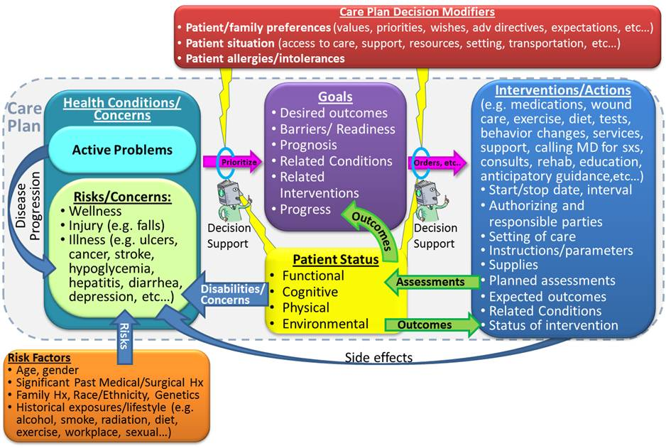
Care Planning Process
Definition, content, sections, and standards of a collaborative care plan that can support care planning for a variety of patient types over time –interoperably.
An animated Powerpoint presentation of this LCC vision of longitudinal care planning is available on the wiki here.

Slide 56
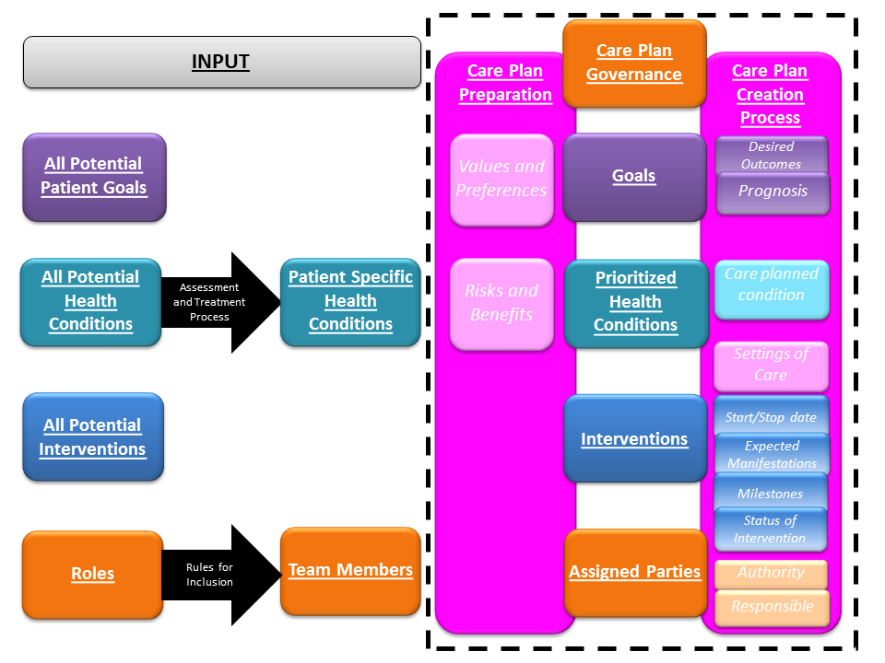
Collaborative Care Plan Model
Care plan inputs and process as described in LCC White Paper (see page 18).

Slide 57
Proposal to Advance Care Plan Standards
Investigate, select, adapt, or develop one or more provider-managed and patient-managed models
Establish a framework for communication from and to the person, his/her designated care team that is keyed to the person’s care plan
Identify applicable health IT exchange standards
Promote a unified semantic payload framework (e.g. terminology) and methodology of use that can support care plan, care management interventions, and exchange
Employ syntactic approaches that include but are not necessarily limited to C-CDAr2/RIM v3 approaches to enable participation by LTPAC providers, respecting their concurrent technology capacities
* Note: This is a proposed approach WG members have identified to meet LCP SWG goals and recommendations from the LCC Whitepaper.

Slide 58
Attributes of a Certifiable Interoperable Collaborative Care Plan Promote:
Person-specific content development and updating that reflects the health needs, personal values, resolve, and bio-regenerative capacity of the medically complex and/or functionally impaired person it serves
Patient-consented care team, care plan and care planning-related information transfer that maximizes team member effectiveness and is bi- and/or multi-directional, as needed
Best practices in care plan development, updating, and maintenance in keeping with applicable cohorts
Dignity and self-actualization in every life stage for appropriate, individualized, coordinated care

Slide 59
Other LCC SWG Accomplishments
Long Term and Post-Acute Care (LTPAC) Transitions of Care SWG:
Priority Transitions. Examined transitions to/from eleven providers
IMPACT Project Data Elements List. Updated and merged LCC Use Case 1.0 Data Elements
  Five transitions of care data sets, all subsets of the LCC Use Case Data Elements. The permanent transfer of care contains the entire set of data elements.
Patient Assessment Summary (PAS) SWG:
Balloted Functional Status, Cognitive Status, & Pressure Ulcer templates for Consolidated CDA (May 2012)
Balloted Patient Questionnaire Assessment Summary Implementation Guide for CDA Release 2 (September 2012)
Mapped the MDS, OASIS, CARE Tool, Massachusetts Universal Transfer Form (IMPACT Dataset #5 with 328 data elements), and C83 data elements (prioritized by Beacon Community Affinity Group). (link)

Slide 60
Impactful U.S. Initiatives
  Update S&I Framework proposal for Implementation Guide (5 min)
  Update IHE PCC Care Plan related – John Farmer/ Laura (5 min)
      IHE Profiles
        Care Management Profile – older to be dusted off
        eNS Profile – summary – done, but has little uptake
        PPOC – Patient Plan of Care – done, but has little uptake
        PCCP – whitepaper – John Hilton
  file://localhost/Users/Splash/Desktop/New Files since moving to new computers/HL7/Care Plan docs/Baltimore Fall 2012/Care Coordination Services Overview 2012 09 12.pptx

Slide 61
Discussion Notes

Slide 62
Future Meetings
Next Agenda
Conference calls between now and January 2013 – see wiki
  90 min., Wednesday 5-6:30pm US Eastern, fortnightly (every 2 weeks)
  Starting September 19

Slide 63
Next meeting Agenda- Sept 19 (Lead: Laura)
Upcoming Topics
  Review of Face to Face Discussion

Slide 64
Appendix

