Slide 1
Structured Data Capture (SDC)
The Use of Structured Data Capture for Clinical Research
November 2015 S&I Initiative Coordinator: Ed Hammond
HHS/ONC Sponsor: Farrah Darbouze

Slide 2
SDC FHIR Milestones
Kickoff for FHIR SDC Profile – May 2014
Draft for Comment Ballot – September 2014
S&I 1st SDC FHIR Virtual Connectathon – April 2015
DSTU Ballot – May 2015
S&I 2nd SDC FHIR Virtual Connectathon – August 2015
DSTU published – September 2015
http://hl7.org/fhir/sdc/sdc.html
Test track in the FHIR Connectathon – October 2015

Slide 3
Structure Data Capture Use Case

Slide 4
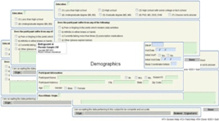
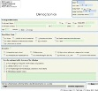
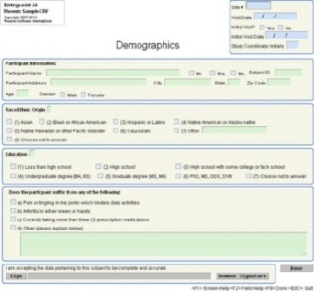
Structured Data Capture Workflow
CDE Library
Sends request for form/template
1
Form/Template
Repository
Form Library
Metadata
Source
2
Sends requested form/template
SDC Scope
EHR System
Specified
Form/Template
3
Converts, populates and displays form
4
Fills, stores/transmits structured data
Displayed
Form
External Data Repository
Extract, Transform,
and Load Data by form/ template
Actor Key
5
Forms Filler
Structured
Data Capture
Forms Manager
External Repository

Slide 5
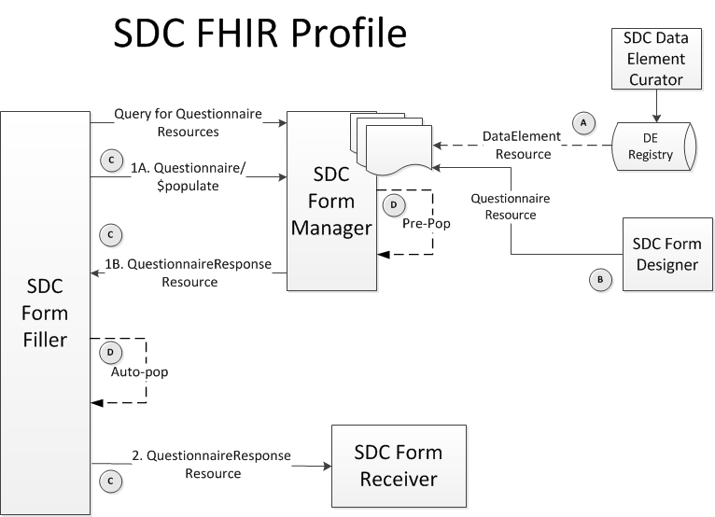
SDC FHIR Profile Workflow
SDC FHIR Actors
SDC Data Element Registry
SDC Form Designer
SDC Form Manager
SDC Form Filler
SDC Form Receiver

Slide 6
Next Steps for the FHIR Profile

Slide 7
SDC Profile Alignment
Data Element Standard
DataElement Resource needs to be aligned with ISO/IEC 11179-3 based SDC Data Element Conceptual Model
Form Definition Model
SDC form definition schema models are currently being updated. Questionnaire and QuestionnaireResponse resources will need to be aligned with changes to the Schema files
Link to HTML/URI
FHIR does not currently support redirect to URI or the pass-back of an HTML

Slide 8
Oct 2015 HL7 WGM
HSI WG meeting to discuss SDC Profile Alignment
O&O should be the sponsoring WG, but should coordinate with the Patient Care WG as Questionnaire is the resource most likely to be impacted

Slide 9
Contact Information
Initiative Coordinator: Dr. Ed Hammond (william.hammond@duke.edu )
Federal Lead: Farrah Darbouze (farrah.darbouze@hhs.gov)
Project Manager: Jenny Brush (jenny.brush@esacinc.com)
Technical and Harmonization Lead: Vijay Shah (vshah@jbsinternational.com)
Harmonization Support: Perri Smith (perri.smith@accenturefederal.com )
DE Subject Matter Expert: Mark Roche (mrochemd@gmail.com)
FHIR Subject Matter Expert: Lloyd McKenzie (lloyd@lmckenzie.com)
SDC Wiki Page: http://wiki.siframework.org/Structured+Data+Capture+Initiative
Weekly All-Hands Meeting Info (Thursdays):
Time: 3:25pm – 4:30Ppm Eastern
URL: https://siframework1.webex.com/
Dial-In Number: 1-650-479-3208
Access Code: 663 397 496

Slide 10
Thank you!

