Slide 1
A Proposed Approach to Binding SNOMED CT to HL7 FHIR
Dr Linda Bird
Senior Implementation Specialist

Slide 2
Discussion Overview
Collaboration Overview
Proposed Approach
Testing on FHIR Resources
Questions and Discussion

Slide 3
Collaboration Overview

Slide 4
IHTSDO HL7 Collaborations
SNOMED CT FHIR Terminology Binding Collaboration
Purpose
For IHTSDO to provide SNOMED CT expert input to assist HL7 International with its efforts to ensure the quality and appropriateness of the use of SNOMED CT in value sets and bindings specified for use in international FHIR resources
Phase 1 – Development of approach (April to September 2015)
Model meaning binding approach for Condition resource
Value set review process for SNOMED CT value sets
Phase 2 – Testing of approach (September 2015 to June 2016)
Model meaning binding for Goal, AllergyIntolerance, Family history and Specimen
Value set view process tested on these resources
Phase 3 – Adoption of approach (July 2016 onwards)
HL7 to use approaches developed for remaining resources

Slide 5
Proposed Approach

Slide 6
SNOMED CT Terminology Binding – Use Cases
Querying instances of FHIR resources
Different instances may use different amounts of precoordination versus populating separate data elements
Data elements in different FHIR resources may have the same or similar meaning
Transforming between different representations
From separate data elements to (pre or post) coordinated
From (pre or post) coordinated to separate data elements
Supporting data validation and semantic interoperability
Management and quality control of model libraries
Search model libraries
Identify semantic overlap and inconsistencies between models

Slide 7
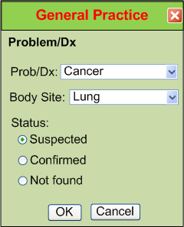
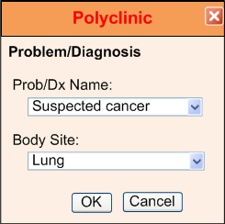
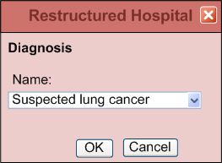
Example – “Suspected Lung Cancer”

Slide 8
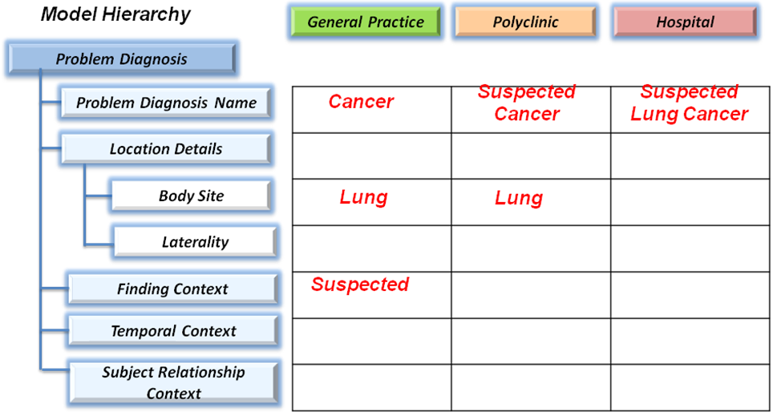
Example – “Suspected Lung Cancer”

Slide 9
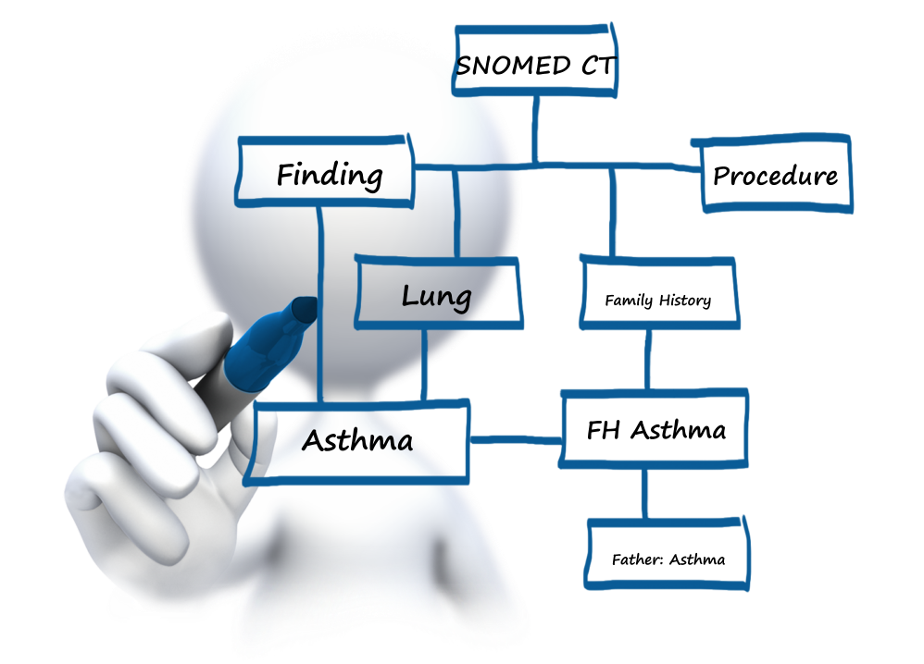
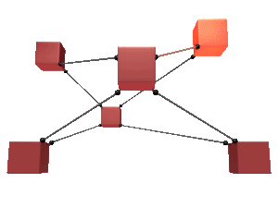
Types of Terminology Binding
Value set binding: Records a set of possible values which can populate a coded data element or attribute in an information model
Model meaning binding: Defines the meaning of an information model artifact using a concept or expression from the terminology
FHIR
Resource
Notes:
There are two main types of terminology binding.
#click
The first and most common type of terminology binding is a ‘Value set binding’. Value set bindings record a set of possible values which can populate a coded data element or coded attribute in an information model.
#click
The other type of terminology binding is a ‘Model meaning binding’. Model meaning bindings define the meaning of an information model artifact using a concept or expression from the terminology. These bindings are sometimes called ‘Semantic bindings’ because they define the meaning or semantics of the associated information model artifact.

Slide 10
Model Meaning Bindings – Proposed Approach
Uses SNOMED CT concept model
FHIR resource
Bound to a SNOMED CT Expression Template
Instantiated using referenced values from resource
Provides a canonical representation of clinical meaning
Enables composing of separate values into a single expression
Allows equivalence and subsumption testing to be performed between resource instances, which use different amounts of precoordination versus separate coded data elements
FHIR coded data elements
Bound to an attribute from the SNOMED CT Concept Model
Enables decomposing of a precoordinated code into separate data elements
Enables querying using attribute hierarchy

Slide 11
SNOMED CT Value Set Review – Proposed Process
Valid display text
Display text is an acceptable synonym for the given ‘code’ (en-US)
Active concepts
All concepts in international value sets are active in international edition of SNOMED CT (unless specifically required to be inactive)
Appropriate concepts
All concepts in the value set are consistent and appropriate for the intended use
No content gaps
No obvious gaps in the content of the value set (for intended use)
Clear context and meaning
Context and qualifying information is represented consistently with no ambiguity, either in the terminology or separate elements
A value set version management strategy is also required

Slide 12
Testing on FHIR Resources
FHIR
Resource

Slide 13
FHIR Resources
Condition
Allergy Intolerance
Procedure
Goal
Family Member History
Specimen

