Slide 1
HL7 EHR WG presents Meaningful Use Functional Profile to CDC EHR FORUM September 10, 2013
Gora Datta
gora@cal2cal.com
Gary Dickinson
gary.dickinson@ehr-standards.com
Hetty Khan
hdk1@cdc.gov
Julie Richards
julie@richardsgroup.org

Slide 2
Agenda
Introduction
ISO/TC215,
HL7 & EHR Working Group,
EHR-System Functional Model (EHR-S FM) & Profiles
HL7 Population Health & the Public Health Functional Profile
EHR-S FM Meaningful Use Functional Profile
Relevance to Public Health and the CDC
How You Can Help
Questions & Discussion

Slide 3
Introduction – ISO/TC215, HL7 & EHR WG
ISO – International Standards Organization
ISO membership - a network of national standards bodies
National bodies represent ISO in their respective country
In USA – ANSI is the national standards body
ISO TC215 - Technical Committee on – Health Informatics
HL7 International
ANSI accredited Standards Development Organization (SDO) for Health IT standards
Individual, Corporate & Governmental membership
International Affiliates in 36 countries (including US)
HL7 EHR Work Group, formed in 2003
Many common members between the two entities

Slide 4
Introduction – EHR-S FM
HL7/ISO-10781 Electronic Health Record System Functional Model (EHR-S FM)
Describes functions and related conformance criteria for EHR Systems
HL7 Draft Standard (2004), HL7 Normative R1 (2007), ISO/HL7 Normative R1.1 (2009)
Release 2 in ballot: HL7 complete, ISO TC215, CEN TC251, IHTSDO, CDISC and GS1 underway
Will publish R2 by January 2014

Slide 5
EHR-S FM Chapter (re)Organization
Direct Care (DC)
Supportive (S)
Information Infrastructure (IN)
Overarching (O)
Care Provision (CP)
Care Provision Support (CPS) | Population Health Support (POP) | Administrative Support (AS)
Record Infrastructure (RI)
Trust Infrastructure (TI)

Slide 6
Introduction – EHR-S FM
Conformance Section
EHR Systems do not conform directly to HL7/ISO-10781 Functional Model
Instead EHR Systems conform to one or more Functional Profiles (of the FM)
FP:Functional Profiles (of FM R1.1)
Ambulatory Care, Behavioral Health, Child Health, Clinical Research, Emergency Medicine, Long-Term Care, Pharmacy/Pharmacist, Records Management/Evidentiary Support (RM-ES), Vital Records…
New with R2
Public Health (8 sub-domains), Dental, Nutrition…

Slide 7
Introduction – EHR-S FM & FP
Functional Profiles (FP) are tailored to specific domains, services and specialties
Functional Profiles allow:
Required-ness upgrade: e.g., MAY to SHALL
Designation of applicable FM functions, criteria
New or revised conformance criteria
New or revised functions, statements, descriptions
Proposals for inclusion in next FM release

Slide 8
Public Health Functional Profile
Birth Defects
Vital Records
(Birth, Death Events)
Cancer Registries
Early Hearing Detection and Intervention
Public Health Laboratory
Common Public Health Functions
Health Statistics
Occupational Disease, Injury and Fatality
Deep Vein Thrombosis/Pulmonary Embolism

Slide 9
Public/Population Health Support
Focus on input to systems that perform medical research, promote public health, & improve the quality of care at a multi-patient level
Population Health Support | POP.1 | Support for Health Maintenance, Preventive Care and Wellness
 | POP.2 | Support for Epidemiological Investigations of Clinical Health Within a Population
 | POP.3 | Support for Notification and Response
 | POP.4 | Support for Monitoring Response Notifications Regarding a Specific Patient’s Health
 | POP.5 | Donor Management Support
 | POP.6 | Measurement, Analysis, Research and Reports
 | POP.7 | Public Health Related Updates
 | POP.8 | De-Identified Data Request Management
 | POP.9 | Support Consistent Healthcare Management of Patient Groups or Populations
POP.6 | Measurement, Analysis, Research and Reports
POP.6.1 | Outcome Measures and Analysis
POP.6.2 | Performance and Accountability Measures
POP.6.3 | Support for Process Improvement
POP.6.4 | Support for Care System Performance Indicators (Dashboards)

Slide 10
Public Health Functional Profile - Purpose
Conforms to HL7 Electronic Health Record Systems Functional Model (EHR-S FM)
Includes a subset of functions of the EHR-S FM required or desired for implementation in EHR systems or health care delivery settings to support the needs of public health
Describes the public health functional requirements that may be included in EHR systems to support public health-clinical information exchanges for specific public health programs (domains)
Articulates the functional requirements needed to support data exchange among providers and public health stakeholders including, but not limited to states, local, and federal agencies

Slide 11
Public Health Functional Profile Vision
Serve as the overarching profile for PH functions relevant to an EHR-S from which other PH profiles may be derived
Contain a core or common set of functional requirements identified for all public health domains
Contain unique functional requirements for specific public health domains
Can be useful input into the current work to develop an EHR-S FM Profile for Meaningful Use to clarify PH’s EHR system-related requirements

Slide 12
EHR-S FM Meaningful Use Profile
Project Scope
Develop an EHR-S FM Profile (US Realm) for Meaningful Use (1, 2 & 3);
Derive from EHR-S FM R2 and ONC 2014 Certification Criteria
Project Need
Interest by ONC and others regarding the correspondence of US MU certification criteria with related EHR System functions and conformance criteria
Potential for EHR Systems to be certified against MU1, MU2 (& MU3) criteria (US) and related HL7/ISO 10781 criteria (international) simultaneously

Slide 13
EHR-S MU FP: Methodology
Map ONC/NIST EHR-S Test Procedures to related HL7/ISO 10781 EHR-S FM Functions/Criteria
ONC/NIST EHRS Test Procedures
(MU Stages 1&2 2014)
HL7/ISO 10781 EHR-S FM Functions/Criteria
(R2 May 013)

Slide 14
Analysis – example from Demographics

Slide 15
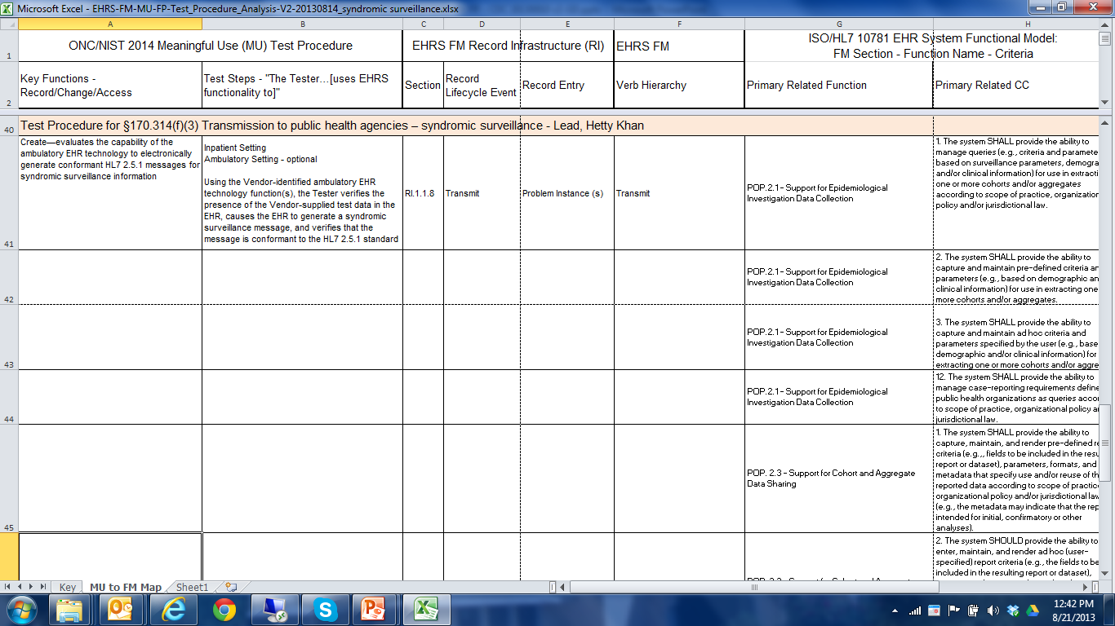
Analysis – example from Syndromic Surveillance

Slide 16
Relevance to Public Health and the CDC
2011 National Quality Strategy Priorities
Population Health (one of the 8 priorities)
MU Stage 1: Key Public Health measures
MU Stage 2: Increasing (“ongoing”) emphasis on various PH measures
MU Stage 3: transitions from a setting-specific focus to a collaborative, patient and family- centric approach.
Conformance to HL7 EHR-S MU FP: a must for all future (certified) EHR Systems!

Slide 17
How Can You Help?
The MU FP team meets every 2nd and 4th Tuesdays at 11am PST US (or 2pm EST)
EHR Interop WG call: 770.657 9270/ 510269#
Material on HL7 Wiki
http://wiki.hl7.org/images/1/15/EHRS-FM-R2-MU-FP-Assignments-20130702.docx
http://wiki.hl7.org/images/8/8a/EHRS-FM-R2-MU-FP-Build_Guidance-20130801.pptx
Spread the word – We need more Volunteers

Slide 18
THANK YOU
Questions & Discussion
HL7 EHR WG Weekly Calls
Rec Mgmt/Evidentiary Support: Mon 12 Noon ET
EHR Interop WG (MU, R3): Tues 2PM ET
EHR Work Group: Tues 3PM ET
Personal Health Record WG: Wed 12 Noon ET
EHR Usability WG: Wed 1PM ET

