Slide 1
PCWG – Chicago WGM C-CDA: Problem/Allergy Problem Status Observation Templates
Stephen Chu, PCWG co-chair
Russ Leftwich, PCWG co-chair
Elaine Ayres, PCWG co-chair
Laura Heermann Langford, PCWG co-chair
Rob Hausam, vocab facilitator
Lisa Nelson, PCWG Liaison from SDWG

Slide 2
Allergy Problem Observation in C-CDA 1.1

Slide 3
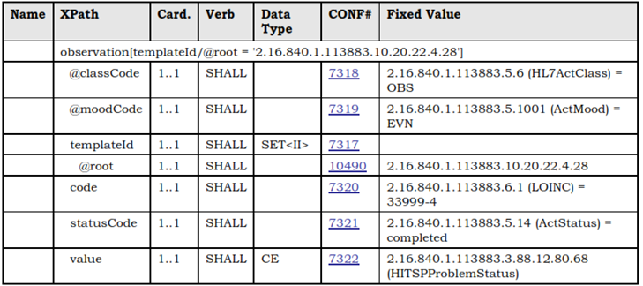
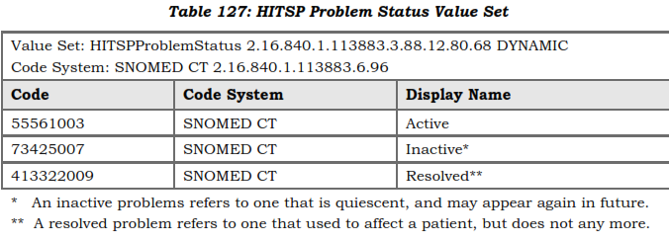
Allergy Status Observation in C-CDA 1.1
Table 126: Allergy
Status Observation

Slide 4
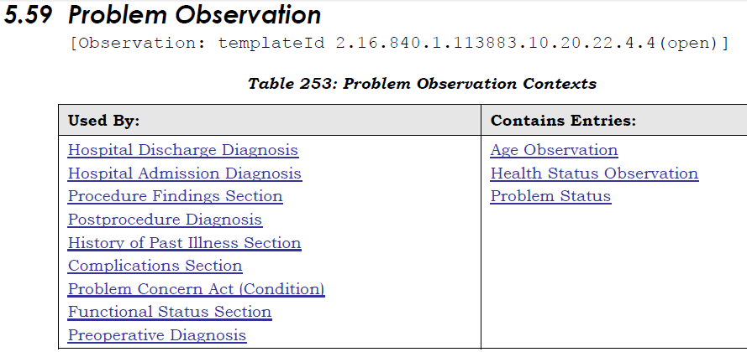
Problem Observation in C-CDA 1.1
The “Problem Status” Observation uses the same HITSPProblemStatus
values
Notes:
Health Status Observation: This template represents observations regarding the outcome of care from the interventions used to treat the patient. These observations represent status, at points in time, related to established care plan goals and/or interventions (Contains “Outcome Observation” template)
Outcome Observation contains: Act Reference (NEW); Author Participation (NEW); Goal Observation (NEW); Intervention Act (NEW); Progress Toward Goal Observation (NEW)

Slide 5
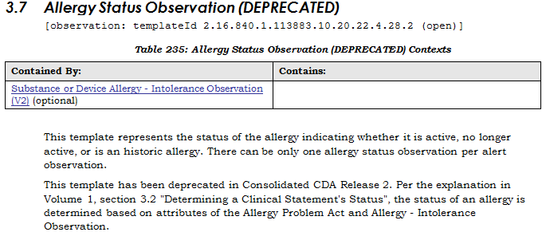
In C-CDA 2.0 Allergy Status Observation and Problem Status templates are deprecated

Slide 6
In C-CDA 2.0 Allergy Status Observation and Problem Status templates are deprecated

Slide 7
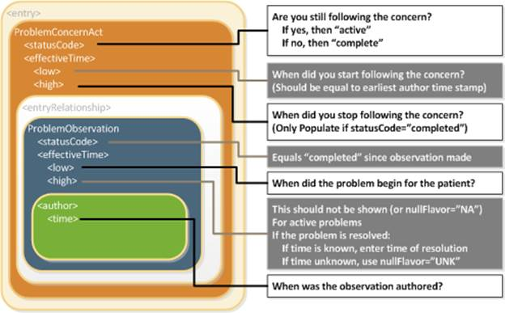
Determining Problem status in absence of Allergy Status Observation and Problem Status
inadequate for
expressing the
rich semantics
clinical status
of the problem
or concern
statusCode:
- metadata
Not displayed
as human
readable data.
How is that
useful for
expressing
clinical status?
Using “statusCode + effectiveTime to communicate “status”: inadequate

Slide 8
In C-CDA 2.0 Allergy Status Observation and Problem Status templates are deprecated
Determining “Problem Concern Status” in the absence of these templates:
The statusCode of the Problem Concern Observation is the definitive indication of the status of the concern
Issues
Status of the concern = status of the Act (status of workflow)
≠ rich semantics of clinical status of the problem/concern
The effectiveTime of the Problem Observation is the definitive indication of whether or not the underlying condition is resolved

Slide 9
Determining Allergy Status
The Allergy Status Observation template has been deprecated in Consolidated CDA Release 2
"Determining a Clinical Statement's Status", i.e. the status of an allergy is determined based on attributes of the Allergy Problem Act and Allergy - Intolerance Observation
statusCode + effectiveTime

Slide 10
Semantics of clinical status: much more complex
The status of most clinical problems or conditions (allergy and intolerance included) need to be represented by one of the following values:
Active
Inactive (semantically different from resolved)
Resolved
Refuted

Slide 11
Semantics of clinical status: much more complex
Cancer, psychiatric/psychological problems (substances dependencies included) require additional status values:
Remission states
In remission
Partial remission
Full/complete remission
Early full/partial remission
Sustained full/partial remission
Relapse states
Relapse
relapse after partial remission
relapse after full remission

Slide 12
Semantics of clinical status: much more complex
The semantic complexity requires the reinstatement of:
Problem status template
Allergy status observation template

