Slide 1
Nutrition in HL7 Standards
HL7 CDA R2 IG: Nutrition in C-CDA Based Care Documents, STU, Release 1 (U.S. Realm)
Lindsey Hoggle, MS, RD, PMP
Director, Nutrition Informatics
@lindseybh

Slide 2
Academy of Nutrition and Dietetics
Vision: A world where all people thrive through the transformative power of food & nutrition
Mission: Accelerate improvements in global health and well-being through food and nutrition

Slide 3


Continuity of Care Across Settings
(% are RDN members working in that area.)
11%
8%
Community
WIC
Nursing Home/LTC
8%
Consultation
& Business
RDN
17%
Out-Patient
32%
Acute Care Hospital
Notes:
Continuity of care is the process by which the patient and the physician are cooperatively involved in ongoing health care management toward the goal of high quality, cost-effective medical care. The red percentages on this slide show the percentage of RDNs who work in the identified care settings.
Typically a transition from one setting to another (for example from a hospital to home or an extended care facility) creates a situation of missing, incomplete, or inconsistent data. This creates gaps in care, errors and/or complexity for the patient and caregivers. Nutrition data should be included in any data sent from one care setting to another.

Slide 4
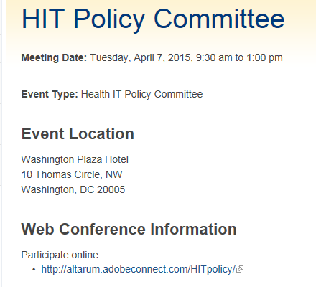
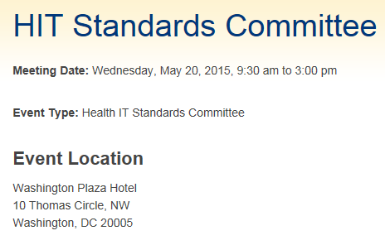
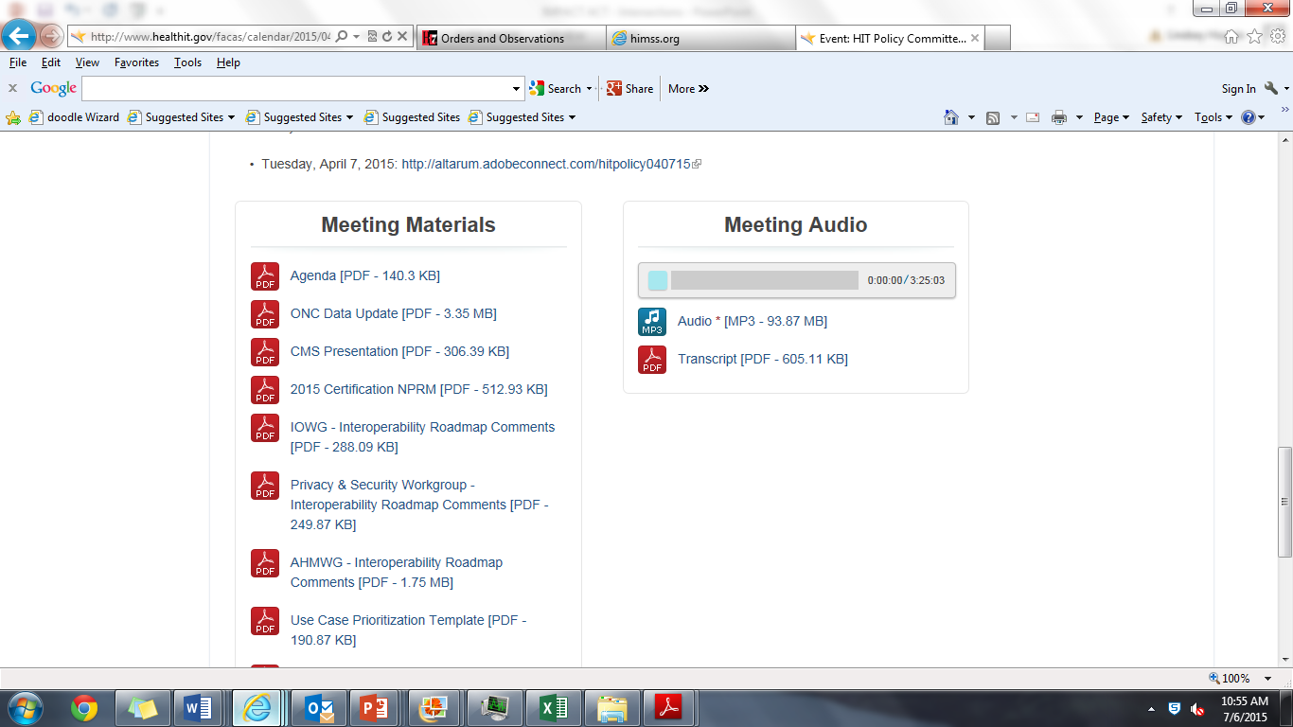

HITECH ACT
Federal Advisory Committee Act (FACA) Committees www.healthit.gov

Slide 5

HITECH Act 2009
December 2009 Meeting
6 non-physician provider organizations
How do our organizations participate as part of the MU Financial Incentive Program?
How do our professions “keep up” with the changes of HITECH?
David Blumenthal, MD, MPH
National Coordinator of Health IT
2009-2011

Slide 6





Nutrition Leaders at HL7
Margaret Dittloff
MS, RD
Elaine Ayres
MS, RD
Over
75 SME
Volunteers
Donna Quirk, MBA, RD, LD
Cathy Walsh
MS, RD

Slide 7
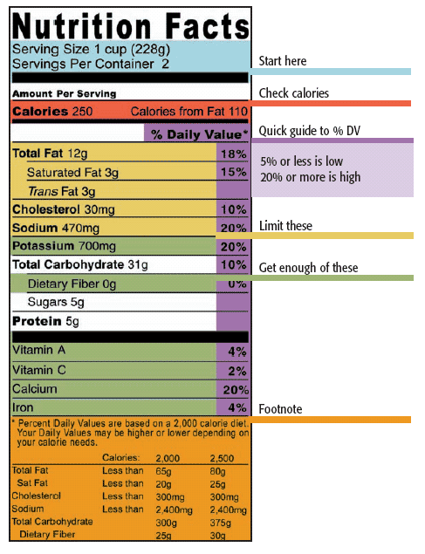
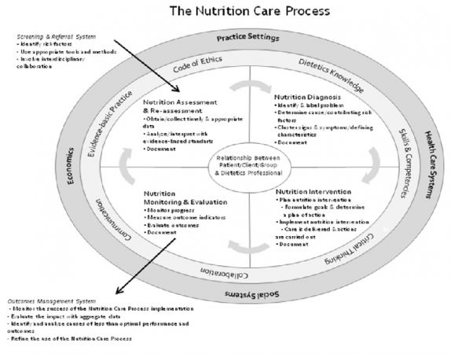

Nutrition Standards
Standardized Language (eNCPT)
Food Labels
Nutrition Composition Tables
Nutrition Care Process
Evidence Analysis
Library

Slide 8

Health Level 7 International
Key Academy Projects
  Nutrition Orders
  Nutrition Orders Domain Analysis Model (May 2016)
  Nutrition Orders V3 Clinical Messaging (DSTU 2013)
  Food and Medication Preferences (Jan 2014 Ballot)
  Allergies, Intolerances & Adverse Reactions Domain Analysis Model
  FHIR (Fast Healthcare Interoperability Resources)
  --Nutrition Orders Resource
  C-CDA R2 – Nutrition Section (DSTU 2014)
  Nutrition Section Template
  Nutrition Status Observation Entry Level Template
  Nutrition Assessment Entry Level Template
  Nutrition Recommendation Entry Level Template
  Virtual Medical Record/Clinical Decision Support
  Oral diets, parenteral and enteral nutrition Orders and Proposals
  EHR-S Electronic Nutrition Care Process Record System Functional Profile (DSTU 2011)
  Personal Health Record Functional Model – Nutrition and Exercise Section
http://wiki.hl7.org/index.php?title=Nutrition_Management

Slide 9
Nutrition Care Process
Assessment
Nutrition Diagnosis
Intervention
Monitoring and Evaluation
Screening
A systematic approach to providing high quality nutrition care

Slide 10
HL7 Consolidated Clinical Document Architecture (C-CDA)
Document Types | C-CDA (R 1.1) | C-CDA (R2.1)
Continuity of Care Document (CCD) |  | Nutrition Section Plan of Treatment (Recommendation)
Discharge Summary | Discharge Diet | Nutrition Section Plan of Treatment (Recommendation)
Progress Note |  | Nutrition Section, Plan of Treatment
Consult Note |  | Nutrition Section, Plan of Treatment
Care Plan (NEW) |  | Health Concern, Intervention
Referral Note (NEW) |  | Nutrition Section, Plan of Treatment
Transfer Summary (NEW) |  | Plan of Treatment (Recommendation

Slide 11

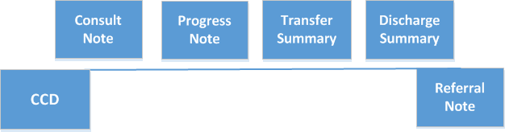

C-CDA R2 & Nutrition Care Process
Assessment
Nutrition Diagnosis
Intervention
Monitoring & Evaluation

Slide 12
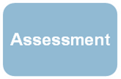
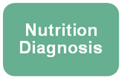
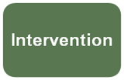
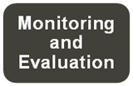
C-CDA & the Nutrition Care Process
Nutrition Status Observation
Nutrition Assessment
Nutrition Recommendations
Structured nutrition documentation in the EHR facilitates creation of clinical statements for CDA
12

Slide 13
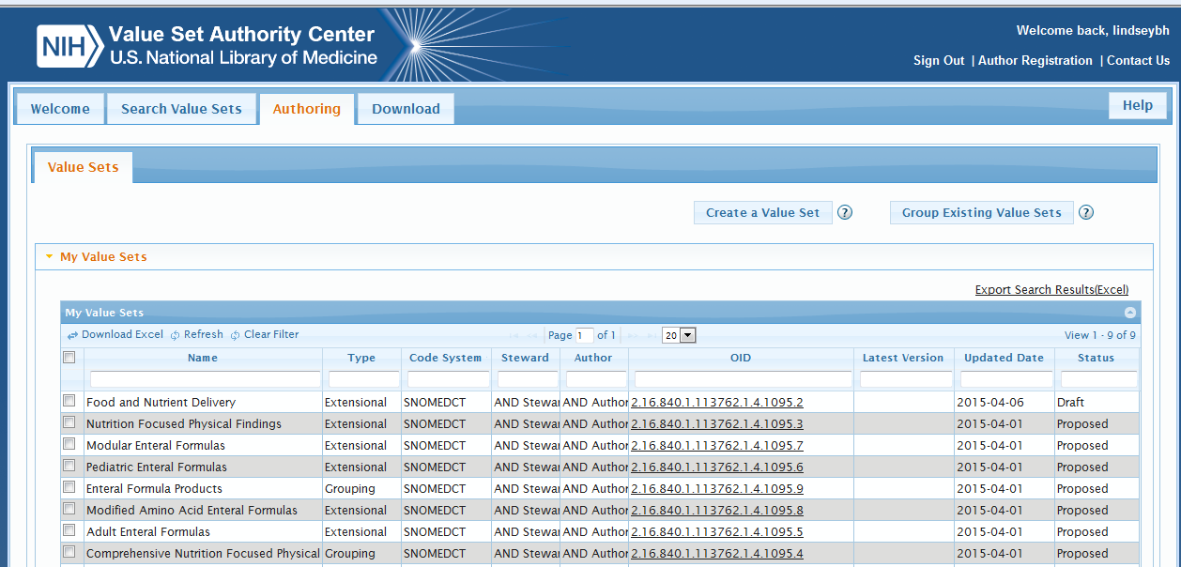
National Library of Medicine
Value Set Authority Center (VSAC)

Slide 14
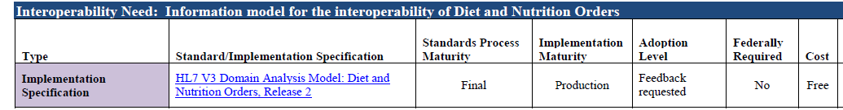
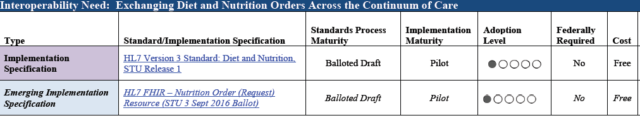
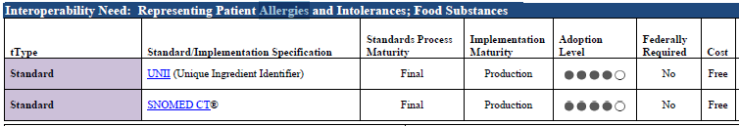
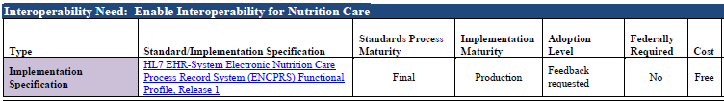
ONC Interoperability and Standards Advisory 2017
https://www.healthit.gov/sites/default/files/2017_isa_reference_edition-final.pdf

Slide 15
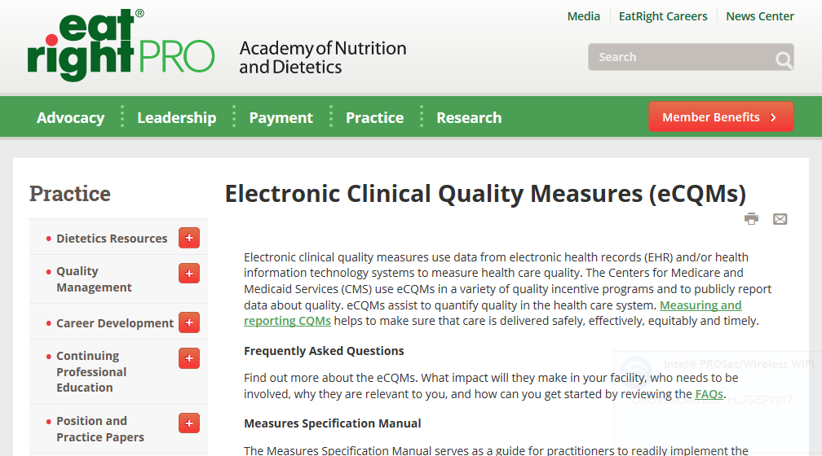
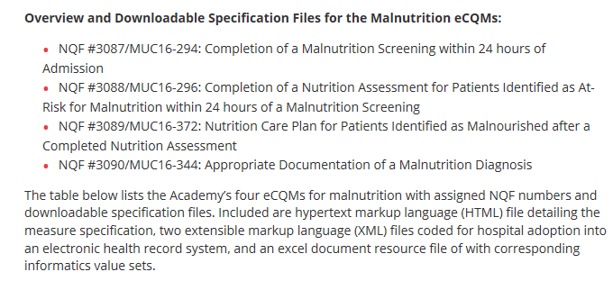
http://mqii.defeatmalnutrition.today/

Slide 16

Request for Support
HL7 CDA R2 IG: Nutrition in C-CDA Based Care Documents, STU, Release 1 (U.S. Realm)

Slide 17



