Slide 1
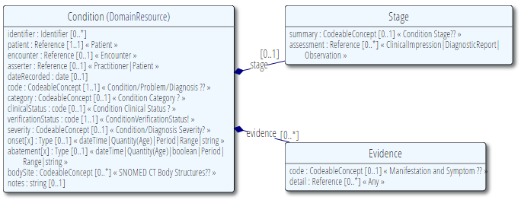
Condition Resource - Overview
Used to record detailed information about conditions, problems or diagnoses recognized by a clinician – e.g.
Recording a diagnosis during an encounter
Populating a problem list or a summary statement

Slide 2
Condition Resource – Assumptions
The meaning of a Condition resource depends on the combination of clinicalStatus and verificationStatus
clinicalStatus
The clinical status of the condition
active, relapse, remission, resolved
verificationStatus
The verification status to support the clinical status of the condition
provisional, differential, confirmed, refuted, entered-in-error, unknown

Slide 3
Condition Resource – Assumptions
clinicalStatus
 |  | Active | Relapse | Remission | Resolved
verificationStatus | Provisional | The statement that the condition is active is provisional. | The statement that the condition is in relapse is provisional. | The statement that the condition is in remission is provisional. | The statement the condition is resolved is provisional.
 | Differential | The statement that the condition is active is differential. | The statement that the condition is in relapse is differential. | The statement that the condition is in remission is differential. | The statement the condition is resolved is differential.
 | Confirmed | The statement that the condition is active is confirmed. | The statement that the condition is in relapse is confirmed. | The statement that the condition is in remission is confirmed. | The statement the condition is resolved is confirmed.
 | Refuted | The statement that the condition is active is refuted. | The statement that the condition is in relapse is refuted. | The statement that the condition is in remission is refuted. | The statement the condition is resolved is refuted.
 | Entered-in-error | The statement that the condition is active was entered in error. | The statement that the condition is in relapse was entered in error. | The statement that the condition is in remission was entered-in-error | The statement the condition is resolved was entered in error.
 | unknown | The condition is active. | The condition is in relapse. | The condition is in remission. | The condition is resolved.

Slide 4
Condition Resource – Assumptions
clinicalStatus
verificationStatus | FINDING CONTEXT | Active | Relapse | Remission | Resolved
 | Provisional | 415684004 |Suspected| | 609412005 |Suspected or known present| | 609412005 |Suspected or known present| | 410593006 |Probably NOT present|
 | Differential | 415684004 |Suspected| | 609412005 |Suspected or known present| | 609412005 |Suspected or known present| | 410593006 |Probably NOT present|
 | Confirmed | 410605003 |Confirmed present| | 410605003 |Confirmed present| | 410605003 |Confirmed present| | 410594000 |Definitely NOT present|
 | Refuted | 410516002 |Known absent| | 36692007 |Known| | 609412005 |Suspected or known present|. | 410515003 |Known present|
 | Entered-in-error | - | - | - | -
 | unknown | 609412005 |Suspected or known present| | 609412005 |Suspected or known present| | 609412005 |Suspected or known present| | 410516002 |Known absent|

Slide 5
Condition Resource – Model Meaning
Element | SNOMED CT Binding
Condition | IF (($code = < 404684003 |Clinical finding|) AND $verificationStatus != ‘entered-in-error’)) THEN 413350009 |Finding with explicit context|: 246090004 |Associated finding| = ([[ $code ]]: 246112005 |Severity| = [[ $severity ]], 363698007 |Finding site| = [[ $bodySite ]]) 408732007 |Subject relationship context| = 410604004 |Subject of record|, 408731000 |Temporal context| = 410512000 |Current or specified time|, 408729009 |Finding context| = [[ $FC ]]

Slide 6
Condition Resource – Model Meaning
Element | SNOMED CT Binding
Condition | ELSEIF (($code = <413350009 |Finding with explicit context|) AND ($verificationStatus != ‘entered-in-error’)) THEN [[ $code ]]: 246090004 |Associated finding| = (404684003 |Clinical finding|: 246112005 |Severity| = [[ $severity ]], 363698007 |Finding site| = [[ $bodySite ]]), 408732007 |Subject relationship context| = 410604004 |Subject of record|, 408731000 |Temporal context| = 410512000 |Current or specified time|, 408729009 |Finding context| = [[ $FC ]]

Slide 7
Condition Resource – Model Meaning
Element | SNOMED CT Binding
code | IF ($code = < 404684003 |Clinical finding|) THEN 246090004 |Associated finding| ELSEIF ($code = < 413350009 |Finding with explicit context|) THEN 116680003 |Is a|
severity | 246112005 |Severity|
bodySite | 363698007 |Finding site|

Slide 8
Condition Resource – Value Sets
SNOMED CT Value Sets
Condition-code
Condition-severity
Condition-stage
Manifestation-or-symptom
Body-site
Other Value Sets in scope of SNOMED CT
Condition-category
Condition-clinical
Condition-ver-status

Slide 9
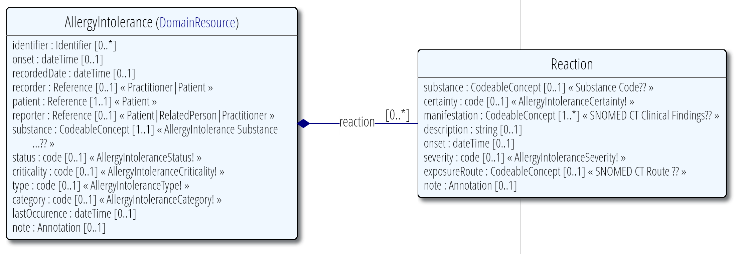
Allergy Intolerance Resource - Overview
Used to record a clinical assessment of an allergy, intolerance, propensity, or a potential risk to an individual to have an adverse reaction on future exposure to a specified substance or class of substances.

Slide 10
Allergy Intolerance Resource - Assumptions
Status: Assertion about certainty associated with a propensity or potential risk of a reaction to identified substance
Status | Finding Context (FC) | Temporal Context (TC)
Active | 410515003 |Known present| | 410512000 |Current or specified time|
Unconfirmed | 415684004 |Suspected| | 410512000 |Current or specified time|
Confirmed | 410605003 |Confirmed present| | 410512000 |Current or specified time|
Inactive | 609412005 |Suspected or known present| | 410513005 |In the past|
Resolved | 609412005 |Suspected or known present| | 410513005 |In the past|
 | 410516002 |Known absent| | 410512000 |Current or specified time|
Refuted | 410594000 |Definitely NOT present| | 410512000 |Current or specified time|
Entered-in-error | - | -

Slide 11
Allergy Intolerance Resource – Model Meaning
Element | SNOMED CT Binding
Allergy Intolerance | IF (($status != ‘entered-in-error’) AND ($substance = (< 105590001 |Substance| OR < 373873005 |Pharmaceutical / biologic product|)) AND ($type = ‘allergy’) AND ($status != ‘resolved’)) THEN 413350009 |Finding with explicit context|: { 246090004 |Associated finding| = (404684003|Clinical finding|: 370135005 |Pathological process| = 472964009 |Allergic process|, { 255234002 |After| = 609327009|Allergic sensitization|, 246075003 |Causative agent| = [[ $substance ]]}) 408732007 |Subject relationship context| = 410604004 |Subject of record|, 408731000 |Temporal context| = [[ $TC ]], 408729009 |Finding context| = [[ $FC ]] }

Slide 12
Allergy Intolerance Resource – Model Meaning
Element | SNOMED CT Binding
Allergy Intolerance | IF (($status != ‘entered-in-error’) AND $substance = (< 105590001 |Substance| OR < 373873005 |Pharmaceutical / biologic product|) AND ($type = ‘allergy’ AND $status = ‘resolved’) THEN 413350009 |Finding with explicit context|: {246090004 |Associated finding| = (404684003|Clinical finding|: 370135005 |Pathological process| = 472964009 |Allergic process|, { 255234002 |After| = 609327009|Allergic sensitization|, 246075003 |Causative agent| = [[ $substance ]] }) 408732007 |Subject relationship context| = 410604004 |Subject of record|, 408731000 |Temporal context| = 410513005 |In the past|, 408729009 |Finding context| = 609412005 |Suspected or known present|}, . . . . . .

Slide 13
Allergy Intolerance Resource – Model Meaning
Element | SNOMED CT Binding
Allergy Intolerance | . . . . . { 246090004 |Associated finding| = (404684003|Clinical finding|: 370135005 |Pathological process| = 472964009 |Allergic process|, { 255234002 |After| = 609327009|Allergic sensitization|, 246075003 |Causative agent| = [[ $substance ]] }) 408732007 |Subject relationship context| = 410604004 |Subject of record|, 408731000 |Temporal context| = 410512000 |Current or specified time|, 408729009 |Finding context| = 410516002 |Known absent|}

