Slide 1
Patient Track
FHIR Connectathon 15
Madrid HL7 WGM
May 2017

Slide 2
Patient Track Level 1 (Intro)
7+ organizations participated
AEGIS, Furore, Helios Software, Infor, SRDC, T-System Inc, Qvera
All participants were able to find success with the various steps

Slide 3
Patient Track Level 2 (Formal)
6+ organizations participated
AEGIS, Furore, Helios Software, SRDC, T-System Inc, Qvera
Others also used the TestScripts in the weeks leading up to Connectathon
all TestScript resources are included in the FHIR svn repository
http://gforge.hl7.org/svn/fhir/trunk/connectathons/MadridMay2017/Connectathon15/Patient-02-Formal

Slide 4
Touchstone results
http://touchstone.com/
Currently have 164 Test Systems registered
FHIR svn Patient Track TestScripts
successfully executed by 3 different servers at this FHIR Connectathon
successfully executed by 2 different clients at this FHIR Connectathon

Slide 5
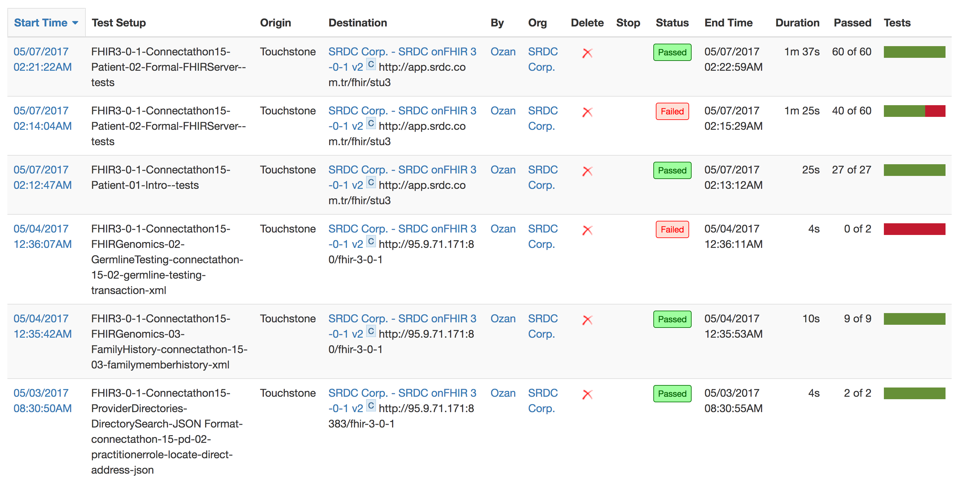
Touchstone results (cont’d)

Slide 6
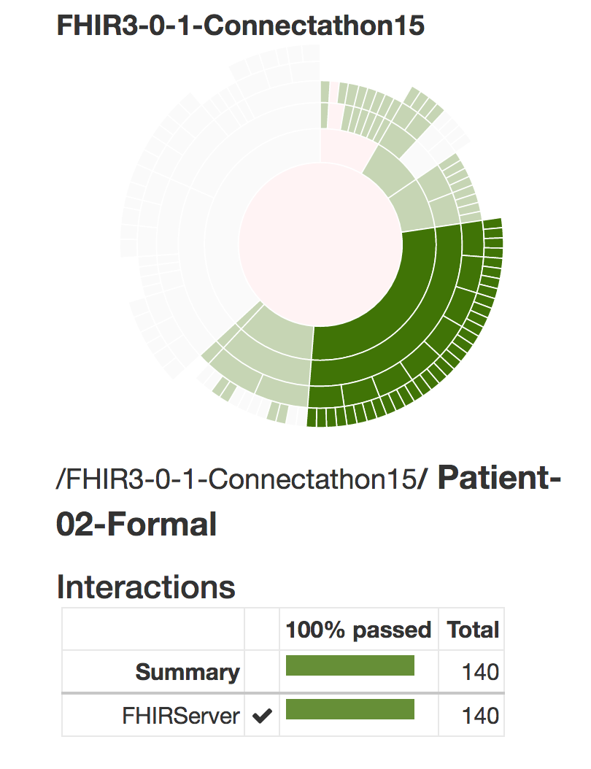
Touchstone results (cont’d)

Slide 7
Crucible statistics
http://projectcrucible.org/
Currently testing 23 active, publicly accessible STU3 servers nightly
13 servers passing the Patient Track tests

Slide 8
Formal Testing Results
 | Create | Update | Read | History | VRead | Search | Delete
FHIR Servers (3) | ✅ | ✅ | ✅ | ✅ | ✅ | ✅ | ✅
FHIR Clients (2) | ✅ | ✅ | ✅ | ✅ | ✅ | ✅ | ✅

Slide 9
Lessons Learned
TestScript instances in FHIR svn for Patient Track are very mature
No changes were made this weekend
Test driven development ensures ease of interoperability with new exchange partners
Clients found quick success with organizations who had successfully passed all of the Patient Track formal tests
TestScript instances have been incorporated into publicly available FHIR test platforms and are being used for more than just the FHIR Connectathon events.

Slide 10
Next Steps
Create TestScript resources for other maturing FHIR resources
Expand formal testing to other connectathon tracks

