Slide 1
Pharmacist Care Plan Project Update
Pharmacy Health Information Technology Collaborative
Presenter: Shelly Spiro RPh, FASCP
Pharmacy HIT Collaborative, Executive Director

Slide 2
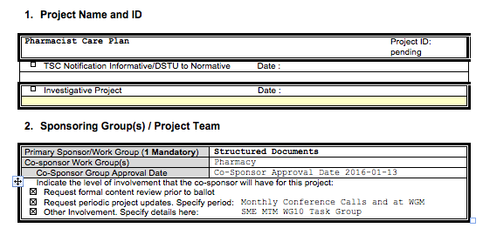
Project Scope Statement

Slide 3
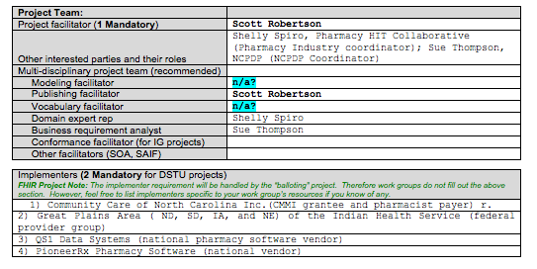
Project Scope Statement

Slide 4
Relationships Pharmacist Use Case 1
HAS COMPONENT
HAS COMPONENT
HEALTH CONCERNS
Risk of bleeds or clots
Ability to access anticoagulation clinic for labs
Patient identified hyper/hypoglycemia
PATIENT GOALS
Prevention of clots and/or bleeds
Maintain targeted BP
Maintain targeted blood glucose level
REFERS TO
EVALUATIONS/OUTCOMES
PROGRESS TO GOALS
On target for goals
Re-enforce education
REFERS TO
HAS REASON
EVALUATES
REFERS TO
HAS SUPPORT
INTERVENTIONS PERFORMED:
Med reconciliation
Assess contributing factors
Patient education on
BP and blood glucose monitoring and recording at least daily
INR testing
OTC interactions
Diet restrictions
Exercise
Interventions Planned
Monitor INR & A1C
Follow-up visit
Review patient recorded BP and blood glucose results,
lab results
Review of dietary restrictions
Assess need for medication changes
Lower hypertensive medication
SUPPORTS
OBSERVATIONS
History of
pulmonary embolism
Hypertension
Diabetes
OBSERVATIONS
Observation of some petechiae
Lab values stable
No patient reported bleeding events
Multiple incidences of low BP
HAS REASON
Notes:
New condition for patient risk of pulmonary embolism. The community pharmacist meets with current patient and their caregiver after a recent discharge from a hospital for a pulmonary embolism. The patient is diagnosed with hypertension and diabetes. The patient has been enrolled in a diabetes OP clinic and has now been referred to an anticoagulation OP clinic. The community pharmacist coordinates MTM services (including reconciliation of medications, allergies and indications for medication use) with the PCP and the diabetes and anticoagulation clinics on patient’s medication-related goals.
Health concern diabetes management
Hypertension
Prevention of bleeds and clots - Anticoagulation medication managment
Pulmonary embolism risk
Monitoring INR
How do you

Slide 5
Relationships Pharmacist Use Case 2
HAS COMPONENT
HAS COMPONENT
HEALTH CONCERNS
Risk deep vein thrombosis
Risk of uncontrolled pain
Side effects of uncontrolled pain
Depression
Dietary disturbances
Cognitive disturbances
PATIENT GOALS
Pain Management pre op and post op
Prevention of DVT
Prevention of infection
REFERS TO
EVALUATIONS/OUTCOMES
PROGRESS TO GOAL
Pre op goal met
HAS REASON
REFERS TO
EVALUATES
HAS SUPPORT
REFERS TO
SUPPORTS
Interventions pERFORMed
Targeted med review
PDMP check
Assess potential allergies/interactions
Pain assessment
Patient education and counseling on
Pain management
Side effects of uncontrolled pain
Symptoms of DVT
interventions Planned
Post discharge med reconciliation
Assessment of Pain
Assessment of side effects of pain management education
OBSERVATIONS
Scheduled for hip replacement
OBSERVATIONS
No indication of controlled substance misuse
Moderate controlled pain on baseline assessment
No allergy/interaction findings
No indication of infection
Patient understands symptoms to be monitored
HAS REASON
Notes:
Patient is scheduled for a hip replacement. The pharmacist under a collaborative practice agreement with the orthopedic surgeon counsels the patient prior to the procedure to assure there are no medication-related problems. After the surgery, the pharmacist coordinates medication-related goals with the patient pertaining to deep vein thrombosis risk and pain management.

Slide 6
Relationships Pharmacist Use Case 3
HAS COMPONENT
HAS COMPONENT
Health concerns
Polypharmacy (multiple physicians & medications)
Risk for non compliance
Risk for duplicative therapy
Risk of medication related adverse events
risk of cognitive impairment affecting medication use
GOALS
Medication Adherence
Optimize drug therapy
Minimization drug therapy problems
Coordination with care providers
REFERS TO
EVALUATIONS/OUTCOMES
PROGRESS TO GOALS
Initiated actions to meet the goal
Completed CMR and identified changes in medication regimen
Initiated care coordination
HAS REASON
REFERS TO
EVALUATES
HAS SUPPORT
REFERS TO
SUPPORTS
Interventions performed
Assessment of adherence barriers
Complex medication regimens
Functional status
Cognitive status
Rationalization of medication regimen
CMR
Identification of medication related adverse events
Identification of drug therapy problems
Interventions planned
Care Coordination with treating physicians and care providers
Follow-up visit to assess adherence
Synchronization
OBSERVATIONS
History of Behavior health issues
History of Multiple chronic diseases
OBSERVATIONS
Conflicting treatment strategies & medications
Drug therapy problems
Memory problems
Confusion regarding instructions for medication use
HAS REASON
Notes:
A patient with behavior health issues and multiple chronic diseases meets with their consultant pharmacist for their yearly comprehensive medication review to meet their Medicare Part D MTM requirement. The pharmacist documents conflicting treatment strategies and medications. The pharmacist recommends strategies/alterations to existing treatment, development of a manageable medication schedule, patient education and outcome follow-up.

Slide 7
Relationships Pharmacist Use Case 4
HAS COMPONENT
HAS COMPONENT
GOALS
Effective Pain Management
Resolution of constipation
Resolution of malnourishment
Identification of PCP for patient
Resolution of opioid abuse condition
Care coordination with treating physicians & care providers
HEALTH CONCERNS
Polypharmacy (multiple physicians & pain medications)
Risk of overdose
Constipation/avoidance of impaction
Malnutrition
Impact of pain on chronic conditions
REFERS TO
EVALUATIONS/OUTCOMES
PROGRESS TO GOALS
Initiated actions to meet the goal
Completed CMR and identified changes in medication regimen
Initiated care coordination
REFERS TO
HAS REASON
EVALUATES
HAS SUPPORT
REFERS TO
SUPPORTS
Interventions PERFORMED
Assessment of
Pain
Medications and adherence for chronic conditions
Complex medication regimens
Cognitive status
CMR
Rationalization of medication regimen
Medication/education for constipation
Interventions PLANNED
Referral to PCP
Referral to Nutritionist
Care Coordination with treating physicians and care providers
Follow-up visit Synchronization
OBSERVATIONS
History of uncontrolled pain
History of 3 chronic diseases
Deteriorating health status (Malnutrition, constipation decreased cognitive ability.)
OBSERVATIONS
Conflicting treatment strategies & medications
Decreased cognitive function
Opioid over use
HAS REASON
Notes:
A patient comes to the community pharmacy to pick up hydrocodone which has been e-prescribed and complaintsof constipation. The pharmacist reviewed the State Prescription Drug Monitoring Program (PDMP) database, and discovers that multiple physicians have treated the patient for pain. The pharmacist suspects the patient may have an opioid abuse condition. Through patient counseling, the pharmacist discovers the patient is mal-nourished, has 3 chronic care conditions, and complains of constipation and also has no primary care provider (PCP). The pharmacist performs comprehensive medication review and helps the patient identify a PCP. The pharmacist documents conflicting treatment strategies and medications including the need for naloxone. The pharmacist recommends strategies/alterations to existing treatment, pain management, development of a manageable medication schedule, nutritional counseling, patient education and outcome follow-up.

Slide 8
Next Steps
Put the ballot on hold until funds for project expert can be secured
Set aside development of a specific Document Template for Pharmacist Care Plan
Within NCPDP Pharmacy Professional Services WG, develop "guidance document" for how to use the "standard" Care Plan document template for the Pharmacist Care Plan use cases
Guidance document would only discuss how the various Pharmacy Care Plan requirements are placed into the existing Care Plan template

Slide 9
Next Steps
Implementers will use the guidance document to implement an eCare Plan using the HL7 eCare Plan template
At a later date, the information from this guidance document would be most of the material needed to generate the new template through the Lantana tools

Slide 10
Discussion
Contact:
Shelly Spiro
Executive Director, Pharmacy HIT Collaborative
shelly@pharmacyhit.org
www.pharmacyhit.org

