Slide 1
Allergy Intolerance Resource – Model Meaning
Element | SNOMED CT Binding
Allergy Intolerance | IF (($status != ‘entered-in-error’) AND $substance = (< 105590001 |Substance| OR < 373873005 |Pharmaceutical / biologic product|) AND ($type = ‘intolerance’ OR $type = ‘’) AND ($status != ‘resolved’’)) THEN 413350009 |Finding with explicit context|: 246090004 |Associated finding| = ( 418038007 |Propensity to adverse reactions to substance|: 246075003 |Causative agent| = [[ $substance ]]) 408732007 |Subject relationship context| = 410604004 |Subject of record|, 408731000 |Temporal context| = [[ $TC ]], 408729009 |Finding context| = [[ $FC ]]

Slide 2
Allergy Intolerance Resource – Model Meaning
Element | SNOMED CT Binding
Allergy Intolerance | IF (($status != ‘entered-in-error’) AND $substance = (< 105590001 |Substance| OR < 373873005 |Pharmaceutical / biologic product|) AND ($type = ‘intolerance’ OR $type = ‘’) AND ($status = ‘resolved’)) THEN 413350009 |Finding with explicit context|: { 246090004 |Associated finding| = ( 418038007 |Propensity to adverse reactions to substance|: 246075003 |Causative agent| = [[ $substance ]]) 408732007 |Subject relationship context| = 410604004 |Subject of record|, 408731000 |Temporal context| = 410513005 |In the past|, 408729009 |Finding context| = 609412005 |Suspected or known present|}, . . . .

Slide 3
Allergy Intolerance Resource – Model Meaning
Element | SNOMED CT Binding
Allergy Intolerance | . . . . { 246090004 |Associated finding| = ( 418038007 |Propensity to adverse reactions to substance|: 246075003 |Causative agent| = [[ $substance ]]) 408732007 |Subject relationship context| = 410604004 |Subject of record|, 408731000 |Temporal context| = 410512000 |Current or specified time|, 408729009 |Finding context| = 410516002 |Known absent|}) ELSEIF ($substance = <373572006 |Clinical finding absent|) THEN [[ $substance ]]

Slide 4
Allergy Intolerance Resource - Assumptions
The following maps to SNOMED CT are appropriate:
reaction. severity | Severity (SV)
Mild | 410515003 |Mild|
Moderate | 415684004 |Moderate|
Severe | 410605003 |Severe|
reaction. certainty | Finding context (FC)
Unlikely | 415684004 |Suspected|
Likely | 410592001 |Probably present|
Confirmed | 410591008 |Definitely present|

Slide 5
Allergy Intolerance Resource – Model Meaning
Element | SNOMED CT Binding
reaction | IF ($reaction.certainty = ‘’) THEN 282100009 |Adverse reaction caused by substance|: 246075003 |Causative agent| = [[ $reaction.substance ]], 246112005 |Severity| = [[ SV ]] 255234002 |After| = (432102000 |Administration of substance|: 363701004 |Direct substance| = [[ $reaction.substance ]], 410675002 |Route of administration| = [[ $reaction.exposureRoute ]] )

Slide 6
Allergy Intolerance Resource – Model Meaning
Element | SNOMED CT Binding
reaction | ELSEIF (($reaction.certainty IN (‘unlikely’, ‘likely’, ‘confirmed’)) THEN 413350009 |Finding with explicit context|: 246090004 |Associated finding| = ( 282100009 |Adverse reaction caused by substance|: 246075003 |Causative agent| = [[ $reaction.substance ]], 246112005 |Severity| = [[ SV ]]), 255234002 |After| = (432102000 |Administration of substance|: 363701004 |Direct substance| = [[ $reaction.substance ]], 410675002 |Route of administration| = [[ $reaction.exposureRoute ]] )) 408732007 |Subject relationship context| = 410604004 |Subject of record|, 408731000 |Temporal context| = 410512000 |Current or specified time|, 408729009 |Finding context| = [[ FC ]])

Slide 7
Allergy Intolerance Resource – Model Meaning
Element | SNOMED CT Binding
status | 408729009 |Finding context|
substance | 246075003 |Causative agent|
reaction. substance | 363701004 |Direct substance|
reaction. severity | 246112005 |Severity|
exposure Route | 410675002 |Route of administration|

Slide 8
AllergyIntolerance Resource – Value Sets
SNOMED CT Value Sets
Allergyintolerance-substance-code
Substance-code
Manifestation-codes
Route-codes
Other Value Sets in scope of SNOMED CT
Allergy-intolerance-status
Allergy-intolerance-type
Allergy-intolerance-category
Allergy-intolerance-criticality
Reaction-event-certainty
Reaction-event-severity

Slide 9
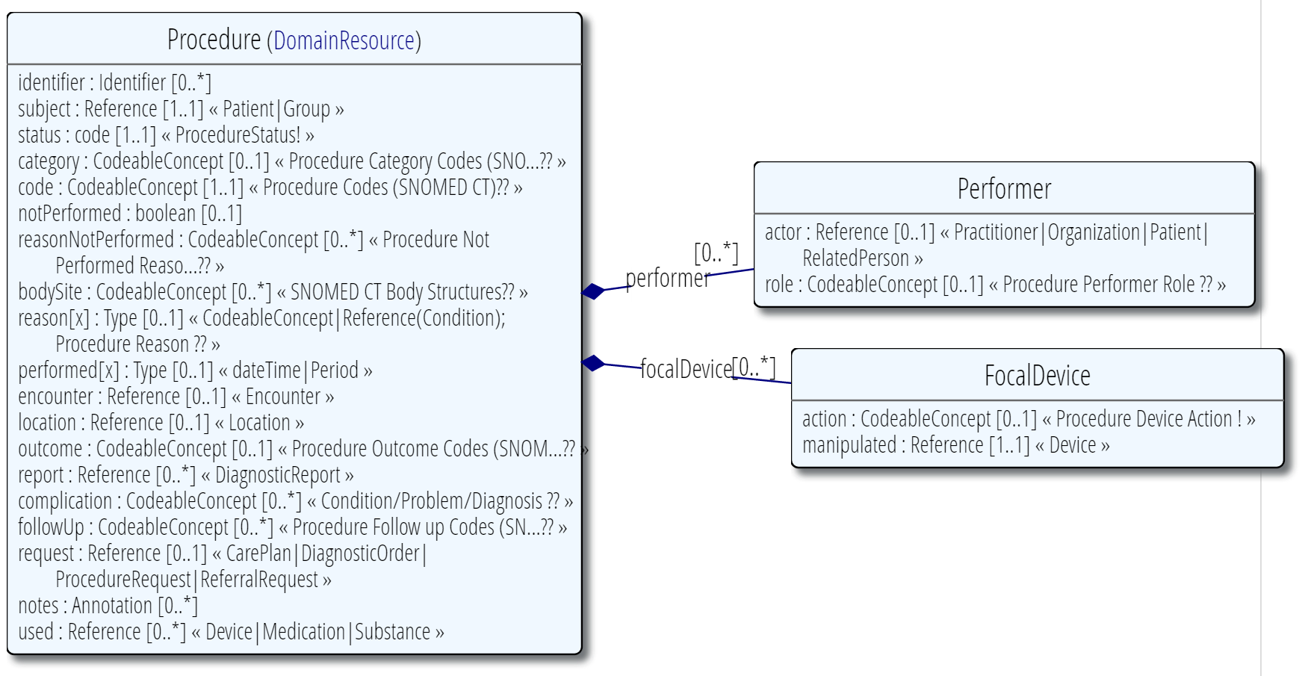
Procedure Resource - Overview
Used to record details of procedures performed on a patient. A procedure is an activity that is performed with or on a patient as part of the provision of care.

Slide 10
Procedure Resource – Assumptions
The procedure was performed on the subject of care
The value of ‘status’ maps to procedure context:
‘notPerformed’ (boolean) maps to procedure context:
‘bodySite’ may represent either the |Procedure site – Direct| or the |Procedure site – Indirect|.
status | Procedure Context (PC)
In progress | 385651009 |In progress|
Aborted | 385657008 |Abandoned|
Completed | 385658003 |Done|
notPerformed = TRUE | 262008008 |Not performed|

Slide 11
Procedure Resource – Model Meaning EDITTING
Element | SNOMED CT Binding
Procedure | IF ($status != ‘entered-in-error’) THEN 129125009 |Procedure with explicit context|: { 363589002 |Associated procedure| = ([[ $code ]] : 363704007 |Procedure site| = [[ $bodySite ]], 363699004 |Direct device| = [[ $focalDevice.manipulated.type ]], 424361007 |Using substance| = [[ IF ($used.code = < 105590001 |Substance|) THEN ($used.code)]]), 424226004 |Using device| = [[ IF ($used.type = < 49062001 |Device|) THEN ($used.type)]]), 408732007 |Subject relationship context| = 410604004 |Subject of record|, 408731000 |Temporal context| = 410512000 |Current or specified time|, 408730004 |Procedure context| = [[ $PC ]]}

Slide 12
Procedure Resource – Model Meaning
Element | SNOMED CT Binding
code | 363589002 |Associated procedure|
bodySite | 363704007 |Procedure site|
focalDevice. manipulated. type | 363699004 |Direct device|
used | IF (($used.code = < 105590001 |Substance|) THEN 424361007 |Using substance| ELSEIF (($used.type = < 49062001 |Device|) THEN 424226004 |Using device|

Slide 13
Procedure Resource – Value Sets
SNOMED CT Value Sets
Procedure-category
Procedure-code
Procedure-not-performed-reason
Body-site
Procedure-reason
Performer-role
Procedure-outcome
Condition-code
Procedure-followup
Other Value Sets in scope of SNOMED CT
Procedure-status
Device-action
Data Element in scope of SNOMED CT
notPerformed: Boolean

Slide 14
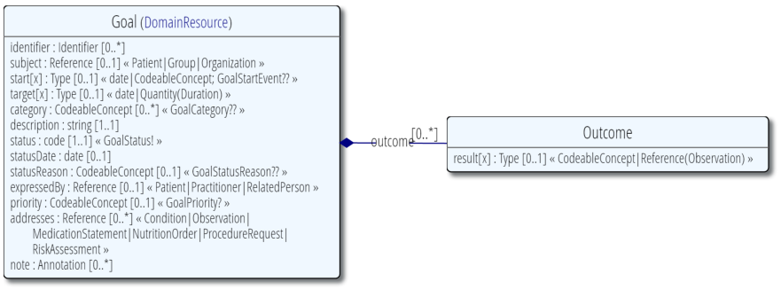
Goal Resource - Overview
Used to express a desired health state or intended objective to be achieved by a subject of care, group or organization over a period or at a specific point of time – e.g. weight loss, restoring an activity of daily living.

Slide 15
Goal Resource – Model Meaning
Element | SNOMED CT Binding
Goal | 413350009 |Finding with explicit context|: 246090004 |Associated finding| = 404684003 |Clinical finding|, 408732007 |Subject relationship context| = [[ $SR ]], 408731000 |Temporal context| = 410512000 |Current or specified time|, 408729009 |Finding context| = 410518001|Goal context| LET SR = (IF $subject = ??)
status | 408730004 |Procedure context|
priority | 260870009 |Priority|
addresses | 363702006 |Has focus|

Slide 16
Goal Resource – Value Sets
SNOMED CT Value Sets
Goal-start-event
Other Value Sets in scope of SNOMED CT
Goal-status
Goal-status-reason
Goal-priority

Slide 17
Family Member History Resource - Overview
Used to record significant health events and conditions for a particular individual related to the subject.

Slide 18
Family Member History Resource - Assumptions
‘relationship’ is recorded using (or mapped to) SNOMED CT
< 125676002 |Person|
Values for ‘status’ are:
Partial, completed, health unknown
When ‘status’ = “health unknown”, no conditions will be recorded.

Slide 19
Family Member History Resource – Model Meaning
Element | SNOMED CT Binding
Family Member History | IF (($status = ‘partial’) OR ($status = ‘completed’)) THEN FOR EACH $condition 413350009 |Finding with explicit context|: 246090004 |Associated finding| = [[ $condition.code ]], 408732007 |Subject relationship context| = [[$relationship]], 408731000 |Temporal context| = 410511007 |Current or past (actual)|, 408729009 |Finding context| = 410515003 |Known present| ELSEIF ($status = ‘health-unknown’) 407559004 |Family history unknown|: 408732007 |Subject relationship context| = [[$relationship]];
relationship | 408732007 |Subject relationship context|
condition. code | 246090004 |Associated finding|

Slide 20
Family Member History Resource – Value Sets
SNOMED CT Value Sets
Family-member
Condition-code
Condition-outcome
Other Value Sets in scope of SNOMED CT
Administrative-gender

Slide 21
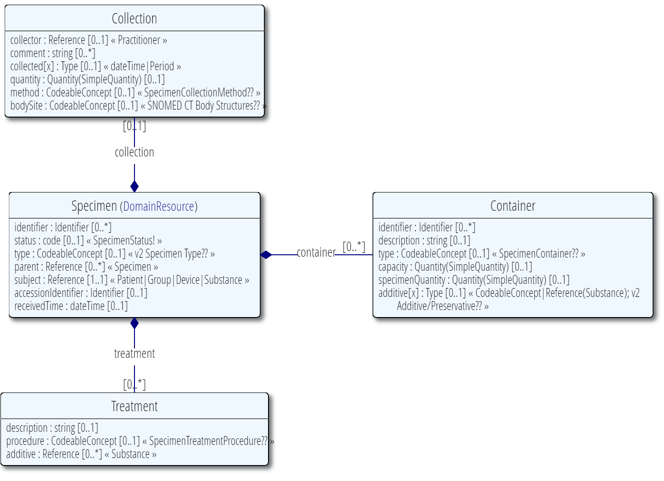
Specimen Resource - Overview
Used to describe a sample used for analysis, and the process for gathering, maintaining and processing the sample.

Slide 22
Specimen Resource – Assumptions
‘collection.method’ and ‘type’ use (or maps to) SNOMED CT
The value of 118170007 |Specimen source identity| can be determined from the ‘subject’

Slide 23
Specimen Resource – Model Meaning
Element | SNOMED CT Binding
Specimen | 123038009 |Specimen|: 118171006 |Specimen procedure| = [[ $collection.method ]], 118170007 |Specimen source identity| = [[ $SSI ]] , 118169006 |Specimen source topography| = [[ $collection.bodySite ]], 70133003 |Specimen substance| = [[ $type ]] LET SSI = (IF ($subject = . . . ))
type | 70133003 |Specimen substance|
method | 118171006 |Specimen procedure|
bodySite | 118169006 |Specimen source topography|

Slide 24
Specimen Resource – Value Sets
SNOMED CT Value Sets
Body-site
Specimen-container-type
Other Value Sets in scope of SNOMED CT
V2/0487 (Specimen type)
Specimen-collection-method
Specimen-treatment-procedure
V2_Additive/Preservative

Slide 25
Questions and Discussions

